Slide 1

Basic Local Alignment Search Tool for Nucleotides (BLASTn) on Reconfigurable Hardware
By Alden Param, Alex Chan, Hmayak Apetyan, Jacob London, Simon Tutak, and Sivaramakrishnan Prabakar, Mostafa El labban, Mohamed El-Hadedy

Slide 2
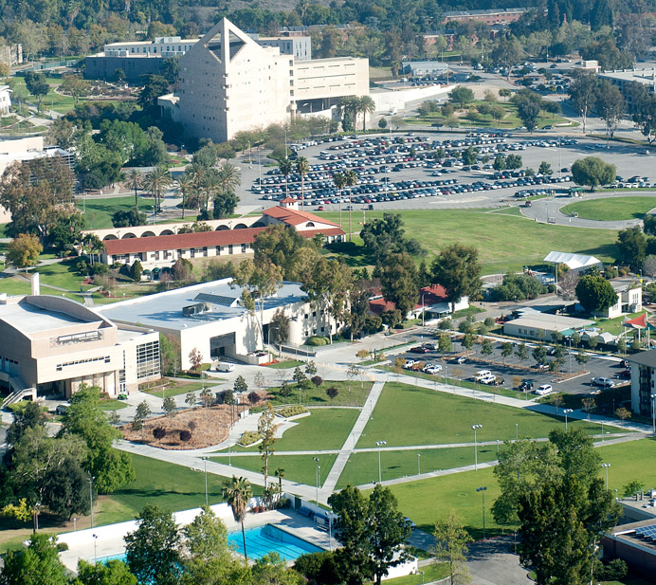
Overview

Slide 3
BLASTn - Overview
Introduction
What is BLASTn?
Why is BLASTn useful?
Motivation
Aim for hardware implementation
Challenging project
Innovation
FPGA implementation of Smith-Waterman
Evaluation
Speed metrics
Conclusion

Slide 4
Introduction

Slide 5
BLASTn - What is BLASTn?
Basic Local Alignment Search Tool for Nucleotides
DNA sequencing algorithm
Finds regions of local similarity between nucleotide query and database sequences
Employs a heuristic search algorithm that allows fast searches through databases by finding sequence hits and then extending them
Main criteria being speed, sensitivity, and specificity
Cannot guarantee 100% accuracy

Slide 6
BLASTn - Why is BLASTn useful?
Speeds up analysis of genomic data
Immensely valuable in the fields of personalized medicine, detection of genomic mutations, and also contributes to the understanding of molecular factors that lead to phenotypic diversity
Genomic data is expected to reach exabyte scale
Surpass YouTube and Twitter by 2025
Field of bioinformatics was developed to store, retrieve, organize, and analyze biological data

Slide 7
BLASTn - Why is BLASTn useful?
Despite advances in tech, it is still difficult to process overwhelming amount of genomic data
BLASTn is a DNA sequencing algorithm that analyzes genomic data
Faster than full alignment procedures (Smith-Waterman)

Slide 8
Motivation

Slide 9
BLASTn - Aim for hardware implementation
Implement a dedicated CPU for big data
Opportunity to create innovative solution
Challenge for us to implement our CpE and EE background
Desire to create an optimization solution for big data
One of the first solutions presented for this topic

Slide 10
Innovation

Slide 11
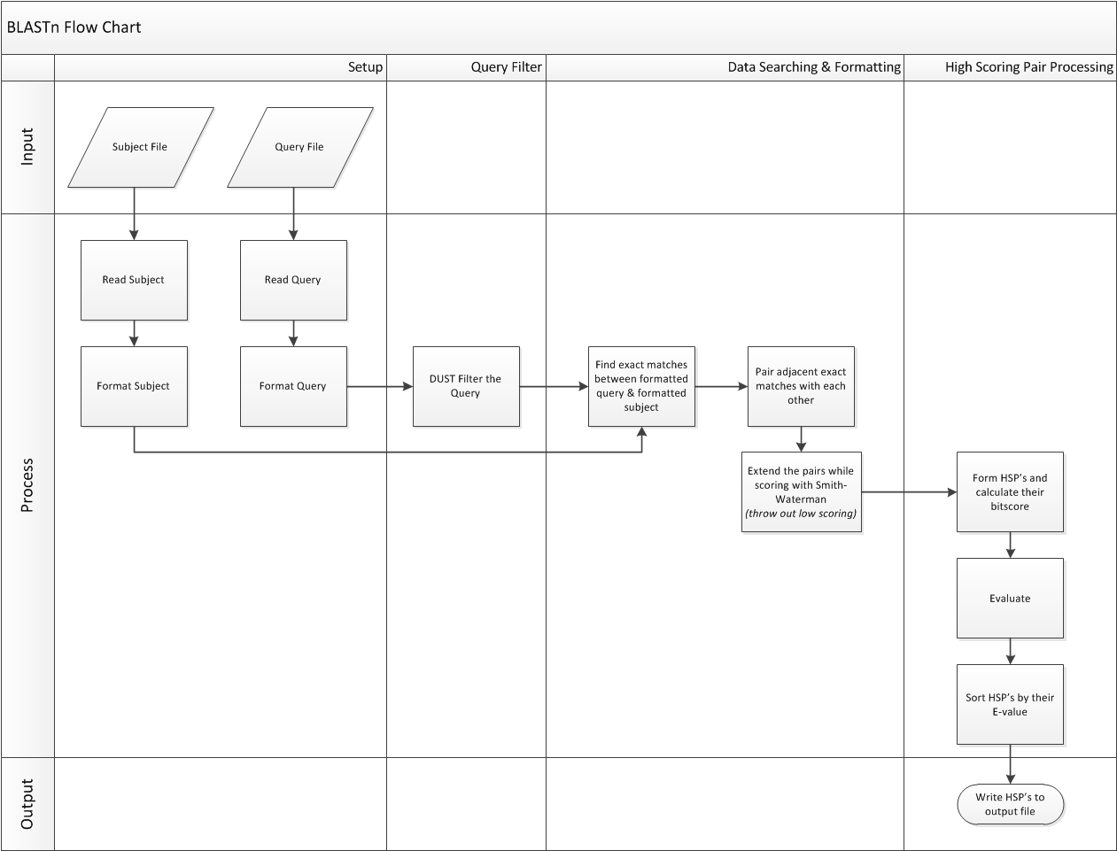

Slide 12
BLASTn - Innovation
Developed Python scripts to simulate BLAST at a high level
Further developed software solution by developing C++ implementation of BLAST
Developed VHDL implementation of Smith Waterman
Leveraged Accelerated Short-Read Alignment in Smith Waterman implementation

Slide 13
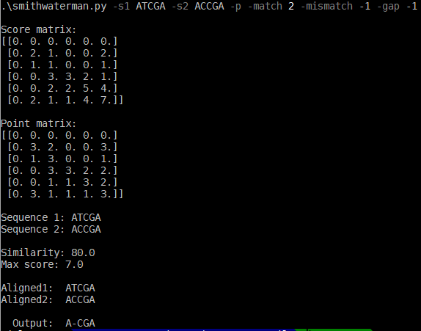
BLASTn - Smith Waterman Python Implementation
Given two sequences
ATCGA
ACCGA
Scores
Match = 2
Mismatch = -1
Gap = -1
The aligned word is A-CGA
T does not match with C
Gap is inserted

Slide 14
BLASTn - Smith Waterman Optimization
Skip unnecessary areas to fill in the matrix
Create scoring matrix in VHDL using Accelerated Short-Read Alignment

Slide 15
Evaluation

Slide 16
BLASTn - Evaluation of Python Implementation
Python implementation used to prototype the BLASTn algorithm
Unit test each module and integration test of the overall process
Emphasized accuracy over speed
Execution was slow (~35 mins) but results validated our prototype
Used python implementation as our shell for other implementations moving forward

Slide 17
BLASTn - Evaluation of C++ Implementation
First C++ implementation took around 31 minutes to fully execute
Used open source application Valgrind to optimize our code base
Allowed us to find, test, and resolve issues with performance and memory usage
Further sped up runtime by using C++ compiler optimization
Obtained final runtime of 8 minutes 30 seconds

Slide 18
BLASTn - Final Evaluation
Our final implementation takes roughly 6000 seconds (over 1 hour), which can be greatly improved upon
Our packing algorithm could be more efficient
Given more time, we could have spent more time to optimize the FPGA implementation, but our C++ software implementation was optimized to a runtime of 8 minutes, which is much faster than the initial 31 minutes.

Slide 19
Conclusion

Slide 20
BLASTn - Conclusion
Learned to overcome challenges
Opportunity to create an innovative solution for Big Data
Learned from mistakes and advanced our problem solving abilities
Software implementation of BLASTn with hardware implementation (FPGA) of Smith-Waterman

Slide 21

BLASTn - Resources
GitHub
DockerHub
Poster

Slide 22
Questions?

