Slide 1
Personality
& Tonality

Slide 2












Brand archetype
The Innocent
goal: safety & happiness
personality: eternal optimist,
strives to be good, trustworthy,
pure, straightforward
drawback: could be
naïve or boring
example brands:
Dove, Coca-Cola
The Sage
goal: wisdom & understanding
personality: knowledgeable,
a mentor, analytical, trusted
source of information
drawback: could be overly
contemplative, too opinionated
example brands:
Google, BBC
The Explorer
goal: discovery & freedom
personality: adventurous,
brave, restless, pioneering,
independent, ambitious
drawback: might not fit
into the mainstream
example brands:
Patagonia, Red Bull
The Outlaw
goal: liberation
personality: rebellious,
shocking, disruptive, powerful,
revolutionary
drawback: could take it too far
and be seen in a negative way
example brands:
Harley-Davidson, Virgin, Diesel
The Magician
goal: power & fulfilling dreams
personality: clever, visionary,
charismatic, imaginative,
close to supernatural
drawback: could take risks
that lead to bad outcomes
example brands:
Apple, Disney, Dyson
The Hero
goal: improve the world
personality: courageous, brave, bold, strong, isn´t interested in being called a hero
drawback: could be arrogant or aloof
example brands:
Nike, BMW
Principal human desire: Yearn for paradise
Principal human desire: Leave a mark on the world
The Lover
goal: inspire love & intimacy
personality: sensual,
passionate, need for deep/strong
sensations, warm, committed
drawback: could be too selfless
or not grounded enough
example brands:
Häagen Dazs, Alfa Romeo, Chanel
The Jester
goal: enjoyment
personality: fun, irreverent,
energetic, impulsive, able to
tell the truth with a joke
drawback: could be seen as
frivolous or disrespectful
example brands:
Old Spice, Ben & Jerry’s, M&M
The Every-Person
goal: belonging
personality: down to earth,
supportive, person next door,
faithful, connects with others
drawback: could lack a
distinctive identity
example brands:
Ikea, eBay
The Caregiver
goal: service
personality: caring, maternal,
compassionate, generous,
selfless, someone to trust
drawback: could be taken for
granted/taken advantage of
example brands:
UNICEF, Nivea, Toms
The Leader
goal: control
personality: leading, responsible,
organized, role model, administrator
drawback: could lack a common connection or be too authoritative/controlling
example brands:
Mercedes, Rolex
The Creator
goal: innovation
personality: nonconformist,
creative, imaginative, inventive,
enjoying self expression
drawback: could be
perfectionistic or impractical
example brands:
Apple, Lego, Adobe
Principal human desire: Connect with others
Principal human desire: Provide structure to the world

Slide 3
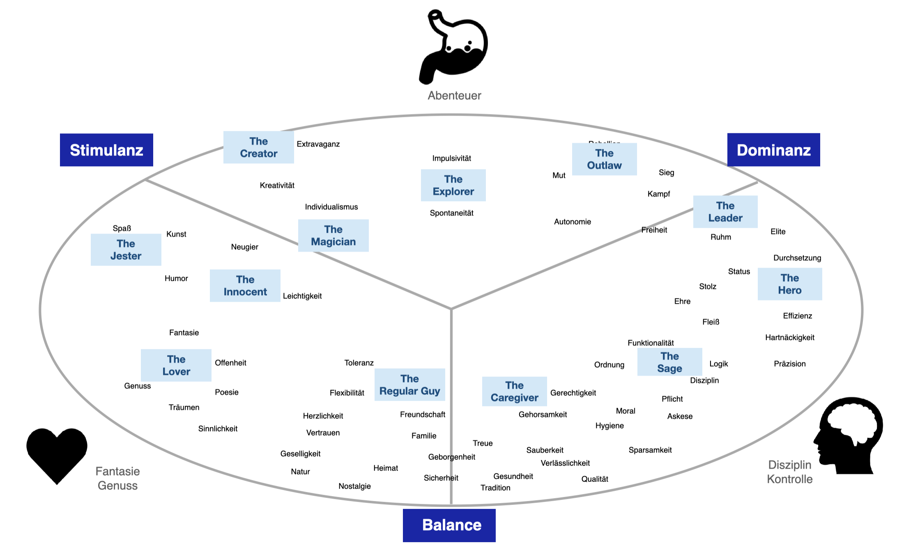
Limbic Map
Creative Explorer
Diversität
…..

Slide 4
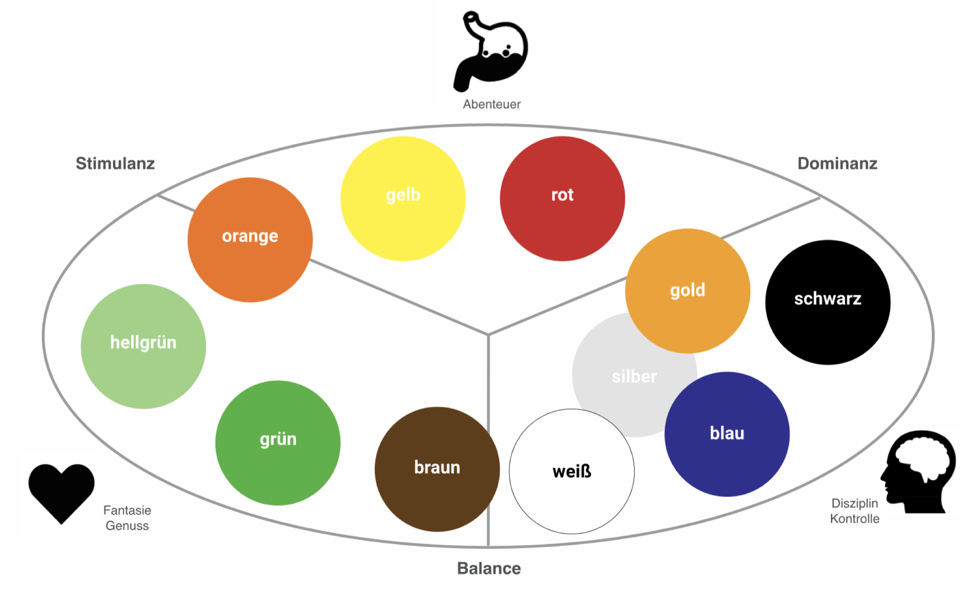
Limbic Map
Creative Explorer

