Slide 1
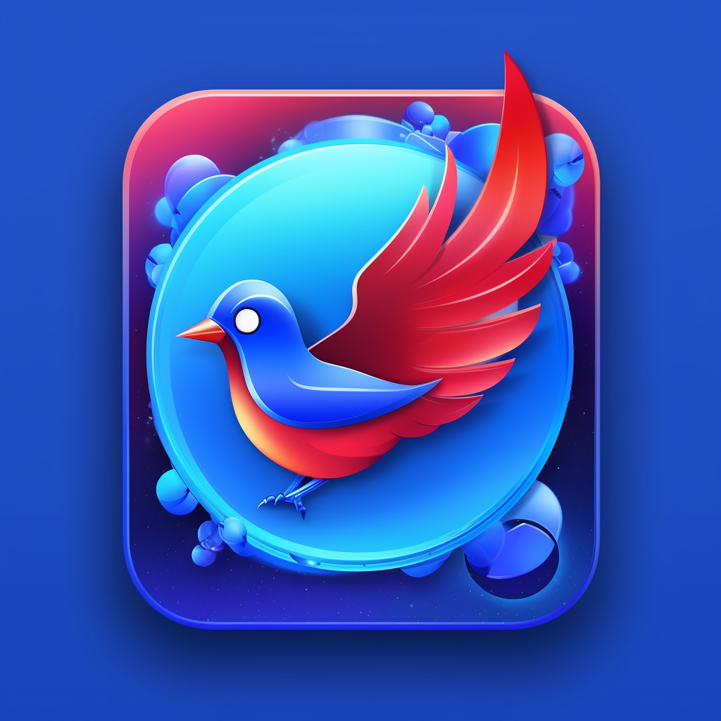
Chater
Chater created
by Bogdan Kapriyan
for course work
06.05.2023

Slide 2
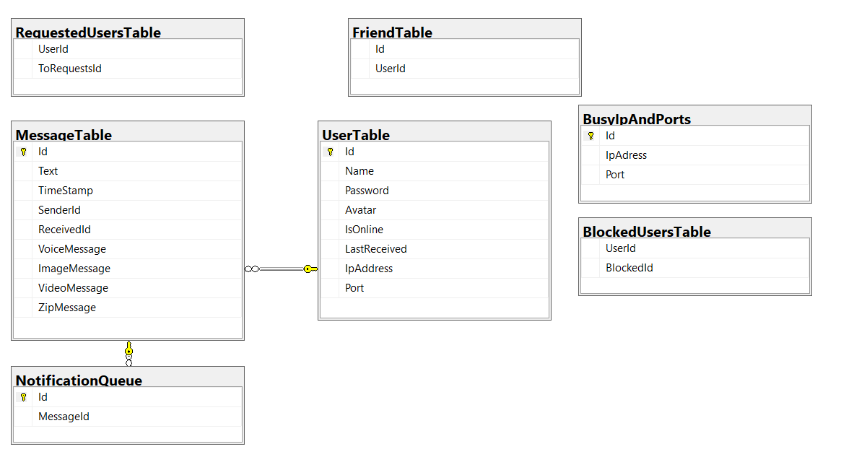
Goals Database struct
1
Add video call
2
Add encryption
3
Upgrade security

Slide 3
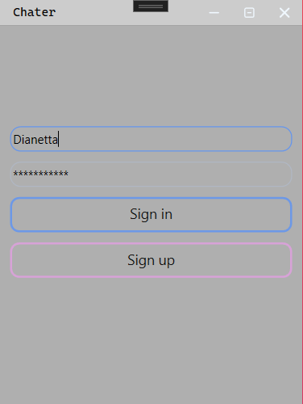
Auth process
You enter field and press button Login or you don’t registered you can press Register page and enter fields and press button Register, you returned an Login page, and you must have password and login.

Slide 4
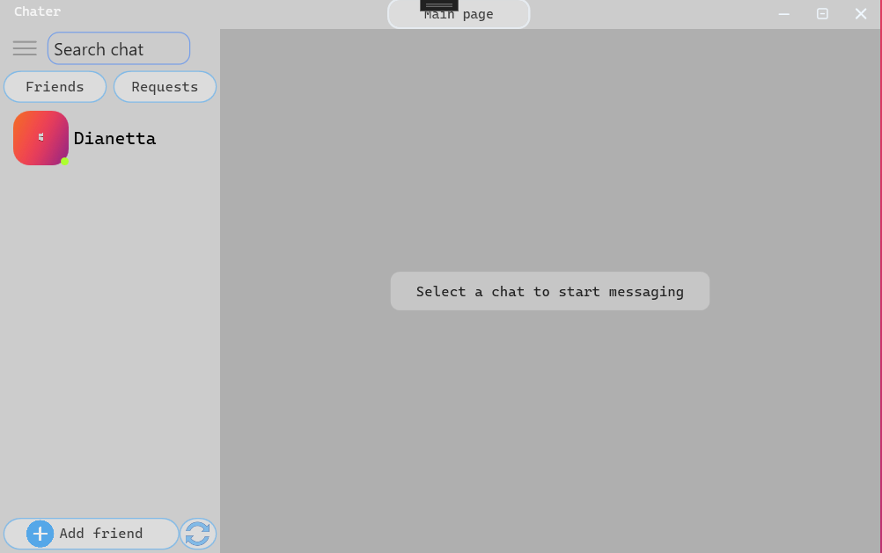
Main page features
you can go to the settings menu, minimize, close applications, search for a chat with a friend by a friend's nickname, go to the list of incoming requests to friends and the list to friends, update the list of friends, it updates itself, but if you need so then please, just there is an add friend button. That's all.

Slide 5
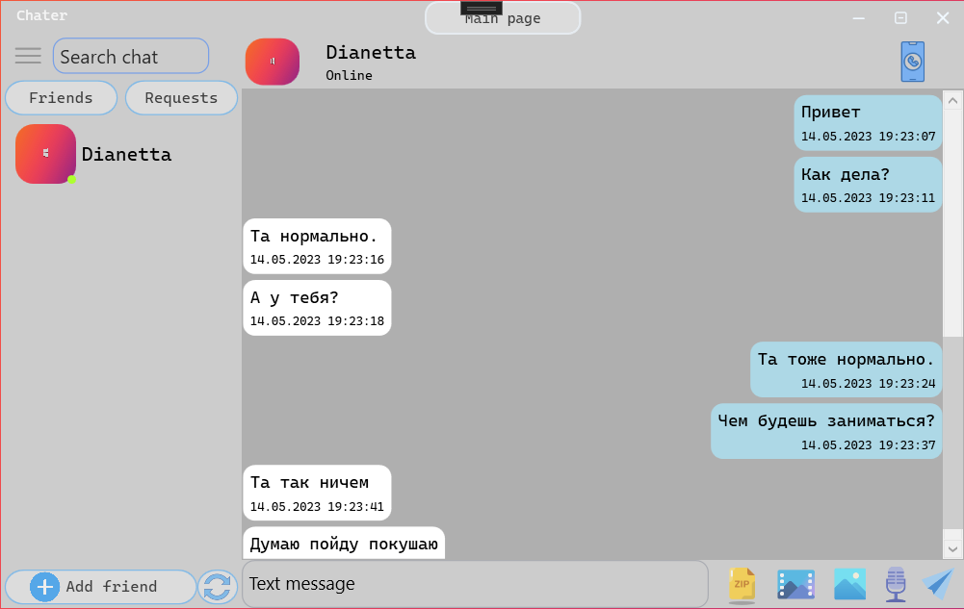
Chat features
You can send text messages, archives, videos, photos, audio messages, make audio calls. You can also delete your messages and delete the entire chat, also if you minimize the application you will receive messages. Also you cant open folder path for zip-file, video-message, image-message and audio-message.

Slide 6
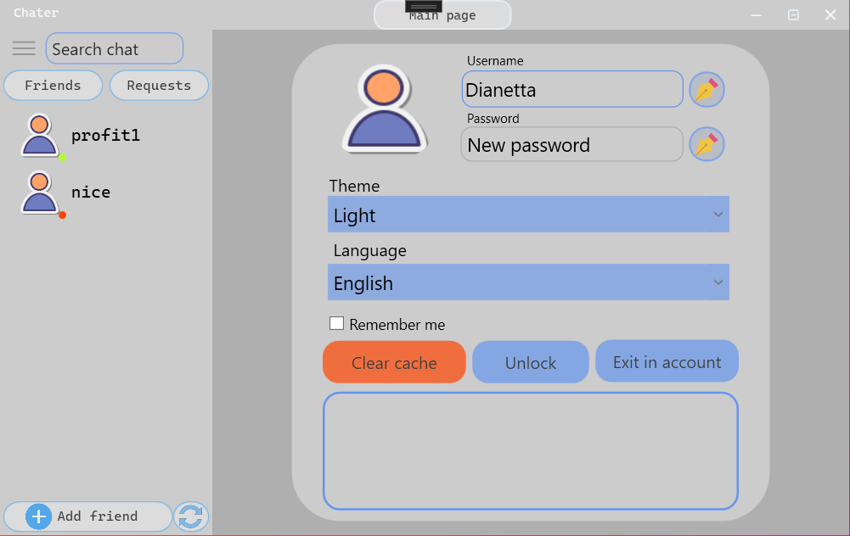
Settings features
You can change your username and password, change the theme and language of the application, clear the cache, unlock the user, log out of your account, you can also save your data for the next login to applications without a username and password.

Slide 7
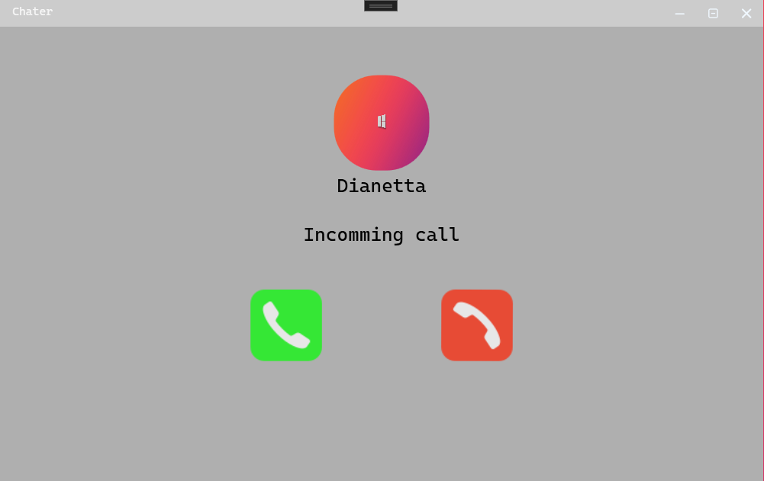
Audio features
When you call, you have the opportunity to reject the call, also if you turn off or lose the Internet, the call will automatically end, the same for the other user you call, he can pick up the phone and reject the call, the call is accompanied by a ringing sound.

Slide 8
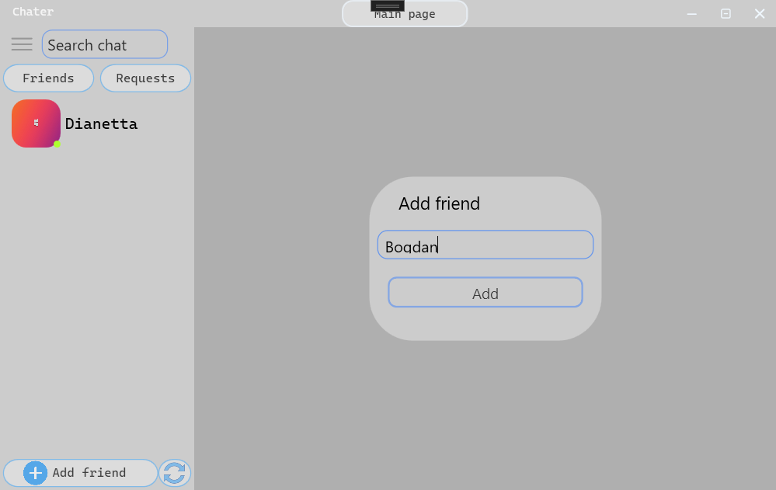
Friends features
You can send a friend request to another user and he can reject the friend request or add you as a friend, also you can remove a friend from the friend list by right clicking on a person and delete a friend, also you can block him, this means that you are not you can send him messages and send friend requests, also with him, but you can unblock him in the settings.

Slide 9
Other characters
The communication between the server and the client is through a helper library, the user interface does not have any access to the server, no third party intervention, the server uses the TCP protocol, and the audio call server uses the UDP protocol for faster information transfer. The files are sent to the server in JSON format.

Slide 10
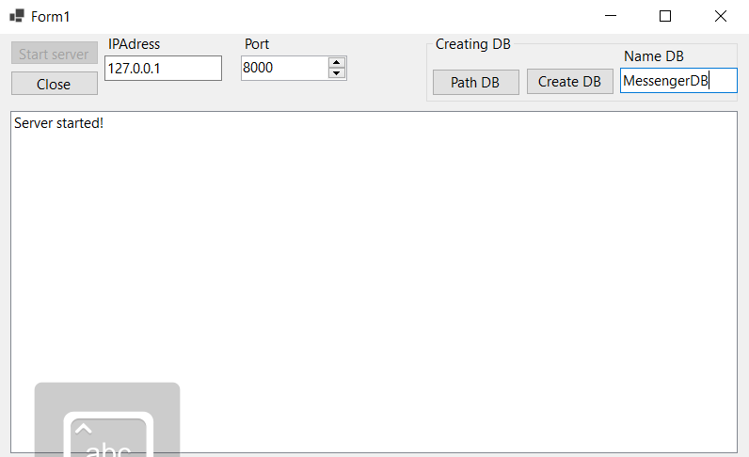
Server features
You can stop the server, start the server, you also have the opportunity to create a new database with a different name, it will contain all the necessary tables and triggers to work with it, this was done to simplify the program check. There is one drawback in my server, this is that only 256 people can use the server, since I use local ports 127.0.0.1 and there can only be 256 IP addresses on the local one in my case.

Slide 11
Thanks for
watching
Chater created by Bogdan Kapriyan.
GitHub -https://github.com/RecountsXxx/Chater

