Slide 1

Shop
Shop created
by Bogdan Kapriyan
for exam work
12.09.2023

Slide 2
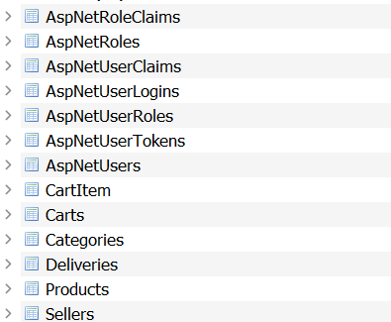
Database struct

Slide 3
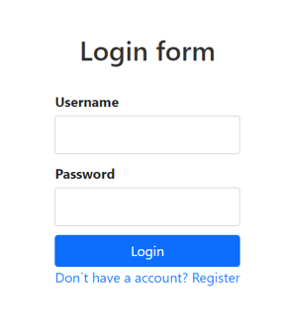
Auth process
You enter field and press button Login or you don’t registered you can press Register and enter fields and press button Register, you returned an Login page, and you must have password and login.

Slide 4
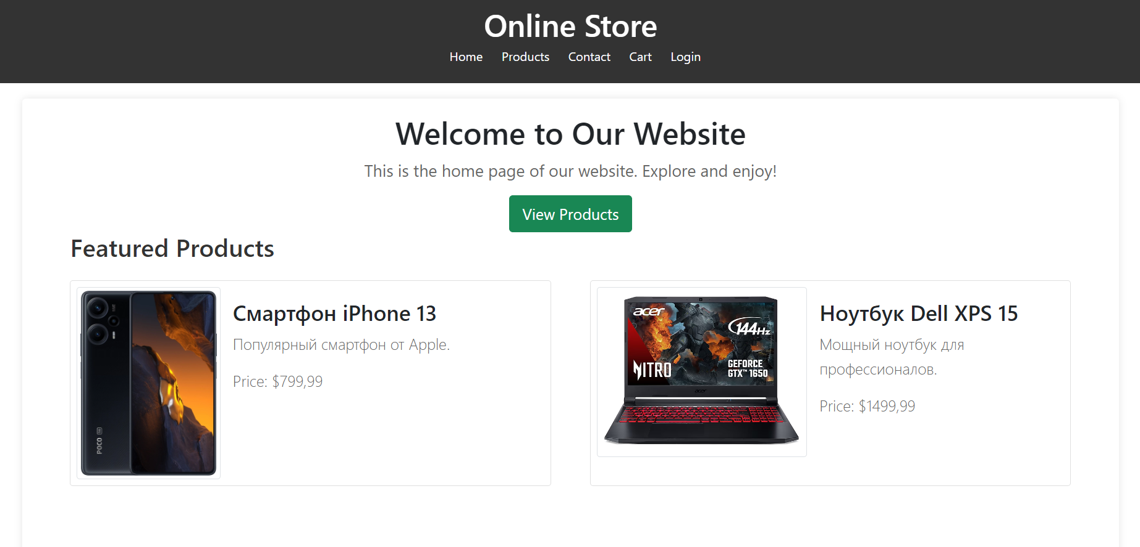
Main page features
You can visit pages such Home you will see featured products and about us, Products you can add product in your card, and you can apply filter for see specific products, Contact this page shows our contacts and our address, Cart you can see your products and checkout, Login you cant register for adding products for your card

Slide 5
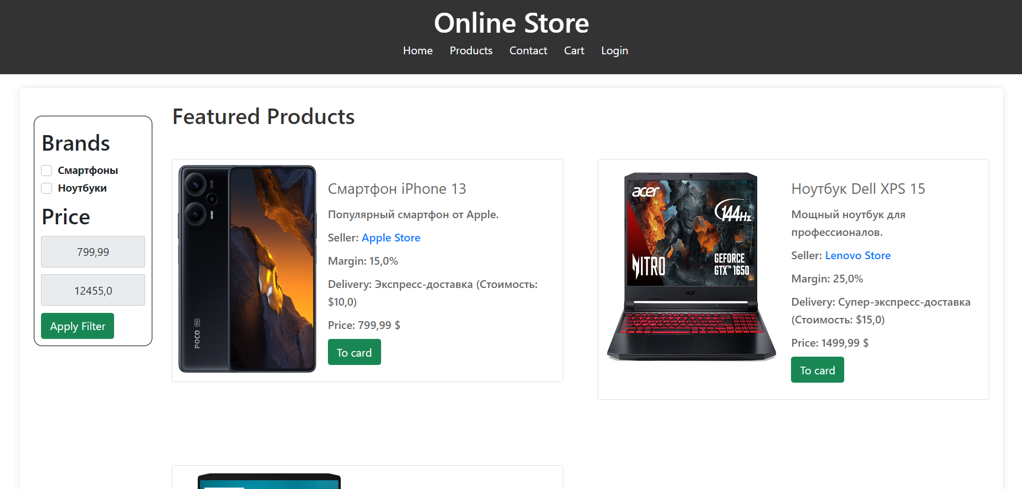
Products features
You can see out products, and you see title, description, price, seller company, and delivery company. Products page includes filter, filter includes such parameters as brands and price limit, to apply filter you need click apply filter and you see your products sorting by filter. Also you cant add product in your cart.

Slide 6
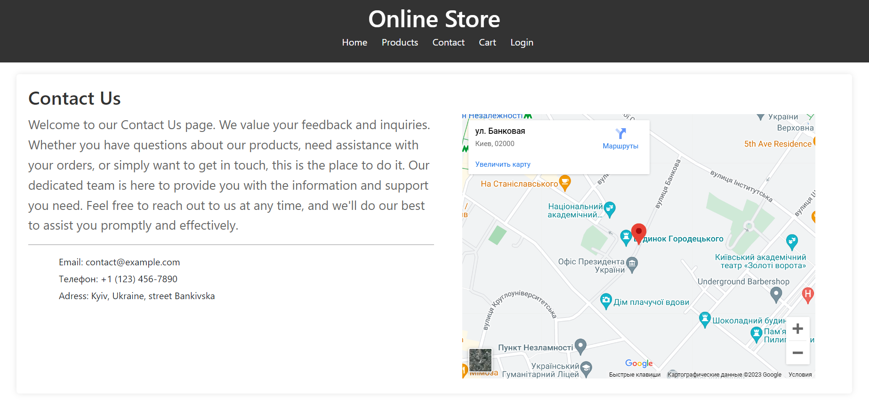
Contacts features
You can see our description, out contacts and, our address. Map integrated by SimpleMap

Slide 7
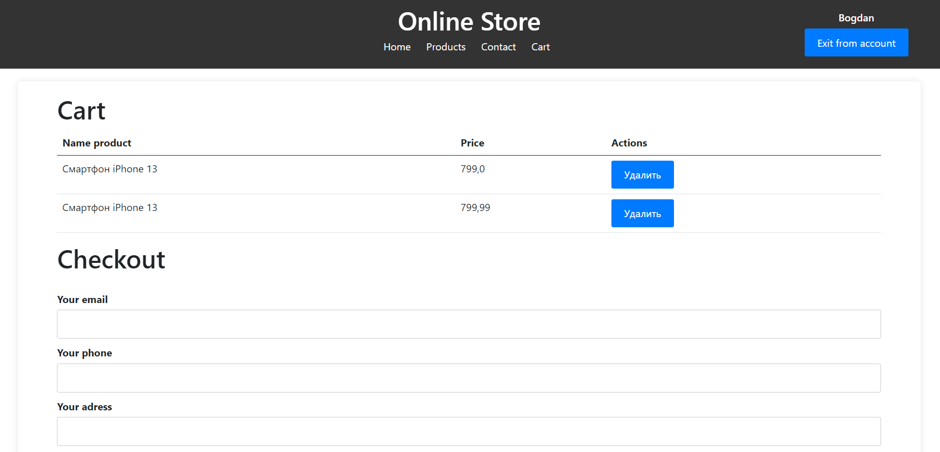
Cart features
When you added product in your cart, you will see products and price, you have features delete product from your cart, also you make checkout with your data.

Slide 8
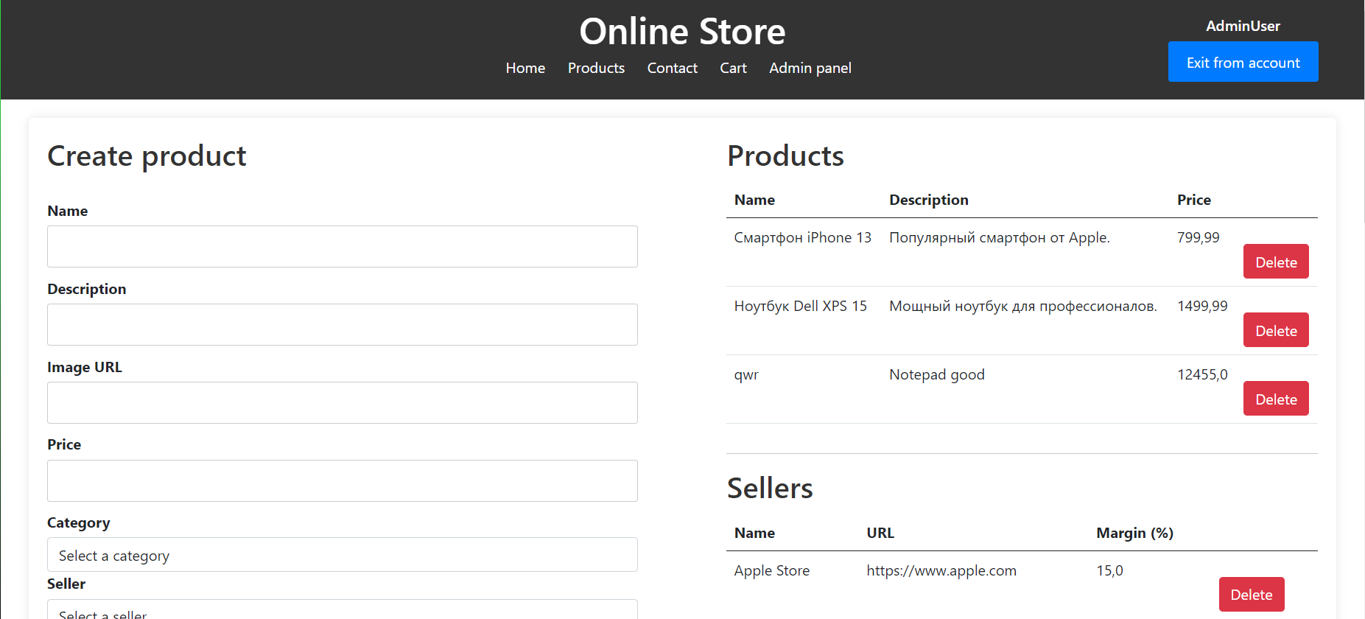
Admin panel features
You can add products, category, delivery company, seller company, Data upload very fast. Also you cant delete products, sellers, deliveries, categories, in table, table have scroll-viewer so there won`t be any problem. In system exists one admin. Users are separated in 2 roles, ‘Admin’, ‘User’.

Slide 9
Other characters
For auth I used such as liblary ASP.Net Core identity, for pages styles I used Bootstrap Framework, and I make responsive design, app used sqlite database, adding and deleting data happening with ASP.Net core Entity Framework.

Slide 10
Thanks for
watching
Shop created by Bogdan Kapriyan.
GitHub -https://github.com/RecountsXxx/Shop-ASP.NET

