Slide 1
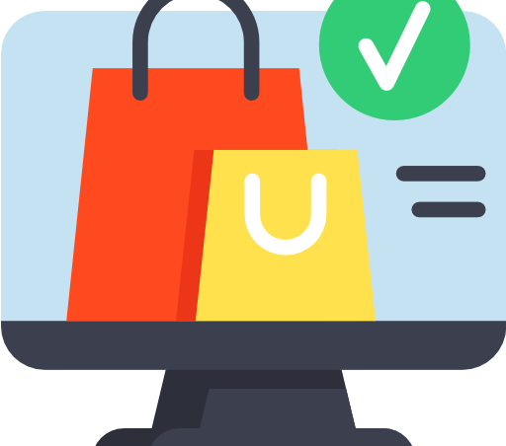
Shop
Shop created
by Bogdan Kapriyan
for exam work
12.09.2023

Slide 2
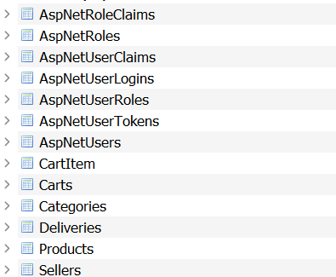
Database struct

Slide 3
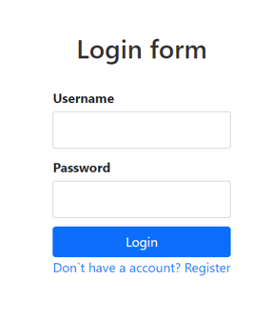
Auth process
You enter field and press button Login or you don’t registered you can press Register and enter fields and press button Register, you returned an Login page, and you must have password and login.

Slide 4
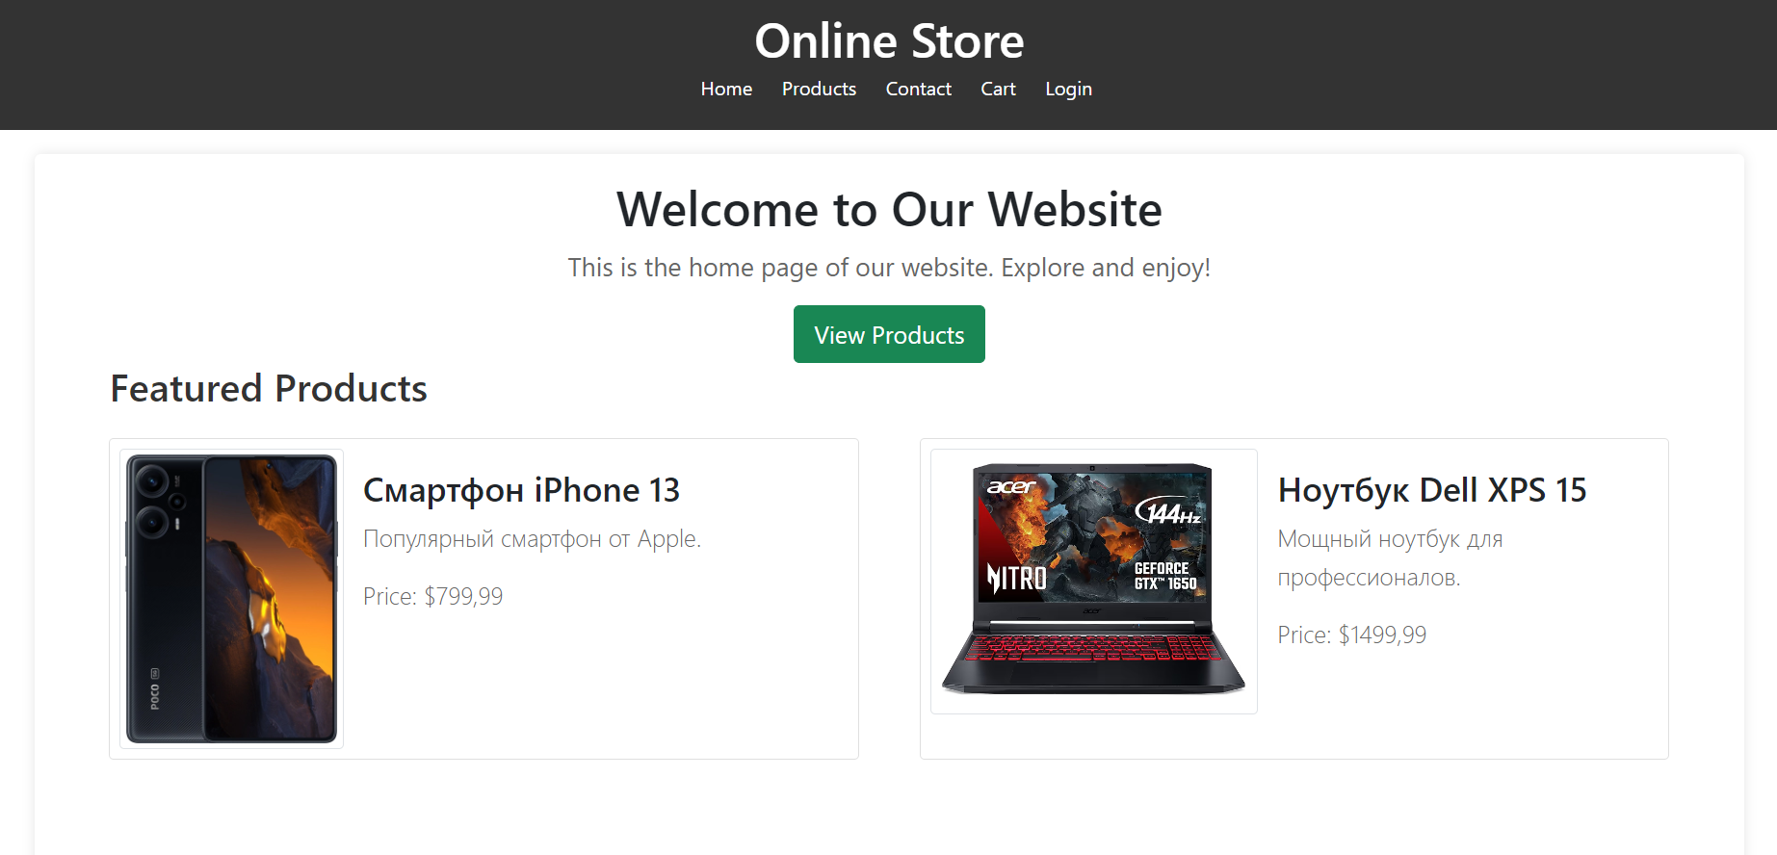
Main page features
You can visit pages such Home you will see featured products and about us, Products you can add product in your card, and you can apply filter for see specific products, Contact this page shows our contacts and our address, Cart you can see your products and checkout, Login you cant register for adding products for your card

Slide 5
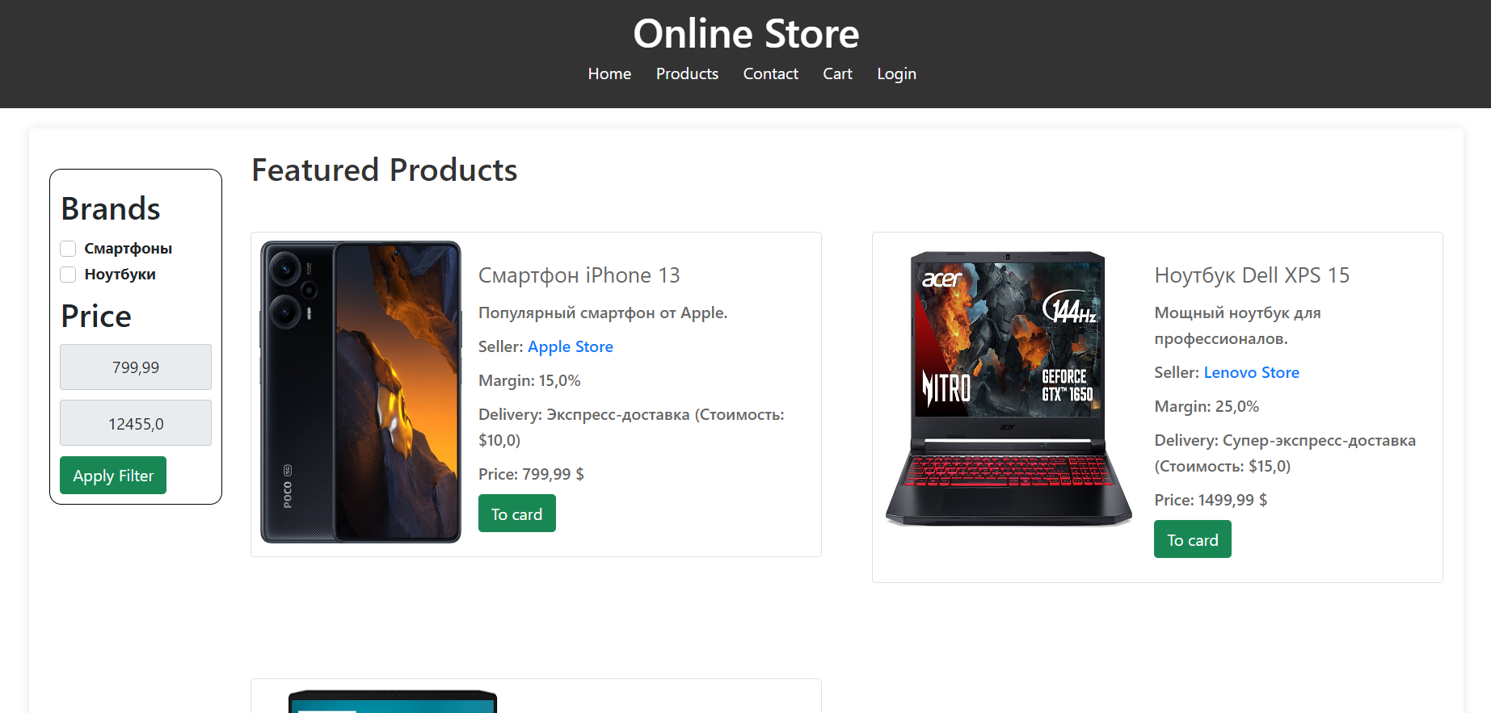
Products features
You can see out products, and you see title, description, price, seller company, and delivery company. Products page includes filter, filter includes such parameters as brands and price limit, to apply filter you need click apply filter and you see your products sorting by filter. Also you cant add product in your cart.

Slide 6
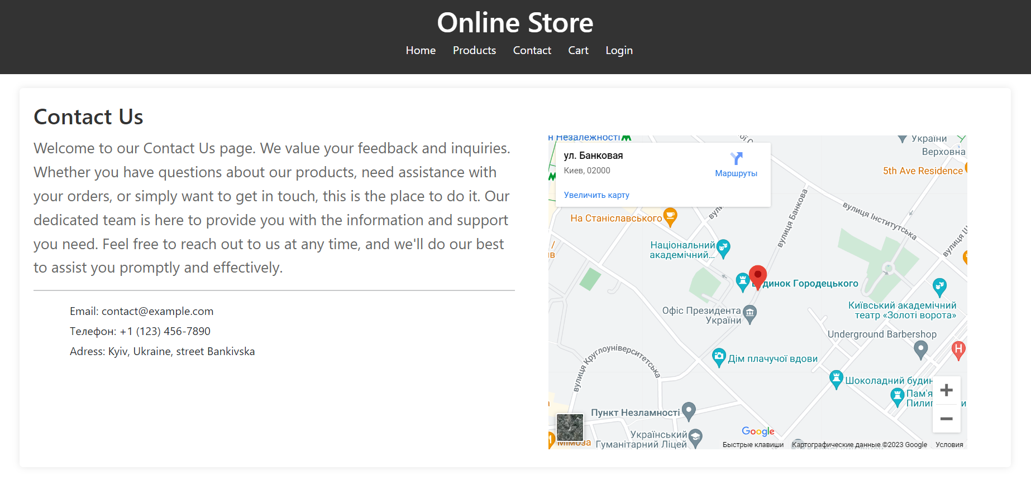
Contacts features
You can see our description, out contacts and, our address. Map integrated by SimpleMap

Slide 7
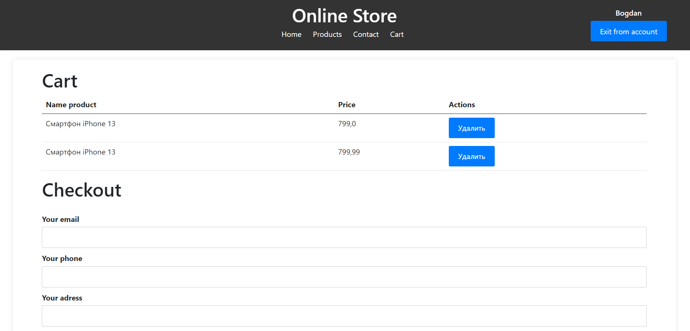
Cart features
When you added product in your cart, you will see products and price, you have features delete product from your cart, also you make checkout with your data.

Slide 8
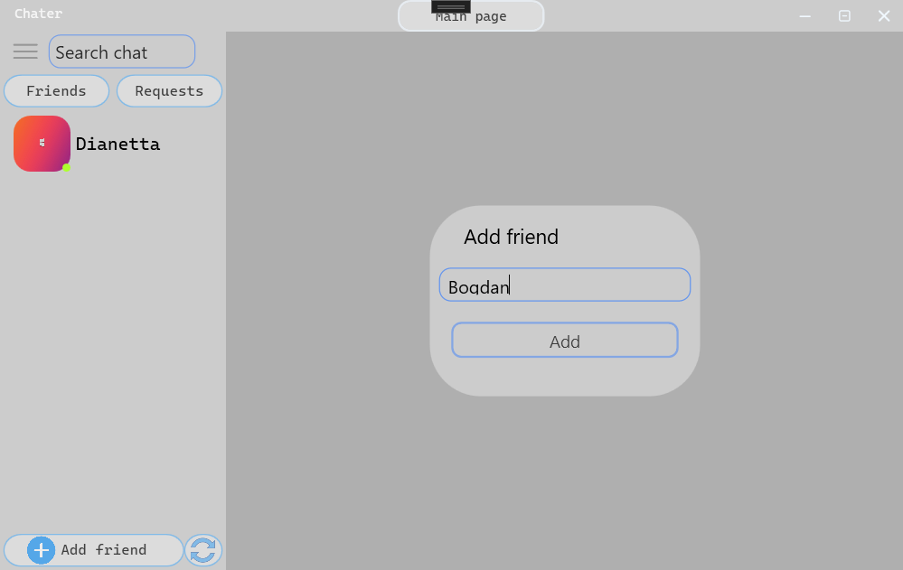
Friends features
You can send a friend request to another user and he can reject the friend request or add you as a friend, also you can remove a friend from the friend list by right clicking on a person and delete a friend, also you can block him, this means that you are not you can send him messages and send friend requests, also with him, but you can unblock him in the settings.

Slide 9

Other characters
The communication between the server and the client is through a helper library, the user interface does not have any access to the server, no third party intervention, the server uses the TCP protocol, and the audio call server uses the UDP protocol for faster information transfer. The files are sent to the server in JSON format.

Slide 10
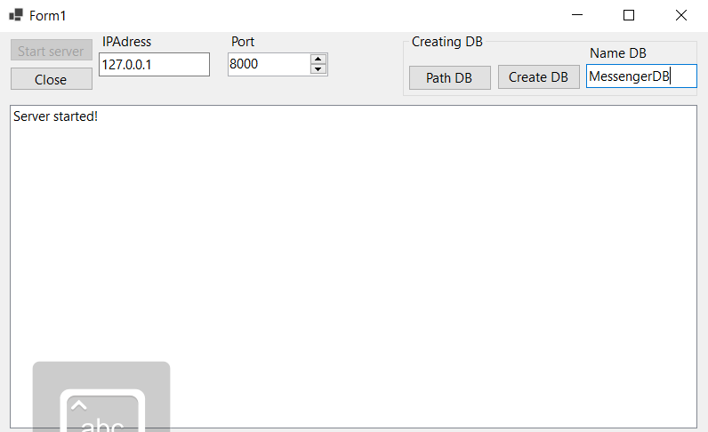
Server features
You can stop the server, start the server, you also have the opportunity to create a new database with a different name, it will contain all the necessary tables and triggers to work with it, this was done to simplify the program check. There is one drawback in my server, this is that only 256 people can use the server, since I use local ports 127.0.0.1 and there can only be 256 IP addresses on the local one in my case.

Slide 11
Thanks for
watching
Chater created by Bogdan Kapriyan.
GitHub -https://github.com/RecountsXxx/Chater

