Slide 1
Eventzip
MVP Presentation

Slide 2
Target audience
Ages 18-34
Millennials
Event Planners
Restaurant Owners
Restaurant Customers
Travelers

Slide 3
Problem-solution
This product will address:
Saving the user time when searching for activities
One stop shop for vacation/event planning that will provide detailed information on venues, restaurants, movies, events, hotels, etc.

Slide 4
Primary goal
A content aggregator that will provided the user with activity and hotel information based on zip code

Slide 5
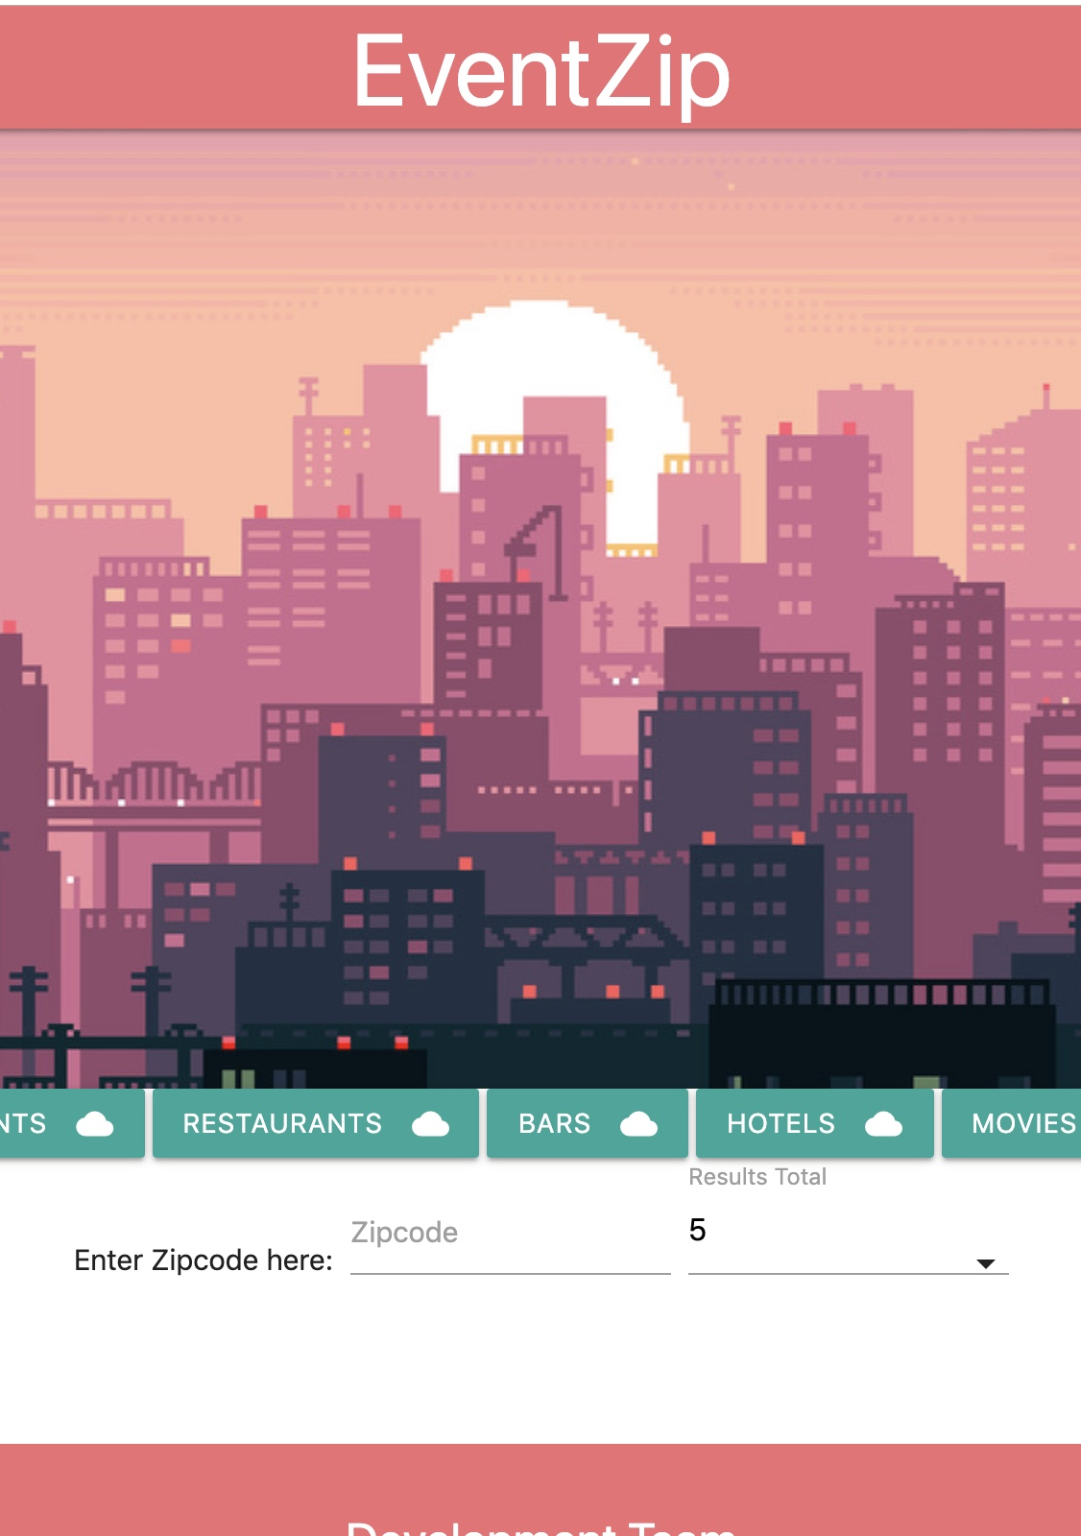
Landing page
The user will select a zip code and number of results to display
The user will then select one of the search buttons to display results based on the search

Slide 6
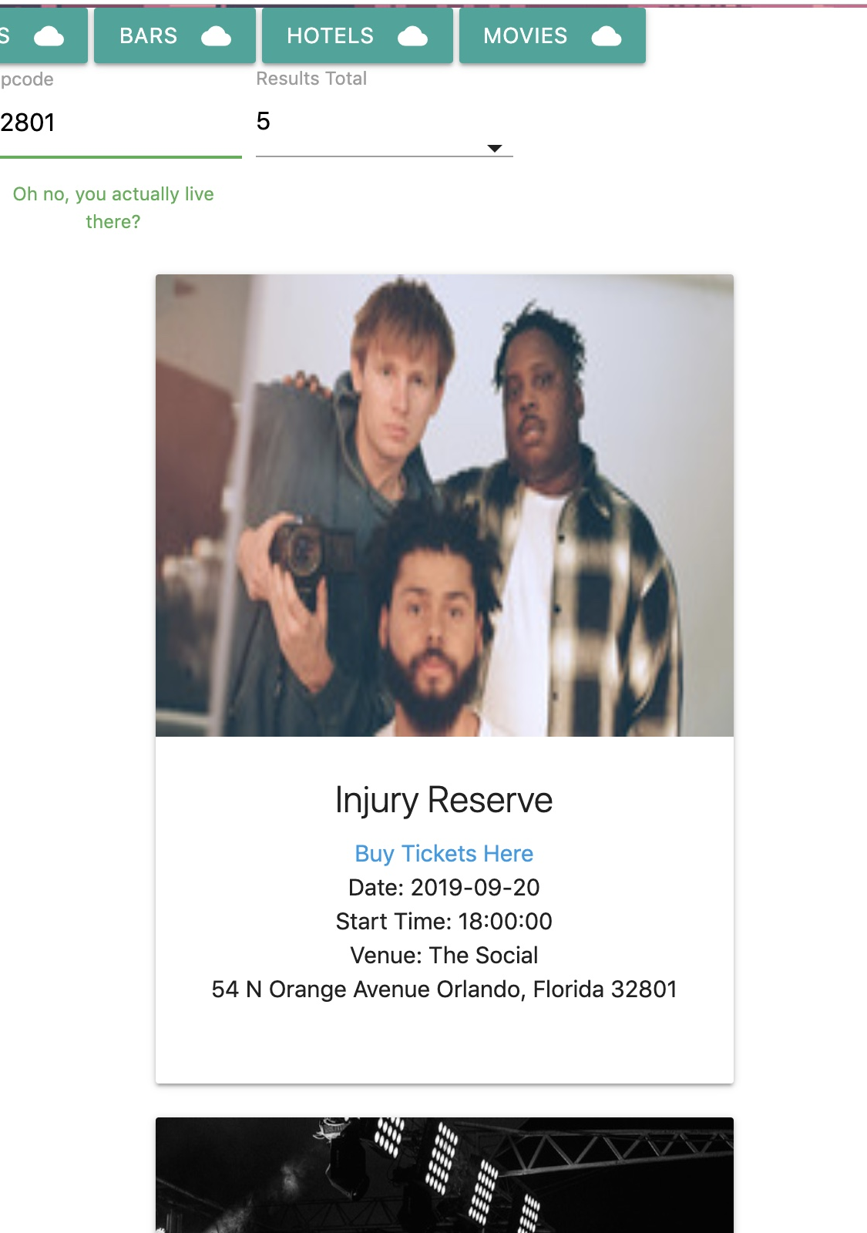
Search results
Results will display based on search parameters ex. Events, Restaurants, Bars, Hotels, Movies
Results will also provide a link to either buy tickets or to the event site.

Slide 7
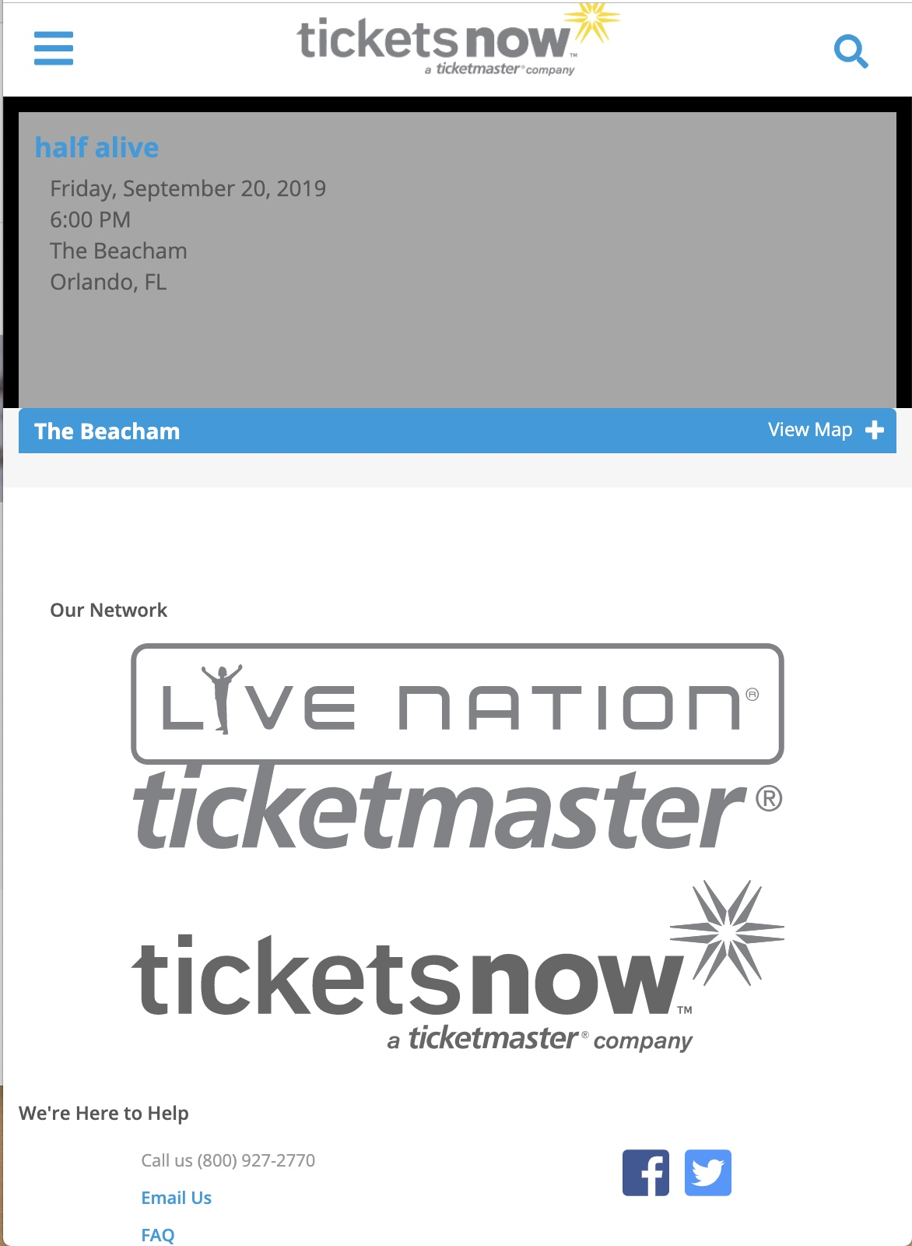
More information
The user can click on the url for each result to either display more information of the specific activity (ie. Yelp page)
Or provide the ability to purchase tickets to the event

