Slide 1
WebSocket Implementation Comparison
Berkay Çağrı Soylu

Slide 2
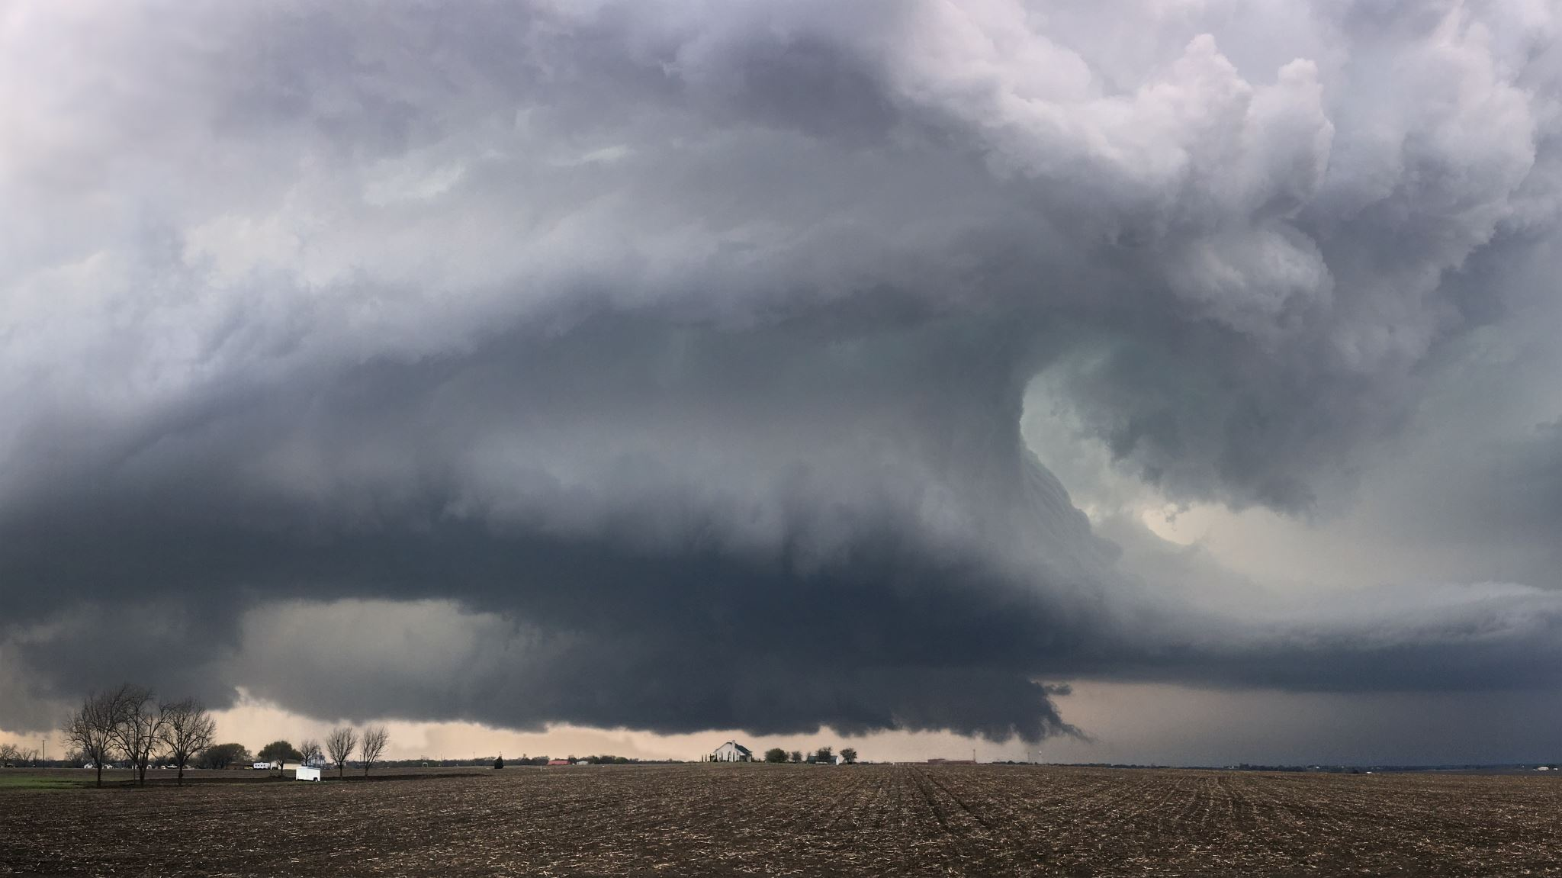
Latency
Websockets: Average Latency - 0.000876 seconds
Tornado: Average Latency - 0.000965 seconds
Observation: Websockets outperformed Tornado by approximately 10% in terms of latency.

Slide 3
Throughput
Websockets: Throughput - 30.3015221337059 messages/per 10 seconds
Tornado: Throughput - 30.2804844366243 messages/per 10 seconds
Observation: Throughput values between Websockets and Tornado are almost identical.

Slide 4

Scalability
Websockets:
High concurrency support
Asynchronous architecture for efficiency
Tornado:
Well-suited for handling concurrent connections
May require fine-tuning for specific scalability requirements

Slide 5

Additional Metrics
Websockets:
Straightforward API
Active community and extensive documentation
Tornado:
Rich feature set
Seamless integration into existing web applications

Slide 6

Conclusion
Latency: Websockets demonstrated superior performance.
Throughput: Both libraries achieved nearly identical throughput, with a margin edge to Websockets.
Scalability: Websockets provides high concurrency support and asynchronous architecture.
Additional Metrics: Websockets offers a straightforward API and active community support.
In conclusion, for this scenario, Websockets is recommended for its superior latency and comparable throughput.

