Slide 1
Our Data Science Process Framework Report
Megan West for Credit One, DEC 2020

Slide 2
Our Goal
The goal of this project is to determine the following:
Can we build a better way to determine how much credit to issue?
Can we improve our approval process?
In this presentation, we will introduce the BADIR data science process framework and describe how each step will enable us to move forward toward these goals.
We will discuss possible pitfalls in our process and state how we will address them.

Slide 3
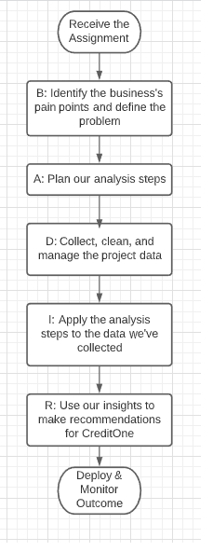
The BADIR Framework
Business: Evaluate the business question and examine root cause
Analysis: Create a plan for analyzing the data
Data Collection: Collect the data from the relevant systems
Insights: Apply our analysis plan to the data we've collected
Recommendation: Make recommendations based on our insights

Slide 4
Business
Our goal is to fully understand the business problem before we attempt to solve it.
Business Questions: Can we improve how we determine loan amounts? Can we improve how we determine loan eligibility?
Both customers and stakeholders will be impacted by the new solution.
If our solution is too restrictive, we could lose customers.
If our solution is too relaxed, our business will lose money.
Pitfall: The issue is urgent. Credit One is losing money to defaults.
We will work as quickly as possible to come up with recommendations.
Insight: We are working with both a yes-or-no question and a question with many possible answers. We will research methods to solve this type of problem.

Slide 5
Analysis Plan
Once we've clearly understood the problem, we'll follow a plan for the analysis process.
The goal of our analysis is to find a better estimate for how much to loan to each customer.
First we'll clean and prepare the data for analysis using data science tools.
Next, explore the data using visualizations and statistical analysis.
Gain initial insights and discern relationships between the features.
Use patterns we have identified to predict defaults using a model we develop.
Use the results to attempt to make judgements about how much to loan our customers.
Evaluate whether our method is superior to the methods currently in place.
Pitfall: We may spend a large amount of time preparing the data for analysis.
We will document the process so that it takes less time in the future.

Slide 6
Data Collection
We will obtain a collection of valid and ethically sourced data. We must clean and prepare this data to ensure that it is high quality.
We will obtain our data from a company database.
We have the following data:
Amount of credit issued
Demographic data including gender, education level, age, and marital status of each customer
Repayment status of the loan per month for six months
Amount of each billing statement
Amount of the customers' previous payments
The outcome-- whether the customer defaulted or not
Known issue: The data may have been stored improperly.
We will need to properly convert it.

Slide 7
Insights
In this stage, we'll apply our analysis process to the data we have obtained and test our hypotheses.
We will explore the data to gain initial insights and to discern relationships between the different features.
We will use the patterns we find to make predictions about how much we should loan each customer (a range of values), and if we should issue a loan to begin with (yes or no).
We will determine which findings will impact Credit One the most.
Pitfall: We may be unable to make accurate predictions.
We will need to re-examine our framework from the beginning.

Slide 8
Recommendation
In this final step, we will take our insights and turn them into actions.
Action is required for the data science process to have a positive impact on the company's continued growth.
We will demonstrate how each recommendation is of value to the business in our final report.

Slide 9
Review
We are recommending this implementation of the BADIR process framework for this project because:
It is thorough. Every aspect of the data science process is covered by the framework's steps, ensuring that each step taken is completed and with a solid reason.
It is simple to remember the acronym and to ask who, what, when, where, why and how questions about each phase.
It keeps the data science process organized and makes keeping records easy. Having a clear record of the process will enable future replication of our results.

