Slide 1
A Hands-On .NET Solution Migration to EKS
An Application Refactoring Scenario Lab
Elgin Lam
July, 2019

Slide 2
Agenda
Strategies for refactoring .NET applications
Let’s review the lab content
Introducing the lab guide
We’re here to support you… watch your time
Q&A

Slide 3
Learning Objectives
.NET Development Environment
.NET Core conversion process and tools
EKS Deployment of .NET Console app

Slide 4
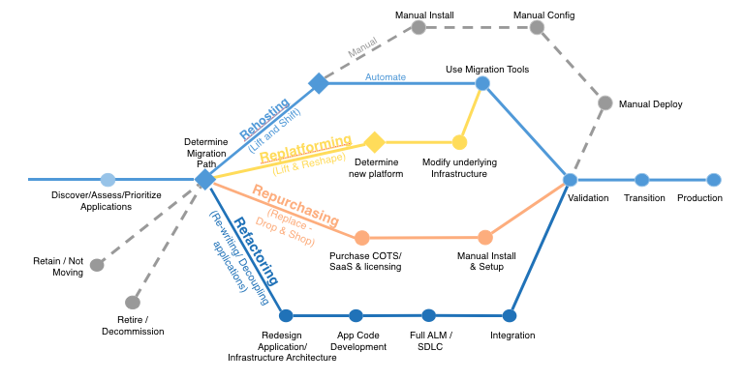
Application Migration Strategies

Slide 5
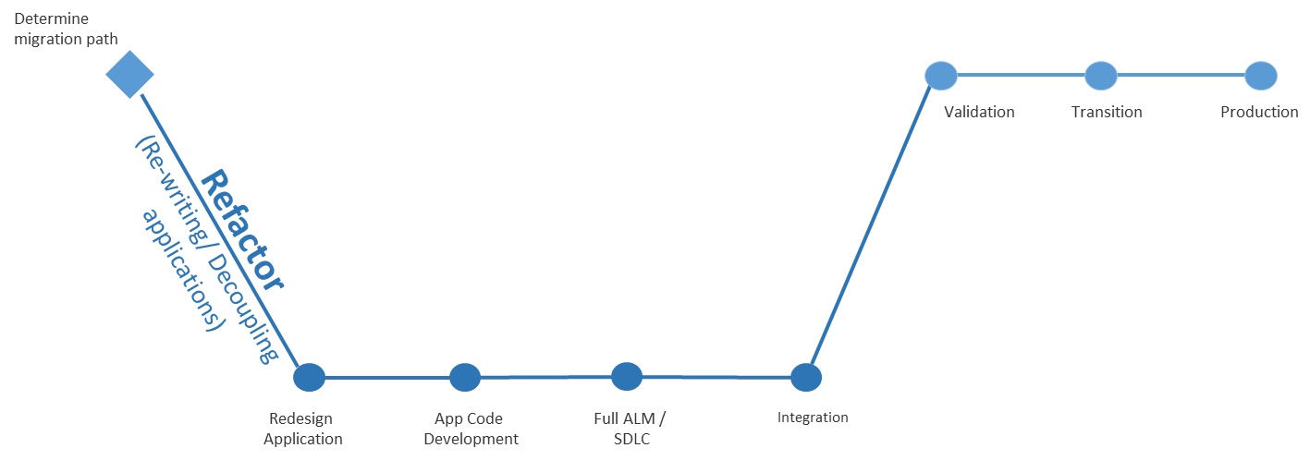
The Refactor Strategy
Pros:
Realize full potential of target cloud platform
Cons:
Requires the largest investment and level of effort to realize

Slide 6
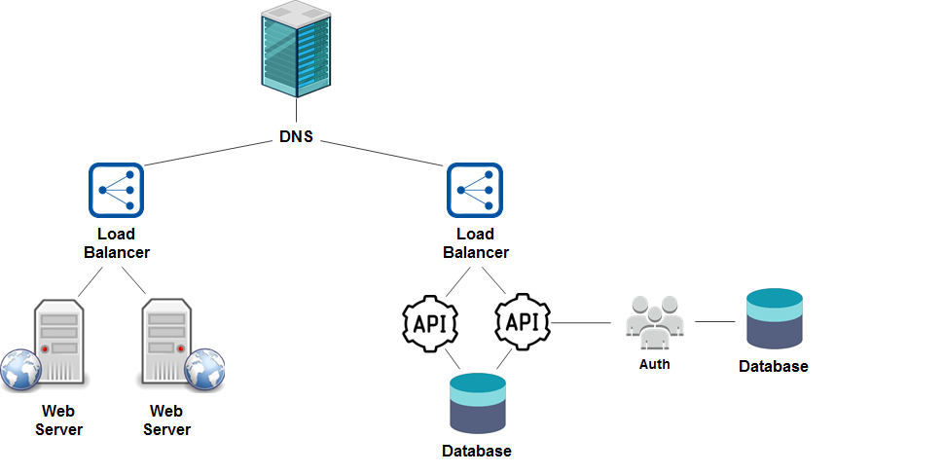
A Traditional Solution Architecture (before)

Slide 7
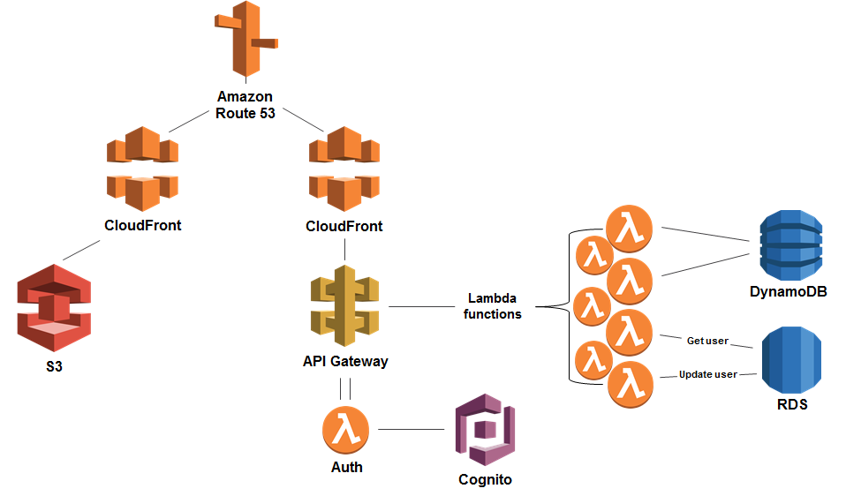
A Refactored Solution Architecture (after)

Slide 8




.NET Framework Application Migration Strategies
Deploy .NET Framework apps “as is” to EC2 Virtual Machines
Every app can have custom server configuration, different .NET Framework versions, IIS configuration, dependencies, etc.
Containerize in Windows Containers and orchestrate with ECS, Fargate, or EKS
Supports different .NET Framework versions, IIS configurations, dependencies
Reduces $$ for OS licensing costs (host only costs)
Port to .NET Core, and run in ECS, Fargate, or EKS as Linux Containers
No OS licensing costs, smaller containers
Also enables deploying apps to Lambda
Low…
Level of Effort
…High

Slide 9
.NET Framework Application Migration Strategies
Review
Can it run on . NET Core?
Remove
Code deprecation due to APIs, libraries, microservices
Replace
Update code dependent on Win32 libraries – logging, registry, WCF, WPF
Refactor
Add code guard conditions
Update libraries, SDKs, APIs

Slide 10
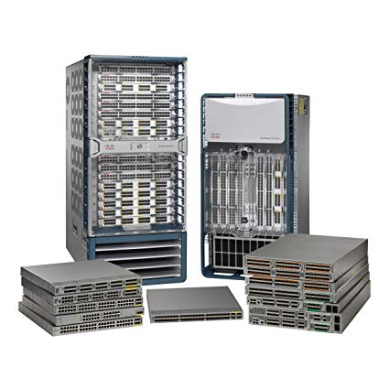
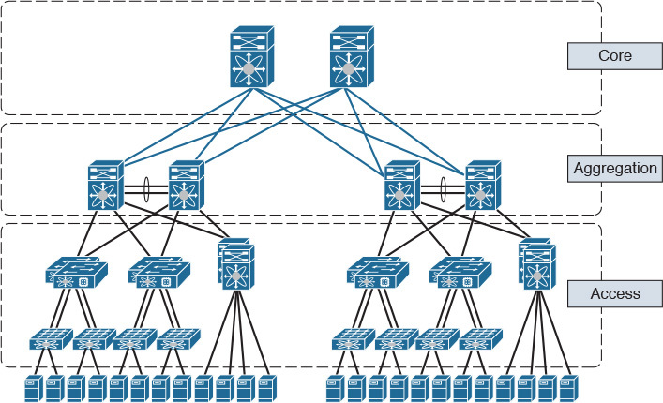
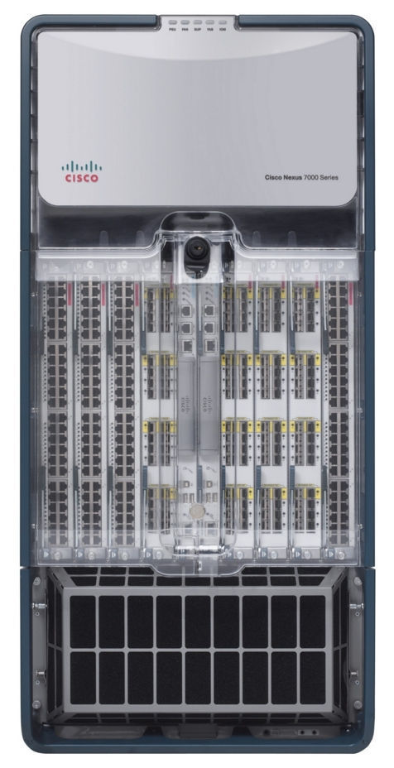
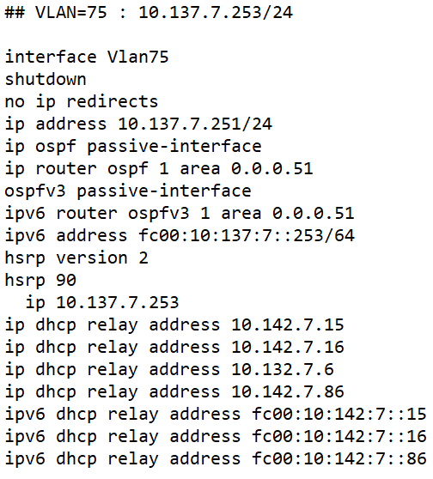
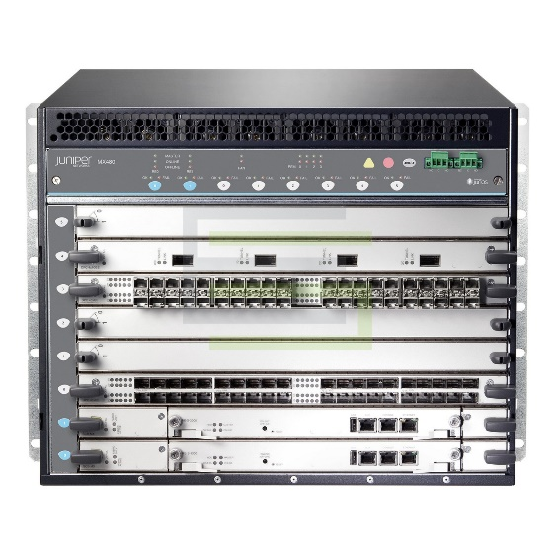
Our Simple but Real-World Application Scenario
A legacy enterprise-class data transformation problem
TRANSFORM
75 family inet address 10.137.7.253/24
Notes:
TODO : Introduce the Enterprise IT problem scenario…

Slide 11
The Lab Guide

Slide 12
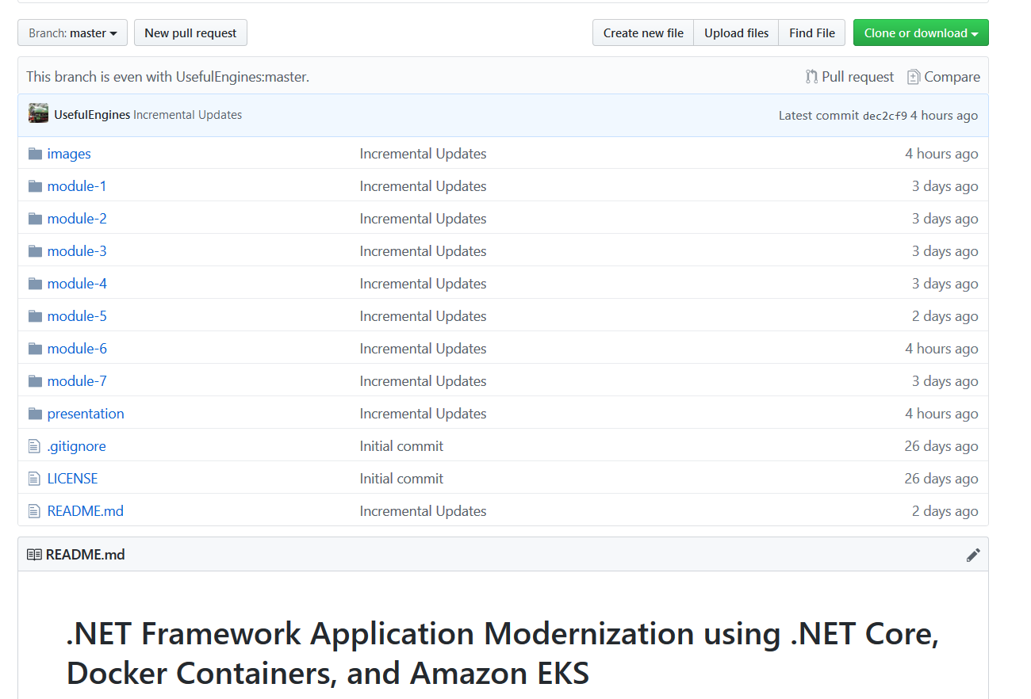

The Lab Guide
http://bit.ly/eks-container-lab

Slide 13
Getting Help! Watch your time… but you can also complete later. It’s a learning exercise, not a race.

Slide 14
Q&A – Thank You! Please provide feedback
Elgin Lam
@elginlam

