Slide 3

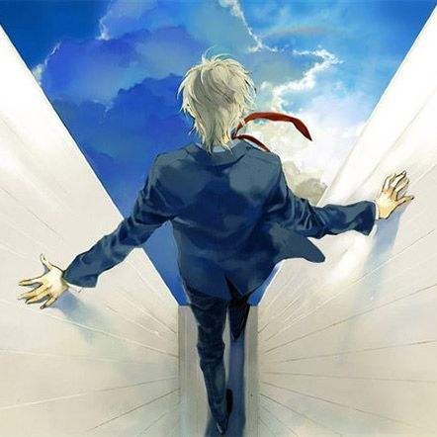


Explorer
在此处创建/更新Emerald工程

Slide 4
RC
Beta

Slide 5
RC
Beta

Slide 6





BUILDER
…
PROJECT
Title
Moristory
Backup
Maker
Animation
Error 404
About
Using Version (Update available)
V19070901
Note

Slide 7
Emerald Builder
…
Emerald Builder

