Slide 1
Obtaining Well Completion Report Data

Slide 2
Overview
Three step process:
Scrape government website to download Well Completion Reports
Convert downloaded pdf and tiff files into the jpeg format
Send jpeg files to Google’s Firebase platform and get back an array of text objects. Relevant data can then be identified and extracted from the data.

Slide 3
Website Scraping
Queensland Government has a new online portal (GSQ Open Data Portal) launched on 3rd August 2020 https://geoscience.data.qld.gov.au/
Searching and downloading files from this new portal can be done using the BeautifulSoup Python package. BeautifulSoup allows you to access and search through the html code of the website.

Slide 4
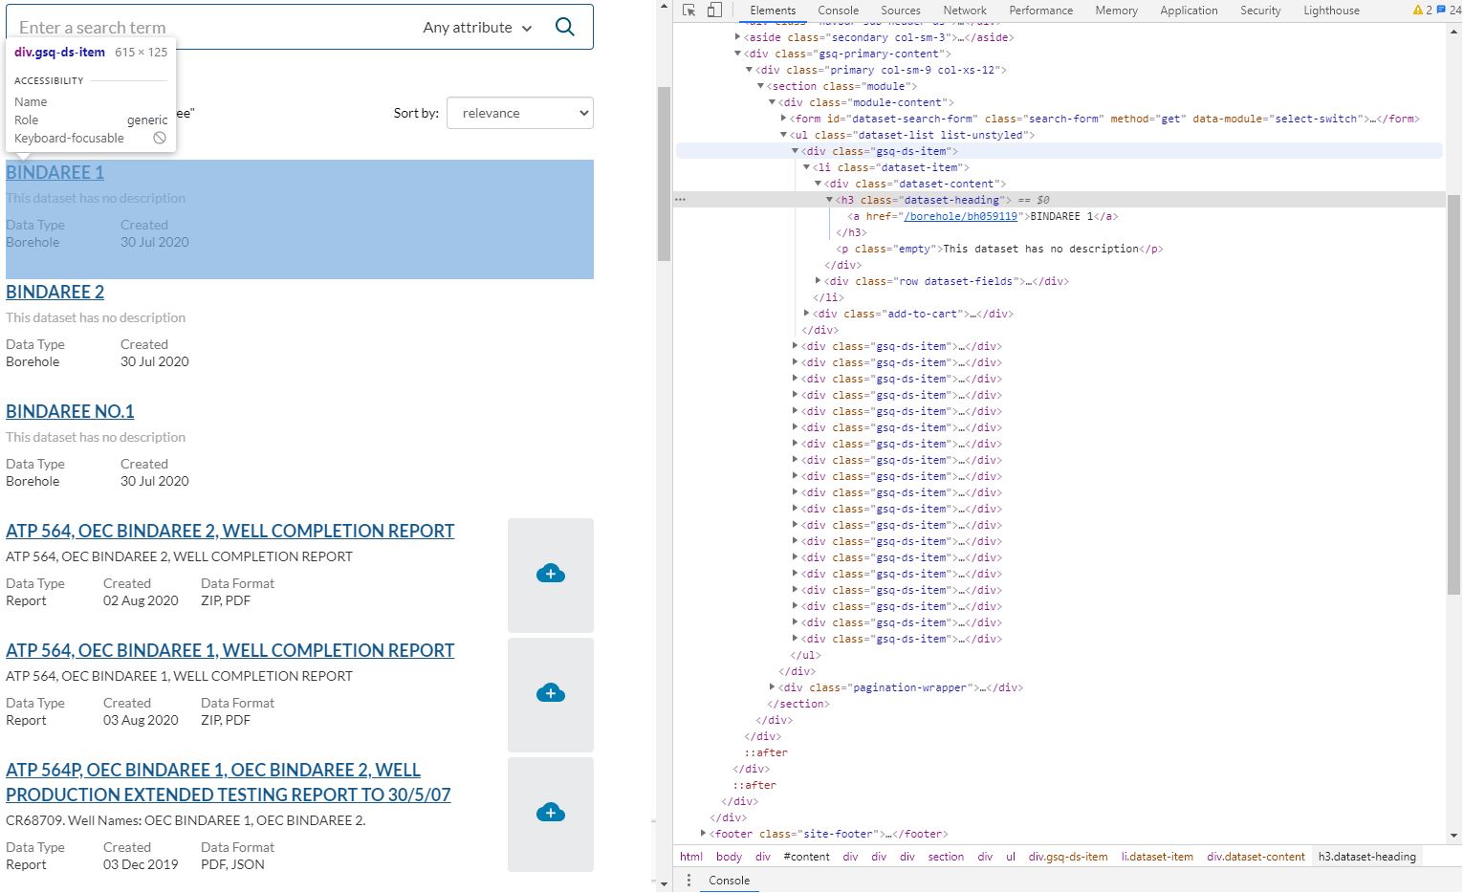
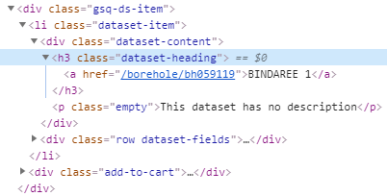

Slide 5
Website Scraping
So far only keyword searches have been used but the GSQ portal supports advanced searches such as AND/OR operations and date range searching
GSQ have also developed an API that could be used in the future instead of html scraping.

Slide 6
Conversion to JPEG
Most Well Completion Reports come in either PDF format or TIFF format
To uses Google Firebase’s text recognition API we need to provide image files such as PNGs or JPEGs
Python Imaging Library (PIL, now called Pillow), an open-source library for image manipulation, is used to convert PDF files and TIFF files to the JPEG format

Slide 7
Text Recognition
Text Recognition is done using the Google Firebase Machine Learning Cloud-based API
Firebase returns an a

