Slide 1
CNN_Regularization
Presented by zhijie

Slide 2
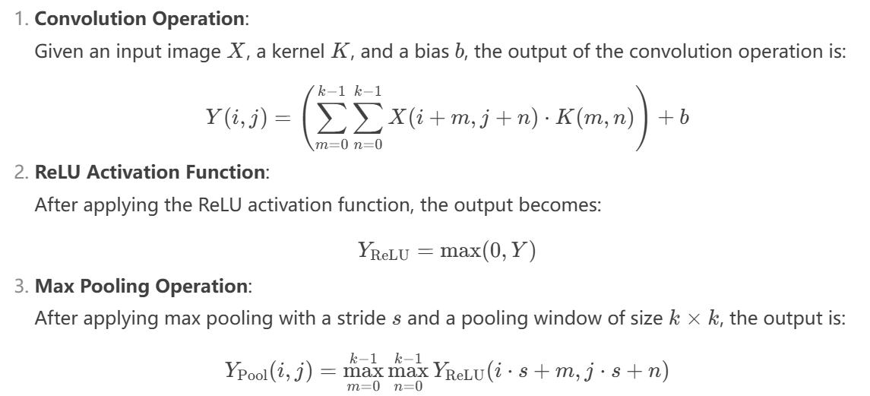
CNN: theory

Slide 3
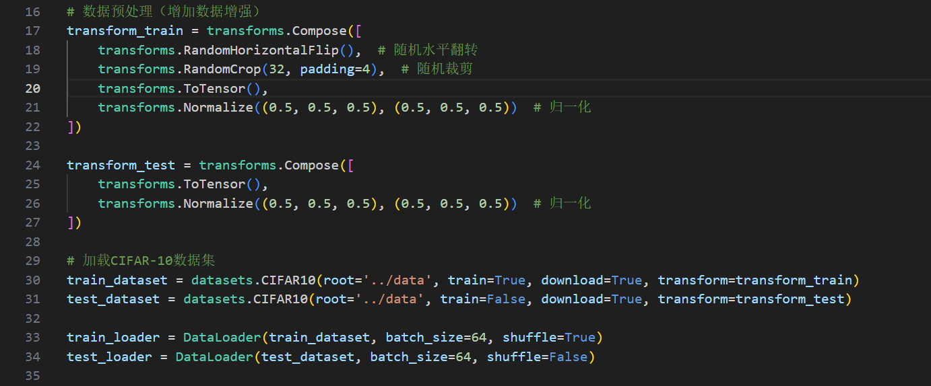
CNN: code
Some work to prepare first:
Dataloader, download MNIST, transform dataset into normalized tensor type, and shuffle the train dataset
Apply regularization(data augmentation) when processing train_dataset
Hyper params: num_epochs=20, lr=0.001, batch_size=64

Slide 4
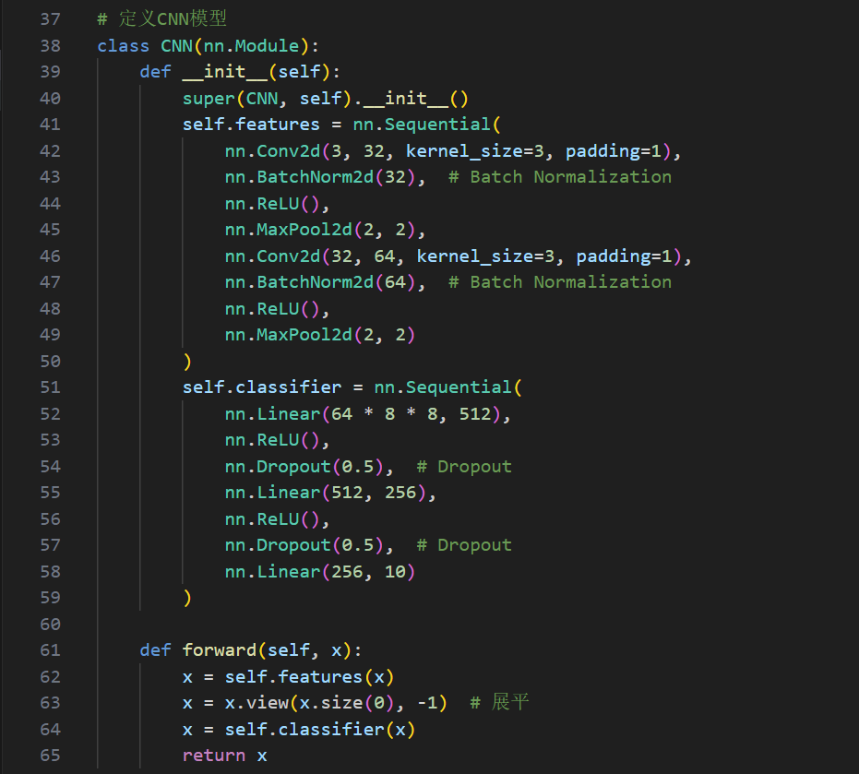
CNN: code
Implementation of the model
I devide the model into two parts: features and clssifier Features: use CNN(conv, relu,maxpool2d) to extract the features of dataset
Classifer: use MLP(linear,relu) to map features to the final classification results
Apply regularization(dropout, batchnorm2d) into both the two parts of the model
And between these two parts, we need to flatten

Slide 5
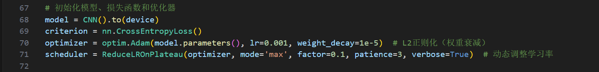
CNN: code
Something suitable for this cnn model:
Choose adam as optimizer, and apply regularization(L2 weight decay)
Use crossentropyloss for criterion
Use ReduceLROnPlateau to schedule the best learning rate automatically

Slide 6
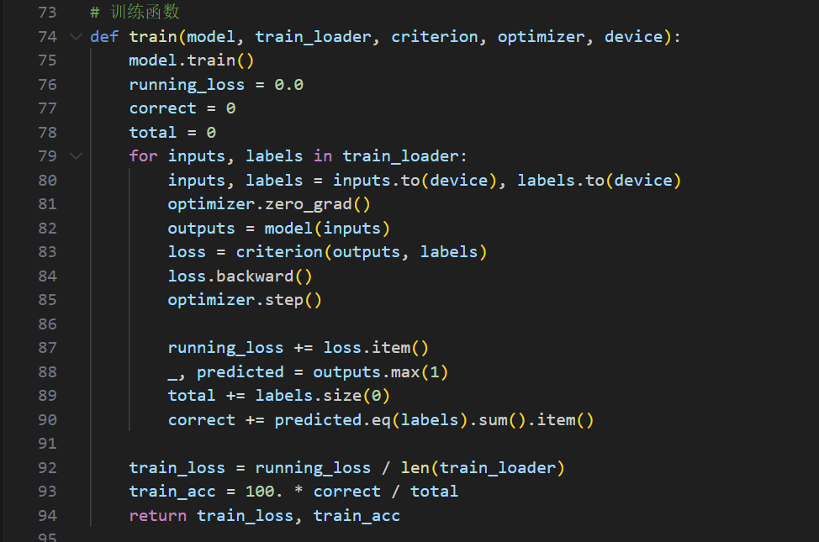
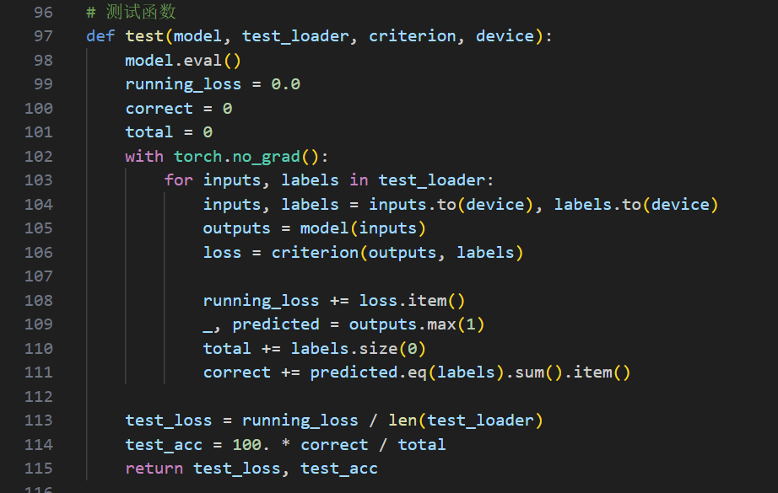
Logistic Regression: code
Train and test function: (the same as last task)
test: with torch.no grad, in this way reducing grad computation, in fact during test we don’t need to compute grad to backward

Slide 7
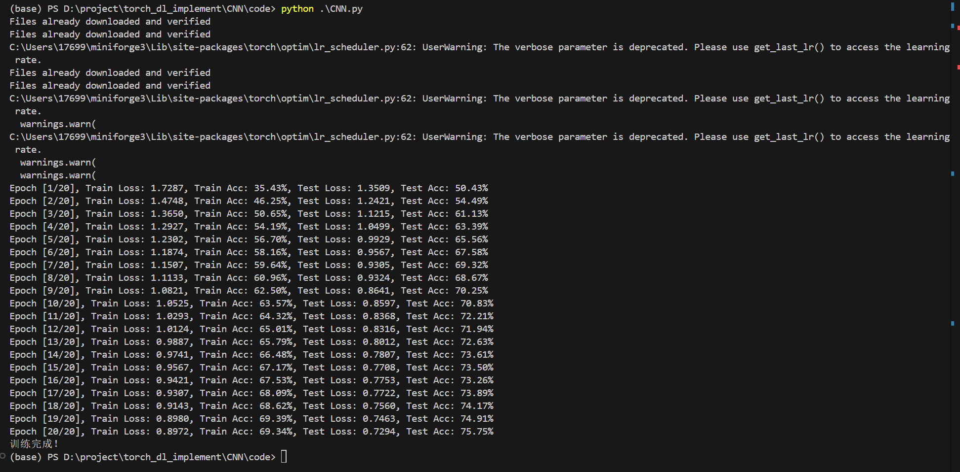
CNN: result

Slide 8
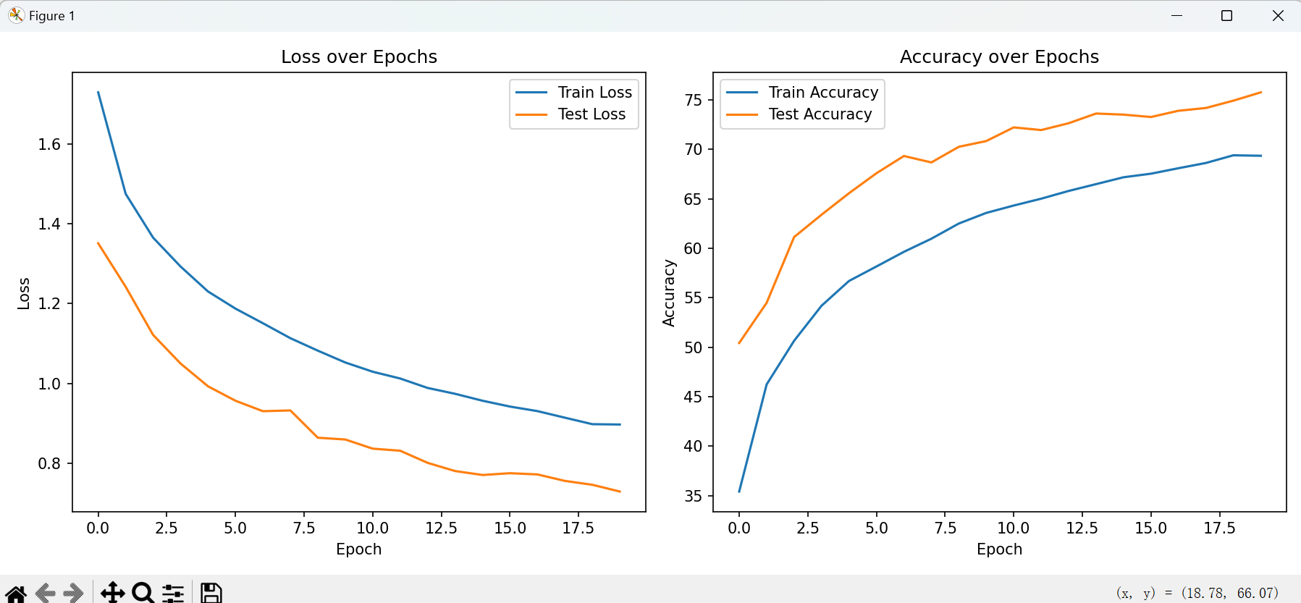
CNN: result

Slide 9
My analysis
Dropout: Used in the fully connected layers (Dropout(0.5)), it randomly drops 50% of the neurons during training, forcing the network to learn more robust features.
L2 Regularization (Weight Decay): Applied in the Adam optimizer (weight_decay=1e-5), it adds a penalty proportional to the square of the weights, discouraging large weights and reducing overfitting.
Batch Normalization: Used after convolutional layers (BatchNorm2d), it normalizes the activations, stabilizing and accelerating training while also providing a slight regularization effect.
Data Augmentation: Applied during training (RandomHorizontalFlip, RandomCrop), it artificially increases the diversity of the training data, helping the model generalize better to unseen data.

