Slide 1
LogisticRegression&MLP
Presented by zhijie

Slide 2
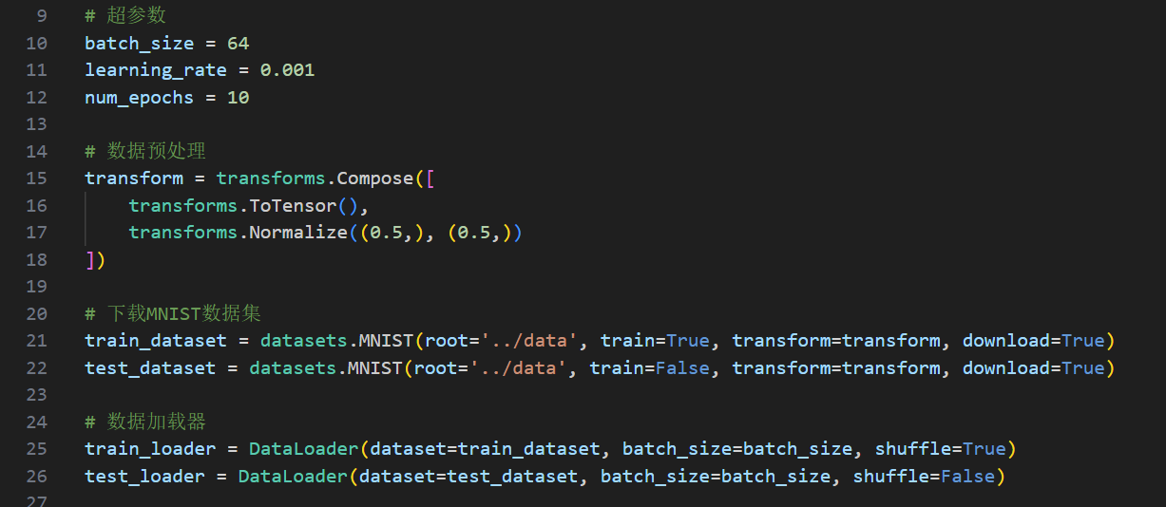
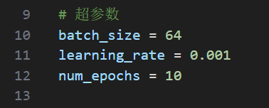
Logistic Regression: code
Some work to prepare first:
Dataloader, download MNIST, transform dataset into normalized tensor type, and shuffle the train dataset
Hyper params:

Slide 3

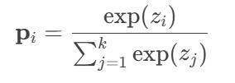

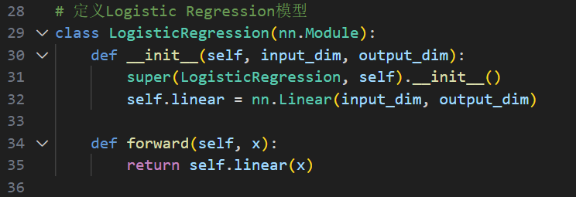
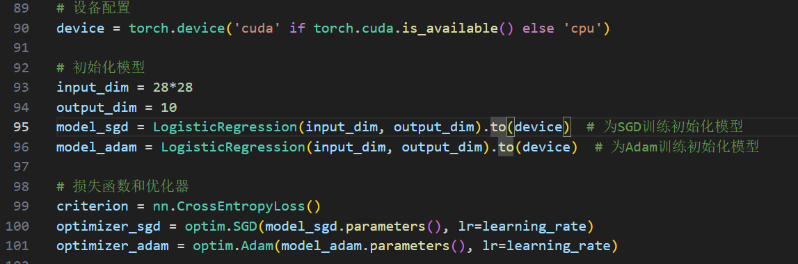
Logistic Regression: code
Mathematical formulation of the model
Implementation of the model
Actually, just a single linear
Softmax is implemented in the loss function which is cross entropy
Train two separate models to compare the performance of these two optimizers: SGD and Adam
In order to train faster, use GPU to train (move dataset to GPU frist )

Slide 4
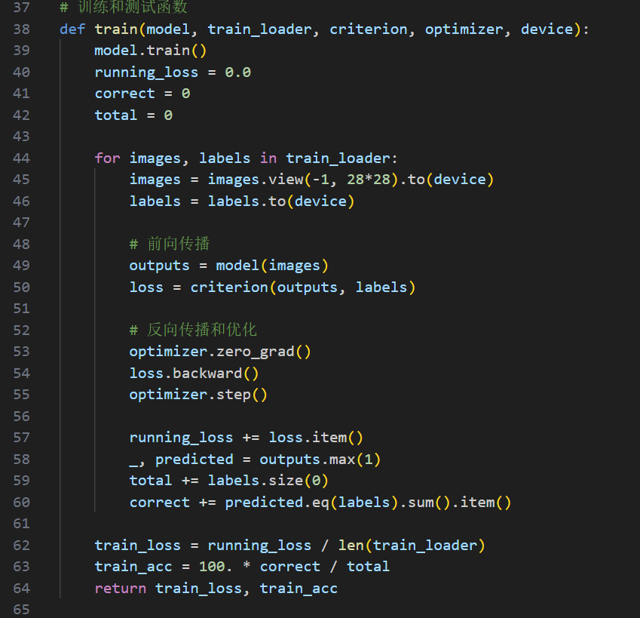
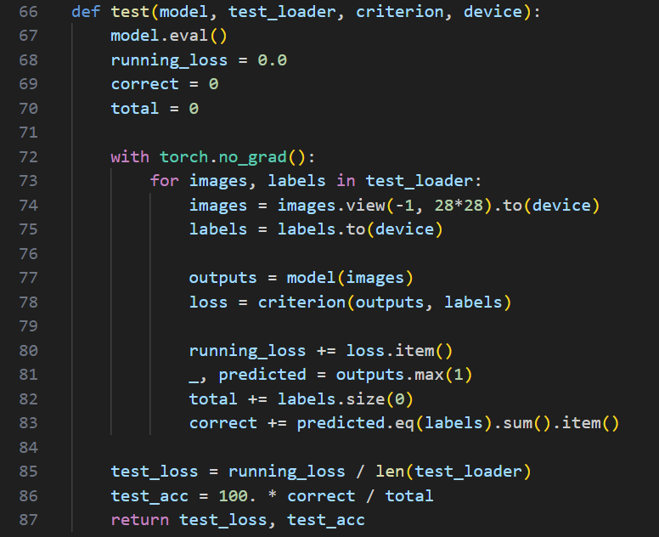
Logistic Regression: code
Train and test function:
test: with torch.no grad, in this way reducing grad computation, in fact during test we don’t need to compute grad to backward

Slide 5
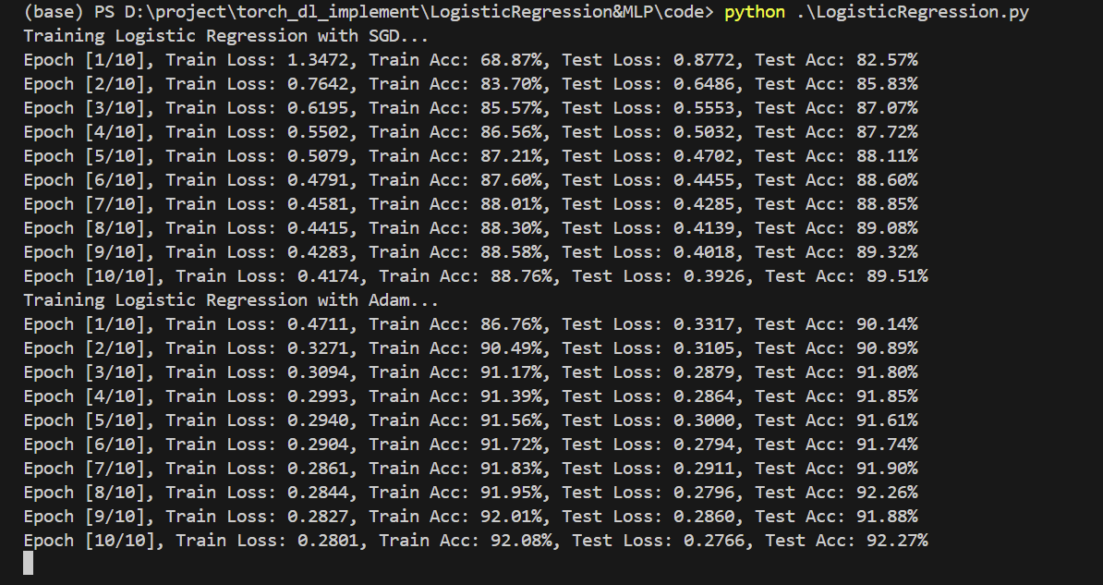
Logistic Regression: result

Slide 6
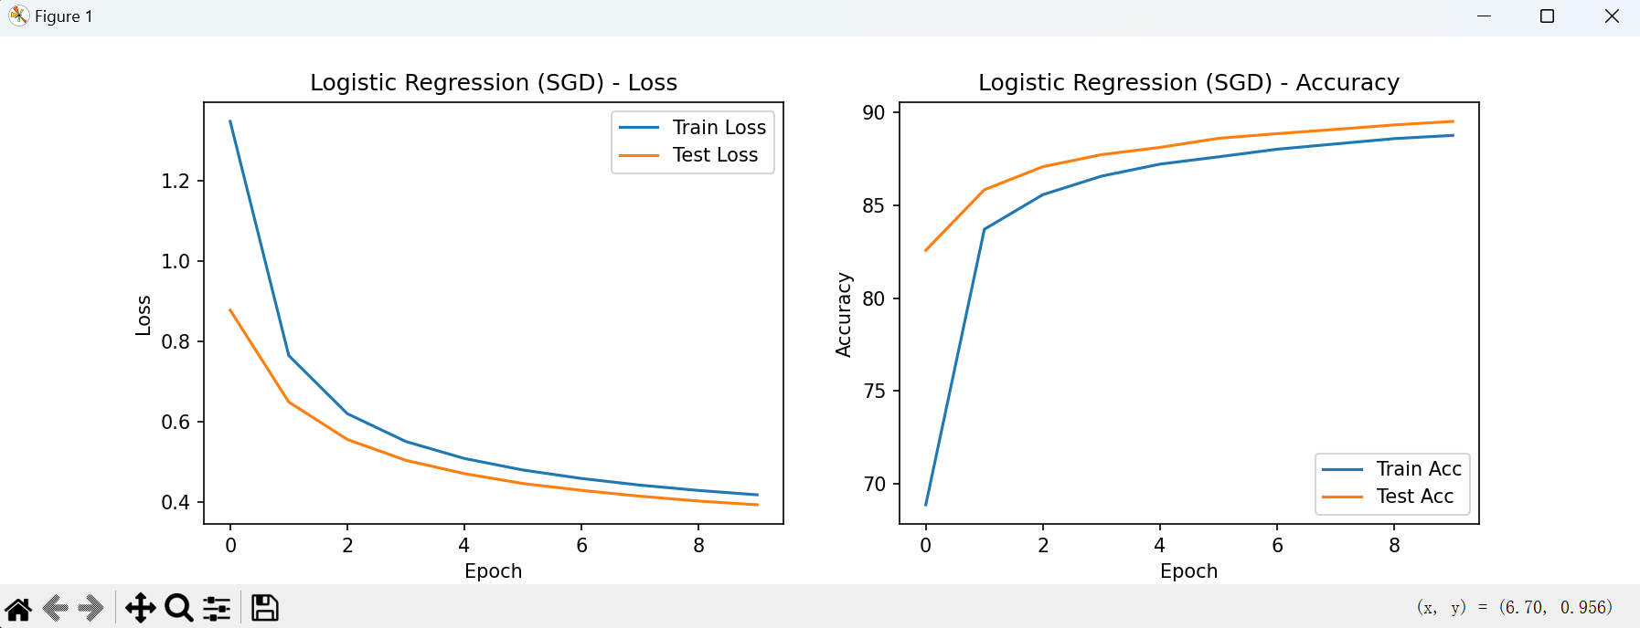
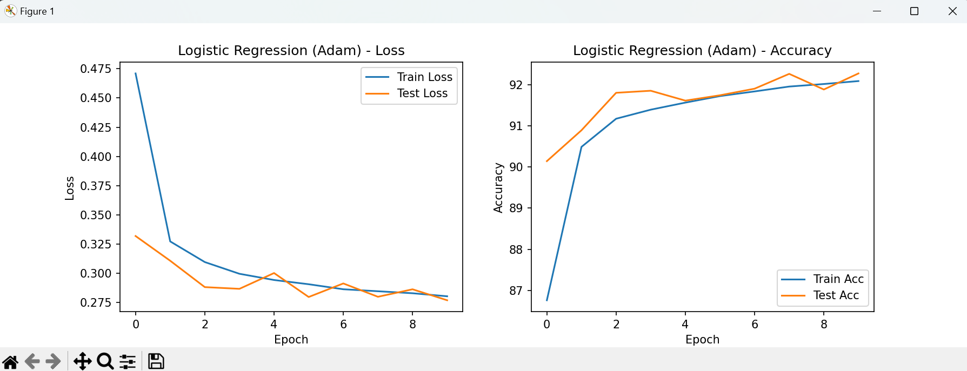
Logistic Regression: result

Slide 7

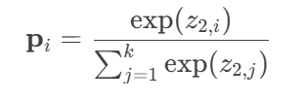

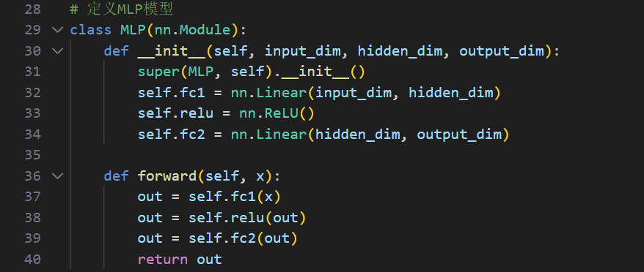
MLP:code
Mathematical formulation of the model
No significant difference compared to logistic regression model
There are two linear layer now and between them, I introduce a RELU layer
Implementation of the model
Same hyper params
Hidden dimension: 128

Slide 8
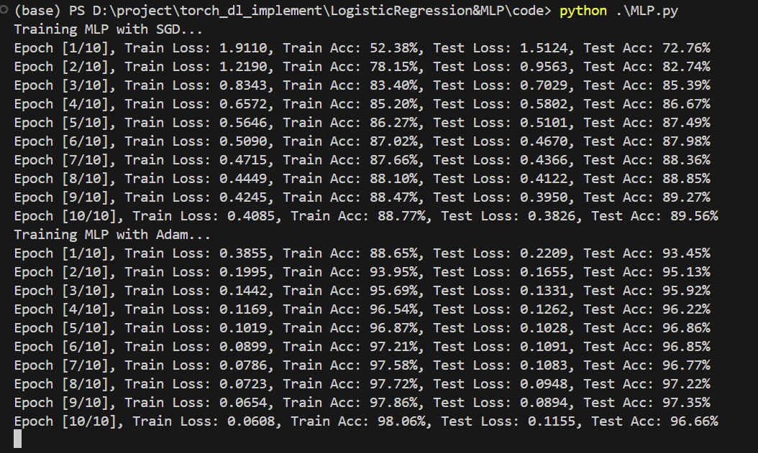
MLP:result

Slide 9
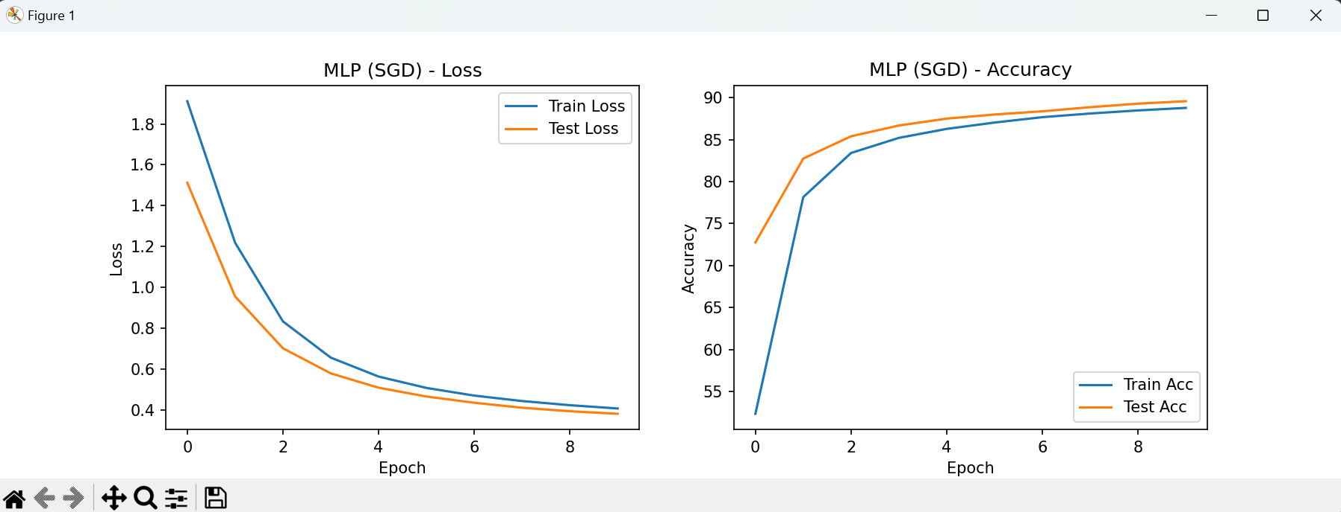
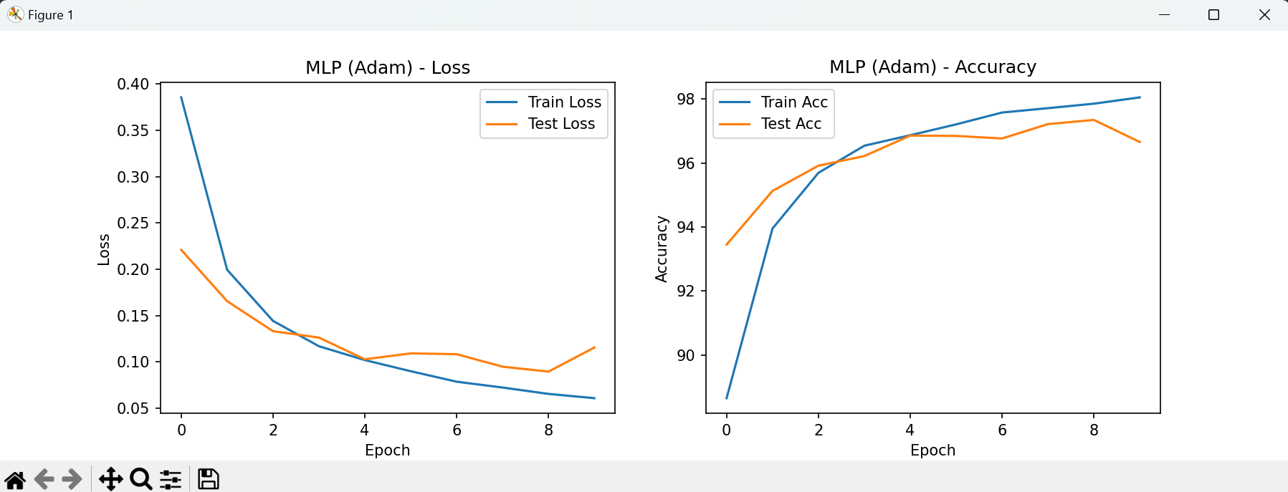
MLP:result

Slide 10

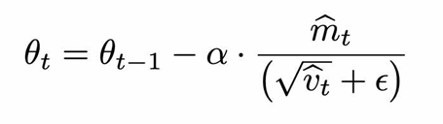
My analysis
SGD is a simple optimization algorithm suitable for large-scale datasets, but it requires manual tuning of the learning rate and may get stuck in local optima for high-dimensional non-convex problems.
Adam combines the advantages of momentum and adaptive learning rates, automatically adjusts the learning rate, and provides more stable training with faster convergence, but it has higher computational overhead.

