Slide 1
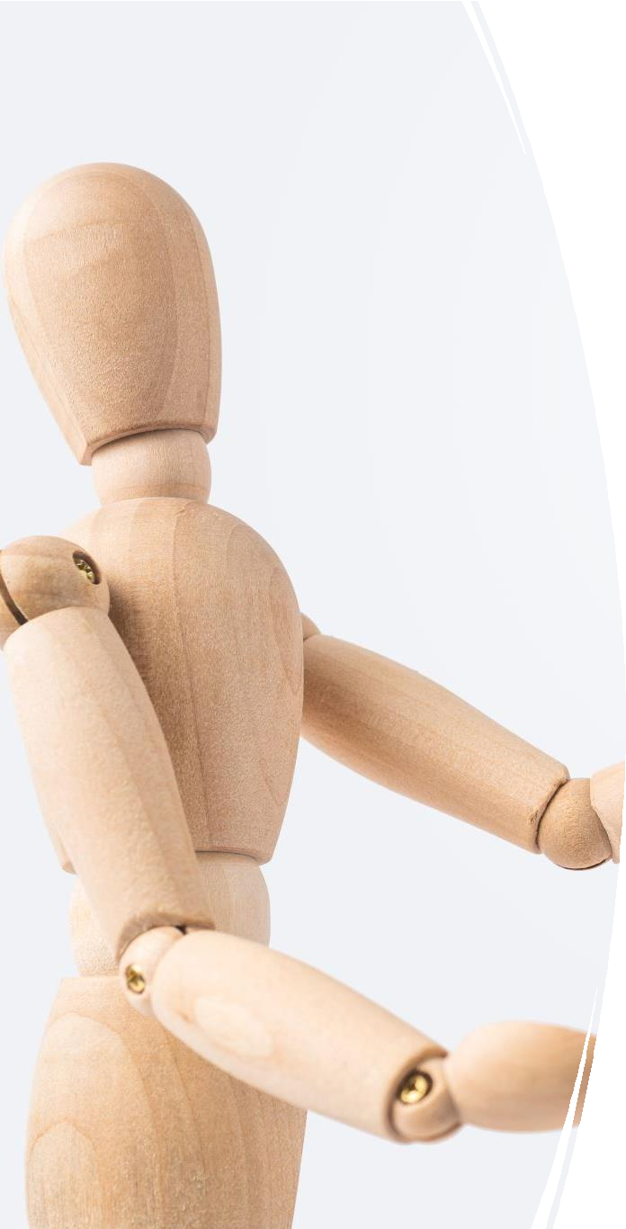
Deep CNN Study: Custom, Attention & Pretrained Models
Presented by Group #2
Md Saif Abrar Chowdhury (2022-3-60-051)
Syeda Rehnova Nobo (2022-3-60-051)
Tasfia Binte Jahangir (2022-3-60-111)
Ahsanur Parul (2022-3-60-190)

Slide 2


Summarize dataset characteristics and preprocessing pipeline
Compare custom CNN, CNN+ML, attention-
based CNN, and pretrained backbones
Document training setup, learning curves, and quantitative performance
Objectives
Identify the best-performing model and justify selection
Show Grad-CAM insights and
generalizability checks

Slide 3
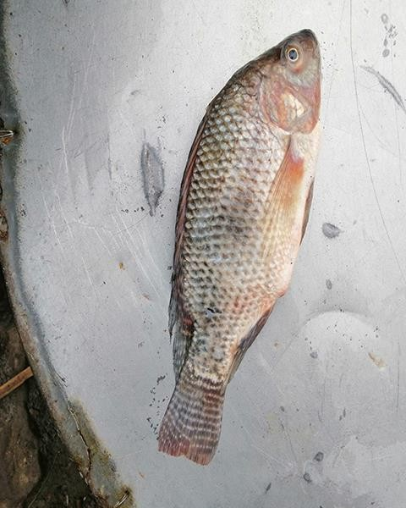
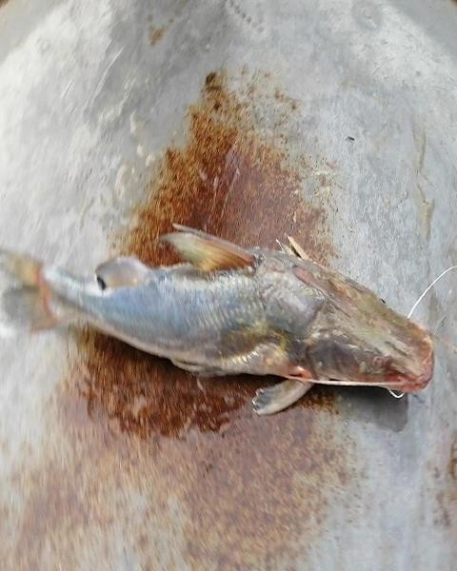
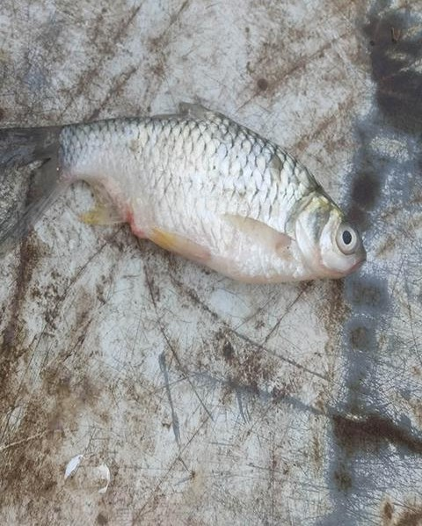
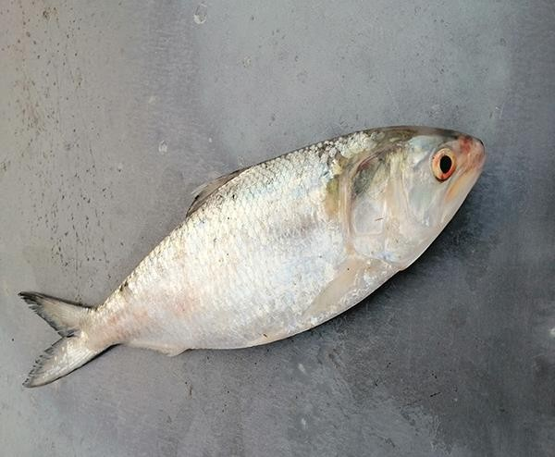
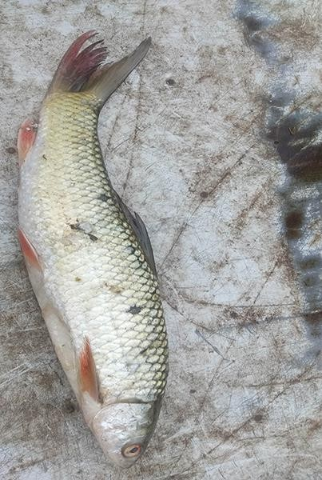
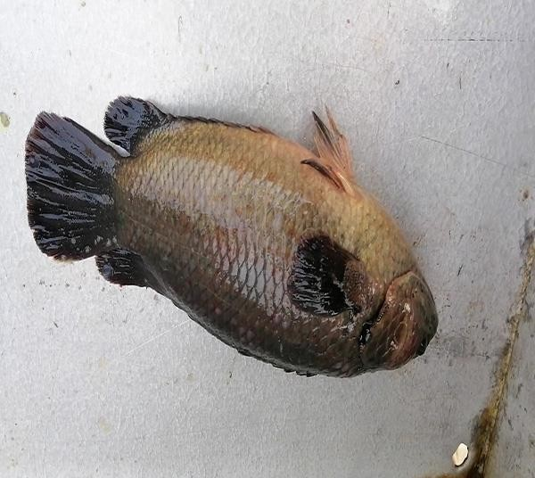
Dataset Details – Fish Species Identification in Bangladesh
Number of Images: ~26,950
Number of Classes: 20 freshwater species
Acquisition: Smartphone
photography
Conditions: Varied lighting & backgrounds

Slide 4
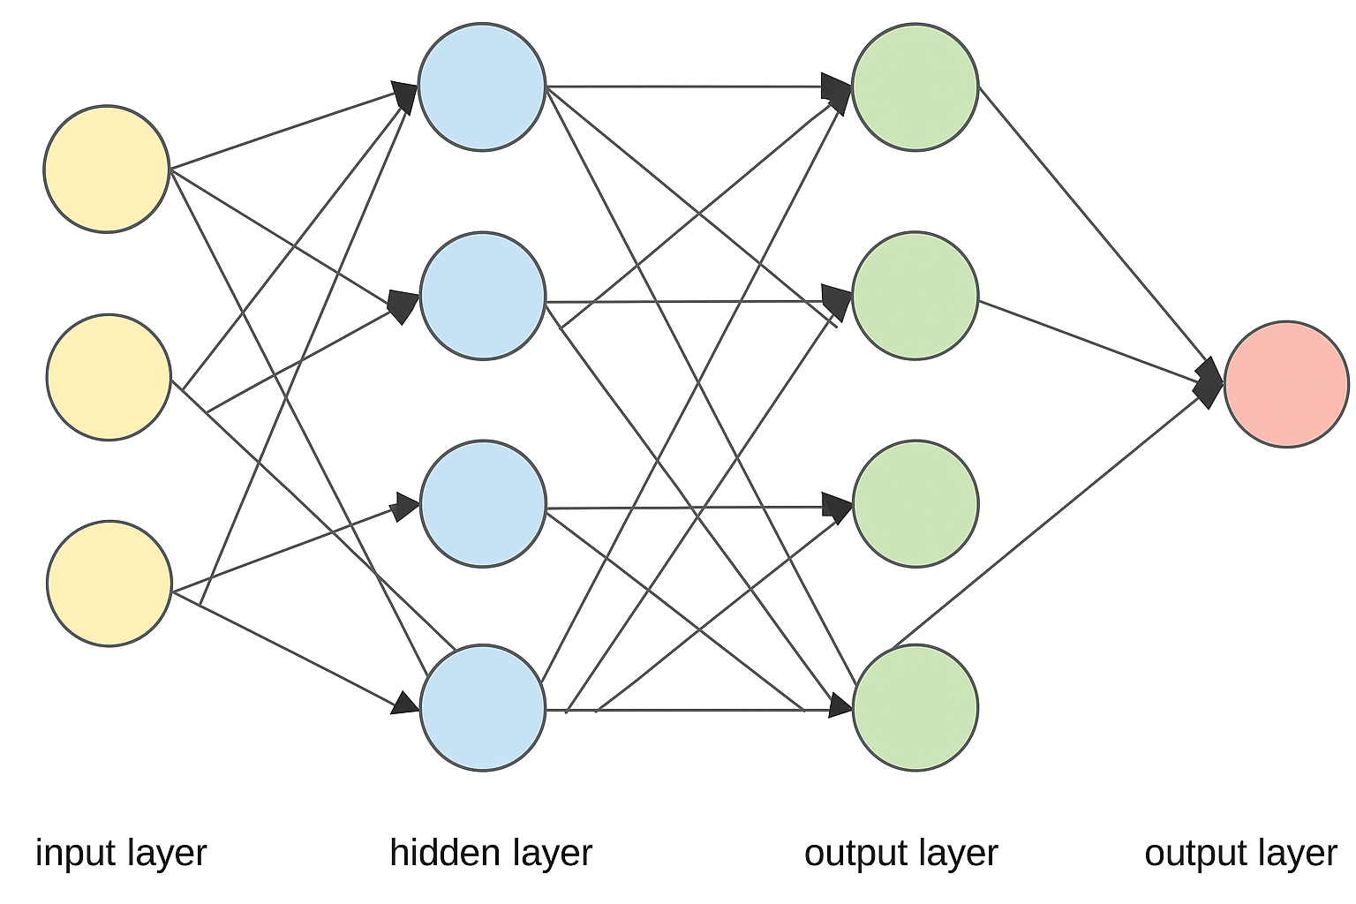
Model Architectures Overview
Baseline Custom CNN
CNN + ML Classifiers (e.g., SVM
/ RF on extracted features)
CNN with Attention (e.g., SE/CBAM)
Pretrained: VGG19, ResNet50, GoogLeNet, EfficientNet

Slide 5
Model Training Parameters
Model Varient- | Epochs | Batch Size | Learning Rate | Patience
Custom CNN + Attention | 120 | 32 | 0.0001 | 10
EfficientNet (Pre-trained) | 30 | 32 | 0.0001 | 5
RestNet50 (Pre-trained) | 20 | 32 | 0.0001 | 5
GoogleNet (Pre-trained) | 30 | 32 | 0.0001 | 5
VGG19 (Pre-trained) | 30 | 32 | 0.0001 | 5

Slide 6
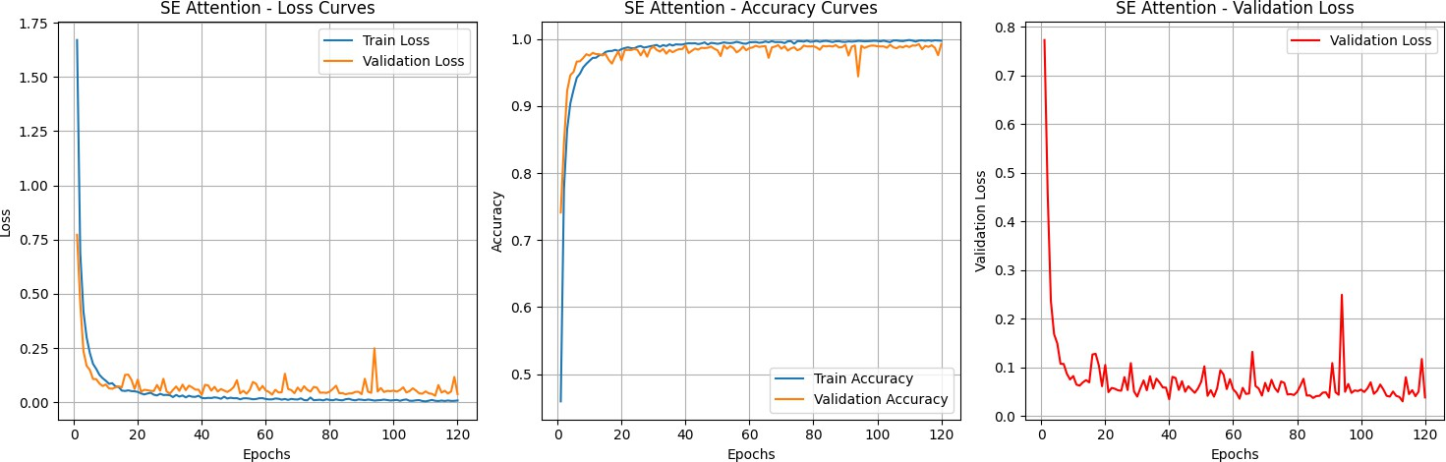
Learning Curves

Slide 7
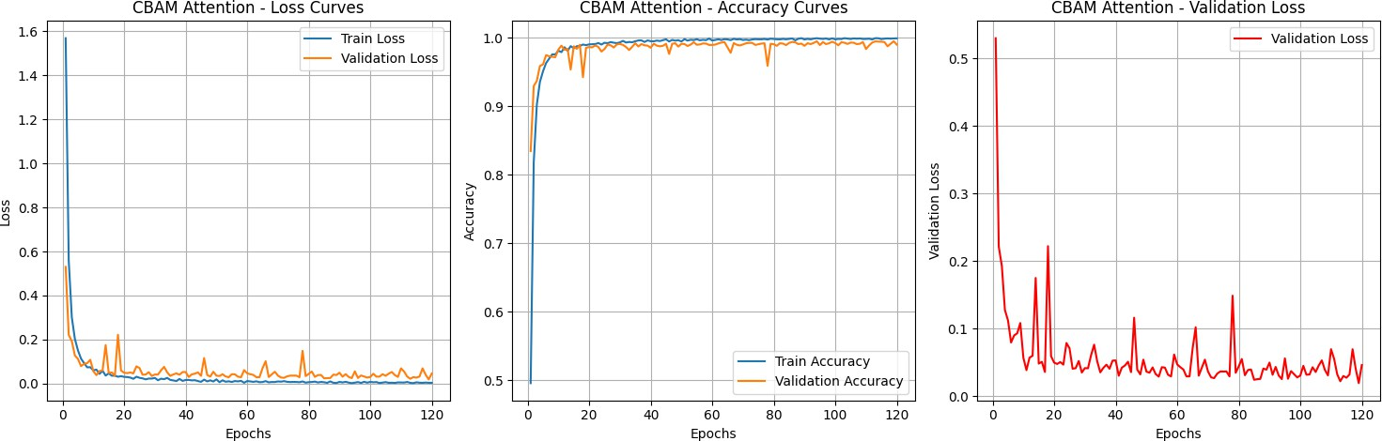
Learning Curves

Slide 8
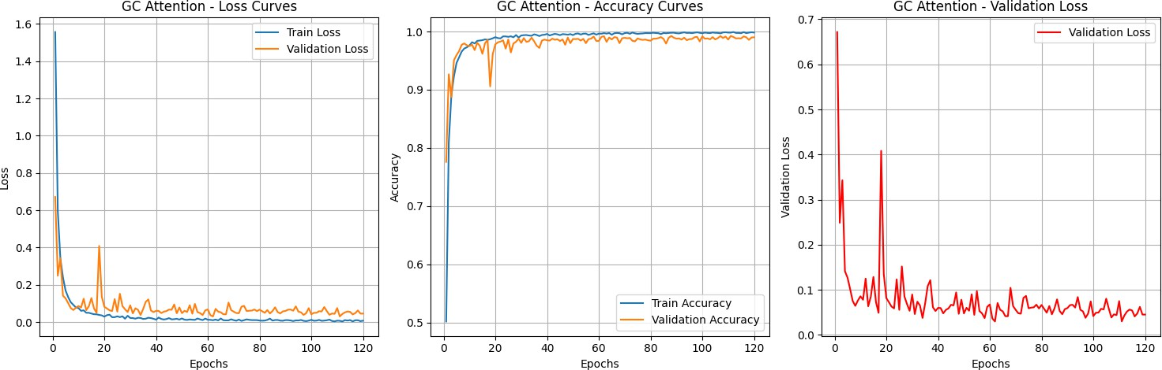
Learning Curves

Slide 9
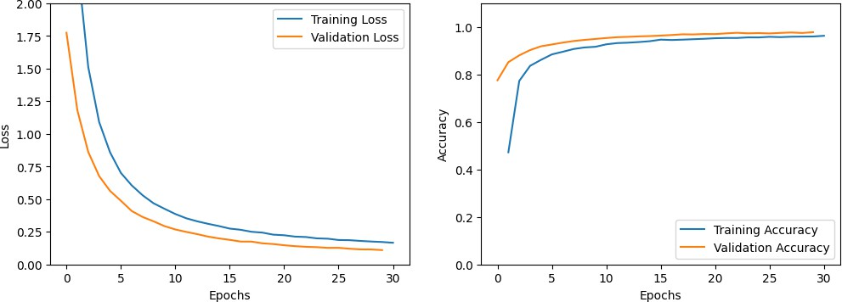
Learning Curves

Slide 10
Performance Table
Pre-Trained Model
Accuracy:
https://docs.google.com/spreadsheets/d/1gEmRfRzN9Ny-EPggk75VYaM-CT5AIeru/edit?usp=drive_link&ouid=102144362899243035151&rtpof=true&sd=true
Comparison:
https://docs.google.com/spreadsheets/d/1PxqbyUlP0T8jiA6cG8g0QjeHcRH485DM/edit?usp=sharing&ouid=102144362899243035151&rtpof=true&sd=true
Inference Time:
https://docs.google.com/spreadsheets/d/1YVtBoznakv2SwVyHHXUFDW9klFfYcbGj/edit?usp=sharing&ouid=102144362899243035151&rtpof=true&sd=true
Custom CNN
https://docs.google.com/spreadsheets/d/1LfDQ2w6K0eFQrFIvOtXEjVGMR9lMnuC7/edit?usp=sharing&ouid=102144362899243035151&rtpof=true&sd=true

Slide 11
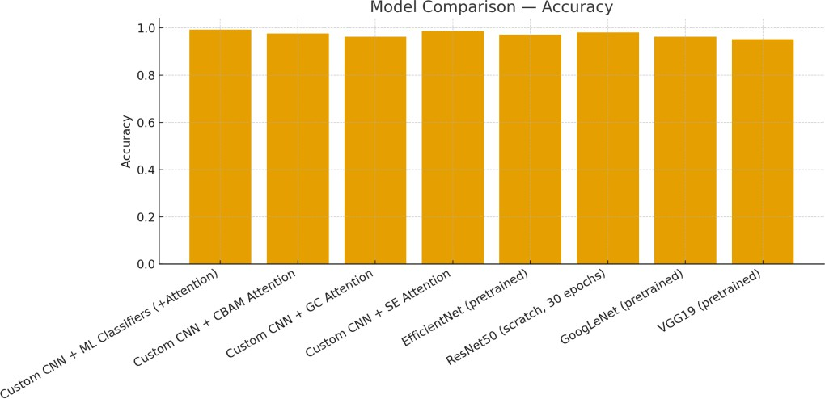
Performance Comparison—Accuracy
Bar chart of accuracy for models with available metrics.
Higher is better; missing bars indicate metrics not found in notebook outputs.

Slide 12


Best-
Performing Models — Summary
Best Custom: Custom CNN + ML Classifiers (+Attention=CBAM) (F1=None, Acc=0.9896)
Best Pretrained:VGG19 (scratch, 30 epochs) (F1=None, Acc=0.98)

Slide 13
Custom best model selected primarily by F1 and accuracy, balancing precision and recall across classes.
The best pretrained model was chosen for superior validation performance and stable convergence.
Qualitative inspection of errors and Grad-CAM saliency confirms focus on discriminative fish morphology.
Compute efficiency and inference time considered for real-time or edge deployment scenarios.
Final Best Model Findings

Slide 14
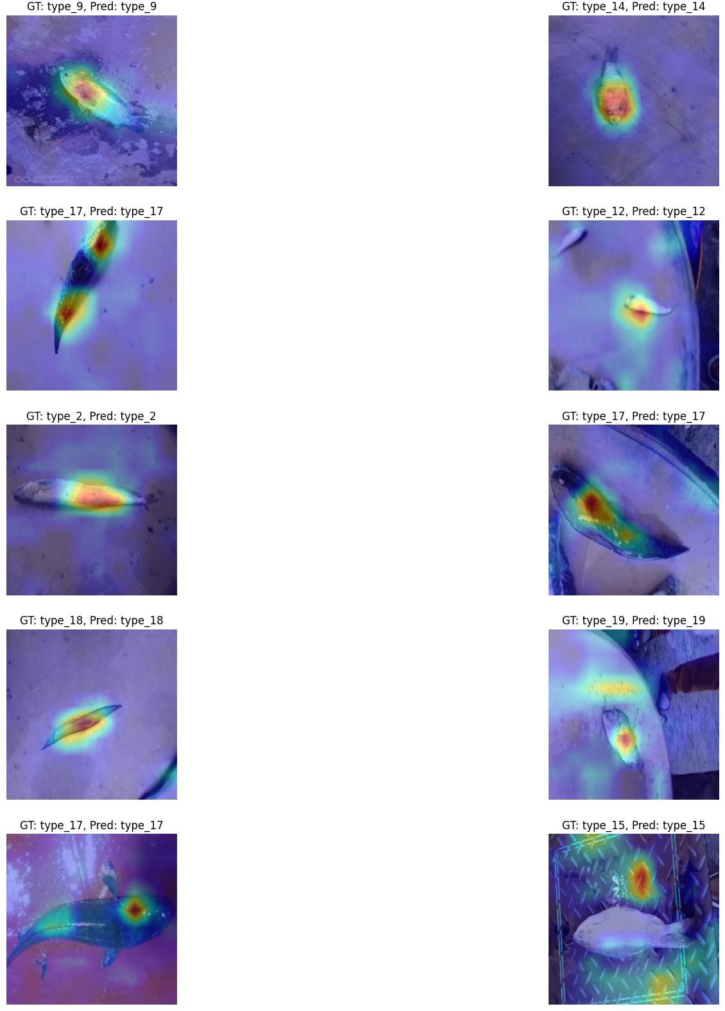
Grad-CAM Visualizations

Slide 15
Conclusion
Pretrained backbones typically outperform small custom CNNs on limited data.
Attention mechanisms can help when class imbalance or subtle features dominate.
Best model chosen on F1/Accuracy; verify with Grad-CAM and external tests.

Slide 16
Team Contributions
Md Saif Abrar Chowdhury (2022-3-60-051) 20%
Syeda Rehnova Nobo (2022-3-60-051) 20%
Tasfia Binte Jahangir (2022-3-60-111) 30%
Ahsanur Parul (2022-3-60-190) 30%

Slide 17

Thank You
For your time & patience.

