Slide 1
Context Free Grammar

Slide 2
Topics to be covered
Chomsky hierarchy
Context free grammar
Recursive definition
FA to regular grammar
Derivation
Ambiguity & unambiguous grammar
Simplified forms & normal forms
CFG to CNF
Union, Concatenation & Kleene’s of CFG

Slide 3
Chomsky Hierarchy

Slide 4
Chomsky hierarchy (Classification of grammar)
Grammar
Unrestricted grammar (type 0)
Restricted grammar
Context sensitive grammar (type 1)
Context free grammar(type 2)
Regular grammar(type 3)

Slide 5
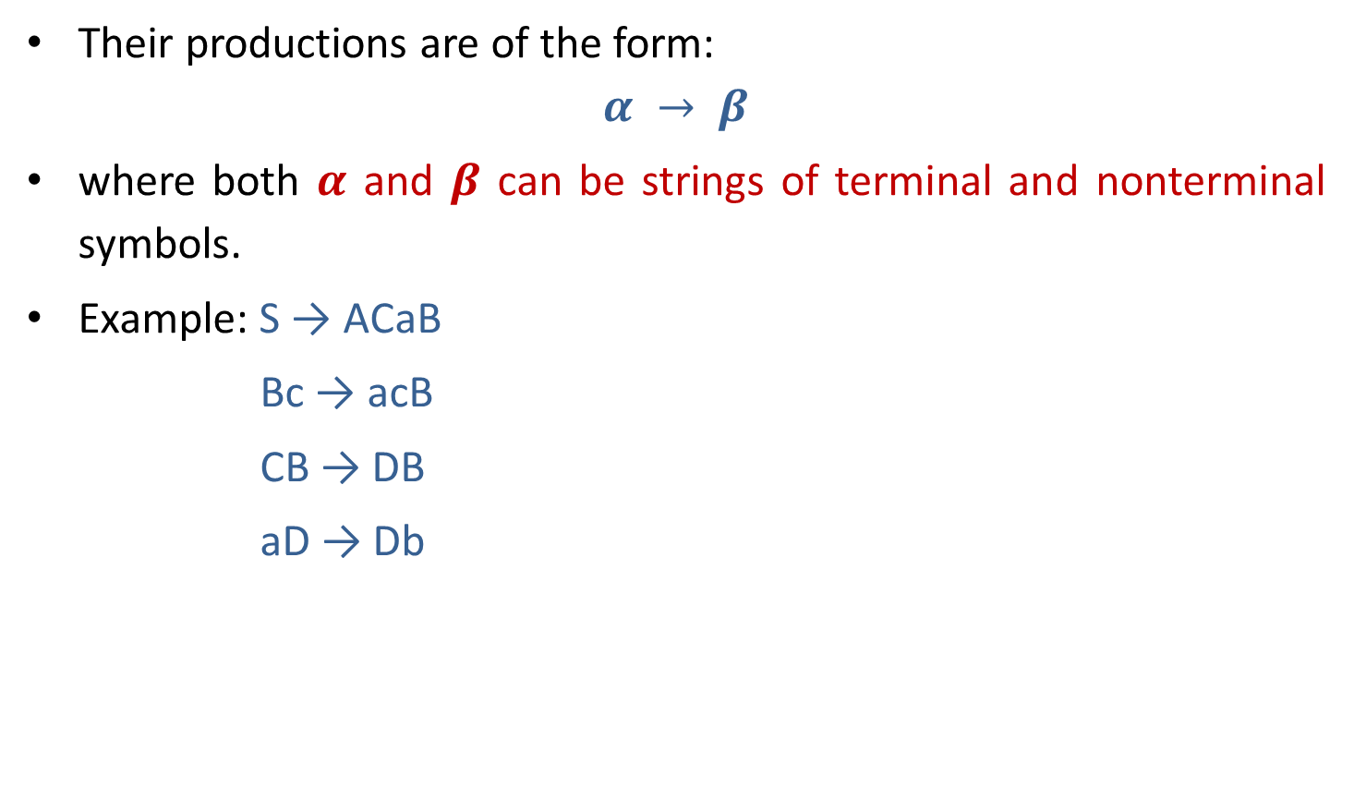
Type 0 grammar (Phrase Structure Grammar)
Their productions are of the form:
$$α → β$$
where both $α$ and $β$ can be strings of terminal and nonterminal symbols.
Example: S → ACaB
Bc → acB
CB → DB
aD → Db

Slide 6
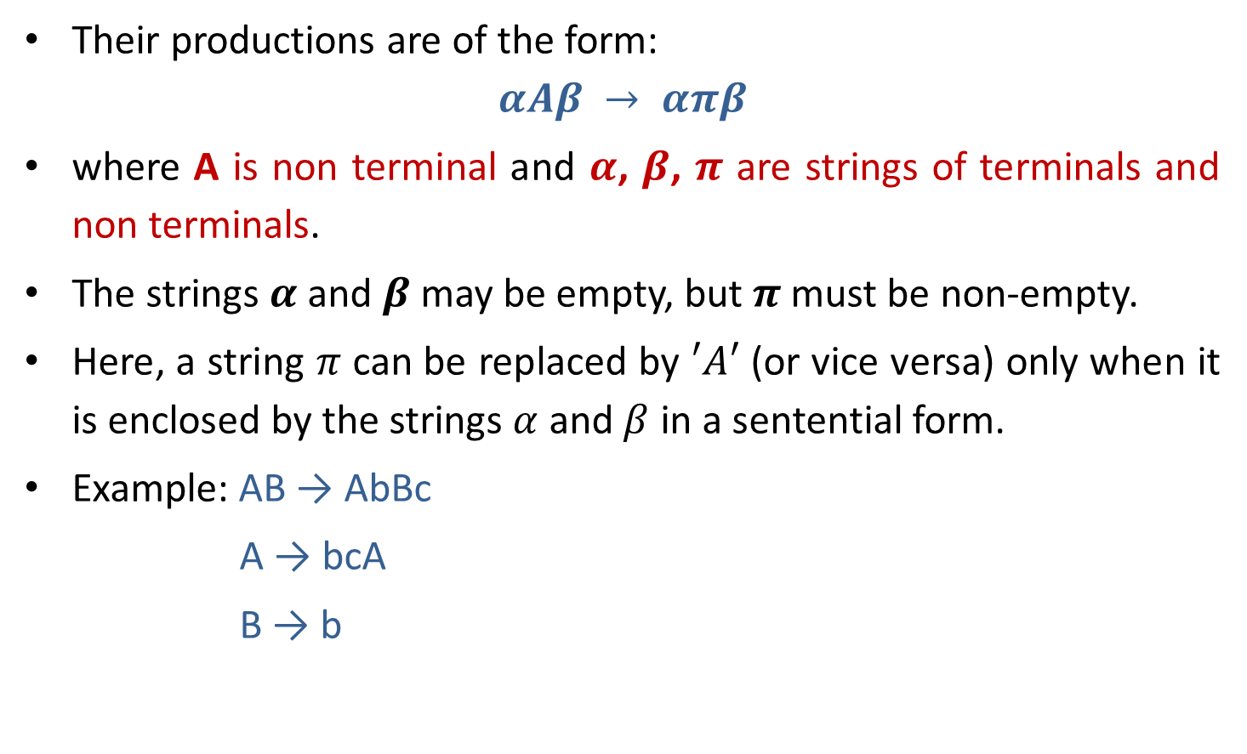
Type 1 grammar (Context Sensitive Grammar)
Their productions are of the form:
$$αAβ → απβ$$
where A is non terminal and $α$, $β$, $π$ are strings of terminals and non terminals.
The strings $α$ and $β$may be empty, but $π$ must be non-empty.
Here, a string $π$ can be replaced by $′A′$ (or vice versa) only when it is enclosed by the strings $α$ and $β$ in a sentential form.
Example: AB → AbBc
A → bcA
B → b

Slide 7
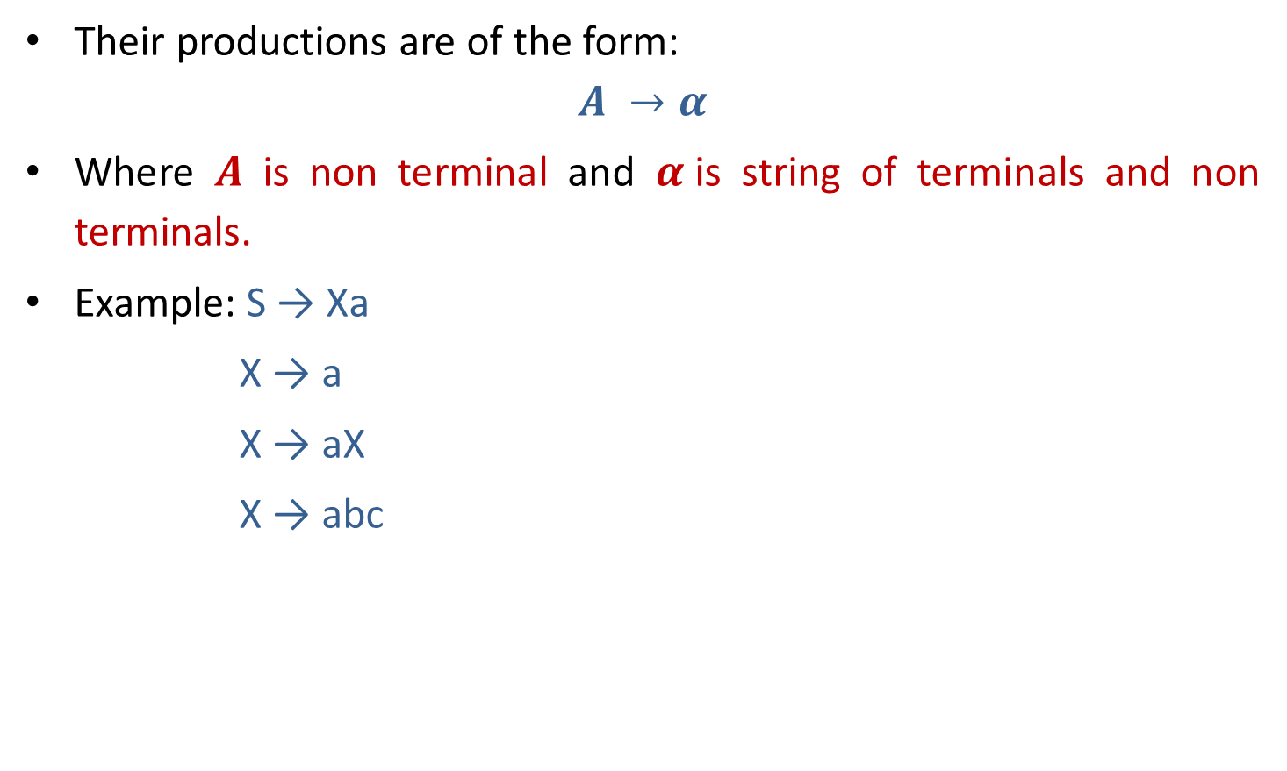
Type 2 grammar (Context Free Grammar)
Their productions are of the form:
$$A →α$$
Where $A$ is non terminal and $α$is string of terminals and non terminals.
Example: S → Xa
X → a
X → aX
X → abc

Slide 8
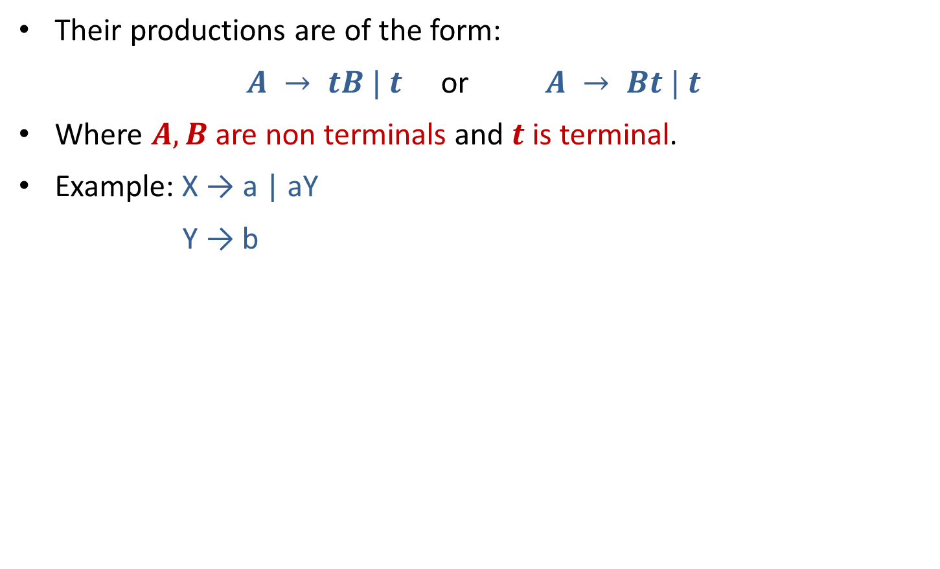
Type 3 grammar (Linear or Regular grammar)
Their productions are of the form:
$A → tB | t$ or $A → Bt | t$
Where $A, B$are non terminals and $t$ is terminal.
Example: X → a | aY
Y → b

Slide 9
Hierarchy of grammar
Type 0(Phrase structure)
Type 1(Context sensitive)
Type 2(Context free)
Type 3 (Regular)

Slide 10
Context free grammar

Slide 11
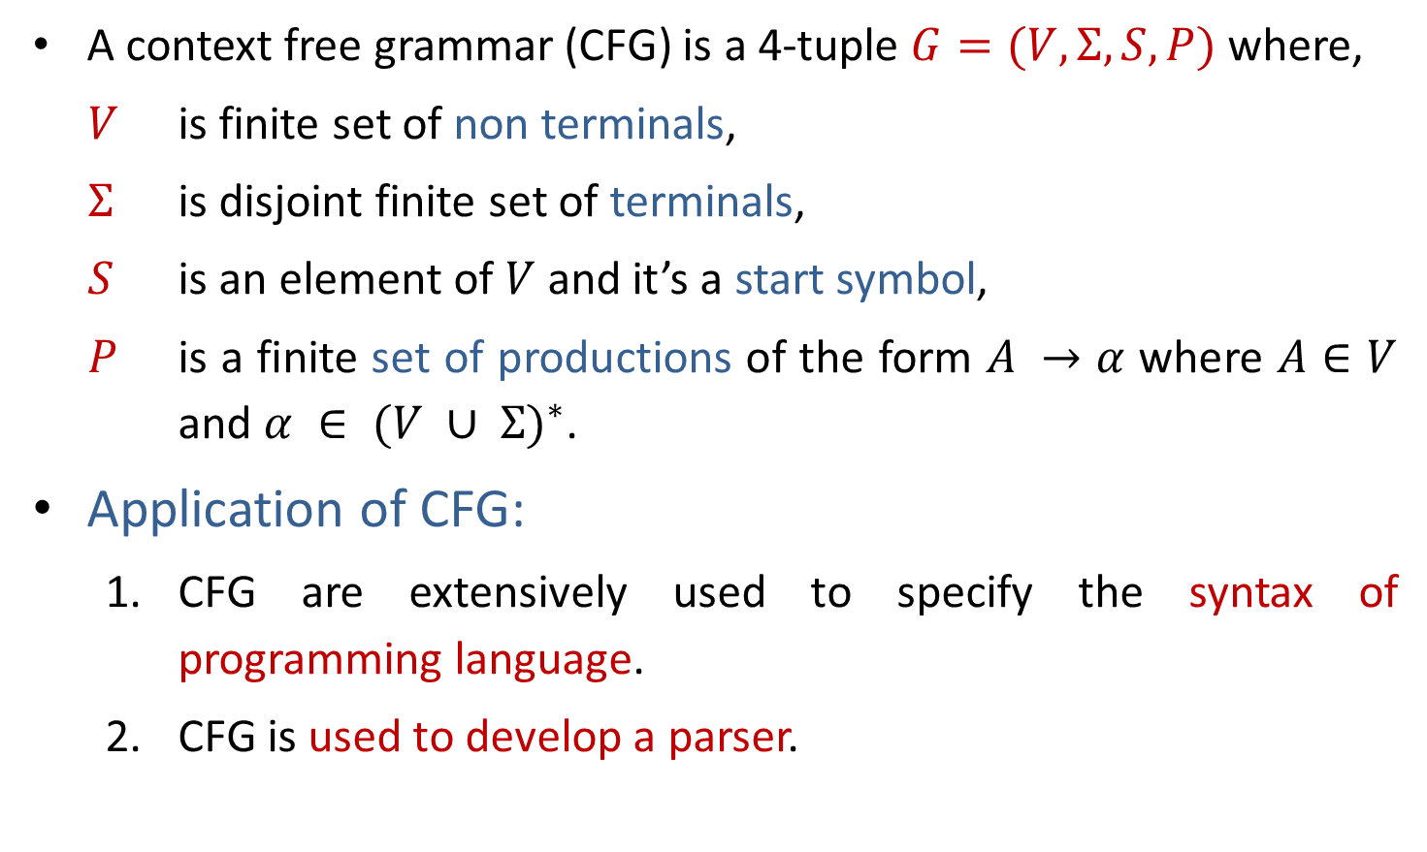
Context Free Grammar
A context free grammar (CFG) is a 4-tuple $G=(V,Σ,S,P)$where,
$V$ is finite set of non terminals,
$Σ$ is disjoint finite set of terminals,
$S$ is an element of $V$ and it’s a start symbol,
$P$ is a finite set of productions of the form $A →α$ where $A∈V$ and $α ∈ {(V ∪ Σ)}^{∗}$.
Application of CFG:
  CFG are extensively used to specify the syntax of programming language.
  CFG is used to develop a parser.

Slide 12
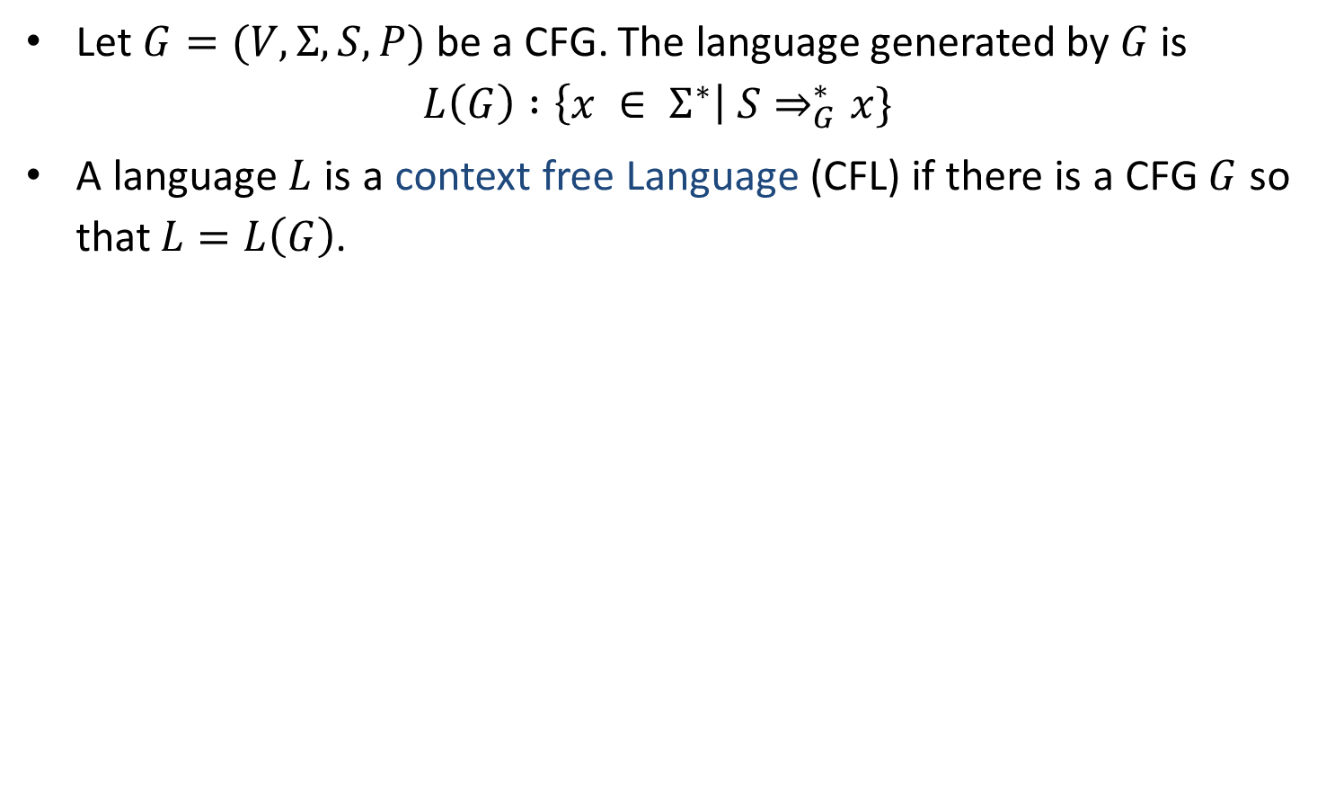
Context Free Language
Let $G=(V,Σ,S,P)$ be a CFG. The language generated by $G$ is
$$L\left(G\right) :\left\{x ∈ Σ^{∗}\right| S⇒_{G}^{∗}x\}$$
A language $L$ is a context free Language (CFL) if there is a CFG $G$ so that $L=L\left(G\right)$.

Slide 13
CFG Examples
Write CFG for either a or b
S→a | b
Write CFG for a⁺
S→ aS | a
Write CFG for a*
S→ aS | ^
Write CFG for (ab)*
S→abS | ^
Write CFG for any string of a and b
S→ aS | bS | a | b

Slide 14
CFG Examples
Write CFG for ab*
S→aX
X→˄| bX
Write CFG for a*b*
S→XY
X→aX|˄
Y→bY|˄
Write CFG for (a+b)*
S→aS | bS | ^
Write CFG for a(a+b)*
S→aX
X→aX | bX | ^

Slide 15
CFG Examples
Write CFG for a* | b*
S→A | B
A→˄| aA
B→^ |bB
Write CFG for (011+1)*(01)*
S→AB
A→011A | 1A | ^
B→01B | ^
Write CFG for balanced parenthesis
S→ [] | {} | [s] | {s} | ^

Slide 16
CFG Examples
Write CFG which contains at least three times 1.
S→A1A1A1A
A→0A | 1A | ^
Write CFG that must start and end with same symbol.
S→0A0 | 1A1
A→0A | 1A | ^
The language of even & odd length palindrome string over {a,b}
S→aSa|bSb|a|b|˄
No. of a and no. of b are same
S→aSb|bSa|aSa|bSb|˄
The language of {a, b} ends in a
S→aS | bS |a

Slide 17
CFG Examples
Write CFG for regular expression (a+b)*a(a+b)*a(a+b)*
S→XaXaX
X→aX|bX|˄
Write CFG for number of 0’s and 1’s are same (n₀(x)=n₁(x))
S→0S1 | 1S0 | ^
Write CFG for L={a^{i}b^{j}c^{k} | i=j or j=k}
For i=j for j=k
S→AB S→CD
A→aAb | ab C→aC | a
B→cB | c D→bDc | bc

Slide 18
CFG Examples
Write CFG for L={ a^{i}b^{j}c^{k} | j>i+k}
S→ABC
A→aAb |˄
B→bB | b
C→bCc |˄
Write CFG for L={ 0^{i}1^{j}0^{k} | j>i+k}
S→ABC
A→0A1 |˄
B→1B | 1
C→1C0 |˄
Write CFG for the language of Algebraic expressions
S→S+S | S*S | S-S | S/S | (S) | a

Slide 19

CFG Examples
CFG for syntax of programming language
<statement> $→$ … | <if-statement> | <for-statement> | …
<if-statement> $→$ if ( <expression> ) <statement>
<for-statement> $→$ for ( <expression>; <expression>; <expression> ) <statement>

Slide 20
Recursive Definitions

Slide 21
Recursive Definitions
Recursive Definition of {a,b}*
˄∈L.
For any S∈L, aS∈L.
For any S∈L, bS∈L.
No other strings are in L.
Recursive Definition of Palindrome
˄, a, b ∈ L
For any S ∈ L , aSa ∈ L and bSb ∈ L
No other string are in L
Recursive Definition of the language {a^{n}b^{n} | n≥0}
˄∈ L
For every S ∈ L, aSb ∈L
No other strings are in L
CFG: S→ aS | bS | ^
CFG: S→ aSa | bSb | a | b | ˄
CFG: S→ aSb | ˄

Slide 22
Derivation

Slide 23
Derivation
Derivation is used to find whether the string belongs to a given grammar or not.
There are two types of derivation:
  Leftmost derivation
  Rightmost derivation

Slide 24
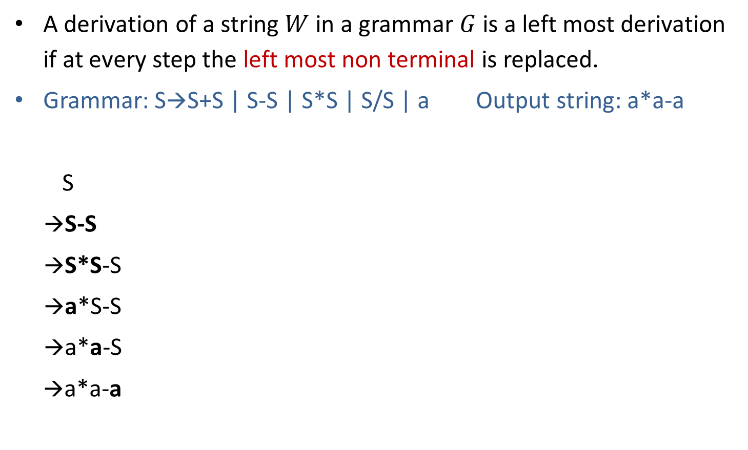
Leftmost derivation
A derivation of a string $W$ in a grammar $G$ is a left most derivation if at every step the left most non terminal is replaced.
Grammar: S→S+S | S-S | S*S | S/S | a Output string: a*a-a
S
→S-S
→S*S-S
→a*S-S
→a*a-S
→a*a-a
S
S
-
S
Parse tree represents the structure of derivation
S
*
S
a
a
a
Parse tree
Leftmost Derivation

Slide 25
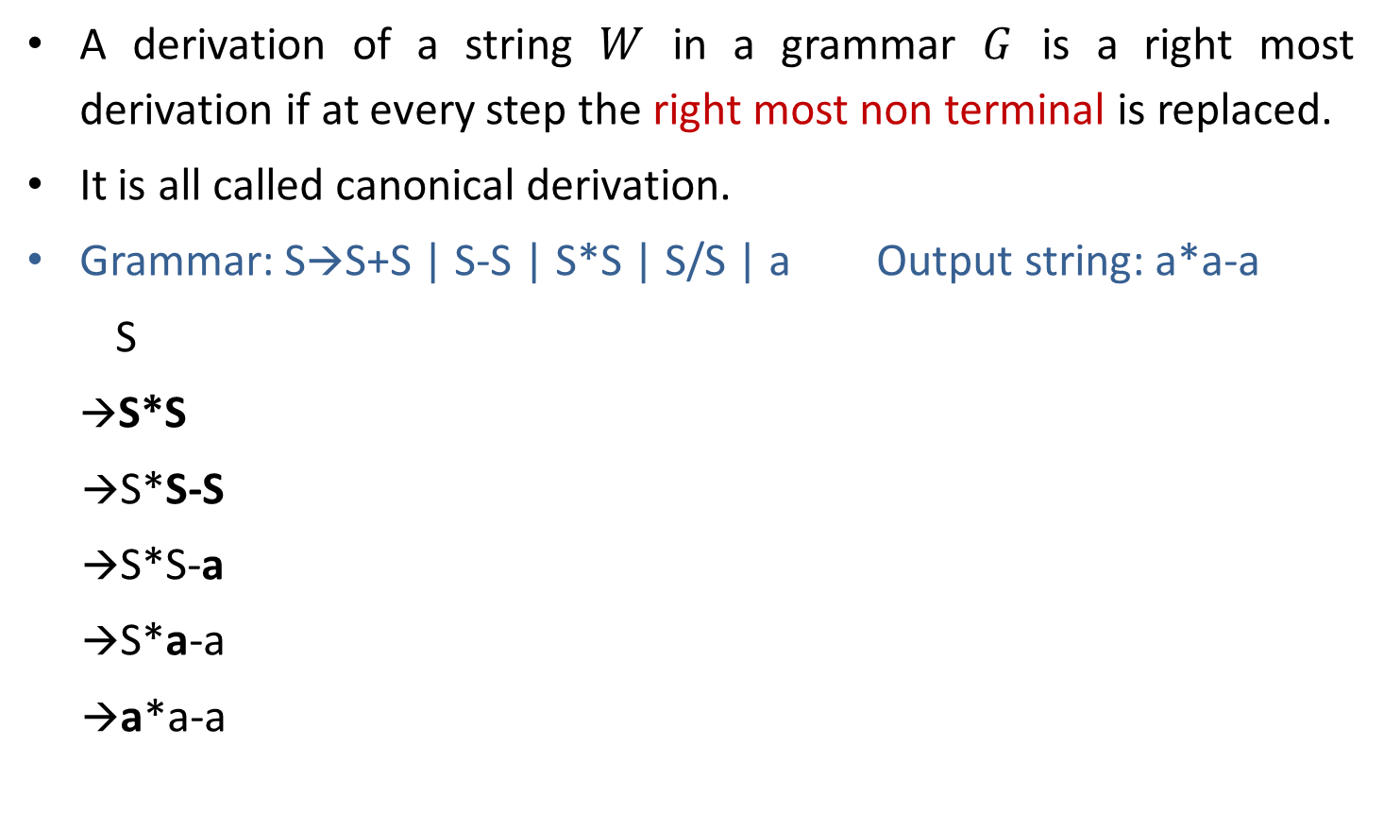
Rightmost derivation
A derivation of a string $W$ in a grammar $G$ is a right most derivation if at every step the right most non terminal is replaced.
It is all called canonical derivation.
Grammar: S→S+S | S-S | S*S | S/S | a Output string: a*a-a
S
→S*S
→S*S-S
→S*S-a
→S*a-a
→a*a-a
S
S
*
S
a
S
-
S
a
a
Parse Tree
Rightmost Derivation

Slide 26
Example: Derivation
S→A1B
A→0A | 𝜖
B→0B | 1B | 𝜖 Perform leftmost & Rightmost derivation.
(String: 00101)
Leftmost Derivation
S
A1B
0A1B
00A1B
001B
0010B
00101B
00101
Rightmost Derivation
S
A1B
A10B
A101B
A101
0A101
00A101
00101

Slide 27
Exercise: Derivation
Perform leftmost derivation and draw parse tree.
S→A1B
A→0A | 𝜖
B→0B | 1B | 𝜖
Output string: 1001.
Perform rightmost derivation and draw parse tree.
E→E+E | E*E | id | (E) | -E
Output string : id + id * id.

Slide 28
Ambiguous grammar

Slide 29
Ambiguous grammar
Ambiguous grammar is one that produces more than one leftmost or more then one rightmost derivation for the same sentence.
Grammar: S→S+S | S*S | (S) | a Output string: a+a*a
S S
→S*S →S+S
→S+S*S →a+S
→a+S*S →a+S*S
→a+a*S →a+a*S
→a+a*a →a+a*a
Here, Two leftmost derivation for string a+a*a is possible hence, above grammar is ambiguous.
S
S
S
*
S
S
+
S
S
+
S
a
a
S
*
S
a
a
a
a

Slide 30
Exercise: Ambiguous grammar
Check whether following grammars are ambiguous or not:
S→ aS | Sa | 𝜖 (string: aaaa)
S→ aSbS | bSaS | 𝜖 (string: abab)
S→SS+ | SS* | a (string: aa+a*)

Slide 31
Unambiguous grammar
Grammar: S→ S+S | S*S | (S) | a
Equivalent unambiguous grammar is
S→ S + T | T
T→ T * F | F
F→ (S) | a
Equivalent
unambiguous
grammar
Output string: a+a*a
S
→ S+T
→ T+T
→ F+T
→ a+T
→ a+T*F
→ a+F*F
→ a+a*F
→ a+a*a
Try for second leftmost derivation
Not possible????
Here, two left most derivation is not possible for string a+a*a hence, grammar is unambiguous.

Slide 32
Simplified forms & Normal forms

Slide 33
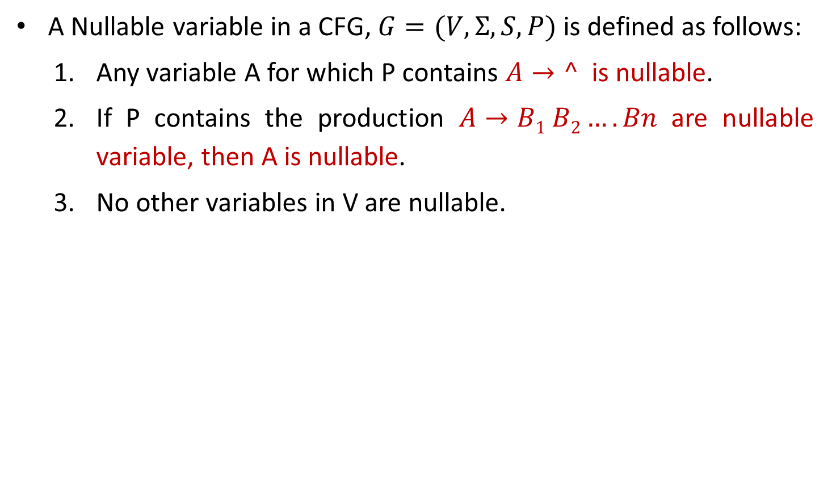
Nullable Variable
A Nullable variable in a CFG, $G=(V,Σ,S,P)$ is defined as follows:
  Any variable A for which P contains $A→^$ is nullable.
  If P contains the production $A→B1 B2….Bn$ are nullable variable, then A is nullable.
  No other variables in V are nullable.

Slide 34
Eliminate ˄ production
S→a X |Yb
X→ ˄ | S
Y→bY|b
S→aX | Yb | a^
X→^ | S
Y→bY|b
S→aX|Yb|a
X→S
Y→bY|b
Nullable variable={X}
Replacing X by ^ in all productions containing X on RHS and rewriting the production again
Removing ^ productions

Slide 35
Exercise: Eliminate ^ production
S→AC
A→aAb|˄
C→aC|a
After elimination of ^ production:
S→AC | C
A→aAb| ab
C→aC|a
S→XaX|bX|Y
X→XaX|XbX|˄
Y→ab
After elimination of ^ production:
S→ XaX | bX | Y | aX | Xa | a | b
X→ XaX |XbX | aX | Xa | a | Xb | bX | b
Y→ab

Slide 36
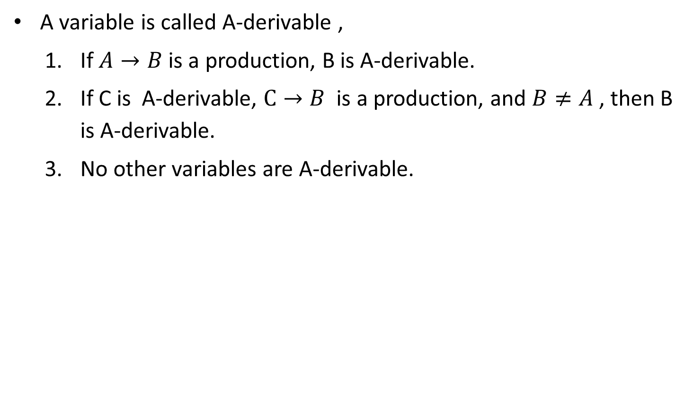
A-derivable
A variable is called A-derivable ,
  If $A→B$ is a production, B is A-derivable.
  If C is A-derivable, $C→B$ is a production, and $B≠A$ , then B is A-derivable.
  No other variables are A-derivable.
S→A
S→B
S-derivable={A,B}
S→A
A→B
S-derivable={A,B}

Slide 37
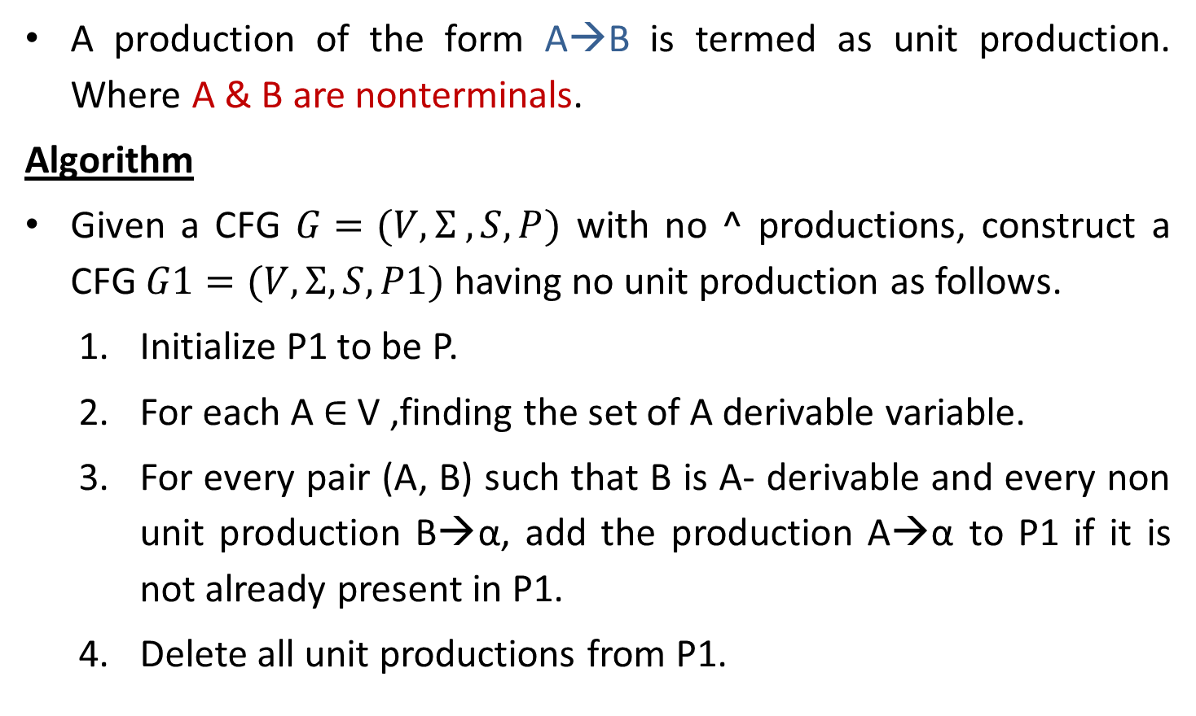
Unit Production & Elimination of Unit productions
A production of the form A→B is termed as unit production. Where A & B are nonterminals.
Algorithm
Given a CFG $G=(V,Σ ,S,P)$ with no ^ productions, construct a CFG $G1=(V,Σ,S,P1)$ having no unit production as follows.
  Initialize P1 to be P.
  For each A ∈ V ,finding the set of A derivable variable.
  For every pair (A, B) such that B is A- derivable and every non unit production B→α, add the production A→α to P1 if it is not already present in P1.
  Delete all unit productions from P1.

Slide 38
Elimination of unit production
S→ABA|BA|AA|AB|A|B
A→ aA|a
B→ bB|b
Unit Productions are S→A and S→B
A→aA|a
B→bB|b
S→ABA|BA|AA|AB
|aA|a
|bB|b
Removing unit productions

