Slide 1
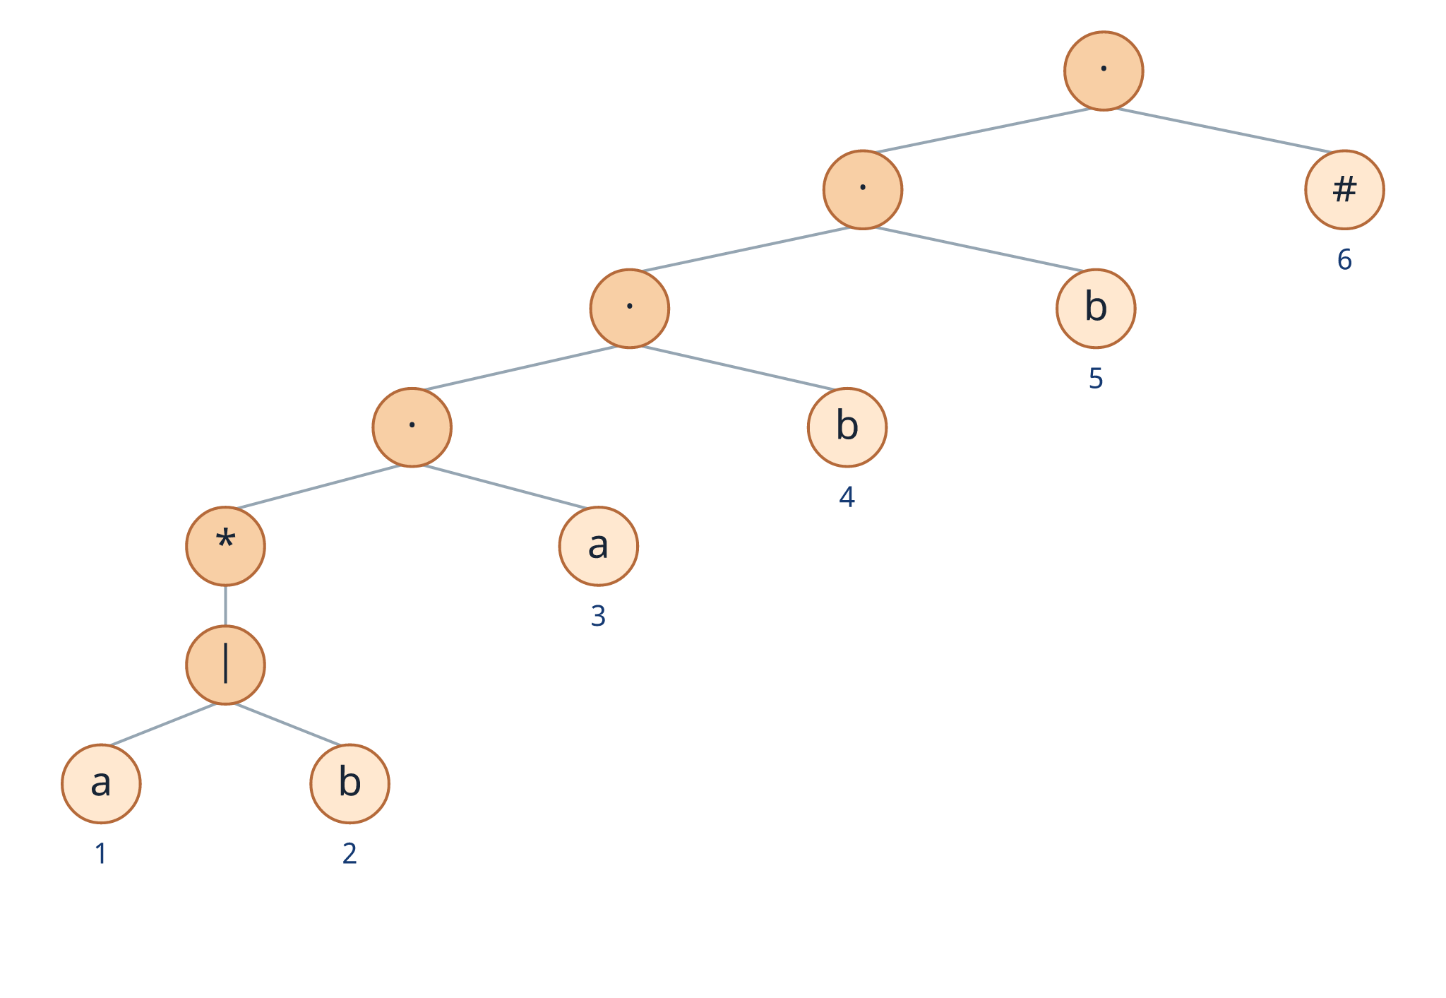
DIRECT SYNTAX-TREE METHOD
Regular Expression
to DFA
Using nullable, firstpos, lastpos, and followpos
Running example: (a|b)*abb#
A step-by-step classroom-ready presentation
Principles of Compiler Design
Notes:
Introduce the topic as the direct construction method. Emphasize that the goal is to obtain a DFA directly from the regular expression without first constructing an NFA. Tell students that the same running example will be used throughout the lecture.

Slide 2
Teaching roadmap and learning outcomes
Overview
By the end of this lesson, students should be able to:
augment a regular expression with the end marker #
The five-step teaching path
construct and number its syntax tree
1
Augment and number
Append # and assign a unique position to every non-ε leaf.
compute nullable, firstpos, lastpos, and followpos
2
Build the syntax tree
generate DFA states and transitions from position sets
Leaves are operands; interior nodes are |, ·, and * operators.
identify the accepting state using the position of #
3
Compute tree functions
Evaluate nullable, firstpos, and lastpos bottom-up.
4
Compute followpos
Use only concatenation and star rules.
Core idea
A numbered leaf represents one possible symbol occurrence. DFA states therefore become sets of possible positions.
5
Construct the DFA
Each DFA state is a set of syntax-tree positions.
Principles of Compiler Design | Direct Regex-to-DFA Method
2
1 Syntax tree
2 Nullable / firstpos / lastpos
3 Followpos
4 DFA construction
Notes:
Preview the complete process before beginning the details. Keep returning to these five steps so students know where they are in the method. Point out that every calculation comes from the syntax tree, not from trial strings.

Slide 3
Running example: augment the regular expression
Step 1
Original expression
Augmented expression
Why append #?
R = (a|b)*abb
R' = (a|b)*abb#
The unique end marker tells us exactly when the entire input has been matched. Any DFA state containing its position becomes accepting.
Append #
Language described by the original regex
Important
# is used only for construction. It is not part of the input alphabet, so the DFA has transitions only on a and b.
All strings over {a,b} that end with abb
abb
aabb
babb
abababb
Teaching check
Ask: Which strings are in the input alphabet? Answer: a and b only.
Principles of Compiler Design | Direct Regex-to-DFA Method
3
1 Syntax tree
2 Nullable / firstpos / lastpos
3 Followpos
4 DFA construction
Notes:
Explain augmentation before any tree construction. The end marker is unique and receives its own position. Clarify that # is not read from the input; it is a construction device used to recognize completion of the regex.

Slide 4
Parse the expression and number the leaves
Step 1
Operator precedence
Number only the non-ε leaves
1
Parentheses
a₁
first a inside (a|b)
b₄
first fixed b
Evaluate (a|b) first.
2
Kleene star
Apply * to the complete parenthesized expression.
b₂
first b inside (a|b)
b₅
second fixed b
3
Concatenation
Then concatenate a, b, b, and # from left to right.
a₃
a after the star
#₆
unique end marker
Explicit structure
(((((a|b)*)·a)·b)·b)·#)
Why positions matter
Two leaves may carry the same symbol but they are different occurrences. For example, b₂, b₄, and b₅ are three distinct positions.
Principles of Compiler Design | Direct Regex-to-DFA Method
4
1 Syntax tree
2 Nullable / firstpos / lastpos
3 Followpos
4 DFA construction
Notes:
Review operator precedence and make the hidden concatenation operators explicit. Number each symbol occurrence separately, even when the same symbol appears multiple times. The position number, not merely the symbol, will drive followpos and DFA states.

Slide 5
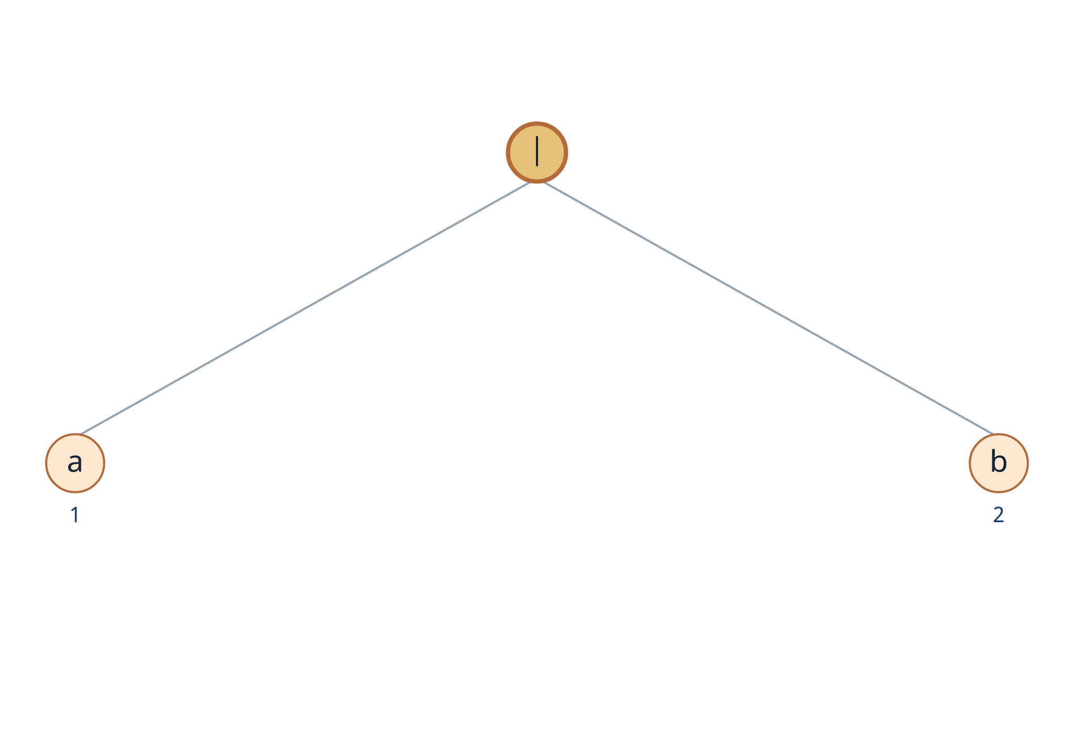
Syntax tree - Step 1: build the union
Step 2
Current subexpression
a₁ | b₂
How to read it
The | node has two alternatives. A valid string from this subtree begins with either position 1 or position 2.
Tree rule
Leaves correspond to operands. Interior nodes correspond to operators.
Resulting subtree: (a₁|b₂)
Principles of Compiler Design | Direct Regex-to-DFA Method
5
1 Syntax tree
2 Nullable / firstpos / lastpos
3 Followpos
4 DFA construction
Notes:
Start from the innermost parenthesized operation. Place the union operator as the parent of leaves a at position 1 and b at position 2. Ask students why the two leaves need different position numbers.

Slide 6
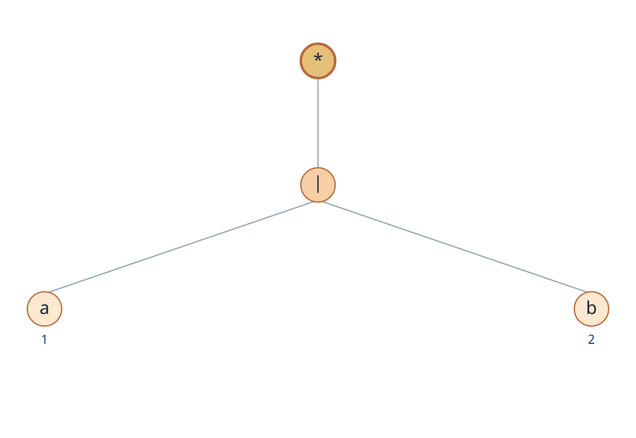
Syntax tree - Step 2: apply the Kleene star
Step 2
Current subexpression
(a₁|b₂)*
Meaning of *
The subtree may repeat zero or more times. Therefore, the star node can generate the empty string ε.
Teaching cue
Ask: Can this subtree produce no symbol at all? Yes. This is why nullable(star) = true.
Principles of Compiler Design | Direct Regex-to-DFA Method
6
1 Syntax tree
2 Nullable / firstpos / lastpos
3 Followpos
4 DFA construction
Notes:
Place a unary star node above the union subtree. Emphasize that star is the only operator here that automatically makes a subtree nullable, because zero repetitions are allowed.

Slide 7
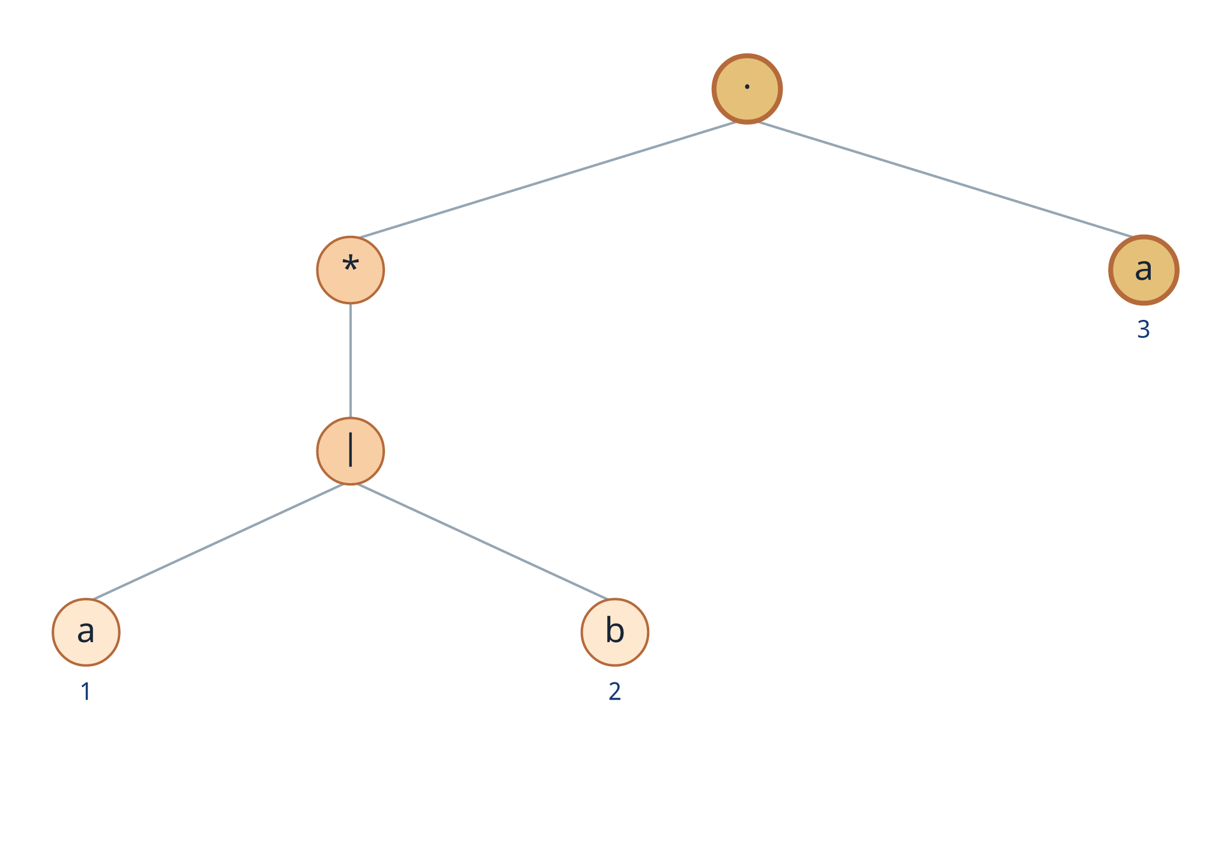
Syntax tree - Step 3: concatenate a₃
Step 2
Current subexpression
(a₁|b₂)* · a₃
Concatenation node
The left child is the star subtree. The right child is the fixed a at position 3.
Key observation
Because the star can produce ε, a string from this concatenation may begin inside the star or directly at position 3.
Principles of Compiler Design | Direct Regex-to-DFA Method
7
1 Syntax tree
2 Nullable / firstpos / lastpos
3 Followpos
4 DFA construction
Notes:
Create a concatenation node whose left child is the star subtree and whose right child is position 3. This is the first point where nullable of the left child will affect firstpos.

Slide 8
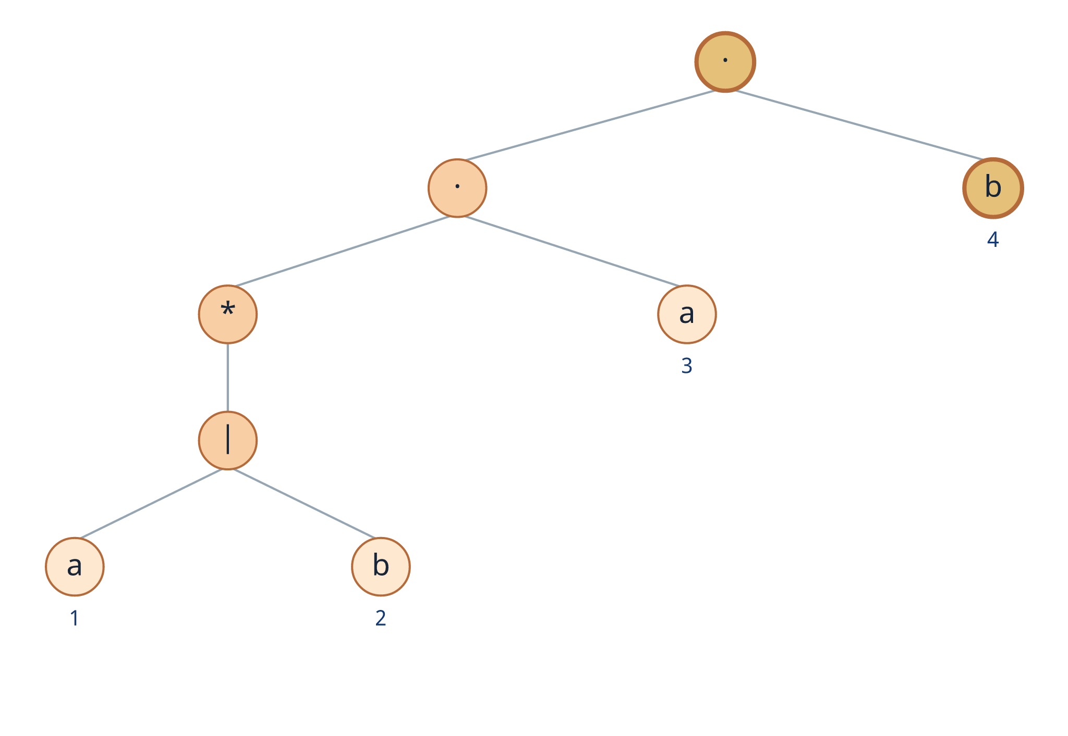
Syntax tree - Step 4: concatenate b₄
Step 2
Current subexpression
((a₁|b₂)* · a₃) · b₄
Left-associative construction
The previously built subtree becomes the left child. The new symbol b₄ becomes the right child.
Position relationship
After position 3, position 4 must follow. This will later produce followpos(3) = {4}.
Principles of Compiler Design | Direct Regex-to-DFA Method
8
1 Syntax tree
2 Nullable / firstpos / lastpos
3 Followpos
4 DFA construction
Notes:
Continue building the tree from left to right. Mention the future followpos relationship: the fixed a at position 3 must be followed by b at position 4.

Slide 9
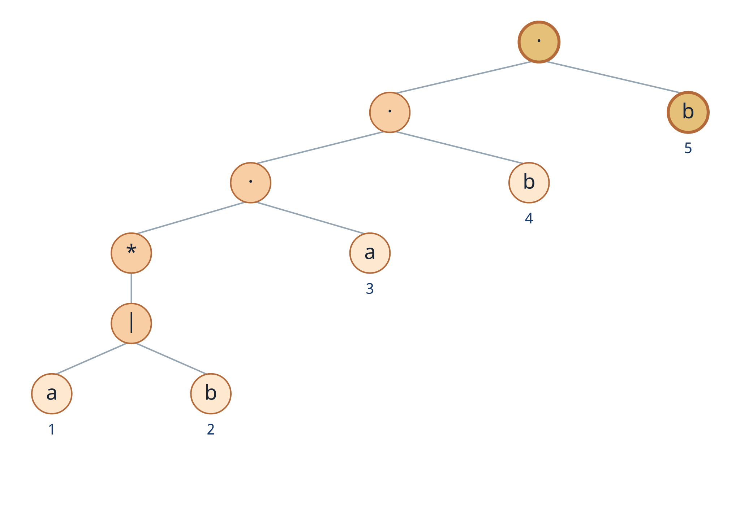
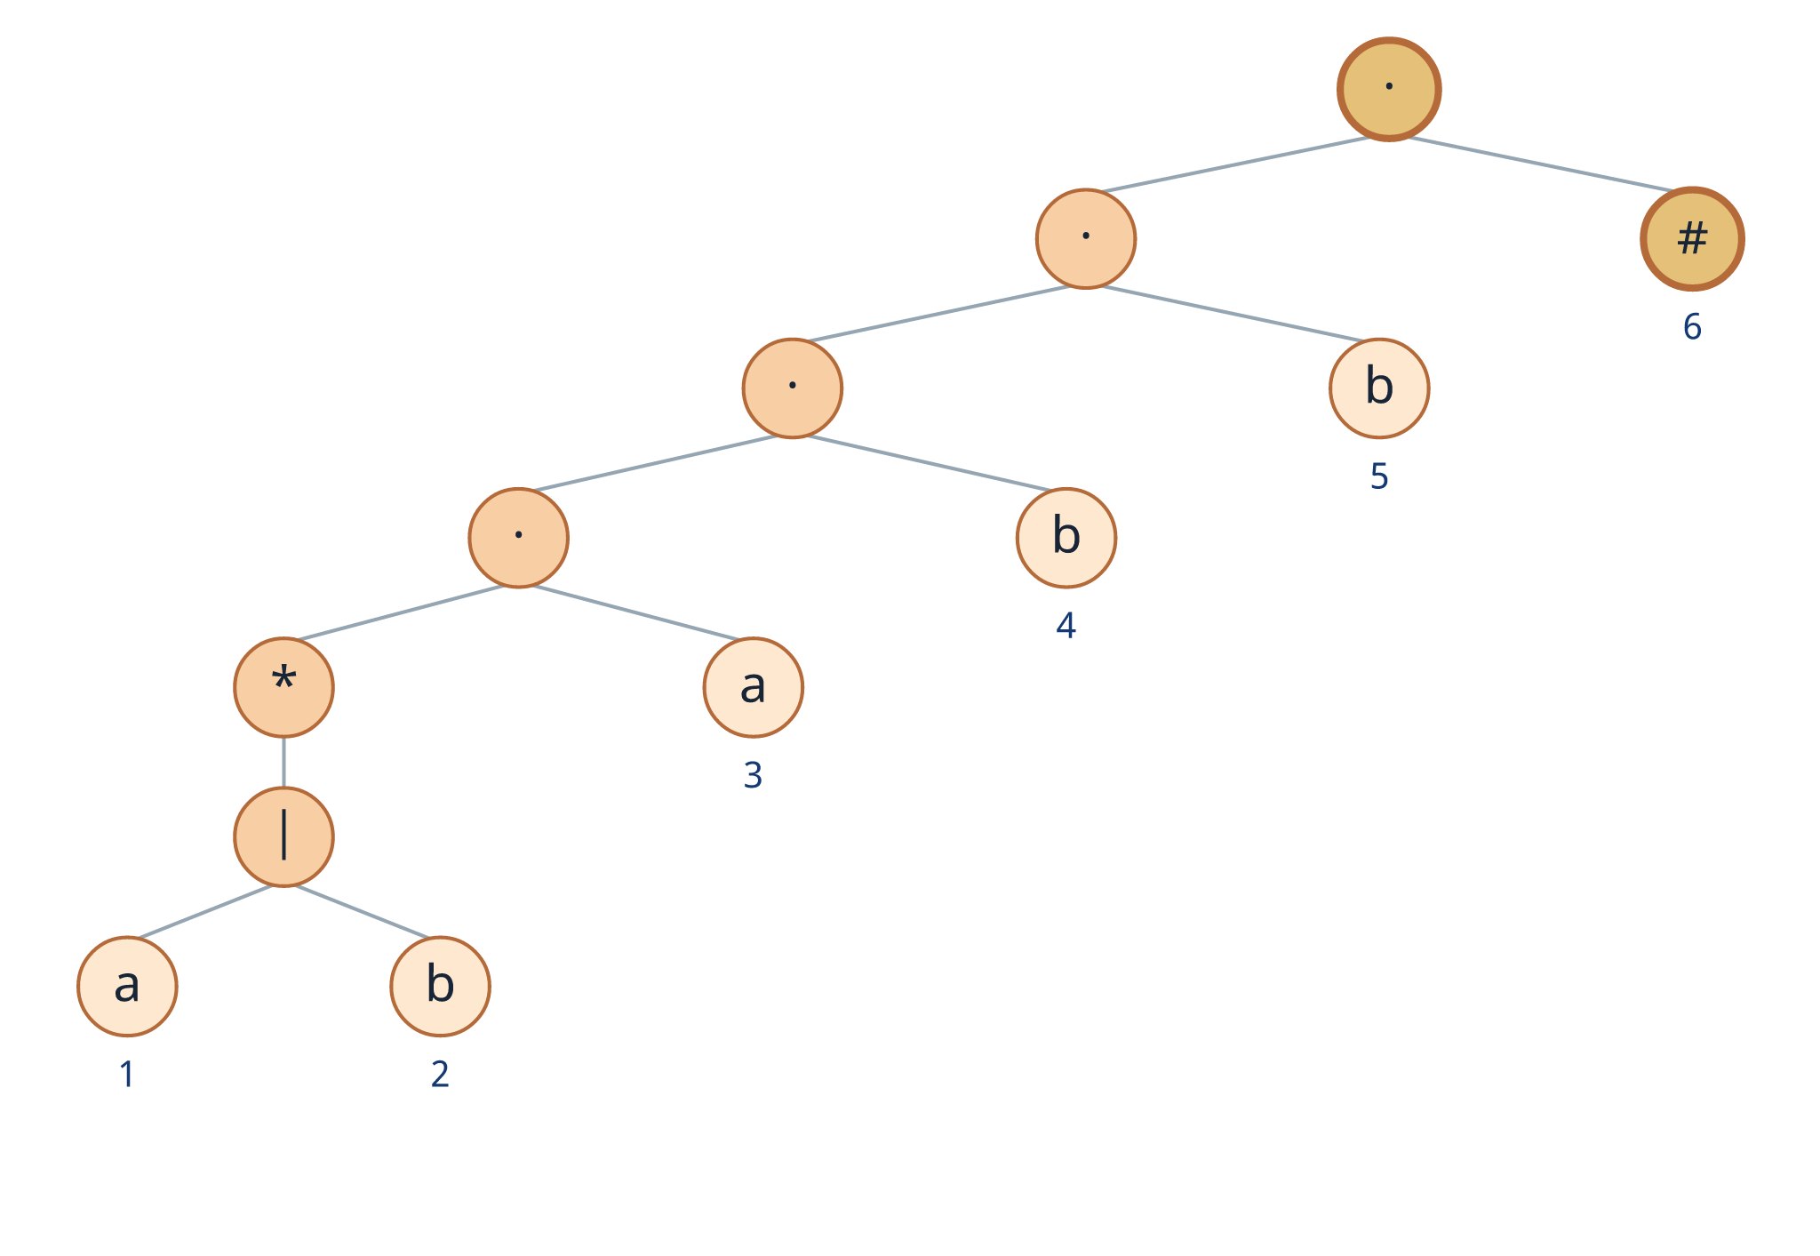
Syntax tree - Steps 5 and 6: add b₅ and #₆
Step 2
Step 5 - concatenate b₅
Step 6 - concatenate #₆
The root now represents the complete augmented regex.
Principles of Compiler Design | Direct Regex-to-DFA Method
9
1 Syntax tree
2 Nullable / firstpos / lastpos
3 Followpos
4 DFA construction
Notes:
Complete the left-associative concatenation chain by adding position 5 and finally the end marker at position 6. The final root represents the entire augmented expression.

Slide 10
Final syntax tree: what does it indicate?
Step 2
Leaves
a, b, and # are operands. Each non-ε leaf has a unique position number.
Interior nodes
|, ·, and * are operators that describe how their child subexpressions combine.
Subtrees
Every interior node represents one subexpression. We compute the tree functions for each subtree.
Positions: a₁, b₂, a₃, b₄, b₅, #₆
Principles of Compiler Design | Direct Regex-to-DFA Method
10
1 Syntax tree
2 Nullable / firstpos / lastpos
3 Followpos
4 DFA construction
Notes:
Pause here and ensure students can read the entire tree. Reinforce that each internal node corresponds to a subexpression and will receive nullable, firstpos, and lastpos values.

Slide 11
The four functions computed from the syntax tree
Step 3
nullable(n)
firstpos(n)
lastpos(n)
followpos(i)
Can the subtree generate ε?
Which positions can appear first?
Which positions can appear last?
Which positions can come next?
Boolean: true or false
Set of position numbers
Set of position numbers
Defined for each leaf position i
Recommended teaching order
nullable → firstpos → lastpos → followpos → DFA
All values are derived from the syntax tree - not by enumerating strings.
Principles of Compiler Design | Direct Regex-to-DFA Method
11
1 Syntax tree
2 Nullable / firstpos / lastpos
3 Followpos
4 DFA construction
Notes:
Define the four functions at a high level before showing their rules. Distinguish the first three, which are properties of tree nodes, from followpos, which is stored for individual leaf positions.

Slide 12
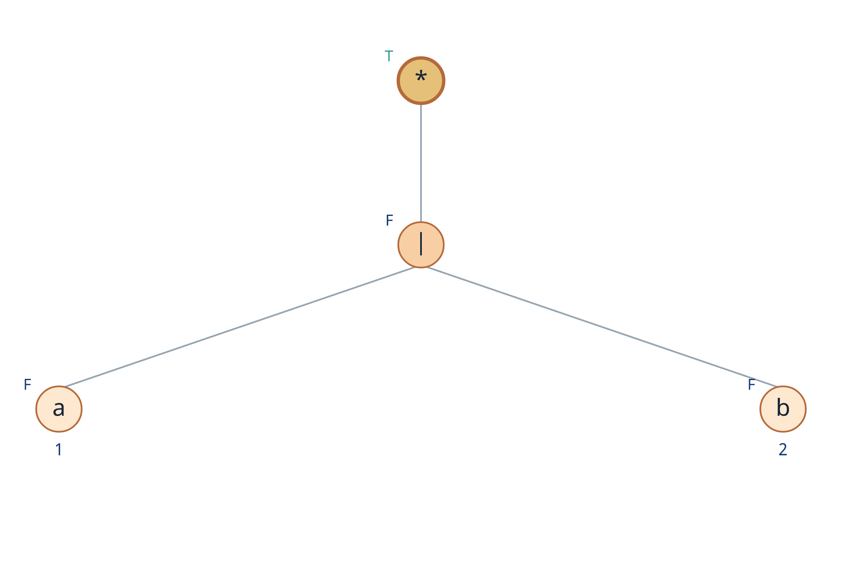
nullable(n): can the subtree generate ε?
Nullable
Definition
Example
nullable(n) = true
(a|b)* is nullable because zero repetitions are permitted.
when the subexpression rooted at n can produce the empty string ε.
Counterexample
A symbol leaf such as a₃ is not nullable because it must consume one input symbol.
Classroom question
Which nodes in our complete tree are nullable?
Only the star node
Principles of Compiler Design | Direct Regex-to-DFA Method
12
1 Syntax tree
2 Nullable / firstpos / lastpos
3 Followpos
4 DFA construction
Notes:
Use the star subtree as the first nullable example. Then contrast it with a leaf. Ask students to predict whether the root can be nullable before applying the formal rules.

Slide 13
Rules for nullable(n)
Nullable
Node n
nullable(n)
Reason
Memory trick
OR for union, AND for concatenation, always true for star.
leaf ε
true
ε is already empty
leaf at position i
false
a symbol must be consumed
For our tree
Every leaf is non-nullable. The union is non-nullable. Only the star is nullable; every concatenation above it becomes non-nullable.
c₁ | c₂
nullable(c₁) OR nullable(c₂)
either alternative may be empty
c₁ · c₂
nullable(c₁) AND nullable(c₂)
both parts must be empty
nullable(root) = false
c*
true
zero repetitions are allowed
Principles of Compiler Design | Direct Regex-to-DFA Method
13
1 Syntax tree
2 Nullable / firstpos / lastpos
3 Followpos
4 DFA construction
Notes:
Walk through the five rules. Stress the difference between OR at a union node and AND at a concatenation node. Apply each rule from leaves upward.

Slide 14
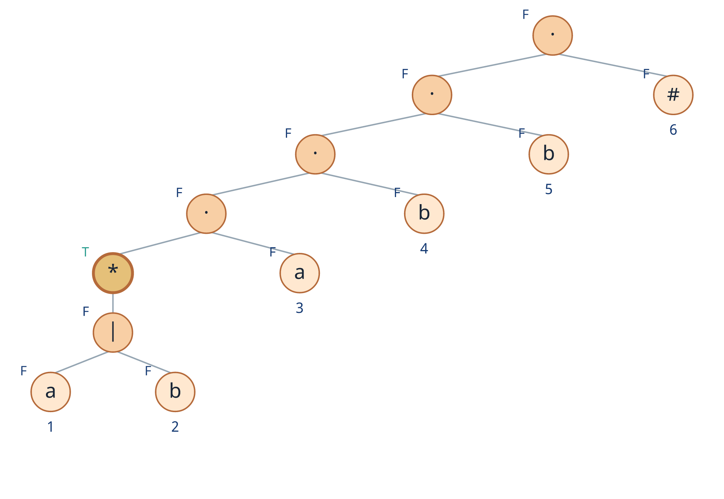
Apply nullable bottom-up to the example
Nullable
Bottom-up calculation
1. Leaves a₁, b₂, a₃, b₄, b₅, #₆ → F
2. Union a₁|b₂ → F OR F = F
3. Star (a₁|b₂)* → T
4. T · F = F
5. Every concatenation above remains F
Only the * node is nullable
nullable(root) = false
Move from the leaves toward the root.
Principles of Compiler Design | Direct Regex-to-DFA Method
14
1 Syntax tree
2 Nullable / firstpos / lastpos
3 Followpos
4 DFA construction
Notes:
Calculate nullable in a strict bottom-up order. Point to the T at the star node and show that concatenating it with the non-nullable a at position 3 makes the new subtree non-nullable.

Slide 15
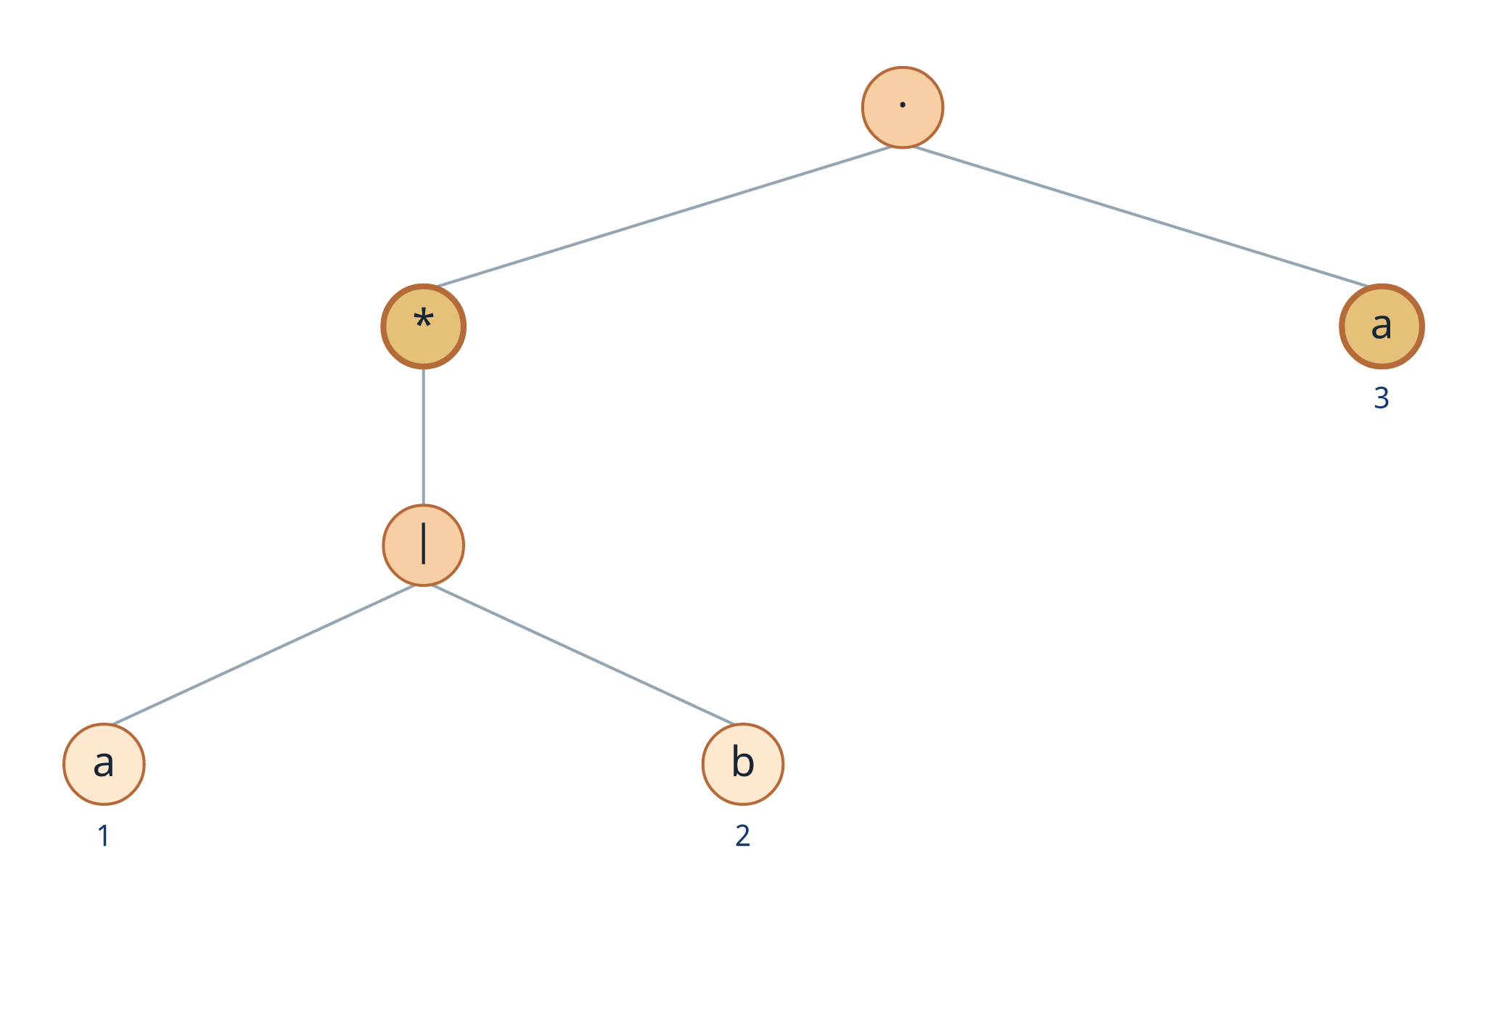
firstpos(n): which positions can appear first?
Firstpos
Definition
Why position 3 is included
The left child is a star and can be empty. Therefore, a string may start at positions 1 or 2 inside the star, or directly at position 3.
firstpos(n)
is the set of leaf positions that can be the first symbol of some string generated by subtree n.
For the subtree (a₁|b₂)*·a₃:
firstpos = {1,2,3}
Ask: Can the left child produce ε?
Principles of Compiler Design | Direct Regex-to-DFA Method
15
1 Syntax tree
2 Nullable / firstpos / lastpos
3 Followpos
4 DFA construction
Notes:
Define firstpos as possible starting positions. Use the concatenation of the star subtree with a3 because it clearly shows why nullable of the left child matters.

Slide 16
Rules for firstpos(n)
Firstpos
Node n
firstpos(n)
Most important rule
At a concatenation node, inspect the left child. If it is nullable, include the right child’s firstpos; otherwise, stop with the left child.
leaf ε
∅
leaf at position i
{i}
c₁ | c₂
firstpos(c₁) ∪ firstpos(c₂)
For our root
The left side of the final concatenation is not nullable, so firstpos(root) stays {1,2,3}.
c₁ · c₂
if nullable(c₁): firstpos(c₁) ∪ firstpos(c₂)
else: firstpos(c₁)
c*
firstpos(c)
Start state = {1,2,3}
Principles of Compiler Design | Direct Regex-to-DFA Method
16
1 Syntax tree
2 Nullable / firstpos / lastpos
3 Followpos
4 DFA construction
Notes:
Focus on the concatenation rule. Students often include the right child unconditionally; remind them that it is included only when the left child is nullable.

Slide 17
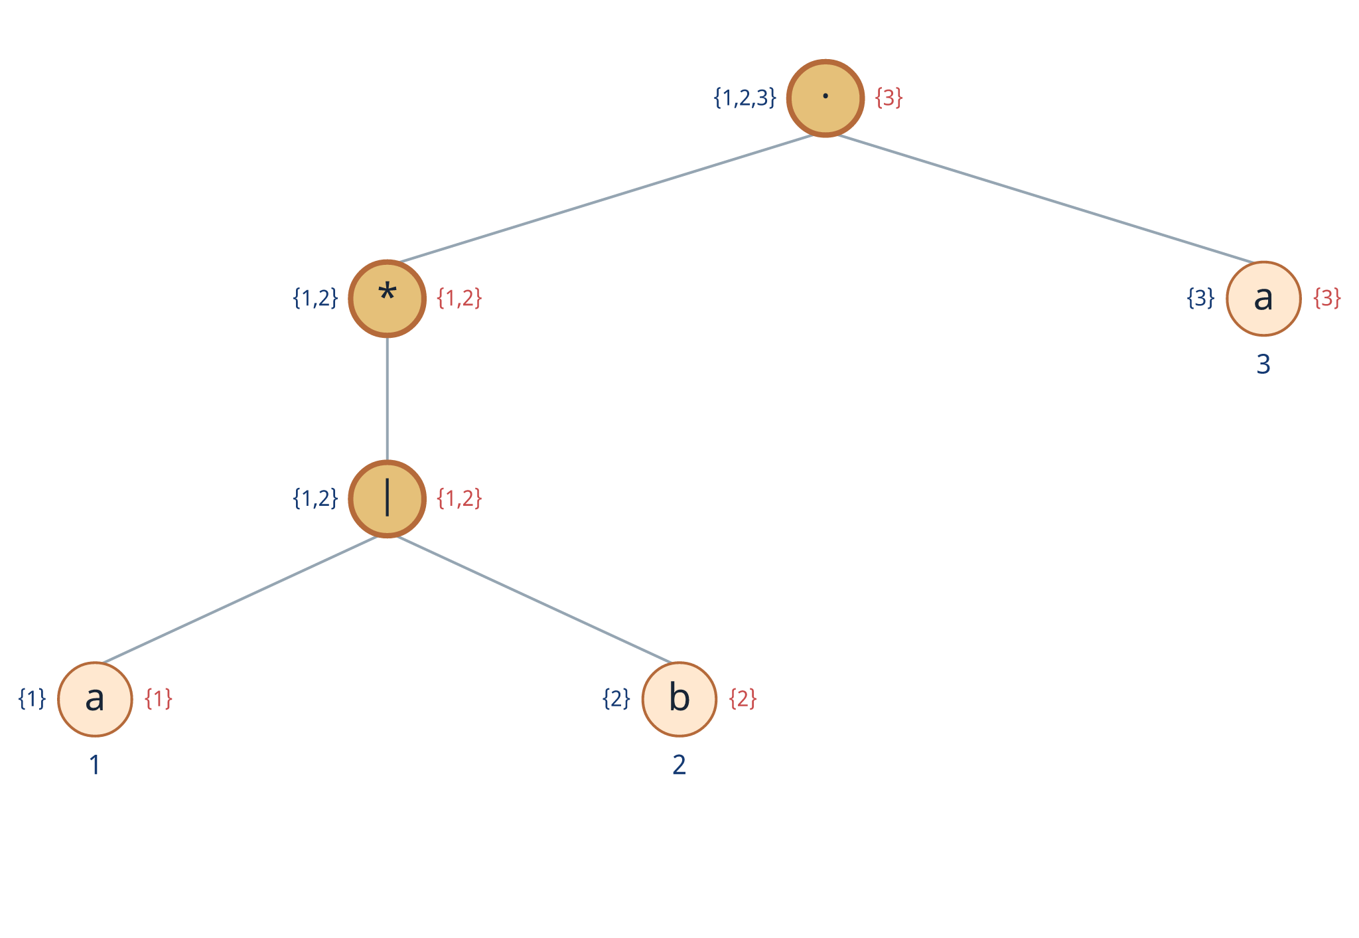
Compute firstpos - lower subtree first
Firstpos
1. Leaves
firstpos(a₁)={1}, firstpos(b₂)={2}, firstpos(a₃)={3}
2. Union
firstpos(a₁|b₂) = {1} ∪ {2} = {1,2}
3. Star
firstpos((a₁|b₂)*) = {1,2}
4. Concatenate a₃
The star is nullable, so {1,2} ∪ {3} = {1,2,3}.
Principles of Compiler Design | Direct Regex-to-DFA Method
17
1 Syntax tree
2 Nullable / firstpos / lastpos
3 Followpos
4 DFA construction
Notes:
Compute firstpos from the leaves upward. Show union and star first. At the first concatenation, explicitly use nullable(star)=true to include position 3.

Slide 18

Compute firstpos - continue to the root
Firstpos
At · b₄
The left child is not nullable, so firstpos remains {1,2,3}.
At · b₅
Again, the left child is not nullable, so firstpos remains {1,2,3}.
At · #₆
The left child is not nullable, so #₆ is not in firstpos(root).
firstpos(root) = {1,2,3}
Principles of Compiler Design | Direct Regex-to-DFA Method
18
1 Syntax tree
2 Nullable / firstpos / lastpos
3 Followpos
4 DFA construction
Notes:
Show that firstpos stabilizes at {1,2,3}. Once the accumulated left subtree becomes non-nullable, adding more right symbols does not change firstpos.

Slide 19

lastpos(n): which positions can appear last?
Lastpos
Definition
For (a|b)*·a₃
The right child a₃ is not nullable, so every generated string must end at position 3.
lastpos(n)
is the set of leaf positions that can be the final symbol of some string generated by subtree n.
For the subtree (a₁|b₂)*·a₃:
lastpos = {3}
Ask: Can the right child produce ε?
Principles of Compiler Design | Direct Regex-to-DFA Method
19
1 Syntax tree
2 Nullable / firstpos / lastpos
3 Followpos
4 DFA construction
Notes:
Define lastpos as possible ending positions. Contrast its concatenation rule with firstpos: lastpos checks whether the right child is nullable.

Slide 20
Rules for lastpos(n)
Lastpos
Node n
lastpos(n)
Mirror image of firstpos
For concatenation, firstpos checks the left child; lastpos checks the right child.
leaf ε
∅
leaf at position i
{i}
For our root
c₁ | c₂
lastpos(c₁) ∪ lastpos(c₂)
The right child is #₆ and is not nullable. Therefore, lastpos(root) = {6}.
c₁ · c₂
if nullable(c₂): lastpos(c₁) ∪ lastpos(c₂)
else: lastpos(c₂)
c*
lastpos(c)
Final marker position = 6
Principles of Compiler Design | Direct Regex-to-DFA Method
20
1 Syntax tree
2 Nullable / firstpos / lastpos
3 Followpos
4 DFA construction
Notes:
Point out the symmetry: firstpos checks nullable of the left child, lastpos checks nullable of the right child. This is a common examination point.

Slide 21
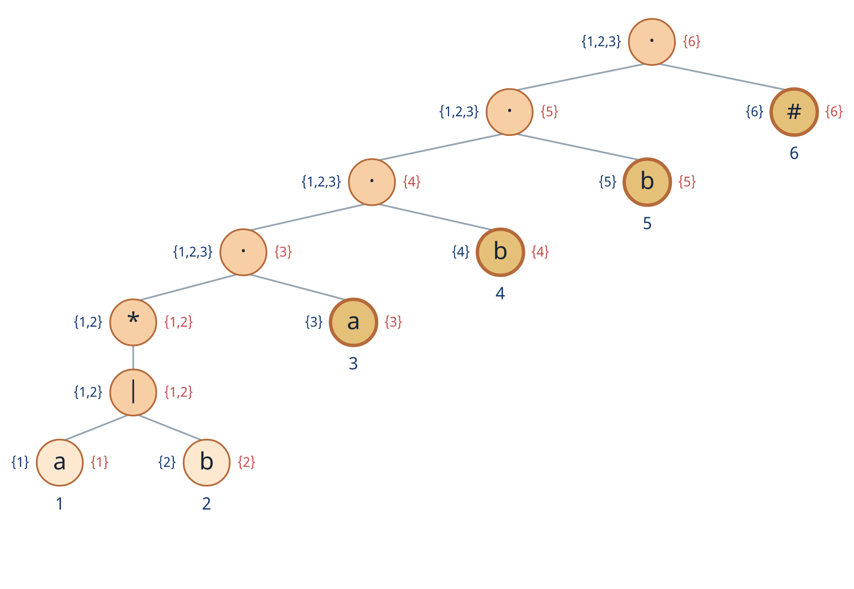
Compute lastpos bottom-up
Lastpos
At (a|b)*·a₃
Right child a₃ is not nullable → lastpos = {3}.
Then ·b₄
Right child b₄ is not nullable → lastpos = {4}.
Then ·b₅
Right child b₅ is not nullable → lastpos = {5}.
Finally ·#₆
Right child #₆ is not nullable → lastpos(root) = {6}.
Principles of Compiler Design | Direct Regex-to-DFA Method
21
1 Syntax tree
2 Nullable / firstpos / lastpos
3 Followpos
4 DFA construction
Notes:
Follow the chain of concatenations. Since every right child is a non-nullable symbol leaf, lastpos simply becomes that right child’s position at each level.

Slide 22
Summary: nullable, firstpos, and lastpos for every subtree
Summary
Subexpression
nullable
firstpos
lastpos
DFA start state
a₁
F
{1}
{1}
firstpos(root) = {1,2,3}
b₂
F
{2}
{2}
a₁|b₂
F
{1,2}
{1,2}
Accepting criterion
The end marker is at position 6. Any state containing 6 will be accepting.
(a₁|b₂)*
T
{1,2}
{1,2}
(a₁|b₂)*·a₃
F
{1,2,3}
{3}
…·b₄
F
{1,2,3}
{4}
Board-writing tip
Use one row per subtree. This reduces mistakes when applying followpos rules.
…·b₅
F
{1,2,3}
{5}
…·#₆ (root)
F
{1,2,3}
{6}
Principles of Compiler Design | Direct Regex-to-DFA Method
22
1 Syntax tree
2 Nullable / firstpos / lastpos
3 Followpos
4 DFA construction
Notes:
Use this table as the checkpoint before followpos. Verify that the start state is firstpos(root) and the accepting position is the position of #.

Slide 23
followpos(i): which positions can come next?
Step 4
Definition
Simple reading
followpos(i)
If position i has been matched, followpos(i) tells the DFA where it may move next.
is the set of positions that may appear immediately after position i in some valid string.
Important: only two syntax-tree rules create followpos entries
Concatenation node c₁·c₂
Star node c*
Union nodes and leaves do not directly add followpos entries.
Principles of Compiler Design | Direct Regex-to-DFA Method
23
1 Syntax tree
2 Nullable / firstpos / lastpos
3 Followpos
4 DFA construction
Notes:
Define followpos operationally as the transition information. Stress that only concatenation and star nodes contribute entries. This simplification is useful for teaching and for examination solutions.

Slide 24
The two followpos rules
Rules
Rule 1 - concatenation
Rule 2 - Kleene star
For n = c₁·c₂:
For n = c*:
For every i ∈ lastpos(c₁),
add every position in firstpos(c₂)
to followpos(i).
For every i ∈ lastpos(c),
add every position in firstpos(c)
to followpos(i).
left can end at i → right can begin next
one repetition can be followed by another
Always union new positions with any entries already present.
Principles of Compiler Design | Direct Regex-to-DFA Method
24
1 Syntax tree
2 Nullable / firstpos / lastpos
3 Followpos
4 DFA construction
Notes:
Present the two rules side by side. Translate each formula into plain language. Emphasize that followpos sets accumulate by union; existing entries are never overwritten.

Slide 25
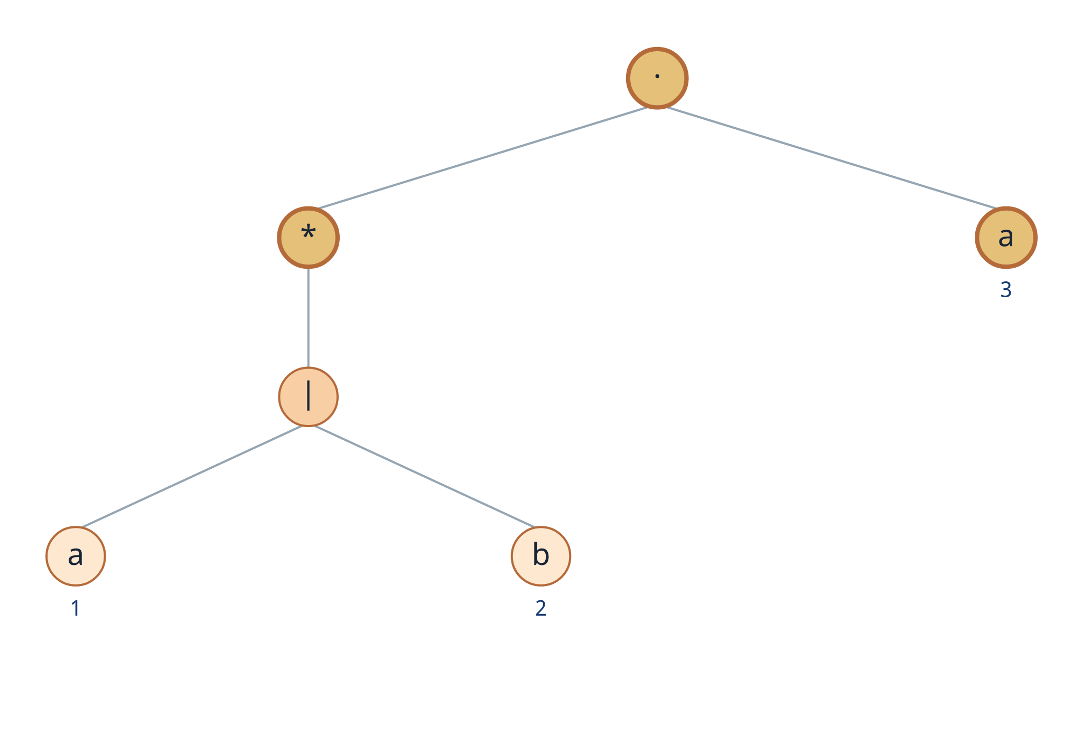
Followpos from the first concatenation
Concatenation
Highlighted node
n = (a₁|b₂)* · a₃
Step 1
lastpos(left) = lastpos((a₁|b₂)*) = {1,2}
Step 2
firstpos(right) = firstpos(a₃) = {3}
Update
Add {3} to followpos(1) and followpos(2).
followpos(1) ⊇ {3}
followpos(2) ⊇ {3}
Principles of Compiler Design | Direct Regex-to-DFA Method
25
1 Syntax tree
2 Nullable / firstpos / lastpos
3 Followpos
4 DFA construction
Notes:
Apply the concatenation rule at the first cat node. The star subtree can end at positions 1 or 2, and the right child can begin only at position 3. Therefore, 3 follows both 1 and 2.

Slide 26
Followpos from the remaining concatenations
Concatenation
…a₃ · b₄
…b₄ · b₅
…b₅ · #₆
lastpos(left) = {3}
lastpos(left) = {4}
lastpos(left) = {5}
firstpos(right) = {4}
firstpos(right) = {5}
firstpos(right) = {6}
Add 4 to followpos(3)
Add 5 to followpos(4)
Add 6 to followpos(5)
After all concatenation nodes: 1→3, 2→3, 3→4, 4→5, 5→6
Principles of Compiler Design | Direct Regex-to-DFA Method
26
1 Syntax tree
2 Nullable / firstpos / lastpos
3 Followpos
4 DFA construction
Notes:
Process each remaining cat node. The fixed suffix a3 b4 b5 #6 creates a simple chain of follow relationships. Point out that followpos(6) remains empty because nothing follows the end marker.

Slide 27

Followpos from the star node
Kleene star
Star subtree
c = (a₁|b₂)
lastpos(c)
firstpos(c)
{1,2}
{1,2}
For each i ∈ {1,2}, add {1,2} to followpos(i).
Merge with the earlier {3}:
followpos(1) = followpos(2) = {1,2,3}
This loop allows any number of a/b symbols before the final abb.
Principles of Compiler Design | Direct Regex-to-DFA Method
27
1 Syntax tree
2 Nullable / firstpos / lastpos
3 Followpos
4 DFA construction
Notes:
Apply the star rule to the union subtree. Since one repetition may be followed by another, positions 1 and 2 can be followed by positions 1 or 2. Union these with the existing entry 3.

Slide 28
Final followpos table
Summary
Position
Symbol
followpos
How to check the table
1 and 2 loop inside (a|b)* and may move to 3.
3 → 4 because a₃ is followed by b₄.
4 → 5 because b₄ is followed by b₅.
5 → 6 because b₅ is followed by #₆.
6 has no successor.
1
a
{1,2,3}
2
b
{1,2,3}
3
a
{4}
4
b
{5}
5
b
{6}
Why this matters
This table is the transition engine for the DFA. Every DFA transition is a union of selected followpos sets.
6
#
∅
Principles of Compiler Design | Direct Regex-to-DFA Method
28
1 Syntax tree
2 Nullable / firstpos / lastpos
3 Followpos
4 DFA construction
Notes:
Verify each row verbally. Students should be able to explain every entry from either a concatenation node or the star node. This table will now be used mechanically to construct the DFA.

Slide 29
Construct DFA states from position sets
Step 5
Algorithm
Transition formula
1
Create the start state
δ(S,x) = ⋃ followpos(p)
A = firstpos(root) = {1,2,3}
2
For each unmarked state S
for p ∈ S labeled x
mark S and process every input symbol x
3
Select matching positions
choose p ∈ S whose leaf is labeled x
4
Take a union
For this example
U = ⋃ followpos(p) for the selected positions
Alphabet = {a,b}
Start state A = {1,2,3}
Accepting states contain 6
5
Add a transition
δ(S,x) = U; create U if it is new
6
Mark accepting states
any state containing position 6 (#)
Principles of Compiler Design | Direct Regex-to-DFA Method
29
1 Syntax tree
2 Nullable / firstpos / lastpos
3 Followpos
4 DFA construction
Notes:
Present the DFA construction as a mechanical worklist algorithm. Emphasize that the input symbols are only a and b. The # position is used only to identify accepting states.

Slide 30
State A = {1,2,3}: calculate its transitions
State A
A = firstpos(root) = {1,2,3}
Input a
Input b
Positions in A labeled a: 1 and 3
Position in A labeled b: 2
followpos(1) ∪ followpos(3)
followpos(2)
= {1,2,3} ∪ {4} = {1,2,3,4}
= {1,2,3}
δ(A,a) = B
δ(A,b) = A
New state discovered: B = {1,2,3,4}
Principles of Compiler Design | Direct Regex-to-DFA Method
30
1 Syntax tree
2 Nullable / firstpos / lastpos
3 Followpos
4 DFA construction
Notes:
Compute both transitions from A. For input a, combine followpos of positions 1 and 3. For input b, use followpos of position 2. Name the new set {1,2,3,4} as state B.

Slide 31
State B = {1,2,3,4}: calculate its transitions
State B
On input a
On input b
a-labeled positions in B: 1 and 3
b-labeled positions in B: 2 and 4
{1,2,3} ∪ {4} = {1,2,3,4}
{1,2,3} ∪ {5} = {1,2,3,5}
δ(B,a) = B
δ(B,b) = C
B has a self-loop on a.
New state: C = {1,2,3,5}
Principles of Compiler Design | Direct Regex-to-DFA Method
31
1 Syntax tree
2 Nullable / firstpos / lastpos
3 Followpos
4 DFA construction
Notes:
From B, input a returns to B because the same a-labeled positions 1 and 3 are present. Input b uses positions 2 and 4 and discovers state C.

Slide 32
State C = {1,2,3,5}: calculate its transitions
State C
On input a
On input b
a-labeled positions in C: 1 and 3
b-labeled positions in C: 2 and 5
{1,2,3} ∪ {4} = {1,2,3,4}
{1,2,3} ∪ {6} = {1,2,3,6}
δ(C,a) = B
δ(C,b) = D
D contains position 6 → accepting
Principles of Compiler Design | Direct Regex-to-DFA Method
32
1 Syntax tree
2 Nullable / firstpos / lastpos
3 Followpos
4 DFA construction
Notes:
State C represents having matched the suffix ab. Reading another b reaches a set containing position 6, so the new state D is accepting.

Slide 33
State D and the complete transition table
State D
State
Position set
on a
on b
D = {1,2,3,6}
Accepting state
A
{1,2,3}
B
A
It contains position 6, the position of #.
B
{1,2,3,4}
B
C
On a: positions 1 and 3 → B
C
{1,2,3,5}
B
D
On b: position 2 → A
D*
{1,2,3,6}
B
A
* D is accepting because its set contains 6.
Principles of Compiler Design | Direct Regex-to-DFA Method
33
1 Syntax tree
2 Nullable / firstpos / lastpos
3 Followpos
4 DFA construction
Notes:
Complete the worklist by processing D. No new states are created. Present the final transition table and mark D as accepting because it contains the end-marker position.

Slide 34
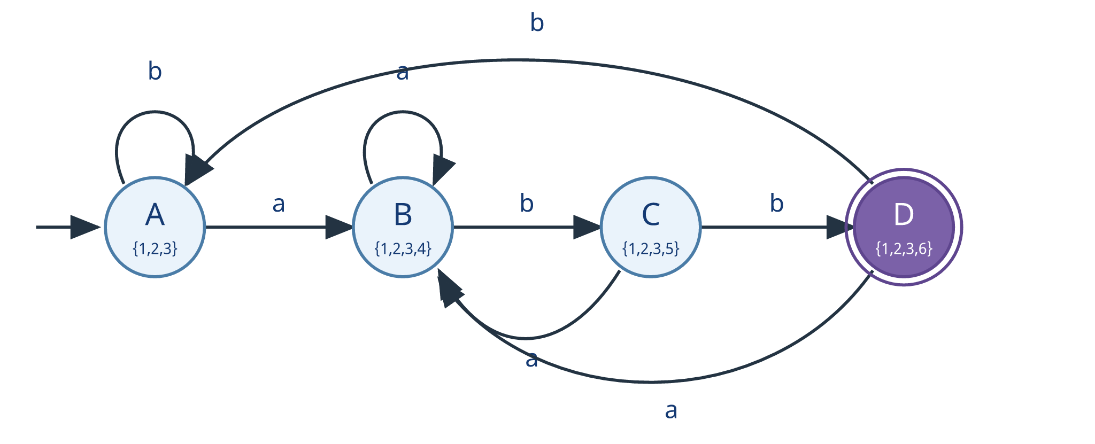
Final DFA
Result
State interpretation
Accepting condition
A: no useful suffix matched
B: suffix a matched
C: suffix ab matched
D: suffix abb matched
D is a double-circle state because it contains position 6 (#).
Principles of Compiler Design | Direct Regex-to-DFA Method
34
1 Syntax tree
2 Nullable / firstpos / lastpos
3 Followpos
4 DFA construction
Notes:
Trace the transitions on the final diagram. Interpret each state as the longest useful suffix of the input seen so far. This interpretation helps students connect the direct construction to the familiar minimal DFA for strings ending in abb.

Slide 35
Test the DFA with sample strings
Validation
Accepted examples
Rejected examples
abb
A —a→ B —b→ C —b→ D ✓
ab
A —a→ B —b→ C ✗
aabb
A —a→ B —a→ B —b→ C —b→ D ✓
abba
A —a→ B —b→ C —b→ D —a→ B ✗
babb
A —b→ A —a→ B —b→ C —b→ D ✓
bbb
A —b→ A —b→ A —b→ A ✗
All end with abb
Final state is not D
Recognized language: all strings over {a,b} ending in abb.
Principles of Compiler Design | Direct Regex-to-DFA Method
35
1 Syntax tree
2 Nullable / firstpos / lastpos
3 Followpos
4 DFA construction
Notes:
Validate the DFA with both accepted and rejected examples. Remind students that acceptance depends on the state after the entire input has been consumed, not on whether D was visited earlier.

Slide 36
Where this method fits and where it is used
Context
Direct syntax-tree route
Traditional route
Regex
Syntax tree + functions
Regex
NFA
DFA
Uses
DFA
lexical analysis in compilers
grep-like pattern matching utilities
No intermediate NFA is required.
regular-expression libraries and engines
Both approaches produce equivalent automata.
Principles of Compiler Design | Direct Regex-to-DFA Method
36
1 Syntax tree
2 Nullable / firstpos / lastpos
3 Followpos
4 DFA construction
Notes:
Place the direct method in context. The source material notes applications in lexical analysis, grep-like utilities, and regex libraries. Explain that the direct method and the NFA route are alternative construction paths.

Slide 37
Exam-ready checklist and classwork
Recap
Six-step checklist
Classwork
✓
Append # to the regular expression.
1
Trace a string
Verify that babb ends in the accepting state.
✓
Build the syntax tree and number every non-ε leaf.
✓
Compute nullable, firstpos, and lastpos bottom-up.
2
Explain the marker
Why is # not included in the DFA input alphabet?
✓
Apply followpos rules at every cat-node and star-node.
3
New construction
✓
Use firstpos(root) as the start state and build transitions.
Apply the same method to (a|b)*aba.
✓
Mark each state containing the position of # as accepting.
One-line summary
followpos tells the DFA where it can move next.
End of lesson
Principles of Compiler Design | Direct Regex-to-DFA Method
37
1 Syntax tree
2 Nullable / firstpos / lastpos
3 Followpos
4 DFA construction
Notes:
Use the checklist as the final recap. Assign one trace question and one new regex construction. Ask students to state the one-line meaning of followpos before ending the class.

