Slide 1
Flow Viz analysis for thermal-source kernels
New analysis workflow
Named probe datasets accept Probe V2 .pbin or compact HDF5 without changing the selected analysis.
Multi-probe products retain SI units and physical probe coordinates for time histories, FFT/PSD, STFT/envelopes, pulse response, nonlinear, and modal analyses.
Typed comparisons support current and archived Asym/Gaus runs with explicit time, frequency, spatial, and wavenumber alignment.
Preflight, provenance, resource estimates, and live phase-level logging make long post-processing runs auditable.
Thermal-source study use
Compare source-kernel cases using the same probes and the same product contract.
Use fixed plotting scales for cross-kernel figures, then retain all alignment and masking choices in artifact provenance.

Slide 2
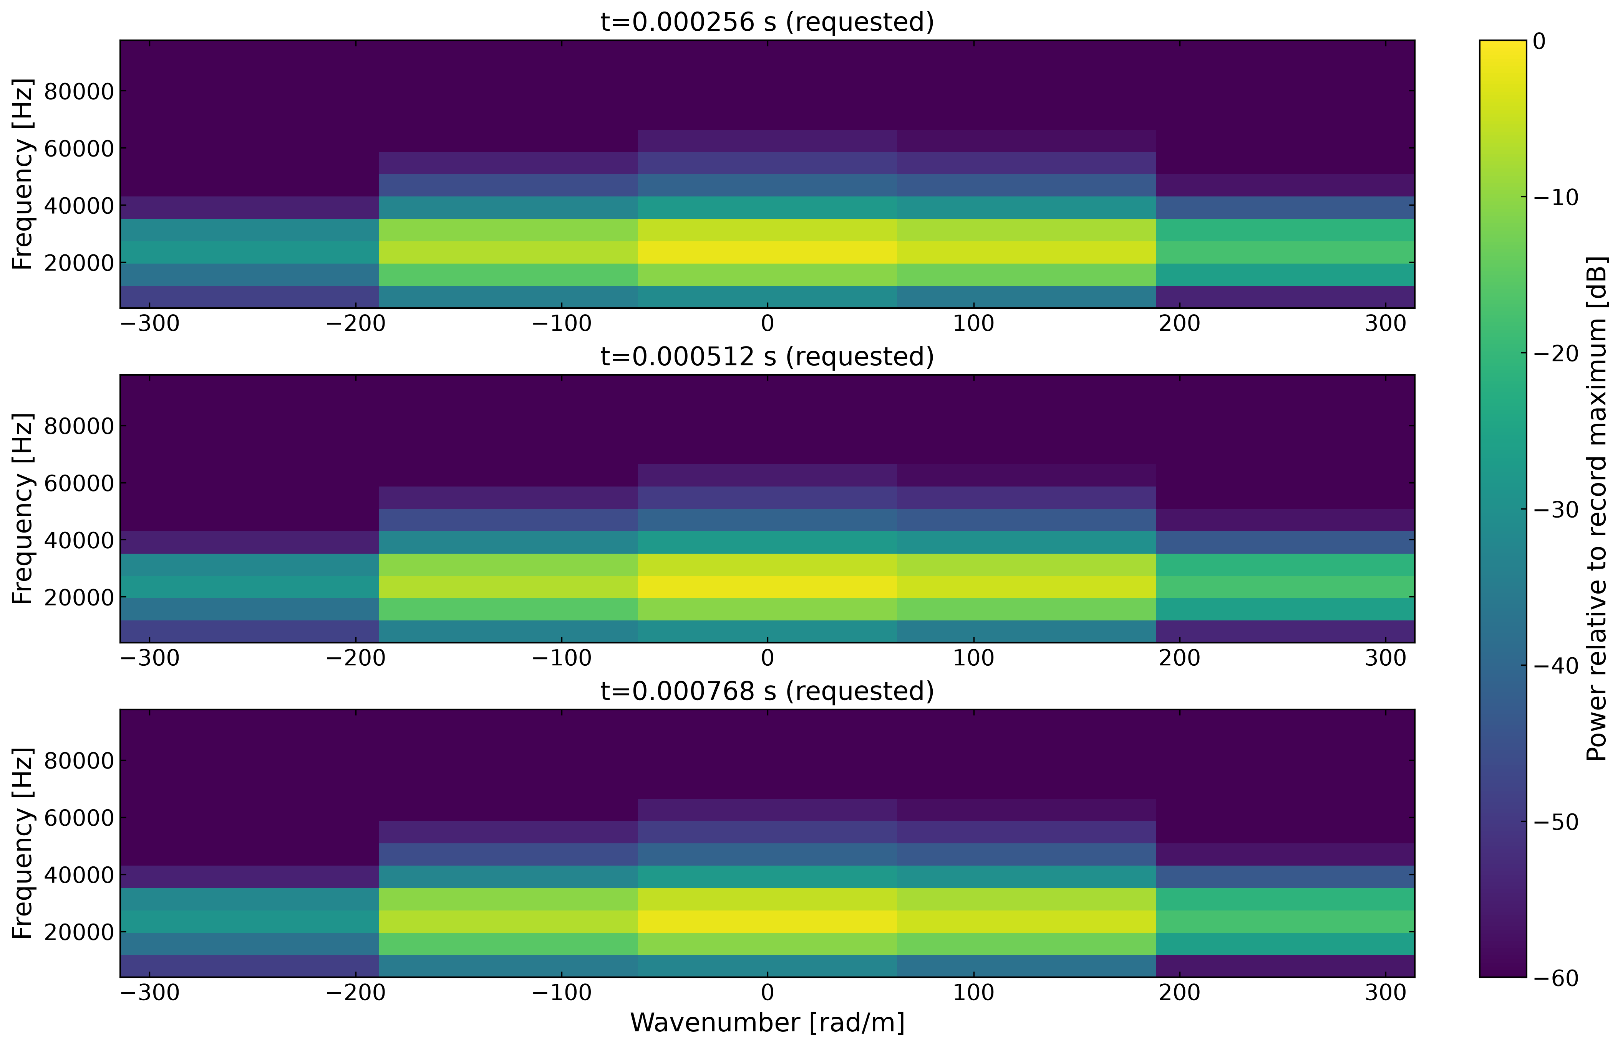
Time-localized wavenumber diagnostics

Slide 3
Illustrative verification output. f–k snapshots show the pulse’s frequency and signed wavenumber content at requested stages. The companion k–time map and ridge history report dominant wavenumber, wavelength, frequency, and phase speed where validity checks pass.

