Slide 1
Flow Viz analysis for thermal-source kernels
New analysis workflow
Probe V2 .pbin and compact HDF5 use the same named dataset model.
Multi-probe products cover histories, FFT/PSD, STFT/envelopes, pulse response, nonlinear, and modal analyses.
Typed Asym/Gaus comparisons align time, frequency, space, and wavenumber.
Preflight and live phase-level logs expose inputs, resources, artifacts, and failures.

Slide 2
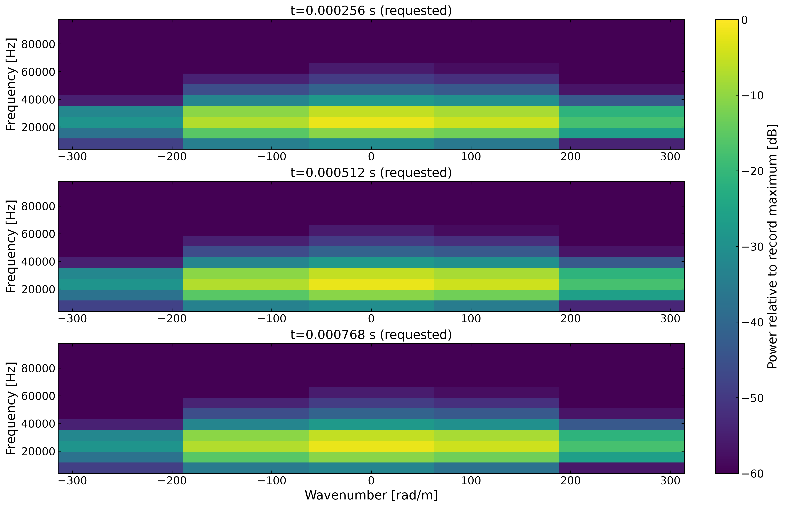
Time-localized wavenumber diagnostics

