Slide 1
Flow Viz analysis for thermal-source kernels

Slide 2
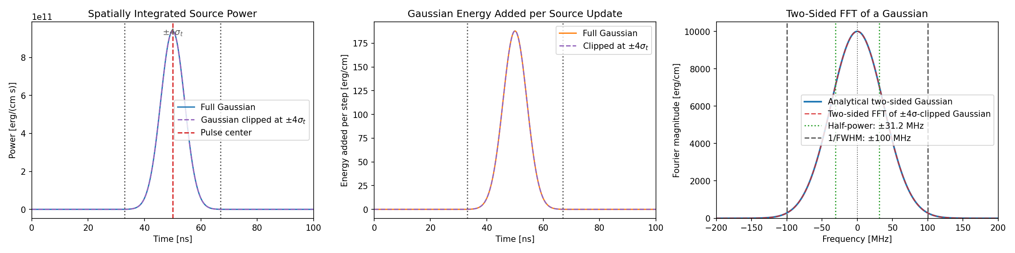
Flow Viz analysis for thermal-source kernels

Slide 3
Recent analysis capability
Named probe datasets accept Probe V2 .pbin or compact HDF5 without changing the selected analysis.
Multi-probe products retain SI units and physical probe coordinates for time histories, FFT/PSD, STFT/envelopes, pulse response, nonlinear, and modal analyses.
Typed comparisons support current and archived Asym/Gaus runs with explicit time, frequency, spatial, and wavenumber alignment.
Preflight, provenance, resource estimates, and live phase-level logging make long post-processing runs auditable.
Illustrative Gaussian-pulse source result. Replace with the configured thermal-source kernel result when presenting study data.

Slide 4
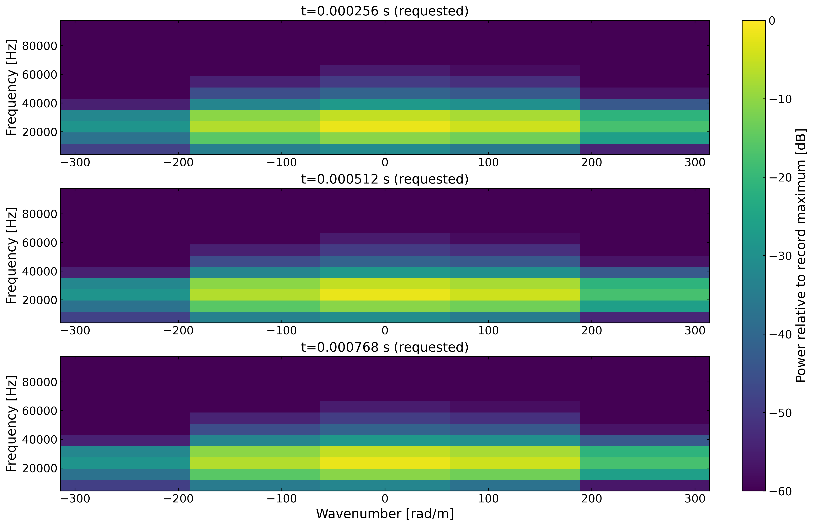
Time-localized wavenumber diagnostics

Slide 5
Useful for the thermal-source pulse
The selected probes form a spatial aperture; the analysis resolves signed wavenumber and frequency during the pulse.
f–k snapshots distinguish the spatial content at specified pulse stages with one shared display scale.
The companion k–time map and ridge history report dominant wavenumber, wavelength, frequency, and phase speed only where the signal passes validity checks.
The same typed products can compare Asym and Gaus kernels, including local-to-archive comparisons.
Illustrative verification output. The requested times and color scale are recorded in artifact provenance.

