Slide 1
Flow Viz analysis for thermal-source kernels

Slide 2
New analysis workflow
Probe V2 .pbin and compact HDF5 use the same named dataset model.
Multi-probe products cover histories, FFT/PSD, STFT/envelopes, pulse response, nonlinear, and modal analyses.
Typed Asym/Gaus comparisons align time, frequency, space, and wavenumber.
Preflight and live phase-level logs expose inputs, resources, artifacts, and failures.

Slide 3
Time-localized wavenumber diagnostics

Slide 4
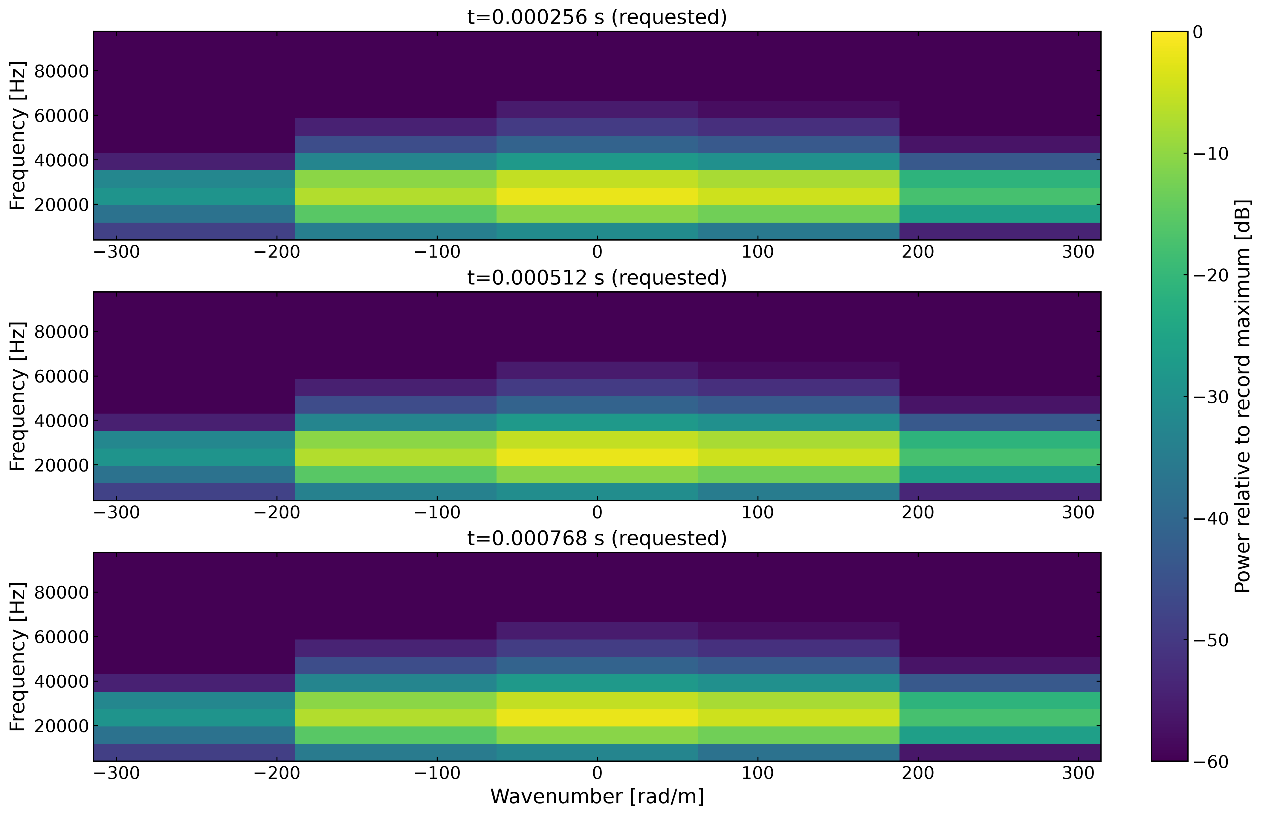

Slide 5
Illustrative verification output. f–k snapshots show the pulse’s frequency and signed wavenumber content at requested stages. The companion k–time map and ridge history report dominant wavenumber, wavelength, frequency, and phase speed where validity checks pass.

