Slide 1
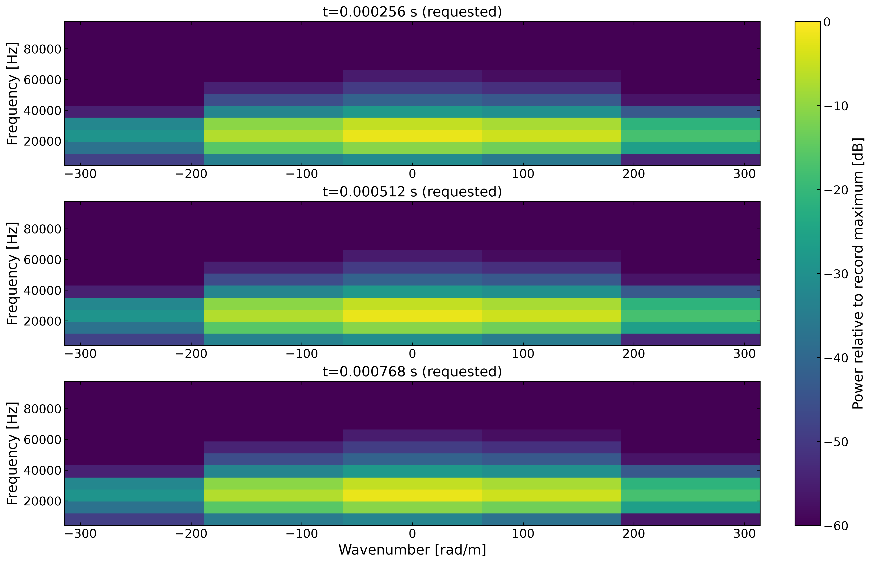
Time-localized wavenumber diagnostics

