Slide 1
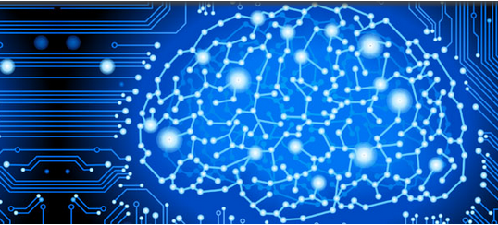


NeuroMiner®
pattern recognition for
neurodiagnostic applications
V1.0
elessar
© Nikolaos Koutsouleris & WP2 team (www.pronia.eu)
The development of this software is funded by the European Commission under the 7th Framework Programme / Grant Agreement No. 602152

