Slide 1
Enumerations
Computer Programming II
North Carolina Department of Instruction

Slide 2
What is an enumeration?
An enumeration is a data type used to efficiently define a related set of constants. It is kind of like an array of constants.
The keyword enum is used to declare an enumeration.
enum WeekDays {Sun, Mon, Tue, Wed, Thu, Fri, Sat}; //example
By default the first element in the enumeration is given a value of 0 and each successive element is incremented by 1. Sat is therefore what value?
To access a value in the enum you use the enum name, the dot operator, and the item name. Therefore, to access Wednesday, for example, you would use:
WeekDays.Wed
Convention is to bi-capitalize both the enum name and the items.

Slide 3
You’ve used them before and why?
When you say:
MessageBox.Show(“Message”, “Title”, MessageBoxButtons.YesNo, MessageBoxIcon.Question);
The last two arguments to the method call are enums. This is much more clear, and easier to read later, than this:
MessageBox.Show(“Message”, “Title”, 0, 1); // what do the last two numbers mean?
enums make code easier to read, understand, and maintain
Whoever defined the enum could change the values and your code would still work.

Slide 4
Using non-default values
You may use initializer(s) to start at something other than the default, or to set values.
enum WorkDays {Sun = 4, Mon, Tue, Wed, Thu, Fri, Sat};
If a successive element is not initialized , the prior + 1 is used.
So Mon in this case is initialized to 5.

Slide 5
Using a non-default data type
The default is an int.
That’s 4 bytes for each element. Plus, each value could be +/- 2+billion.
To save space, use a byte, short, or ushort.
enum WeekDays : byte {Sun, Mon, Tue, Wed, Thu, Fri, Sat};
Approved types for an enum are byte, sbyte, short, ushort, int, uint, long, or ulong.
Decimal enums are not allowed.
Read pages 78-79 in the Farrell book and https://docs.microsoft.com/en-us/dotnet/api/system.enum?view=netframework-4.7.1 for more information on enums.

Slide 6
Casting
Accessing an enum’s value as an actual number requires typecasting.
What is typecasting or more frequently casting? Casting is a device present in C languages whereby you can convert a piece of data from one type to another.
With base types it is only required if data might be lost in the conversion, for example, double to int. With classes it is required to change from a parent type into a child type.
The syntax to cast from one type to another is to put “(newtype)” in front of the piece of data. For example:
int dayNumber = (int) WeekDays.Sun; // turn a day into an int
// or conversely
WeekDays dayOfWeek = (WeekDays) 4; // turn an int into a day

Slide 7
More casting examples
Turn an Object into a Book:
Book myBook = (Book) obj; // best to check with “is”
Turn a double into an int:
int x = (int) 3.4; // x will be assigned 3
Implicit conversion is allowed between base types where information cannot be lost:
double dblX = 3; // no cast required

Slide 8
Using “is” before a cast
Some casts are invalid. For example, you should not try to cast a Shape into a Dog.
You should check with “is” before casting classes:
if (obj is Book)
{
Book newBook = (Book) obj;
lblOutput.Text = String.Format(“The book price is {0:C2}”, newBook.price); // “C” is the currency formatter
}
Otherwise you may get an InvalidCastException. Your code may compile but not run.

Slide 9
Further reading
For more details and examples about casting: https://docs.microsoft.com/en-us/dotnet/csharp/programming-guide/types/casting-and-type-conversions

Slide 10
You do it!
Open the last iteration of your Animals project.
The Veterinarian’s office who is using your software wants to start documenting the gender of an animal. They want five possibilities: Male, Female, Neutered, Spayed, Unknown.
Create an enum inside the Namespace. Call it Gender and name the items the five names above. Remember the naming convention.
Modify your abstract Animal class to include an auto-implemented property of the enum type you created.
Modify (do not delete) the constructor you already have in your Animal class to set the gender of the Animal to “Unknown” using your enum value.
NOTE: you should never delete a constructor for code that has been shipped! Why?
Modify your abstract Animal class to ADD a new constructor including the gender as a parameter. (Note: if you have a default parameter on a constructor, it has to be the last one!)
Continue on the next slide…

Slide 11
You do it!
In each child class, do the following:
ADD a constructor (do not modify) that includes the gender as a parameter and have it call the new base constructor.
Modify the ToString() to include the gender.
Now in your button click, do the following:
Create a random number generator.
Generate a random number in the range of your enum with the following code:
Gender randomGender = (Gender)gen.Next((int)Gender.Male, (int)Gender.Unknown + 1); // notice all the casting!!
Pass the randomGender to the new constructor you created for each animal.

Slide 12
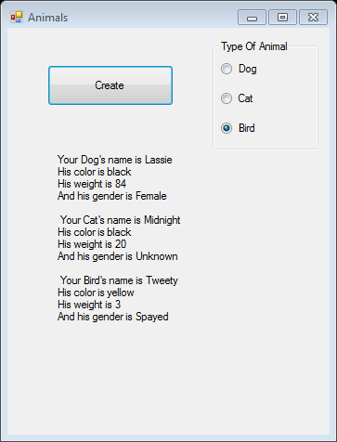
Output
Your output should look something like the following:

