Slide 1
Objects and Classes: Behavior
Programming II
North Carolina Department of Public Instruction

Slide 2
Review
When you instantiate an object from a class using the keyword new, a constructor is called.
A constructor is a special method that helps construct an object. It is defined inside the class.
If you do not provide a constructor in your class, a default constructor (one with no parameters) is generated for you by C#.
Your class can have as many constructors as you like, but they all must have the same identifier – the same name as the class – and they must have different parameter lists.
When you have multiple methods or constructors with the same name but different parameter lists, this is called overloading.
It is good practice to have every constructor initialize all instance variables.

Slide 3
Before moving ahead: Constructor Nuances
To keep from having to repeat initialization code in all your constructors, which is error prone, you can have each constructor call the most complex constructor using the “this” keyword. This is called a constructor initializer.
class Dog
{ // properties omitted for space
public Dog() : this(“”,””,0) {} // ctor initializer
public Dog(string name) : this(name,””,0) {} // ctor initializer
public Dog(string name, string color, double weight)
{
this.name = name;
this.color = color;
this.weight = weight;
}
} // end class Dog

Slide 4
One More Constructor Nuance
You can provide property settings outside of the constructor when using the new keyword, as shown below. This is called an object initializer.
Dog coco = new Dog {name = “Coco”, color = “brown”};
Is the same as:
Dog coco = new Dog();
coco.name = “Coco”;
coco.color = “brown;
This is just a shortcut provided by the language. If you don’t like it, don’t use it. Your software development shop will have guidelines about whether or not to use language features like this.

Slide 5
Behavior
Remember, an object is an encapsulation of data and behavior.
We have learned how to give our classes (and therefore the objects created from them) data as properties or fields.
We provide behavior with methods. Methods that provide object behavior are inside the class, just like the data:
class Dog
{ // properties omitted for space
// ctors omitted for space
public string Bark()
{
return “Woof, woof!”;
}
}

Slide 6
You do it!
Open your Animals project.
Change your constructors to look like slide number 3 (use constructor initializers).
Modify your Dog class to have the Bark() method given on the previous slide.
In your button click, make the last dog you create “bark” by calling the method you added and putting the result in the label. For example:
lblOutput.Text += lassie.Bark();
Test your code. Your output should look the same as before with “Woof, woof!” at the bottom.
Then continue with the next slide.

Slide 7
You do it!
Now that you have a working Bark() method, let’s make it a little more interesting.
Download the CorrectDogBark.wav file from Canvas.
Modify your Bark() method to look like the following (add using System.Media at top):
public void Bark() // notice change of return type!!
{
SoundPlayer simpleSound = new SoundPlayer(@"c:\Users\loakley\Downloads\CorrectDogBark.wav");
simpleSound.Play();
}
Notice the location of the .WAV file must be YOUR downloads folder (or wherever you choose to put the file). Also note that you are creating a SoundPlayer object with the word “new”.
Change the lblOutput statement from the previous slide to just lassie.Bark(). Test your code with this change. Do you hear the bark after you create your third dog? You may need to use earbuds. When you get this working, move to the next slide.

Slide 8
You do it!
Now add two more classes to your project: a Cat class, and a Bird class. Copy the Dog class and modify it. Make sure you are not putting one class inside another.
Change the Bark() method to Meow() in the Cat class. Download the CatMeow.wav from Canvas to play in the method.
Change the Bark() method to Tweet() in the Bird class. Download the KilldeerSong.Wav from Canvas to play in the method.
Modify your form to include a group of three radio buttons indicating what type of animal should be created: Dog, Cat, or Bird.
When the user pushes the button, use an if/else statement based on the radio buttons to determine which type of animal to create.
Create one instance of the animal, write it’s data to the label, and call it’s sound-making method.
Test each type of animal.
Make your output look something like the following:

Slide 9
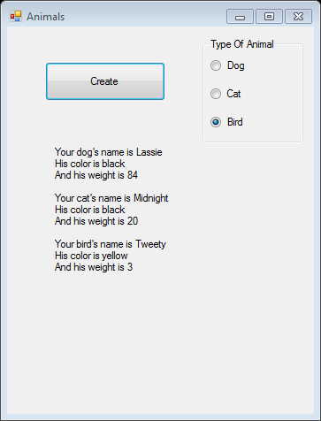
Output

