Slide 1
Objects and Classes: Inheritance
Programming II
North Carolina Department of Public Instruction

Slide 2
Review
Behavior is added to classes (and therefore objects that are instantiated from them) with methods.
A class can have as many methods as needed to provide the desired behavior.
Methods that have the same name but different parameter lists are said to be overloaded.

Slide 3
The Animals Project
Now think back to your Animals project.
Yesterday you added classes Cat and Bird that were essentially identical to the Dog class except for the sound they made.
This should have sent up a warning flag in your brain: repetition of code is always a sign that you probably have a design flaw.
So if having repetitious classes is a design flaw, how do you fix it?
Object-oriented languages provide a very elegant solution to this problem. It is called Inheritance.
Inheritance is the third pillar of object-oriented programming.
So what is it?

Slide 4
Inheritance
Inheritance is the ability to provide a superclass, master class, parent class, or base class (they are known by all of these names) from which other classes derive and get much of their state and behavior.
The base class is more general. The subclass (the one that derives from the base class) is more specific.
You can have multiple levels of inheritance.
The subclass gets all of its parent’s data and behavior (properties and methods), as well as whatever it adds to make the parent class more specific.

Slide 5
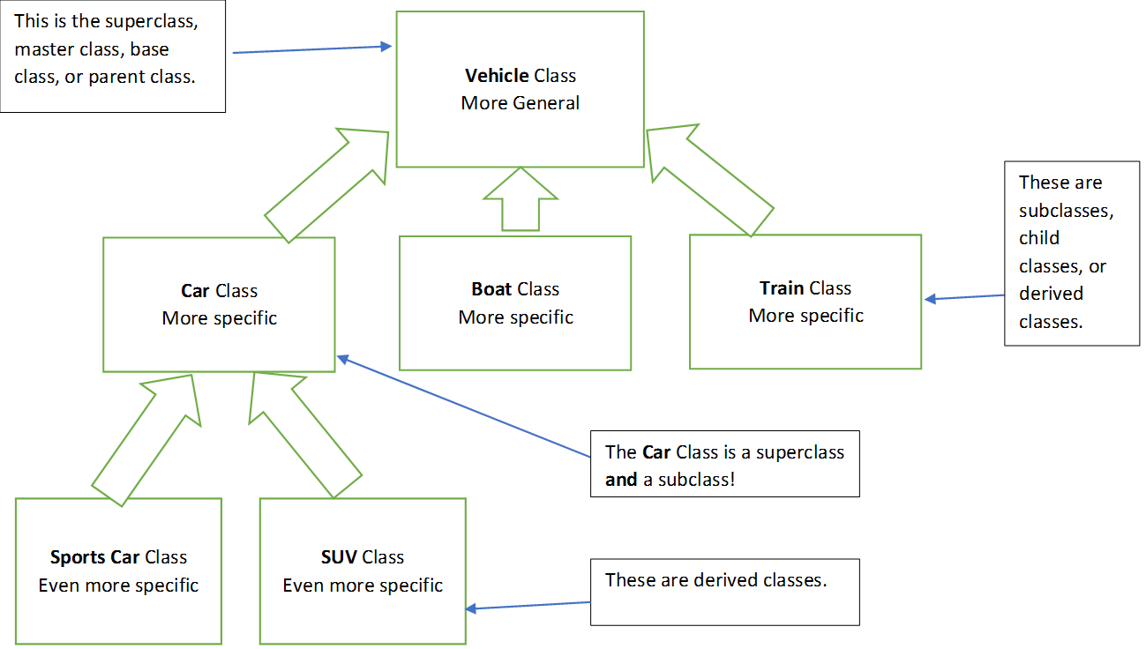
Sample Inheritance Diagram

Slide 6
Statements About the Inheritance Diagram
That sort of picture is called a class hierarchy.
In object-oriented systems, the arrows are drawn from child to parent. This is consistent with the Unified Modeling Language (UML) that is used industry-wide to describe systems.
As you move down the hierarchy, the classes become more specific. As you move up the hierarchy, the classes become more general.
As you move down the hierarchy, the classes become LARGER. Why? Because the children contain not only the data and behavior of the parent, but also whatever data and behavior the child adds to make it more specific.
You can check the validity of your class design, your hierarchy, with the “is-a” statement: can you say each child class “is-a” parent class? For example, with the previous diagram, does it make sense to say “A Sports Car is a Car”? “A Car is a Vehicle”? If this statement can be made about all of your parent/child relationships, then you have a valid design.

Slide 7
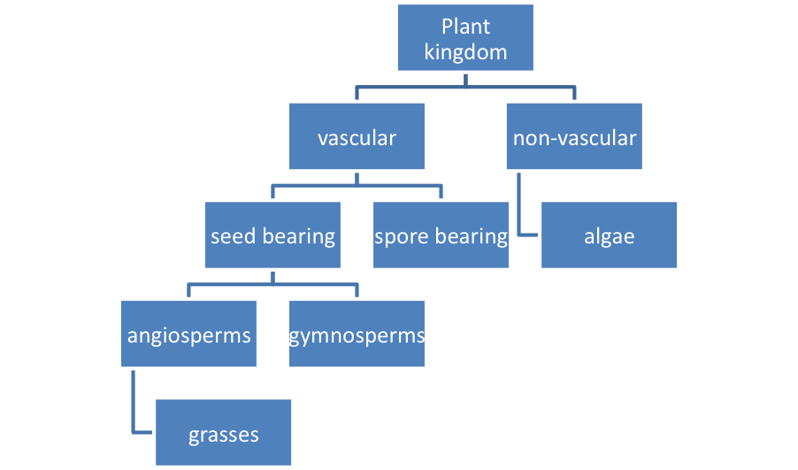
Another Class Hierarchy Example
Is this class hierarchy valid? Use the “is-a” test.

Slide 8
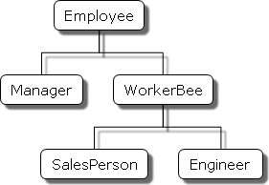
Another Class Hierarchy Example
Is this class hierarchy valid? Use the “is-a” test.

Slide 9
Inheritance Syntax
The syntax to make one class “inherit” from another is simply:
class Child : Parent
{ // contents of class omitted
}
The child class gets all the properties and methods of the parent.
It can add whatever new properties and methods it needs to make it more specific.
It can also override methods in the base (parent) class if the parent made the method virtual or abstract. (virtual indicates the child class can optionally override the method, whereas abstract means the child MUST override the method).

Slide 10
Inheritance Example: Shape Base Class
abstract class Shape // abstract keyword means this class
{ // cannot be instantiated
public string name {get; private set;} // allow the name to be retrieved and only set internally
public Shape( string name) // ctor
{
this.name = name;
}
public abstract double getArea(); // require child classes to implement getArea
public string getName() // provide a method to get the name (redundant)
{
return name;
}
}

Slide 11
Inheritance Example: Rectangle Child Class
class Rectangle : Shape // Rectangle inherits from abstract class Shape
{
public double width { get; set; } // declare two properties not in the base class
public double height { get; set; }
public Rectangle(double width, double height) : base("Rectangle") // call the “base” class ctor
{
this.width = width; // then initialize the properties we added
this.height = height;
}
public override double getArea() // getArea() was abstract so we are required to implement it
{ // with the “override” keyword
return width * height;
}
}

Slide 12
Inheritance Example: Circle Child Class
class Circle : Shape // inherit from Shape class
{
public double radius { get; set; } // declare one property not in the base class
public Circle(double radius) : base ("Circle") // make the ctor call the base class ctor
{
this.radius = radius;
}
public override double getArea() // provide an implementation for getArea()
{
return Math.PI * radius * radius;
}
public double getCircumference() // add a method not in the base class
{
return 2 * Math.PI * radius;
}
}

Slide 13
Inheritance Example: Using Shapes
private void btnCreate_Click(object sender, EventArgs e)
{
Rectangle rect = new Rectangle(5, 10);
lblOutput.Text = String.Format("You created a {0} with width {1} and height {2}. It has an area of {3}.\n", rect.getName(), rect.width, rect.height, rect.getArea());
Circle circ = new Circle(5);
lblOutput.Text += String.Format("You created a {0} with radius {1}. It has an area of {2}.\n", circ.getName(), circ.radius, circ.getArea());
}

Slide 14
Back to Animals
Now that you know about inheritance and what a proper class hierarchy looks like, how could you use this in your Animals program?
The answer is to make an Animal (not Animals with an “s”, that would collide with your project name) super class that includes all of the data and constructors needed to make a generic animal, then let Dog, Cat, and Bird inherit all of this, and then provide a method that is the only “distinguisher” between them – the sound they make (I know this is over simplification when it comes to real animals).
Your class hierarchy will look like the following.

Slide 15
Animal Class Hierarchy
Animal Class
Is this a valid class hierarchy? Does it pass the “is-a” test?
Dog Class
Cat Class
Bird Class

Slide 16
You do it!
Open your Animals project.
Create an abstract Animal class from which your other classes will derive:
abstract class Animal // abstract class cannot be instantiated
{
public string name { get; set; } // properties common to all animals
public string color { get; set; } // (oversimplification)
public double weight { get; set; }
public Animal(string name, string color, double weight) // provide only one ctor
{
this.name = name;
this.color = color;
this.weight = weight;
}
public abstract void MakeNoise(); // force child classes to implement a
} // MakeNoise() method with abstract keyword

Slide 17
You do it!
Modify your Dog, Cat, and Bird classes to inherit from Animal. Here is the Dog:
class Dog : Animal // inherit from Animal
{
public Dog() : this("","",0) { } // call the more complex ctor
public Dog (string name) : this(name, "",0) { } // call the more complex ctor
public Dog (string name, string color, double weight = 0) : base (name, color, weight) { } // call the base (Animal) ctor
public override void MakeNoise() // must use the override keyword
{
SoundPlayer simpleSound = new SoundPlayer(@"c:\Users\loakley\Downloads\CorrectDogBark.wav");
simpleSound.Play();
}
}

Slide 18
You do it!
Now make the same modifications to your Cat and Bird classes.
Your driver code (button click) should run unmodified.
Your output should look and sound the same as before.
Finished? Do the Shapes project that uses the abstract Shape class and Rectangle and Circle classes shown in this PowerPoint. Use the button click code provided to test your classes.

Slide 19
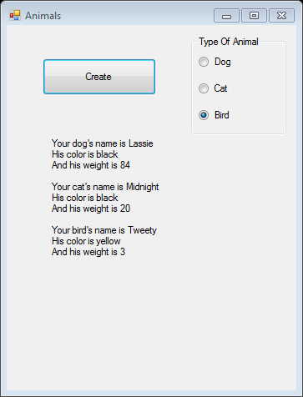
Animals Output

Slide 20
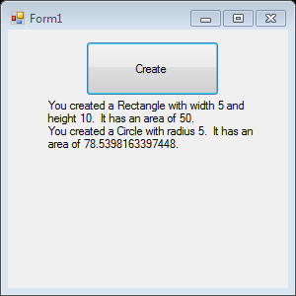
Shapes Output

