Slide 1




Skin Cancer (Melanoma) Detection Using Deep Learning Model
Team Members:
Arnob Chakraborty(0222210005101114)
Prottoy Dhar(0222210005101117)
Bristy Deb(0222210005101119)

Slide 2
Introduction
Melanoma is the deadliest skin cancer worldwide
Early detection can ensure up to 90% cure rate
Manual diagnosis is slow & subjective
Deep learning can improve accuracy
Need accurate automated system

Slide 3


Goals
Classify dermoscopic images as benign or malignant using:
Custom CNN
VGG16
MobileNetV2

Slide 4
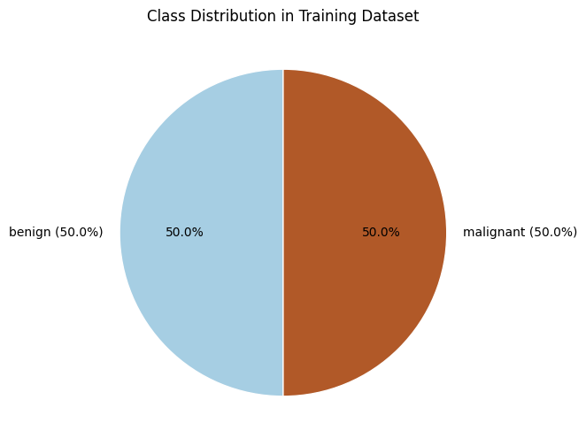
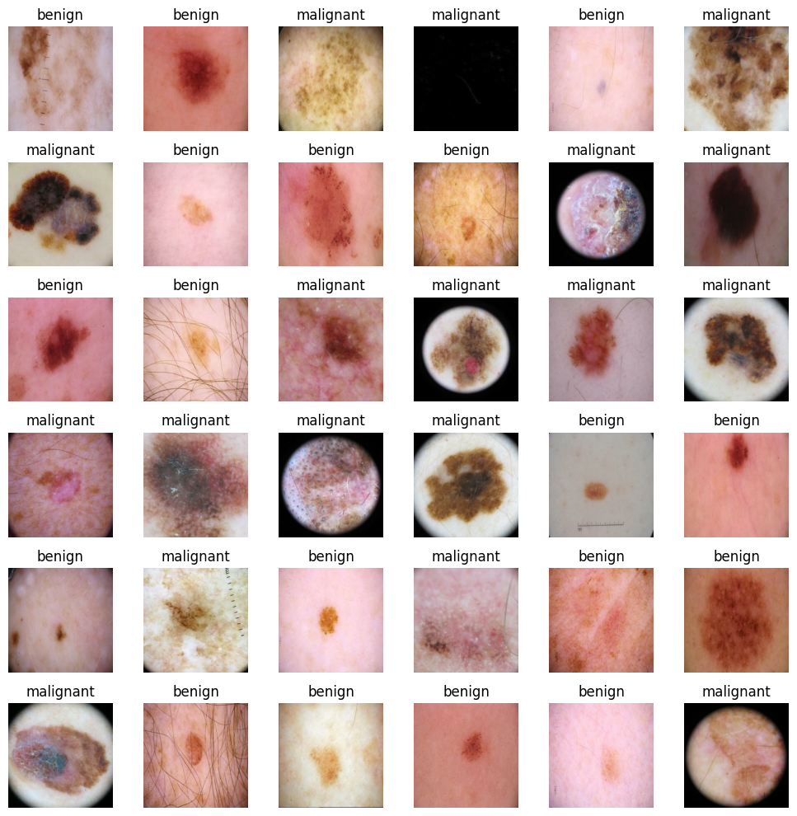
Dataset Overview
Originally 10,015 dermoscopic images
After subsampling → 1,200 images (balanced 50/50)
Image dimension standardized (224×224×3)
Sample Images :

Slide 5
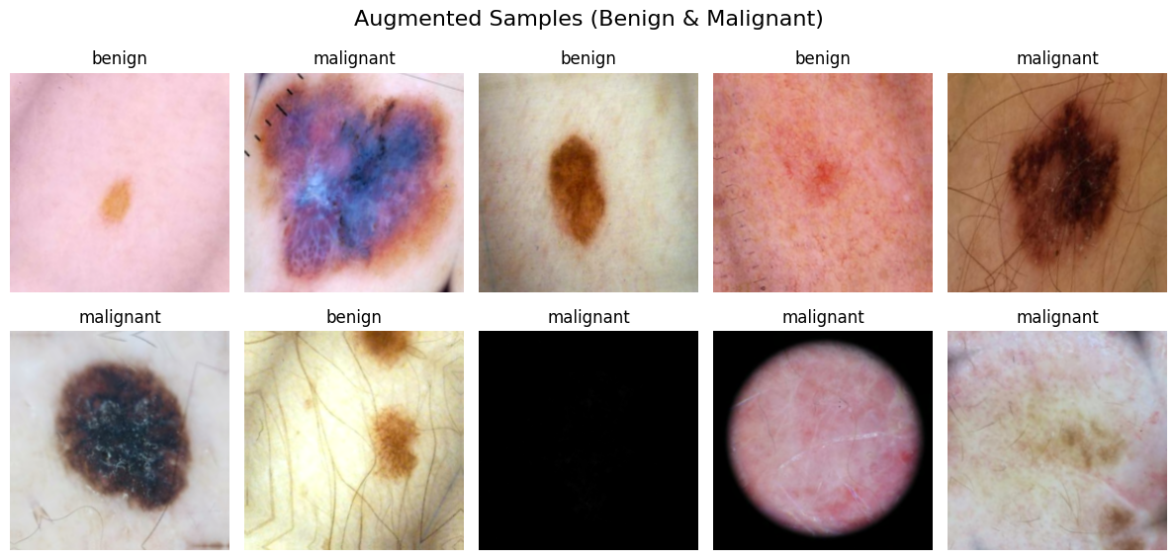
Preprocessing & Augmentation
Resizing
RGB normalization
Data augmentation (rotation, flip, zoom, etc.)
Class weighting to solve imbalance
Data Augmentation Sample Images :

Slide 6
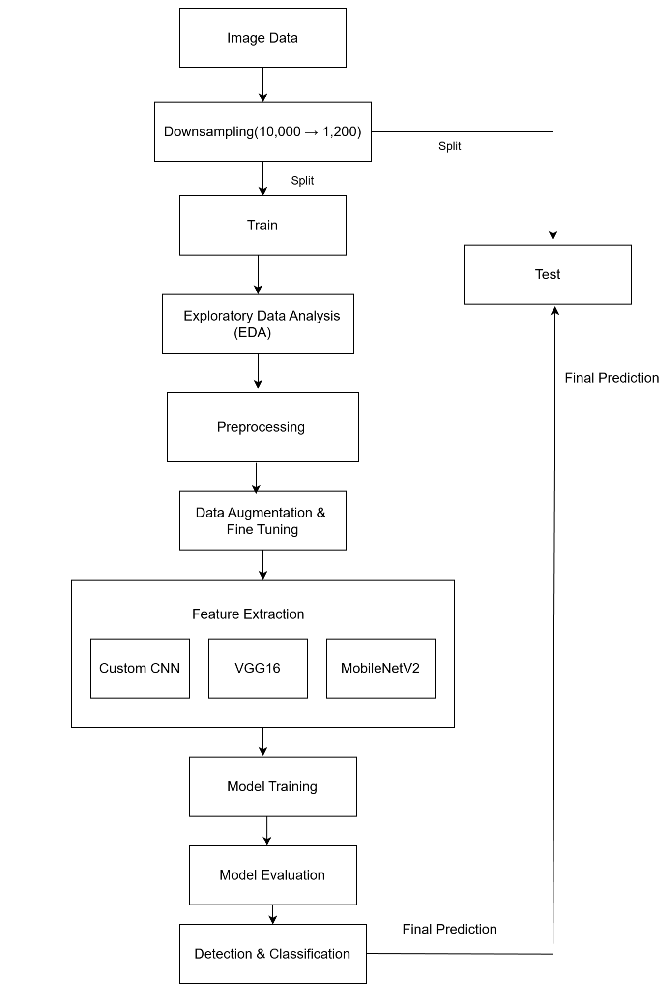
Workflow

Slide 7
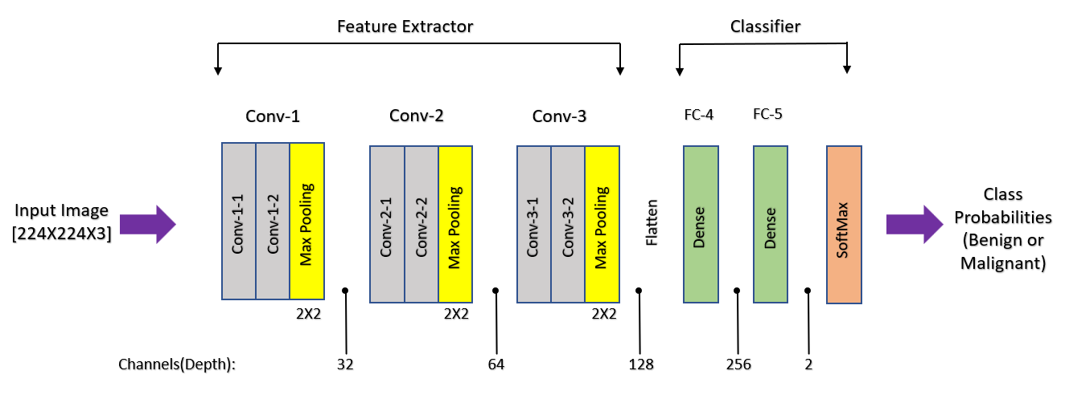
CNN Architecture

Slide 8
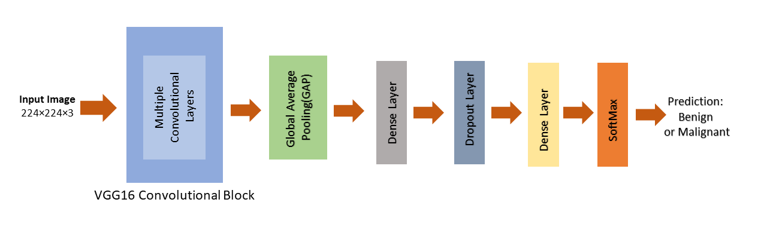
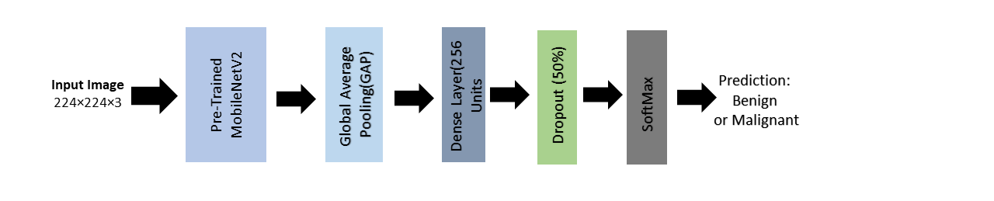
VGG16 Architecture
MobileNetV2 Architecture

Slide 9
Results (Accuracy Comparison)
Model | Accuracy
CNN | 84%
VGG16 | 87%
MobileNetV2 | 82%

Slide 10
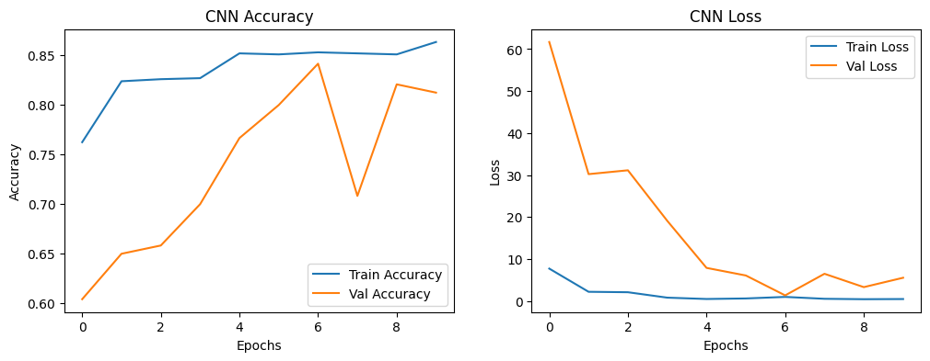
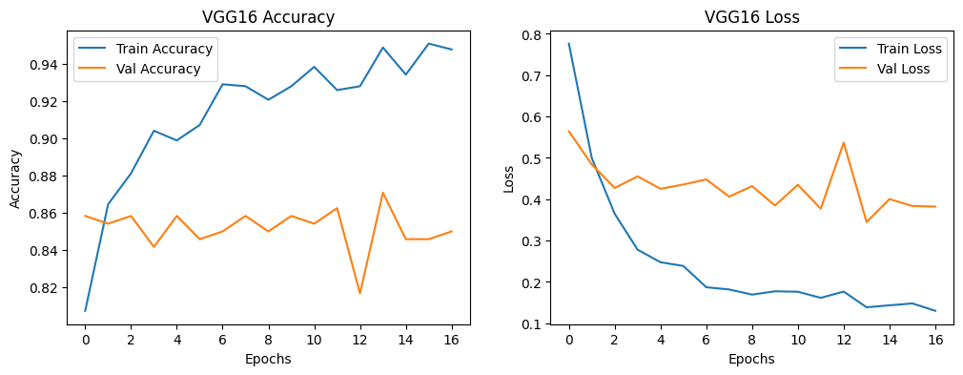
Learning Curves
CNN
CNN is slightly overfitting
VGG16
VGG16 shows most stable convergence

Slide 11
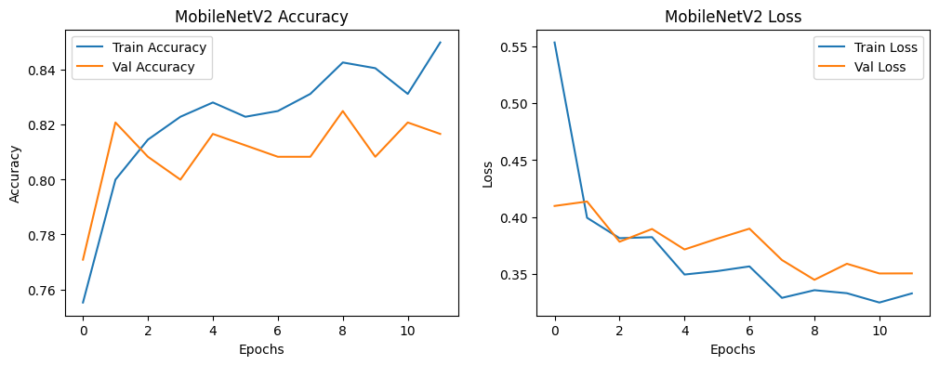
Learning Curves
MobileNetV2
Learning curve shows good stability but lower accuracy

Slide 12
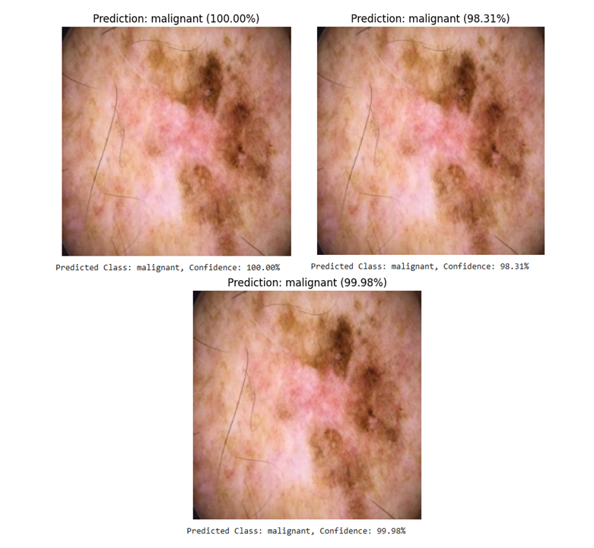
Final Prediction

Slide 13
Limitations
Small dataset (1,200 images)
Potential overfitting
Bias risk (skin tone, age, ethnicity)
Limited generalization
Need privacy & fairness

Slide 14
Future Work
Train on full HAM10000
Stronger augmentation
Domain-specific fine-tuning
Real clinical testing

Slide 15
Conclusion
All models classify melanoma successfully
VGG16 gives best accuracy(87%)
Deep learning can support early melanoma screening
Transfer learning is critical for small medical datasets
Model still needs real-world clinical validation

Slide 16
Thank You

