Slide 1

Session 1
Agenda
Intro to Git/GitHub
Agile
Project selection
Tasks ?

Slide 2
Introduction to Git and GitHub

Slide 3

Has this happened to you?

Slide 4
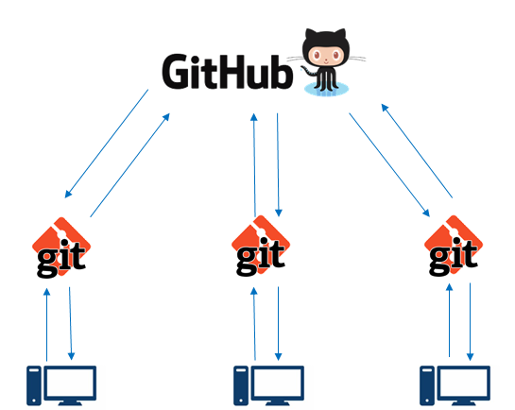
Git and GitHub allow for easy management and sharing of data analytic content

Slide 5


Difference between Git and GitHub
Version control system used on your computer
“Git manages the evolution of a set of files—called a repository or repo—in a sane, highly structured way. It is like the “Track Changes” feature from Microsoft Word, but more rigorous, powerful, and scaled up to multiple files” (Brian 2017)
Hosting service for git projects—essentially DropBox for git projects
Mainly used for collaboration and/or distributing code and software

Slide 6
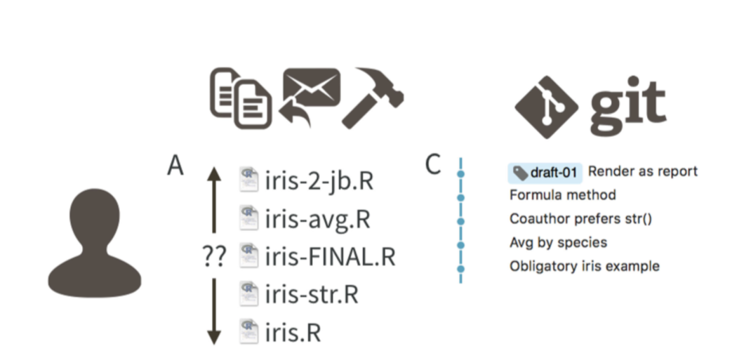
Git allows for tracking of a project through commit messages
Figure from Bryan (2017)

Slide 7
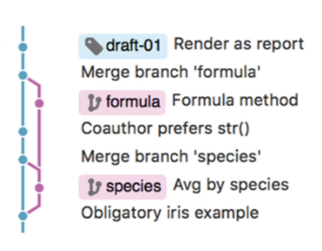
You can use branches when working as a team or on a new feature
Figure from Bryan (2017)

Slide 8
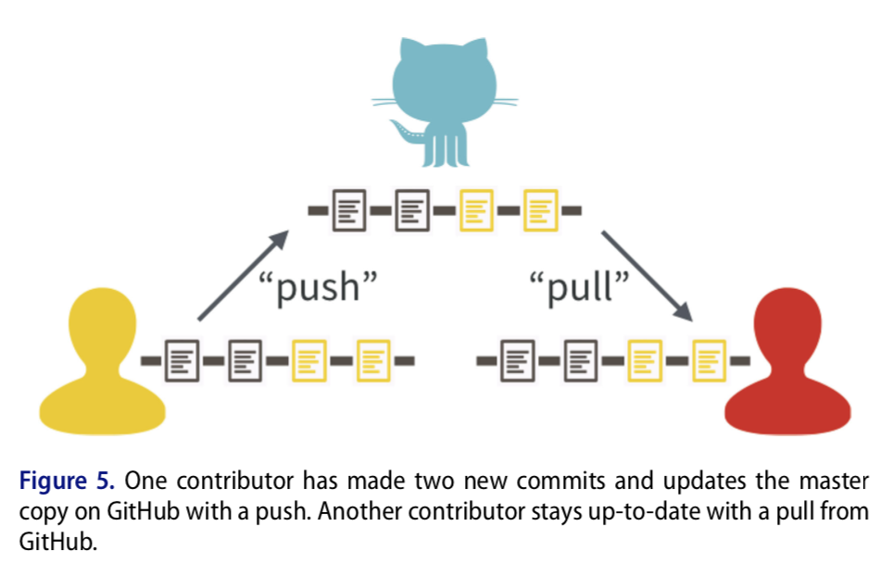
GitHub allows for easy collaboration on projects
Figure from Bryan (2017)

Slide 9
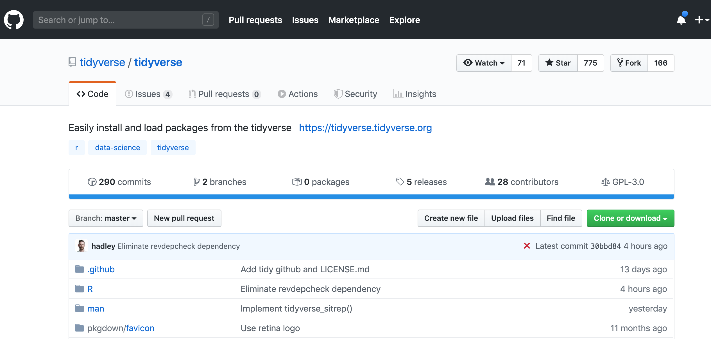
GitHub provides a great way to distribute software

Slide 10
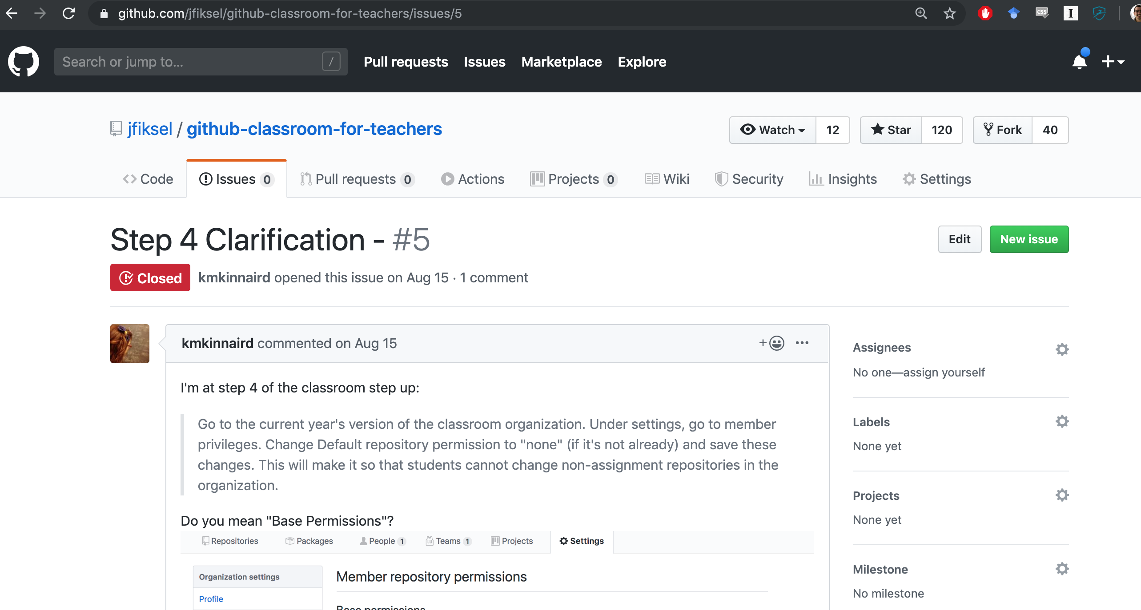
You can also submit issues if you’re having trouble with software

Slide 11
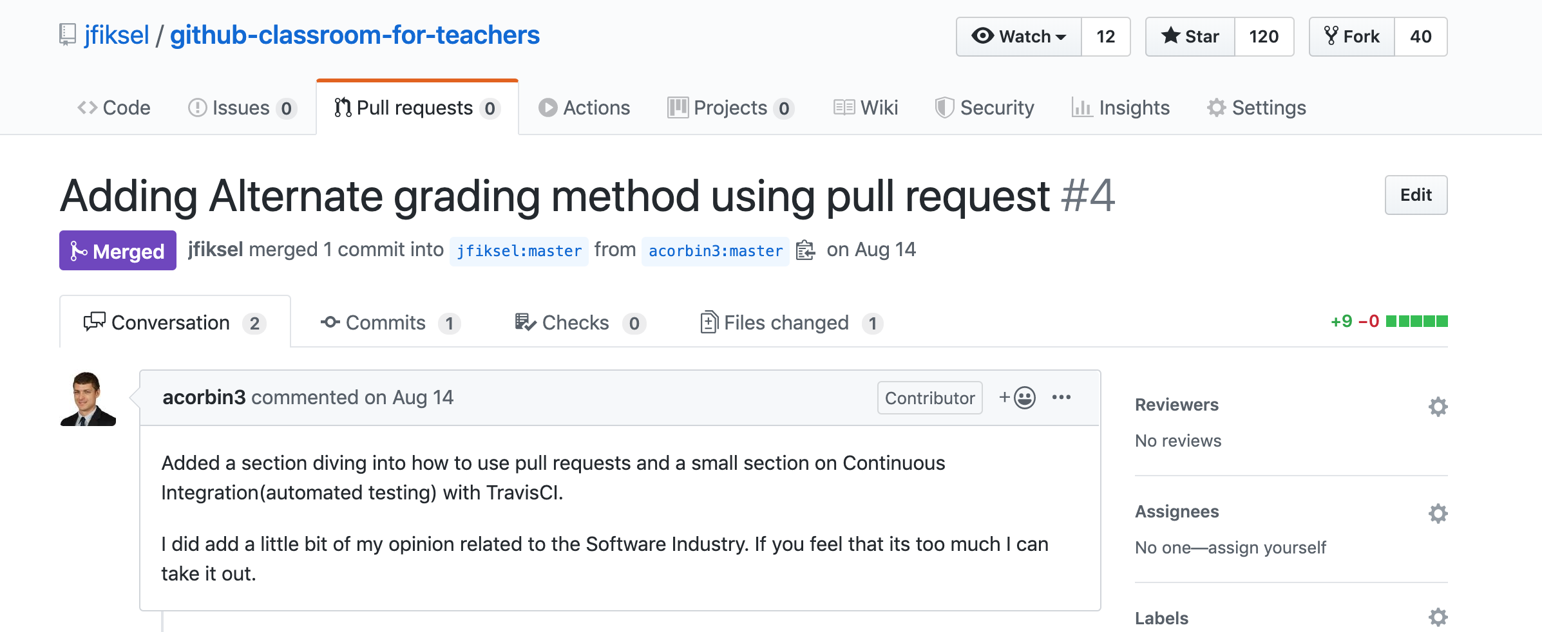
Pull requests allow you to collaborate on all public projects on GitHub!

Slide 12
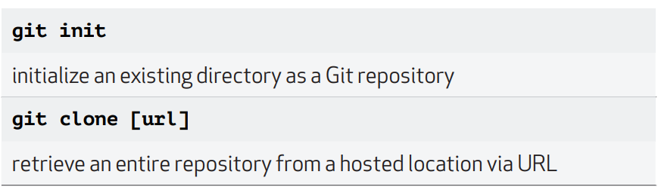
SETUP & INIT: Configuring user information, initializing and cloning repositories

Slide 13
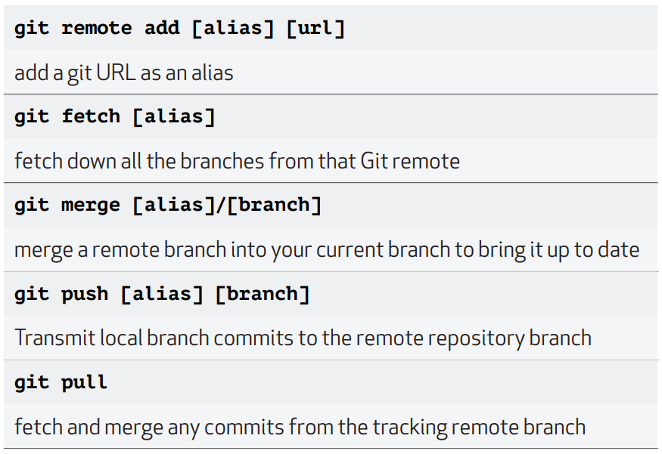
SHARE & UPDATE: Retrieving updates from another repository and updating local repos

Slide 14
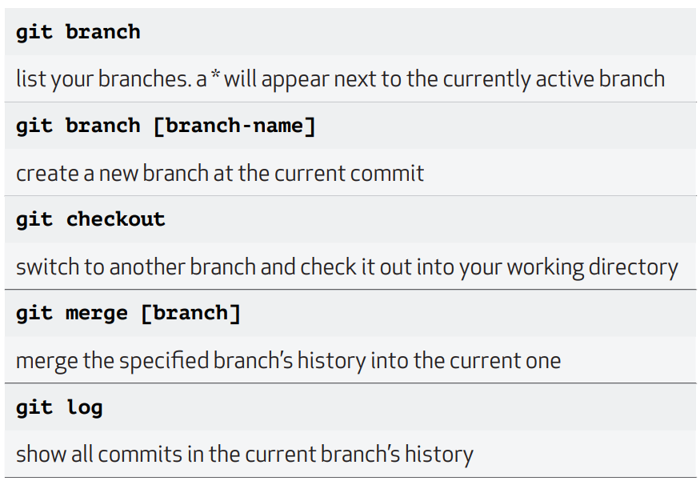
BRANCH & MERGE: Isolating work in branches, changing context, and integrating changes

Slide 15
References
https://happygitwithr.com/
Extremely useful tool for learning Git and GitHub—based off using R/RStudio for analyses
https://learngitbranching.js.org/
Can help you visualize the process of using Git
https://github.com/jfiksel/intro_to_git_and_github
Presentation link
Cheatsheet

