Slide 1
RedBiT
An Open-Source Chat Platform
Developers: Horváth Péter István, Debreczeni Alex János, Szigetvári Kevin István

Slide 2

About RedBit
A fully open-source chat project.
Developed as a school project.
Minimal data collection.
Full transparency about data handling.

Slide 3


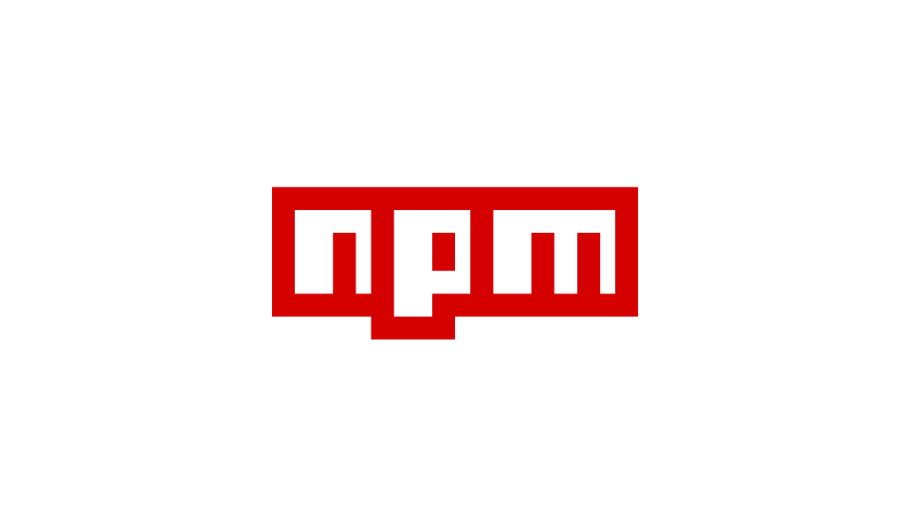

Technologies
Meta Framework: Nuxt.js
Database ORM: Prisma
Package Manager: NPM
Mailing: Google SMTP

Slide 4

Main Navigation - Homepage
Access: https://redbit.netlify.app/
Main Navigation Menu:
  Home
  About
  Contacts
  Chat

Slide 5
Overview - HomePAge
Homepage Overview:
  Slogan section
  Features
  Highlights
  Developer Team
  Packages list

Slide 6
Main Navigation – Chat Page
Dynamic Navigation Panel:
  Server Selector:
  Chat Selector
  User Information & Settings

Slide 7
Overview – Chat page
Homepage Overview:
  Header
  Sidebar
  Main content area(chat)

Slide 8
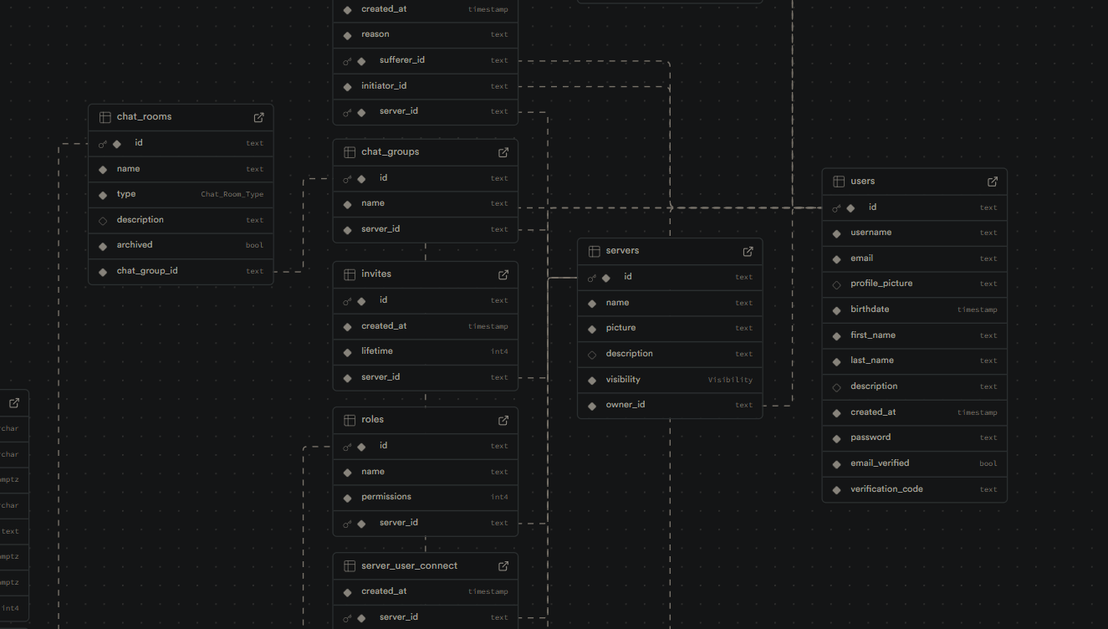
Database & Hosting
Database ORM: Prisma.io
Schema Location: /prisma/schema.prisma
Deployed on Supabase

Slide 9
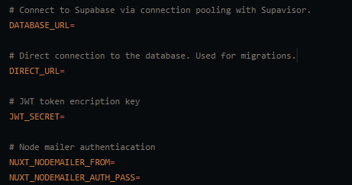
Envierment variables
Environment Variables:
DATABASE_URL
DIRECT_URL
JWT_
NUXT_NODEMAILER_FROM,
NUXT_NODEMAILER_AUTH_

Slide 10
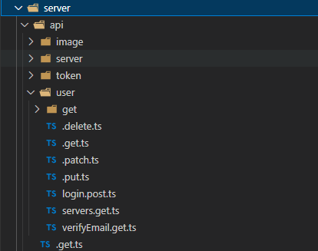
Api
Authorization: Most Endpoints header with a valid access token.
File based routing: /api/user/.get.ts
Responses are standard responses types
Made with nuxt built in beckend soulution

Slide 11
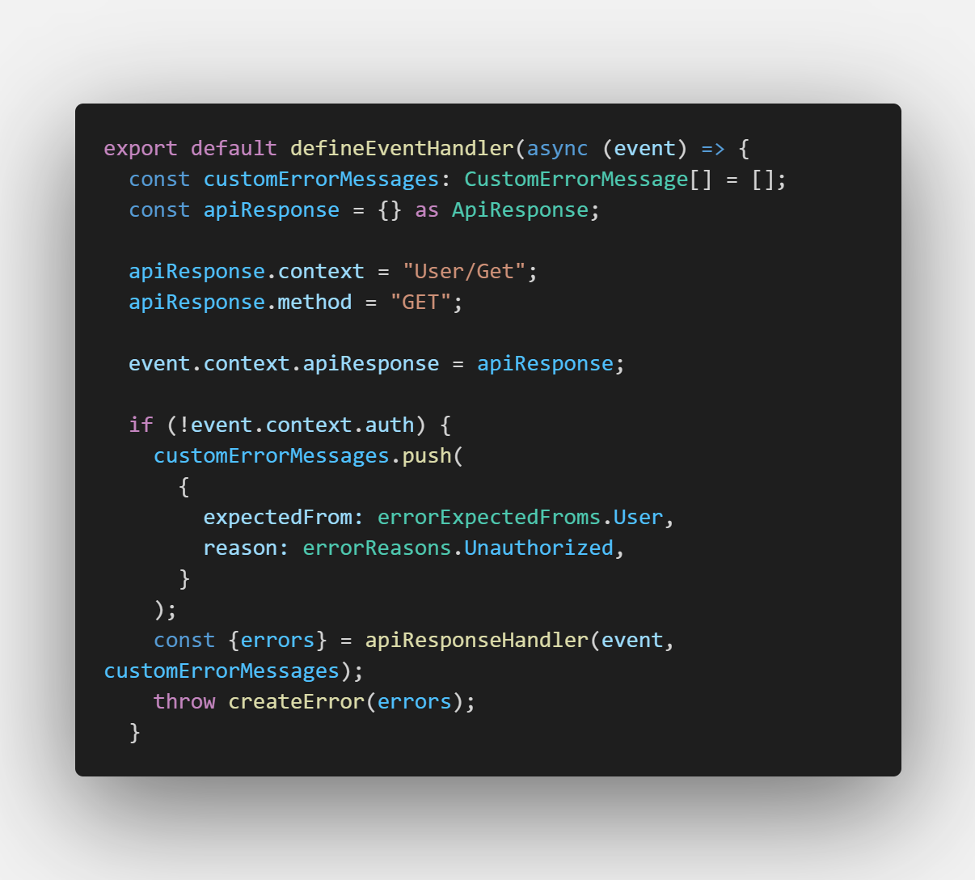
API Endpoints (Examples)
User Registration:/api/user.put.ts (creation, field validation)
User Login: /api/user/login.post.ts (authentication)
Get User Data: /api/user/ (authorized user data)
Server Creation: /api/server.put.ts

Slide 12
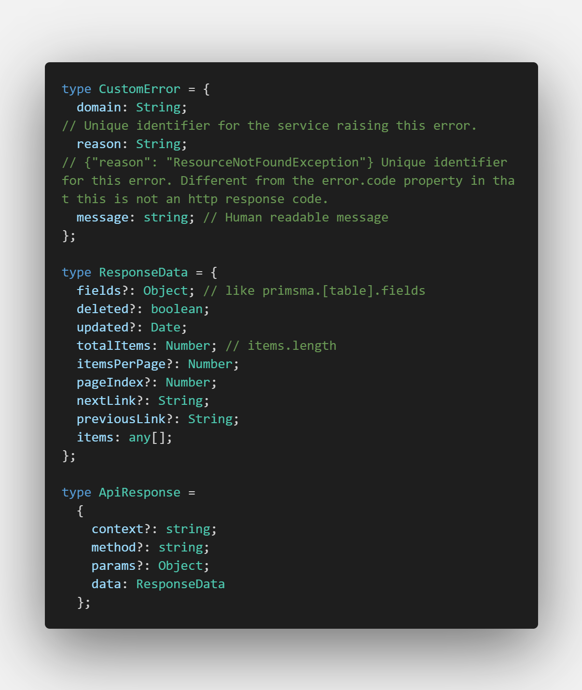
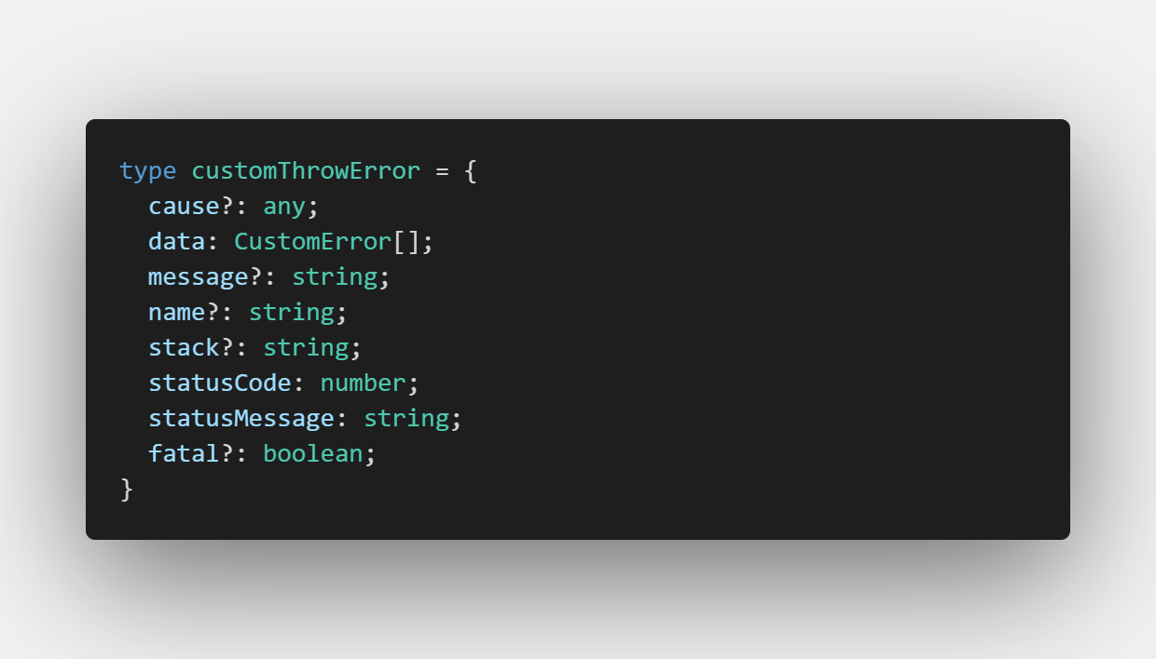
Api response
Api response type
Error type

