Slide 1
Blockchain Interoperability
Cross-chain Oracles
Matthieu BETTINGER

Slide 2
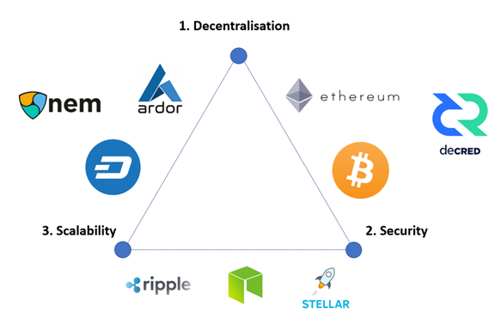
Context: Blockchain Interoperability
Solution silos, no Silver Bullet
Custom needs
→ Heterogeneous integration
Slow emergence of interop. solutions
The Blockchain Trilemma
— Figure by Pedro Febrero, Coinrivet

Slide 3


RedChainLab
Sidechain scalability;
Trusted Execution Environments (TEE);
...
X

Slide 4
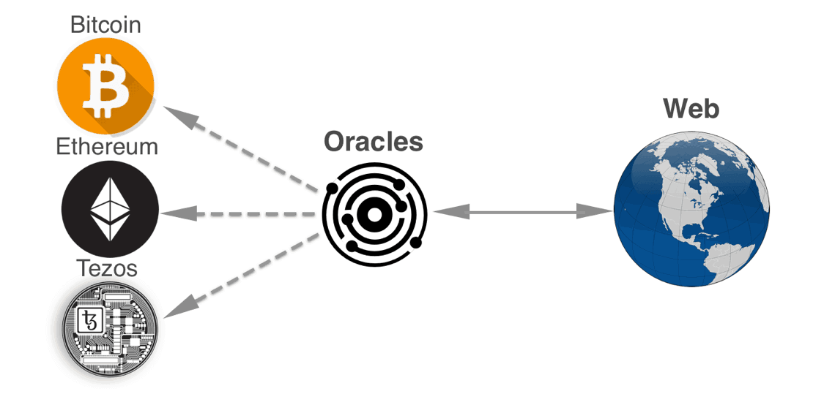
Oracles
Connection between blockchains and the world
  Source of trustable information
    → Decentralised and/or Attested Computations
https://themoneymongers.com/blockchain-oracles/

Slide 5
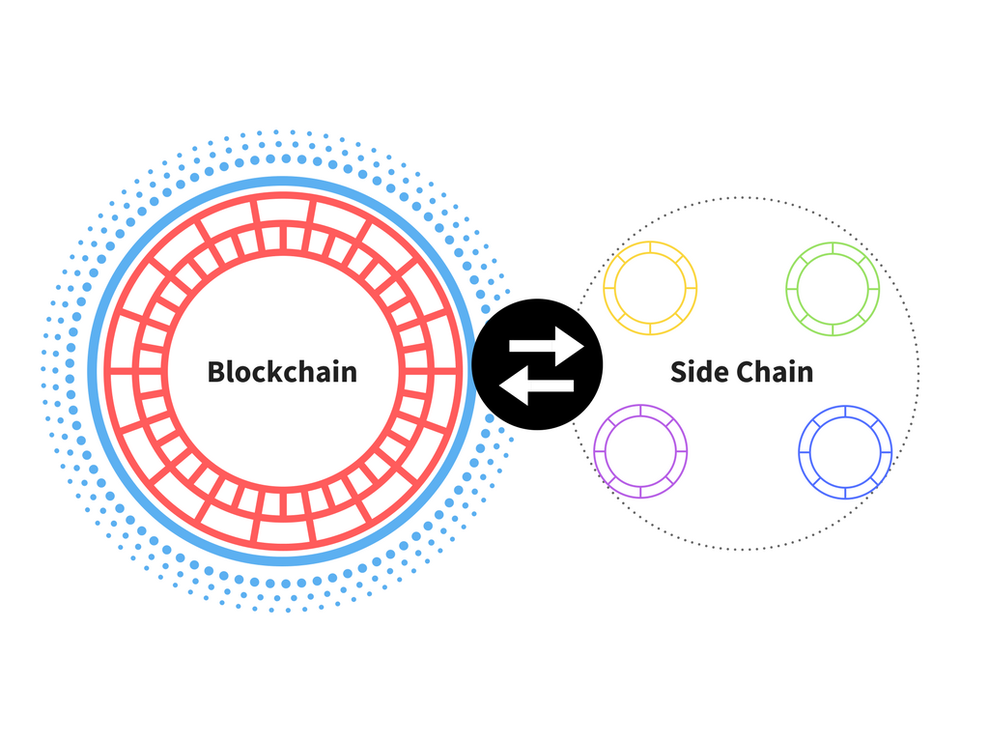
Identified Problem
Costs of trustable oracles on mainchains
→ Computation in sidechains
  + Lower costs, better throughput
  – Isolated information
How to transfer data in a low-cost and trustable way ?
https://blockgeeks.com/guides/blockchain-wiki/

Slide 6
Proposed Solution
Low-cost Cross-chain oracles with TEEs
  Efficient information creation on sidechains
  Trust-preserving data transfer to other chains

Slide 7
Key Concepts
Blockchain bridges : intercommunication
Data replication : what, when, where ?
Chain of trust : Integrity, points of failure

Slide 8
Planning
State of the Art:
Blockchain
interoperability
March
Relevant
subfields for
contribution
Use case
definition
Perimeter
Definition/
Analysis
SotA
Existing solutions
/Related topics
April
Experimental
protocol
SotA of Building Blocks:
e.g. integrity properties,
attacks with impacts on trust
Design points
May/June
June
→ Sept.
Implementation
Formal Proofs:
Integrity, Trust preservation
Evaluation
Less assumptions / More satisfied properties

Slide 9
Blockchain Interoperability
Cross-chain Oracles
Matthieu BETTINGER

