Slide 1
EARTHQUAKE
MADE BY –LAIBAH RAHMAN

Slide 2
The biggest earthquake in history
1. 1960 Valdivia earthquake.
2. 2011 Tohoku earthquake and tsunami.
3. 2004 Indian ocean earthquake and tsunami.
4. 1964 Alaska earthquake .

Slide 3
How do earthquakes happen ?
Earthquakes happen when two tectonic plates ride past each other in the earth`s crust. When planets move the rocks extends or squeezed until it splinters .This squeezing and stretching are what causes the ground to shake and progress.

Slide 4
SOME FACTS ABOUT EARTHQUAKES
Earthquakes usually happen on the edge of tectonic plates.
Earthquakes occur when the plates get stuck but keep trying to move .
Before earthquake foreshocks might occur .
After an earthquake aftershocks are likely to happen.

Slide 5
How many people died in recent earthquake ?
The figures are unfathomable :47,000 people died ,thousands of other missing ,millions of homeless . In minutes , two massive earthquake that rocked in Turkey and Syria turned entire cities into mounds of rubble . Two weeks later ,the scale of the devastation is still being unearthed .

Slide 6
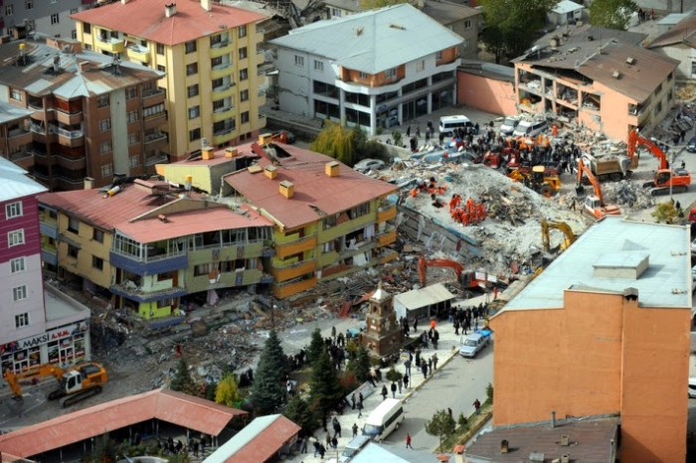
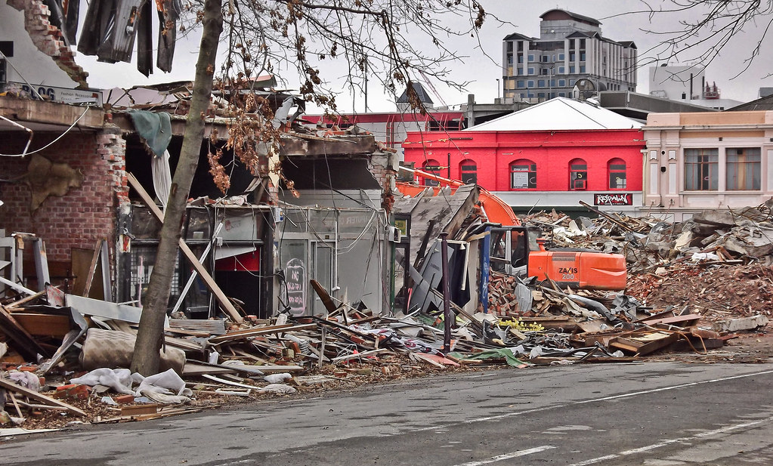
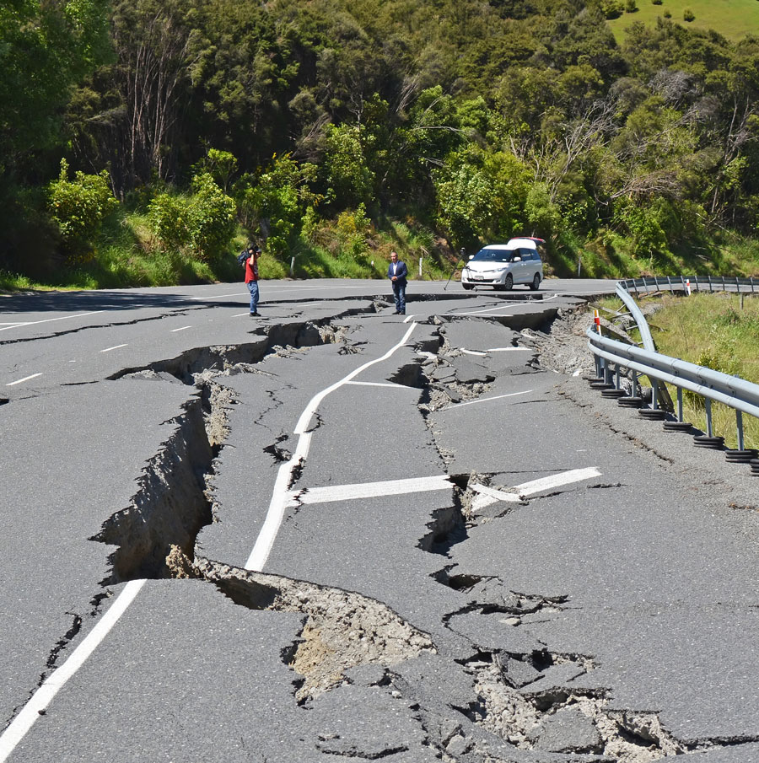
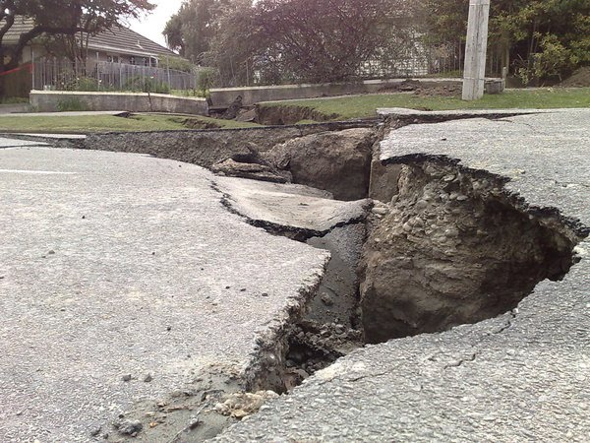
HERE ARE SOME PICTERS
This Photo by Unknown Author is licensed under CC BY-SA-NC
This Photo by Unknown Author is licensed under CC BY-NC-ND

Slide 7

THANK YOU FOR LISTENING
This Photo by Unknown Author is licensed under CC BY

