Slide 1

Java Persistence Api
JSR-317

Slide 2
JPA это не HIBERNATE!
HIBERNATE это не JPA!

Slide 3
Занимается
Поддержка сохранности данных, предоставляемая JPA, покрывает области:
непосредственно API, заданный в пакете javax.persistence;
платформо-независимый объектно-ориентированный язык запросов Java Persistence Query Language;
метаинформация, описывающая связи между объектами.
Генерация DDL для сущностей

Slide 4


SQL query
Result Set
JPA
PROVIDER
Object
Entity class

Slide 5
Entity (Сущность) — POJO-класс, связанный с БД с помощью аннотации (@Entity) или через XML.
К такому классу предъявляются следующие требования:
Должен иметь пустой конструктор (public или protected)
Не может быть вложенным, интерфейсом или enum
Не может быть final и не может содержать final-полей/свойств
Должен содержать хотя бы одно @Id-поле
При этом entity может:
Содержать непустые конструкторы
Наследоваться и быть наследованным
Содержать другие методы и реализовывать интерфейсы
Entities могут быть связаны друг с другом (один-к-одному, один-ко-многим, многие-к-одному и многие-ко-многим).
Объект по отношению к БД находится в одном из состояний:
Persist Detached Transient

Slide 6
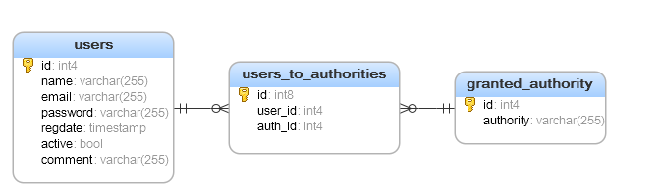

Slide 7
@Entity @Table(name = "users") public class UserEntity implements IdentifiableEntity{ @Id @GeneratedValue(strategy = GenerationType.IDENTITY) @Column(name="id") private Integer id; @Column(name="password") private String password; @ManyToMany(fetch = FetchType.EAGER, cascade = CascadeType.ALL) @JoinTable(name = "users_to_authorities", joinColumns = @JoinColumn(name = "user_id"), inverseJoinColumns = @JoinColumn(name = "auth_id")) private List<GrantedAuthorityEntity> authorities; @Column(name="regdate") private Date regdate; @Column(name="active") private boolean active; @Column(name="comment") private String comment; }

Slide 8


Slide 9
select userentity0_.id as id1_1_0_, userentity0_.active as active2_1_0_, userentity0_.comment as comment3_1_0_, userentity0_.email as email4_1_0_, userentity0_.name as name5_1_0_, userentity0_.password as password6_1_0_, userentity0_.regdate as regdate7_1_0_, authoritie1_.user_id as user_id1_2_1_, grantedaut2_.id as auth_id2_2_1_, grantedaut2_.id as id1_0_2_, grantedaut2_.authority as authorit2_0_2_ from users userentity0_ left outer join users_to_authorities authoritie1_ on userentity0_.id=authoritie1_.user_id left outer join granted_authority grantedaut2_ on authoritie1_.auth_id=grantedaut2_.id where userentity0_.id=2

Slide 10
Select userentity0_.id as id1_1_0_, userentity0_.active as active2_1_0_, userentity0_.comment as comment3_1_0_, userentity0_.email as email4_1_0_, userentity0_.name as name5_1_0_, userentity0_.password as password6_1_0_, userentity0_.regdate as regdate7_1_0_, authoritie1_.user_id as user_id1_2_1_, grantedaut2_.id as auth_id2_2_1_, grantedaut2_.id as id1_0_2_, grantedaut2_.authority as authorit2_0_2_ from users userentity0_ left outer join users_to_authorities authoritie1_ on userentity0_.id=authoritie1_.user_id left outer join granted_authority grantedaut2_ on authoritie1_.auth_id=grantedaut2_.id where userentity0_.id=2

Slide 11
Select userentity0_.id as id1_1_0_, userentity0_.active as active2_1_0_, userentity0_.comment as comment3_1_0_, userentity0_.email as email4_1_0_, userentity0_.name as name5_1_0_, userentity0_.password as password6_1_0_, userentity0_.regdate as regdate7_1_0_, authoritie1_.user_id as user_id1_2_1_, grantedaut2_.id as auth_id2_2_1_, grantedaut2_.id as id1_0_2_, grantedaut2_.authority as authorit2_0_2_ from users userentity0_ left outer join users_to_authorities authoritie1_ on userentity0_.id=authoritie1_.user_id left outer join granted_authority grantedaut2_ on authoritie1_.auth_id=grantedaut2_.id where userentity0_.id=2

Slide 12
Select userentity0_.id as id1_1_0_, userentity0_.active as active2_1_0_, userentity0_.comment as comment3_1_0_, userentity0_.email as email4_1_0_, userentity0_.name as name5_1_0_, userentity0_.password as password6_1_0_, userentity0_.regdate as regdate7_1_0_, authoritie1_.user_id as user_id1_2_1_, grantedaut2_.id as auth_id2_2_1_, grantedaut2_.id as id1_0_2_, grantedaut2_.authority as authorit2_0_2_ from users userentity0_ left outer join users_to_authorities authoritie1_ on userentity0_.id=authoritie1_.user_id left outer join granted_authority grantedaut2_ on authoritie1_.auth_id=grantedaut2_.id where userentity0_.id=2

Slide 13
Select userentity0_.id as id1_1_0_, userentity0_.active as active2_1_0_, userentity0_.comment as comment3_1_0_, userentity0_.email as email4_1_0_, userentity0_.name as name5_1_0_, userentity0_.password as password6_1_0_, userentity0_.regdate as regdate7_1_0_, authoritie1_.user_id as user_id1_2_1_, grantedaut2_.id as auth_id2_2_1_, grantedaut2_.id as id1_0_2_, grantedaut2_.authority as authorit2_0_2_ from users userentity0_ left outer join users_to_authorities authoritie1_ on userentity0_.id=authoritie1_.user_id left outer join granted_authority grantedaut2_ on authoritie1_.auth_id=grantedaut2_.id where userentity0_.id=2

Slide 14
|---------|-------------|--------------|-------------|-----------|---------------|------------------------|--------------|--------------|---------|---------------| |id1_1_0_ |active2_1_0_ |comment3_1_0_ |email4_1_0_ |name5_1_0_ |password6_1_0_ |regdate7_1_0_ |user_id1_2_1_ |auth_id2_2_1_ |id1_0_2_ |authorit2_0_2_ | |---------|-------------|--------------|-------------|-----------|---------------|------------------------|--------------|--------------|---------|---------------| |2 |true |NEWCOMMENT |test@mail.ru |NAME |PASS |2017-09-07 16:51:30.444 |2 |2 |2 |ROLE_TEST | |---------|-------------|--------------|-------------|-----------|---------------|------------------------|--------------|--------------|---------|---------------| UserEntity( id=2, name=NAME, email=test@mail.ru, password=PASS, authorities=[GrantedAuthorityEntity( id=2, authority=ROLE_TEST)], regdate=2017-09-07 16:51:30.444, active=true, comment=NEWCOMMENT)

Slide 15
Entity Table Id Generated value Sequence generator Column Temporal Enumerated JoinTable JoinColumn One to one One to many Many to one Many to many Eager Lazy All Persist Merge Remove Refresh NamedNativeQuery

Slide 16
Статьи: Шпаргалка по JPA и Hibernate: https://habrahabr.ru/post/265061/ Стратегии загрузки JPA: https://dou.ua/lenta/articles/jpa-fetch-types/ Persist vs merge: http://cor-win.blogspot.com/2012/04/jpa-20-persist-vs-merge.html Стратегии загрузки Hibernate: https://dou.ua/lenta/articles/hibernate-fetch-types/

Slide 17
Для самостоятельного прочтения: Транзакции в JPA Database thread pools и их производительность: C3P0 pool, Zaxxar HikariCP, DBCP Hibernate как JPA provider JPQL, HQL, TQL Spring Data Jpa

Slide 18
Спасибо за внимание!

Slide 19
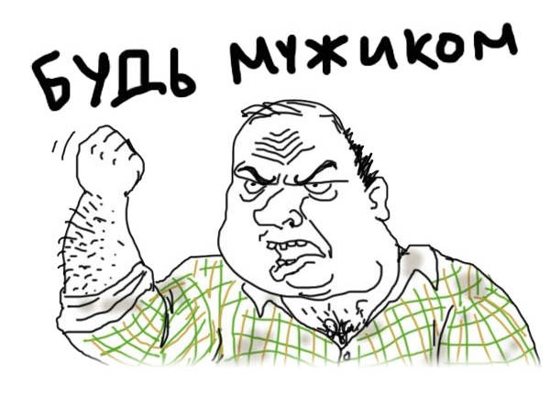
ПИШИ СВОЙ ORM!

