Slide 1

Data Structures
Lecture 12: Parallel Programming with OpenMP

Slide 2

Parallel Programming
Parallel computing is a form of computation that allows many instructions in a program to run simultaneously, in parallel.
In order to achieve this, a program must be split up into independent parts so that each processor can execute its part of the program simultaneously with the other processors.
Parallel computing can be achieved on a single computer with multiple processors, a number of individual computers connected by a network or a combination of the two.
Parallel computing has become very interesting lately due to the availability of multi-core3 and multi-processor computers at a reasonable price for the average consumer
Why Parallelism ?
Reduce the amount of time an algorithm takes.
Notes:
Why stacks?

Slide 3
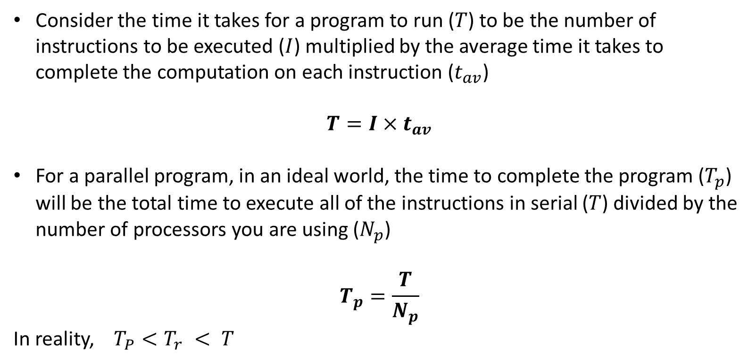
Parallelism Efficiency (1)
Notes:
Why stacks?

Slide 4
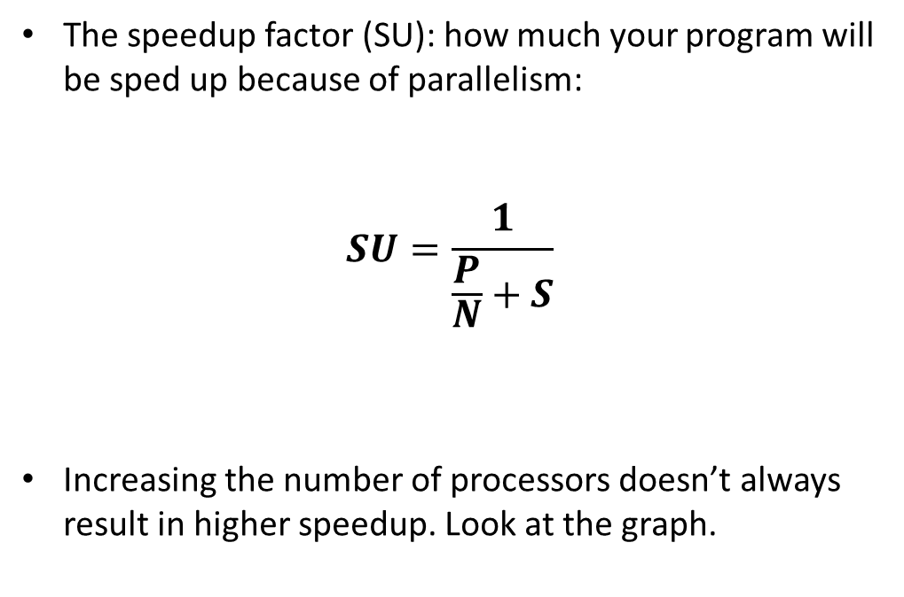
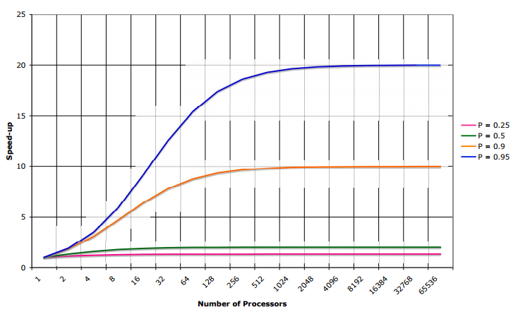
Parallelism Efficiency (2)
SU: speedup
P: the parallel part in percentage
N: number of parallel processors
S: the serial part in percentage
Notes:
Why stacks?

Slide 5
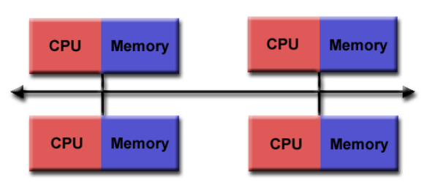
Distributed Memory
In a distributed memory configuration, each processor has its own local memory and is connected to the other processors by some kind of network.
The advantage of using a distributed memory parallelisation is that the memory is scalable.
If you increase the number of processors, the size of the memory available also increases.
The disadvantage is that it can be quite difficult to write a distributed memory parallel program and a program can not easily be made parallel after it has been written in
Notes:
Why stacks?

Slide 6
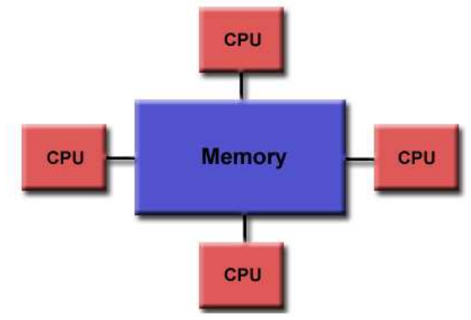
Shared Memory
In a shared memory configuration, each processor has direct access to the global memory.
This configuration allows multiple processors to operate independently while still having access to all the same memory resources.
The advantages of using a shared memory parallelization is that it is relatively simple to make existing serial codes parallel.
The disadvantages: bottleneck because of multiple processors sharing memory, making sure the data is safe because it can be accessed concurrently.
Notes:
Why stacks?

Slide 7
OpenMP
OpenMP (Open Multi-Processing) was first released in 1997 and is a standard Application Programming Interface (API) for writing shared memory parallel applications in C, C++ and Fortran.
OpenMP has the advantages of being very easy to implement on currently existing serial codes and allowing incremental parallelisation
Notes:
Why stacks?

Slide 8
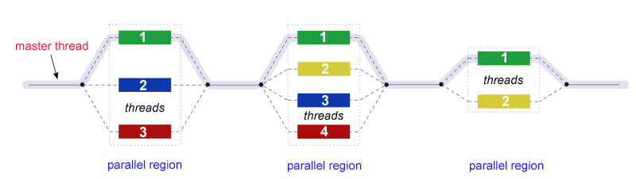
Fork-Join Model
OpenMP uses the fork-join model of parallel execution:
All OpenMP programs begin as a single process: the master thread. The master thread executes sequentially until the first parallel region construct is encountered.
FORK: the master thread then creates a team of parallel threads.
The statements in the program that are enclosed by the parallel region construct are then executed in parallel among the various team threads.
JOIN: When the team threads complete the statements in the parallel region construct, they synchronize and terminate, leaving only the master thread.
The number of parallel regions and the threads that comprise them are arbitrary.
Reference: https://computing.llnl.gov/tutorials/openMP/
Notes:
Why stacks?

Slide 9

OpenMP Example (1)
#include <iostream>
#include "omp.h"
using namespace std;
int main(){
omp_set_num_threads(3);
#pragma omp parallel{
int ID = omp_get_thread_num();
printf("Hello (%d) ", ID);
printf("World (%d) ", ID);
}
}
The parallel region is placed between the directive #pragma omp parallel {...}.
The runtime library function omp get thread num() returns the thread ID to the program.
omp_set_num_threads creates a number of threads run inside a program.
This program will essentially created three threads and make them run the parallel block at the same time.
sample output
Reference: http://www.openmp.org/mp-documents/omp-hands-on-SC08.pdf
Notes:
Why stacks?

Slide 10
OpenMP Example (2)
#include <iostream>
#include "omp.h"
using namespace std;
int main(){
#pragma omp parallel num_threads(3){
int ID = omp_get_thread_num();
printf("Hello (%d) ", ID);
printf("World (%d) ", ID);
}
}
You can specify the number of threads here
sample output
Reference: http://www.openmp.org/mp-documents/omp-hands-on-SC08.pdf
Notes:
Why stacks?

Slide 11
Private and Shared Variables (1)
Inside a parallel region of a program, variables can either be shared or private or default.
shared(list)
private(list)
default(shared|none)
Default Clause
The Default clause allows the user to specify the default scope for all of the variables in the parallel region.
The above declarations state that all the variables in the parallel region are private apart from variables a and b that are shared.
#pragma omp parallel default(private), shared(a,b)
Notes:
Why stacks?

Slide 12
Private and Shared Variables (2)
Shared Variables
If you declare the variable list as shared ( shared(list) )
All variables in list will be considered shared.
shared(list)
private(list)
default(shared|none)
Private Variables
If you declare the variable list as variable ( private(list) )
No other openmp thread has access to this ”private” copy
By default most variables are considered shared in OpenMP. Exceptions include index variables and variables declared inside parallel region.
Notes:
Why stacks?

Slide 13
Private and Shared Variables (3)
THREADS
ID
THREADS
ID
THREADS
ID
THREADS
ID
The memory is (logically) shared by all the cpu's.
There is also private memory for every openmp thread.
shared variables ”threads” and ”id” still exist, but every thread also has a private copy of variables”threads” and ”id”. There will not be any race condition for these private variables
Thread 0
Thread 1
Thread 2
Thread 3
var: THREADS
var: ID
shared memory
Notes:
Why stacks?

Slide 14

What Can We Parallelize?
for (i = 1; i<n; i++){
a[i] = 2 * a[i - 1];
}
for (i = 1; i<n; i++){
b[i] = (a[i] - a[i - 1]) * 0.5;
}
NO
YES
a(i) depends on a(i-1), so it can not be parallelized.
In this case, all of the iterations are independent so it is possible to make this loop parallel.
Notes:
Why stacks?

Slide 15
Announcement
Coding Sessions started yesterday. Good Engagement.
Project 2 was extended until April 9.
Project 3 was announced. It is due on May 4.
Notes:
Why stacks?

Slide 16
Parallelizing a for loop (1)
OpenMP has the construct openmp parallel for, which allows us to parallelize a for loop.
The compiler will assign different threads to work on different iterations
thread 1
thread 2
thread 3
omp_set_num_threads(3); //create 3 threads
#pragma omp parallel for
for (int i = 0; i < 10; ++i){
int ID = omp_get_thread_num();
string result = "i: " + to_string(i) + ": thread No " + to_string(ID) + "\n";
cout << result;
}
2
5
6
0 | 1 | 2 | 3 | 4 | 5 | 6 | 7 | 8 | … | …
i
0
1
3
4
7
8
Notes:
Why stacks?

Slide 17
Parallelizing a for loop (1)
OpenMP has the construct openmp parallel for, which allows us to parallelize a for loop.
Consider the following serial piece of code, which increments a counter 1000 times.
At the end of this code, count = 1000000
Let’s parallelize the code with openmp parallel for
int count = 0;
int MAX = 1000000;
for (int i = 0; i < MAX; ++i)
count++;
cout << "serial count is: " << count << endl;
Notes:
Why stacks?

Slide 18
Parallelizing a for loop (2)
omp_set_num_threads(3);
count = 0;
int MAX=10000000;
#pragma omp parallel for shared(MAX)
for (int i = 0; i < MAX; ++i)
count++;
cout << "parallel count is: " << count << endl;
This piece of code creates a team of three threads, and then divides the work amongst them to increment the count in parallel.
Unfortunately this code doesn’t produce the result we are expecting (1000000). Instead, it produces a different number every time you run it.
Why does this happen?
Because multiple threads are accessing the same data (count) at the same time (race condition)
Notes:
Why stacks?

Slide 19
Race Condition (1)
A race condition occurs when two or more threads can access shared data and they try to change it at the same time.
Because the thread scheduling algorithm can swap between threads at any time, you don't know the order in which the threads will attempt to access the shared data.
Thread 1
Thread 2
We would have expected count to be 952
count = 950
count = count + 1
Thread 1 reads count as 950
At the same time thread 2 reads count as 950
Thread 1 updates count as 950 +1 (951) (However, thread 2 still believes count to be 950)
At the same time thread 2 updates count as 950 + 1 (951)
Notes:
Why stacks?

Slide 20
Race Condition (2)
Two withdrawals of money from the same bank account at the same time.
Imagine that a couple have a joint account with a $1,000 balance. Imagine that the two of them attempt to withdraw $1000 from the same account at exactly the same time at two different branches. If the system is poorly designed, it may allow them to withdraw $1,000 at the same time, which is obviously undesirable. Obviously banking systems don't allow that because every transaction happens once at a time, and the financial assets can’t be modified by more than one process at the same time due to locks.
Notes:
Why stacks?

Slide 21
Race Condition (3)
Solution
OpenMP solves the race condition problem by means of synchronization.
Process synchronization refers to the idea that multiple processes are to join up or handshake at a certain point, in order to reach an agreement or commit to a certain sequence of action
Data Synchronization is the process of establishing consistency among data from a source to a target data storage and vice versa and the continuous harmonization of the data over time
Data synchronization can be achieved with OpenMP by means of:
atomic (data synchronization)
critical (process synchronization)
Locks (data synchronization)
Reduction (data synchronization)
Reference: https://en.wikipedia.org/wiki/Data_synchronization
Notes:
Why stacks?

Slide 22
atomic
atomic provides data synchronization meaning it protects data from being read/written at the same time by multiple threads.
now count will incremented 1,000,000 times as we’d expect.
omp_set_num_threads(3);
count = 0;
#pragma omp parallel for shared(MAX)
for (int i = 0; i < MAX; ++i){
#pragma omp atomic
count++;
}
cout << "parallel count is: " << count << endl;
This will protect count from race condition (being updated by multiple threads at the same time)
Reference: https://en.wikipedia.org/wiki/Data_synchronization
Notes:
Why stacks?

Slide 23
critical
critical specifies that code is only be executed on one thread at a time.
now count will incremented 1,000,000 times as we’d expect.
omp_set_num_threads(3);
count = 0;
#pragma omp parallel for shared(MAX)
for (int i = 0; i < MAX; ++i){
#pragma omp critical{
count++;}
}
cout << "parallel count is: " << count << endl;
This will protect count from race condition (because only one thread at a time will run this)
Reference: https://msdn.microsoft.com/en-us/library/b38674ky.aspx
Notes:
Why stacks?

Slide 24
Locks
OpenMP allows you to specify locks that guarantee data updates to be atomic (only one thread at a time can access a piece of data).
Pros
omp_lock_t writelock;
omp_init_lock(&writelock);
#pragma omp parallel for shared(MAX)
for (int i = 0; i < MAX; ++i){
omp_set_lock(&writelock);
count++;
omp_unset_lock(&writelock);
}
omp_destroy_lock(&writelock);
Initialize the lock
More flexibility than atomic (it can cover multiple statements)
Better performance than critical
Set the lock
Unset the lock
Cons
Destroy the lock
Forgetting to unset the lock can create huge problems (deadlocks)
Reference: http://stackoverflow.com/questions/2396430/how-to-use-lock-in-openmp
Notes:
Why stacks?

Slide 25
Reduction
OpenMP allows you to use reduction to parallelize some forms of recurrence calculations (associative and communicative operators) without modifying the code much.
Reduction is preferred to atomic/critical if you have
accumulative statements because the code is not modified.
Operators supported for reduction
#pragma omp parallel for shared(MAX) reduction(+:count)
for (int i = 0; i < MAX; ++i){
count+=1;
}
+
*
-
&
|
^
&&
||
Notes:
Why stacks?

Slide 26
atomic vs. critical vs. locks
 | Performance | Statements | Synchronization | Warnings
atomic | Faster | One | Data
critical | Slower | Multiple | Process
locks | Faster | Multiple | Data | problematic if you forget to unset the locks
reduction | Slower | Usually one | Data
Notes:
Why stacks?

Slide 27

Task
Not in the book
Write parallel code that finds the indices of the occurrences of an item in array.
For instance, for the array below, the list for the indices of the item 5 is {1,5}
0 | 1 | 2 | 3 | 4 | 5 | 6 | 7
10 | 5 | 2 | 3 | 9 | 5 | 20 | 15

Slide 28
Solution
Not in the book
list<int> find(vector<int>& vec, int target){
list<int> list;
omp_set_num_threads(4);
#pragma omp parallel for
for (int i = 0; i < vec.size(); ++i){
if (vec[i] == target){
list.push_back(i);
}
}
return list;
}
No need for synchronization. We are not accessing the same data at the same time.

Slide 29
Finding one item
What if we want to find one item in an array as opposed to all the occurrences?
Can we write this code?
int find_one_item_loop(vector<int>& vec, int target){
int index = -1;
#pragma omp parallel for
for (int i = 0; i < vec.size(); ++i){
if (vec[i] == target){
index=i;
break;
}
}
return index;
}
OpenMP will not allow you to exit out of a for loop that is parallelized with parallel for
Solution: Use sections instead (we’ll discuss that later)
Notes:
Why stacks?

Slide 30
Task
Not in the book
Write parallel code that finds the minimum element in a vector
int min(vector<int>& vec){
int min_value = -1;
if (vec.size()>1)
min_value = vec[0];
#pragma omp parallel for
for (int i = 0; i < vec.size(); ++i){
#pragma omp critical
{
if (vec[i] <min_value){
min_value = vec[i];
}
}
}
return min_value;
}
In order to guarantee that we are getting the minimum value, we need to make sure we are comparing with the most uptodate min as well as we need to make sure that the min value is updated atomically.
Solution: Use critical
However, the performance of this function will be close to the serial min function. The solution is to use sections instead.

Slide 31
Task
Not in the book
Write parallel code that stores the unique items in an unordered array, and also returns the number of unique items.
For instance, the result of this should be {3, 20}
0 | 1 | 2 | 3 | 4 | 5 | 6 | 7
2 | 5 | 2 | 3 | 9 | 5 | 20 | 9

Slide 32
Solution
Not in the book
Write parallel code that stores the unique items in an unordered array, and also returns the number of unique items.
Binary_Search_Tree<int> unique_values(vector<int>& vec){
Binary_Search_Tree<int> all_items_tree;
Binary_Search_Tree<int> unique_tree;
#pragma omp parallel for
for (int i = 0; i < vec.size(); ++i){
if (all_items_tree.find(vec[i]) == NULL){//if we haven't seen the item before
all_items_tree.insert(vec[i]);
unique_tree.insert(vec[i]);
}
else{ // we have seen the item before
unique_tree.erase(vec[i]); //delete it
}
}
return unique_tree;
}

Slide 33
Parallel Sections
The sections construct allows you to get different threads to carry out different kinds of work, since it permits us to specify several different code regions.
#pragma omp parallel sections
{
#pragma omp section
/**some code running in parallel by a thread **/
#pragma omp section
/**some code running in parallel by another thread **/
} /**end of parallel region**/
Notes:
Why stacks?

Slide 34

Parallel Sections: Example
void print_thread_info(string section_num){
int ID = omp_get_thread_num();
string result = "section " + section_num + ": thread No " + to_string(ID);
cout << result << endl;
}
void section_basic_example(){
omp_set_num_threads(3); //create three threads
#pragma omp parallel sections
{
#pragma omp section
print_thread_info("1");
#pragma omp section
print_thread_info("2");
#pragma omp section
print_thread_info("3");
}
}
Each thread will independently run its own section.
Notes:
Why stacks?

Slide 35
Task
Not in the book
Write parallel code that uses sections in order to find an item in a vector

Slide 36
Solution
Not in the book
void find_item(int low, int high, int target, vector<int>& vec, int& index){
for (int i = low; i < high ; i++){
if (index != -1)
break;
if (vec[i] == target && index == -1){
index = i;
break;
}
}
}
Thread 1
Thread 2
0 | 1 | 2 | 3 | 4 | 5 | 6 | 7
10 | 2 | 5 | 3 | 9 | 1 | 20 | 15
STOP
STOP
int find_item_sections(vector<int>& vec, int target){
int index = -1;
#pragma omp parallel sections shared(index)
{
#pragma omp section /** thread 1**/
find_one_item(0, vec.size() / 2, target,vec, index);
#pragma omp section /** thread 2 **/
find_one_item(vec.size() / 2, vec.size(), target, vec, index);
}
return index;
}
index = 2
index = -1
What if we can make the number of sections correspond to the number of threads ?

Slide 37
Solution
Not in the book
void find_one_item_msections(vector<int>& vec, int low,int high, int threads,int target, int& index){
if (threads == 1 || low>=high)
find_one_item(low, high, target, vec, index);
else if (threads > 1){
int midpoint = (high + low) / 2;
#pragma omp parallel sections shared(index)
{
#pragma omp section
find_one_item_msections(vec, low, midpoint, threads / 2, target,index);
#pragma omp section
find_one_item_msections(vec, midpoint, high, threads / 2, target,index);
}
}
}
If the number of threads is more than 2, we divide a section into two sections.
This is called nested parallelism.
We need to enable it.

Slide 38

Merge Sort Game (1)
Serial Merge Sort
Legend
unsorted
sorted
0 | 1 | 2 | 3 | 4 | 5 | 6 | 7
10 | 5 | 2 | 3 | 9 | 1 | 20 | 15
0 | 1 | 2 | 3 | 4 | 5 | 6 | 7
1 | 2 | 3 | 5 | 9 | 10 | 15 | 20
merge
0 | 1 | 2 | 3
10 | 5 | 2 | 3
4 | 5 | 6 | 7
9 | 1 | 20 | 15
0 | 1 | 2 | 3
2 | 3 | 5 | 10
4 | 5 | 6 | 7
1 | 9 | 15 | 20
merge
merge
0 | 1
5 | 10
2 | 3
2 | 3
0 | 1
10 | 5
2 | 3
2 | 3
4 | 5
1 | 9
4 | 5
9 | 1
6 | 7
20 | 15
6 | 7
15 | 20
merge
merge
merge
merge
0
10
1
5
2
2
3
3
4
9
5
1
6
20
7
15
Notes:
Why stacks?

Slide 39
Task
Not in the book
Using Serial Merge Sort, sort the following unsorted array
0 | 1 | 2 | 3 | 4 | 5 | 6 | 7
10 | 5 | 2 | 3 | 9 | 1 | 20 | 15

Slide 40
Merge Sort Game (2)
Parallel Merge Sort (Two Threads)
Legend
unsorted
sorted
Thread 1
Thread 2
0 | 1 | 2 | 3 | 4 | 5 | 6 | 7
1 | 2 | 3 | 5 | 9 | 10 | 15 | 20
0 | 1 | 2 | 3 | 4 | 5 | 6 | 7
10 | 5 | 2 | 3 | 9 | 1 | 20 | 15
merge
0 | 1 | 2 | 3
2 | 3 | 5 | 10
0 | 1 | 2 | 3
10 | 5 | 2 | 3
4 | 5 | 6 | 7
1 | 9 | 15 | 20
4 | 5 | 6 | 7
9 | 1 | 20 | 15
merge
merge
0 | 1
5 | 10
0 | 1
10 | 5
2 | 3
2 | 3
2 | 3
2 | 3
6 | 7
15 | 20
4 | 5
1 | 9
6 | 7
20 | 15
4 | 5
9 | 1
merge
merge
merge
merge
0
10
1
5
2
2
3
3
4
9
5
1
6
20
7
15
Notes:
Why stacks?

Slide 41
Task
Not in the book
Parallel Merge Sort (two threads): Team up with a classmate next to you, and sort the following unsorted array with parallel merge sort. (each student will act as a processor that works within an independent thread).
0 | 1 | 2 | 3 | 4 | 5 | 6 | 7
10 | 5 | 2 | 3 | 9 | 1 | 20 | 15

Slide 42
Merge Sort Game (2)
Parallel Merge Sort (Four Threads)
Legend
unsorted
sorted
Thread 1
Thread 2
0 | 1 | 2 | 3 | 4 | 5 | 6 | 7
1 | 2 | 3 | 5 | 9 | 10 | 15 | 20
0 | 1 | 2 | 3 | 4 | 5 | 6 | 7
10 | 5 | 2 | 3 | 9 | 1 | 20 | 15
merge
0 | 1 | 2 | 3
10 | 5 | 2 | 3
0 | 1 | 2 | 3
2 | 3 | 5 | 10
4 | 5 | 6 | 7
9 | 1 | 20 | 15
4 | 5 | 6 | 7
1 | 9 | 15 | 20
merge
merge
Thread 1
Thread 3
Thread 2
Thread 4
6 | 7
20 | 15
0 | 1
5 | 10
4 | 5
1 | 9
6 | 7
15 | 20
0 | 1
10 | 5
2 | 3
2 | 3
4 | 5
9 | 1
2 | 3
2 | 3
merge
merge
merge
merge
0
10
1
5
2
2
3
3
4
9
5
1
6
20
7
15
Notes:
Why stacks?

Slide 43
Task
Not in the book
Parallel Merge Sort (four threads): Team up with three classmates next to you, and sort the following unsorted array with parallel merge sort. (each student will act as a processor that works within an independent thread).
0 | 1 | 2 | 3 | 4 | 5 | 6 | 7
10 | 5 | 2 | 3 | 9 | 1 | 20 | 15

Slide 44
Task
Not in the book
Parallelize the following serial merge sort code.
void mergesort(std::vector<int>& array, std::vector<int>& result, int lowerBand, int upperBand) {
int midpoint=-1;//add midpoint, upperBand,lowerBand
if (lowerBand < upperBand) {
midpoint = (lowerBand + upperBand) / 2;
mergesort(array, result, lowerBand, midpoint); //merge sort the left half
mergesort(array, result, midpoint + 1, upperBand); //merge sort the right half
merge(array, result, lowerBand, midpoint + 1, upperBand);
}
}

Slide 45
Solution
Not in the book
void mergesort_p_omp(std::vector<int>& array, std::vector<int>& result, int lowerBand, int upperBand,int threads) {
int midpoint = (lowerBand + upperBand) / 2;
if (threads == 1) {
mergesort_serial(array,result,lowerBand,upperBand);
}
else if (threads > 1) {
#pragma omp parallel sections
{
#pragma omp section
mergesort_p_omp(array, result, lowerBand, midpoint,threads/2); //merge sort the left half
#pragma omp section
mergesort_p_omp(array, result, midpoint + 1, upperBand, threads / 2); //merge sort the right half
}
merge(array, result, lowerBand, midpoint + 1, upperBand);
}}

Slide 46

Task
Not in the book
Parallelize the following serial eight-queen code.
/** Try to place the ith queen on a row */
bool place_queen(int i) {
if (i == 8) {
if (is_solution()) {
cout << "Solution # " << (++numsolutions)
<< endl;
print_board();
cout << endl;
return true;
}
else
return false;
}
for (int j = 0; j < 8; j++) {
row[i] = j;
place_queen(i + 1);
}
return false;
}
 | 0 | 1 | 2 | 3 | 4 | 5 | 6 | 7
0
1
2
3
4
5
6
7

Slide 47
Solution
Not in the book
bool place_queen_parallel(int i) {
if (i == QUEENS) {
if (is_solution()) {
cout << "Solution # " << (++numsolutions) << endl;
print_board();
cout << endl;
return true;
}
else
return false;
}
if (i == 0){ /** first queen **/
#pragma omp parallel for
for (int j = 0; j < QUEENS; j++) {
row[0] = j;
place_queen_parallel(1);
}
}
else /** other queens **/
for (int j = 0; j < QUEENS; j++) {
row[i] = j;
place_queen_parallel(i + 1);
}
return false;
}
Since each queen allocates the next queen, it would be tough to parallelize the allocation of all queens. The first queen’s allocation doesn’t depend on a previous queen’s allocation. Hence, it can be safely parallelized.
Other queens’ allocation is serial

