Slide 1
Introduction
Scope and Context
The to understand which customers are most likely to take a term deposit i.e which features or dataset is playing the main role for customer success for a term deposit
Understand significant factors which can identify the customer.
Analyze the nature of the data to make suitable actions.
Predicting the customer success probability to take a term deposit help focus on certain customers and improve the model with detailed analysis to increase efficiency.
Analysis Assumptions
The dataset have different percentage of missing values, which have been imputed using mean if the percentage is less than 5%.
Missing values in the target column have been removed it can not be imputed.
Customers aged more than 100 years have been removed.
Certain features have been changed to absolute values.
Features with more than 50% missing values have been removed because the data is insufficient

Slide 2







Project Overview
Optimization
Raw Data
Visualizing and analyzing the data using Powerbi and Excel
Feature Engineering
Converting the data to be comprehensive for ML
Feature Selection
Model and Results
Deploy to real world and monitor
Process of reducing the number of features

Slide 3
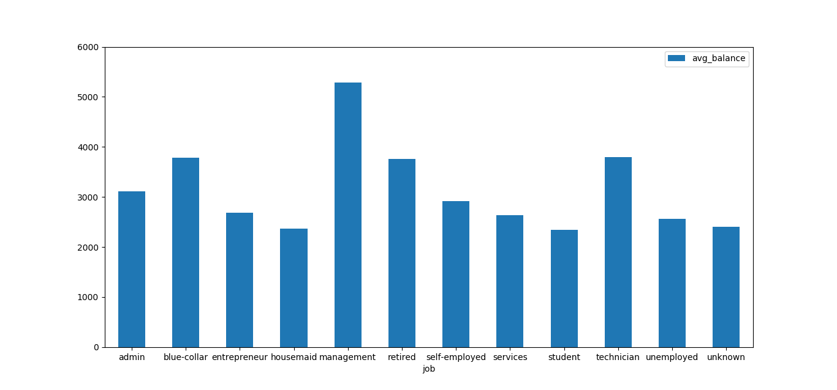
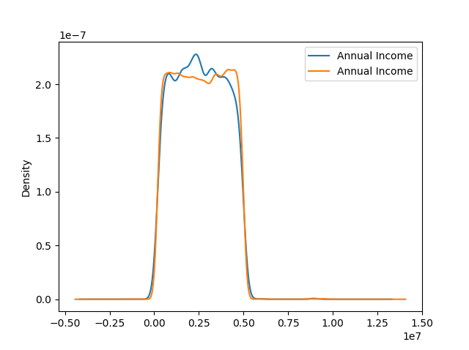
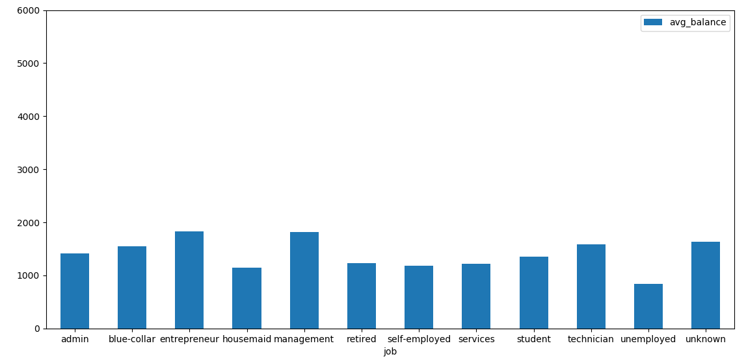
The above bar graph shows the average balance of each profession with no loan customers while the bellow with loan customers.
This clearly shows that customers with loan does higher expenses
The above normal distribution of the annual income of a customer in which the red represents customer with no loan while the red have taken loan.
The graph shows that customers with loan have lower income which explains the reason they take loans

Slide 4
Feature Engineering and Selection
Analysis Assumptions
Feature Engineering have been made based on the following assumptions
The dataset have different percentage of missing values, which have been imputed using mean if the percentage is less than 5%.
Missing values in the target column have been removed it can not be imputed.
Customers aged more than 100 years have been removed.
Certain features have been changed to absolute values.
Features with more than 50% missing values have been removed because the data is insufficient
Feature | Importance
duration | 0.07075
last_contact_day | 0.0266
balance | 0.01761
contact | 0.015423
housing | 0.011345
age | 0.009678
previous | 0.00936
job | 0.0075698
marital | 0.0061
campaign | 0.005
Gender | 0.003446
education | 0.003079
Insurance | 0.00169
loan | 0.000995
Annual Income | 1.5920e-05
Count_Txn | 0
The higher the value the more it is proportional and relevant to the target
Feature Selection
Feature Engineering have been made based on the following assumptions
The method of reducing the input variable to your model by using only relevant data and getting rid of noise in data.
Thus, reducing the size of datasets, also to know which features has the most impact on the outcome which reduces the campaign focus area
Using the method of mutual importance the table on the right shows the results.

Slide 5

Models
After preparing the dataset, it is passed to a learning algorithm to obtain a model which is then used to predict unseen data.
The algorithm used was AdaBoostClassifier which predicted a probability of 90% accuracy whether a customer will be considering a term deposit or not

