Slide 1
Continuous Delivery with openshift
Andrea Morena
Senior Solutions Architect
Red Hat

Slide 2
Continuous Integration
Continuous Delivery

Slide 3
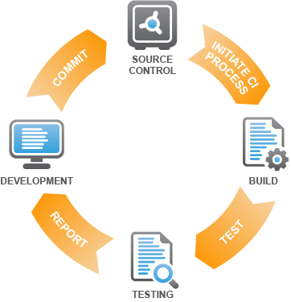
Continuous Integration
Focused only on code and testing without the release management
DEFINITION:
Everytime somebody commits a change, the entire application is built and a comprehensive set of automated tests are run against it. (Humble and Farley, 2011)
Requires frequent code check ins, good test coverage, preferably a CI server
BENEFITS:
Normal state of the application is working, functional
If the application is broken, it is treated as abnormal and requiring immediate attention
Principles
  Integrate and build every day
  Repository/Version Control
  Build Automation
  Automated unit testing and Integration testing
  UAT testing in an environment similar to production

Slide 4
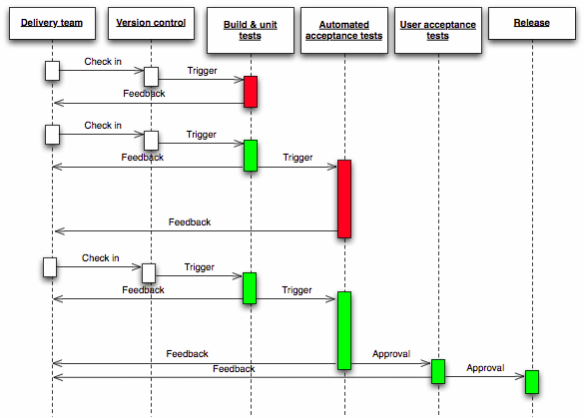
Continuous Delivery Process
Continuous Delivery is the natural extension of Continuous Integration
Rapid provisioning for the underlying infrastructure: IaaS and PaaS as well is needed

Slide 5
Continuous Integration with OpenShift
OpenShift continuous integration encompasses the operating environment of the application (“the platform”), not just the application itself
Normal state of both the application and the platform is working, functional
If the application or the platform is broken, it is treated as abnormal and requiring immediate attention
Frequent, continuous platform builds transform environment provisioning bottlenecks into automated solutions, making it easier to deploy to, scale, and migrate environments

Slide 6



Continuous Integration with OpenShift
CI continually deploys platform and application combinations, validating a complete operating environment.
5
REPORT
RESULTS
PaaS ENVIRONMENT:
TEST
DEVELOPER
ENTERPRISE
CI/CD
SERVER
1
PLATFORM
PUSHES
2
NOTIFIES
APPLICATION
ENTERPRISE
SCM
3
FEATURE
BRANCH
PULLS
BRANCH
4
PLATFORM
PROVISIONS PLATFORM
PUSHES BRANCH
TESTS
TEARS DOWN PLATFORM
APPLICATION

Slide 7
Deployment Pipeline Example
Well-described, optimized process for moving an application through the life cycle from idea to production
Enterprise version control system
UAT STAGE
ENVIRONMENT
CONFIGURATION
DEPLOYMENT
MANUAL USER
TESTING
USABILITY TESTING
DEVELOPER
COMMITS, TRIGGERING AUTOMATED BUILD
COMMIT STAGE
ACCEPTANCE STAGE
QA
AUTHORIZES
PUSH-BUTTON DEPLOY
PRODUCTION STAGE
OPERATIONS
AUTHORIZES
PUSH-BUTTON DEPLOY
COMPILATION
UNIT
TESTS
CODE
QUALITY
TESTS
ENVIRONMENT
CONFIGURATION
DEPLOYMENT
AUTOMATED (FUNCTIONAL) ACCEPTANCE TESTS
INTEGRATION TESTS
ENVIRONMENT
CONFIGURATION
DEPLOYMENT
ROLLBACK CAPABILITY
AUTOMATIC
ENVIRONMENT
CONFIGURATION
DEPLOYMENT
LOAD TESTING
STRESS TESTING
SOAK TESTING
SPIKE TESTING
QA
AUTHORIZES
PUSH-BUTTON DEPLOY
PRODUCTION STAGE
Enterprise artifact repository

Slide 8
Deployment Pipeline Practices
Only build your binaries once
Deploy the same way to every environment
Smoke test deployments
Deploy into a copy of production
Every change should propagate through the pipeline instantly
If any part of the pipeline fails, stop the line
Source: Humble and Farley, Continuous Delivery, 2011

Slide 9
Openshift-enabled deployment pipeline practices
Openshift Implications
Only build your binaries once
Deploy the same way to every environment
Smoke test deployments
Deploy into a copy of production
Every change should propagate through the pipeline instantly
If any part of the pipeline fails, stop the line
Use PaaS API to create standardized deployment process without having to create your own platform automation.
Use PaaS cartridge specification to
create standardized deployment template without having to create your own platform automation.
Use high-density, high-turnover PaaS containers to reduce pipeline queuing.

Slide 10
CONTINUOUS DELIVERY THROUGH
Red HAT’s PLATFORM AS A SERVICE (OPENSHIFT)
OPENSHIFT
SELF PROVISIONING
SELF DEPLOYMENT
ENVIRONMENT
STANDARDIZATION
ENABLE PROTOTYPING
AUTO SCALING
AND
IMPROVE RESOURCES
UTILIZATION
CENTRALIZED
OPS MANAGEMENT
DEV
QA
UAT
PROD
CONTINUOUS DELIVERY
PRODUCT
FEATURE
IDEA
IDE
CONFIGURATION
MANAGEMENT
CONTINUOUS
INTEGRATION
MONITORING
PRODUCT
MANAGER
DEVELOPERS
TEST
ENGINEERS
OPERATIONS
PERSONNEL
CYCLE TIME

Slide 11
DEMO

Slide 12




Deployment Pipelines with OpenShift
DEMO
COMMIT
STAGE
ACCEPTANCE STAGE
UAT
STAGE
PRODUCTION
STAGE
DEV PaaS
QA PaaS
UAT PaaS
PROD PaaS
Automated
Test
Team Approves
Operations Team Approves
DEVELOPERS
DEVELOPERS
TESTERS
OPERATIONS
DEVELOPER
COMMITS, TRIGGERING AUTOMATED BUILD
ENTERPRISE
CI/CD SERVER
ENTERPRISE SCM
ENTERPRISE
ARTIFACT REPOSITORY
https://github.com/amorena/democdonpaas
Notes:
Developer is particularly careless

