Slide 1

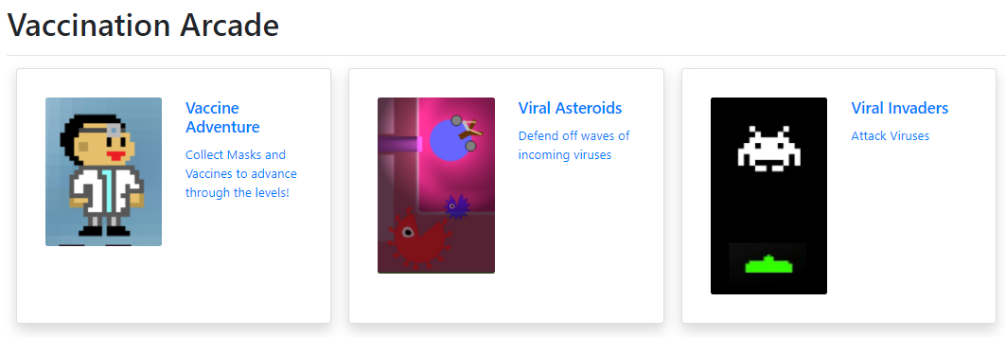
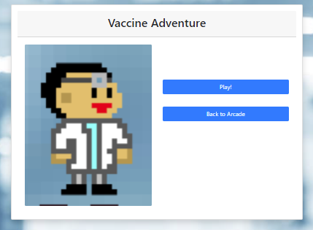
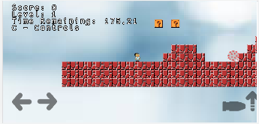
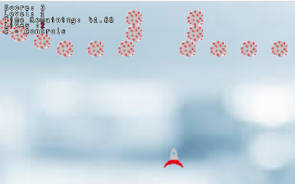
Vaccine Hesitancy Game
for
Texas A&M’s PEER Program
Team: SE TEAM 11
Drake Johnson
Mary Julian
Aniket Patel
Kaushal Tungaturthy
Identify the Project
Defining User Stories
Development and Production
Given a list of potential projects and clients, we chose the top 3 that interested us, then client was assigned.
Our client gave us the creative freedom on designing a vaccine hesitancy game
First meeting with client established the goal and key features of the project
Met with client bi-weekly during the second half of semester to update on progress and obtain feedback
Implemented client’s user stories mentioned and discussed features to improve
Assigned roles and user stories accordingly
Communicated with client, created and completed user stories, demo’ed game, & recorded progress over 4 iterations
Primarily BDD was done with manual testing
Our Client
Non-Profit Organization: The Partnership for Environmental Education & Rural Health (PEER) Program at Texas A&M College of Veterinary Medicine & Biomedical Sciences (CVMBS)
Client Name: Dr. Walker
Stakeholders: PEER Program, students who will play the game, those student’s parents and guardians
Problem to Solve
Create arcade style JavaScript-based games that can be deployed to PEER Program WordPress site
Games should do the following:
Bring awareness towards benefits of vaccines, particularly that of COVID-19, for those who are vaccine hesitant
Be fun to play with a theme around vaccines
Be compatible and working on all major browsers on desktop and mobile
Main Features Implemented
Player moves, shoots and kills converging enemy viruses
Upgrading characters, collecting masks, presenting information related to vaccines
More viruses spawn, move faster, and are more difficult to kill as difficulty increases
Win game after reaching the last level in Vaccine Adventure , lose game if the player succumbs to viruses in Vaccine Adventure or if the 4 lives player exhausts all the lives in Viral Invaders
Challenges Encountered
JavaScript and Kaboom: Unfamiliarity with the ServerPress deployment lead to confusion, some crucial time spent on choosing a framework and learning and adjusting to a new environment.
User stories: We split user stories after sound discussion during every sprint meeting held weekly
TDD/BDD: Tests are usually written before implementation, but for a game that was built with the Kaboom framework and had changing implementations depending on customer input, we couldn’t really do TDD. We had to have users manually test and document the features in the game because normal testing frameworks doesn’t work with phaser. Thus, less TDD and more BDD was used in testing.
Time: Some user stories could not be implemented due to constraints of WordPress Server. We also were not able to add as many games to the arcade as originally planned.
Development Environment
Familiarity with the language, framework and development environment is important to have prior to development.
Communication with client and documenting helps us understand the client’s needs and stay on the right path.
Testing
Testing is essential in making the game works as implemented however since it’s not compatible with TDD, we had to manually test and use mostly BDD. Testing by playing the game makes sure the features work as implemented, makes finding glitches faster and also we gain knowledge on possible improvements to the game.
Prioritization
We prioritized a smooth user experience that works on multiple displays and browsers versus having a large amount of games.
We prioritized ‘gamifying’ the experience of measures required to stop the spread of viruses.
Arcade Page
Game Page
Vaccine Adventure
Viral Invaders
Notes:
Outline of poster:
Who the client is
What is the problem we are solving for them
What was our solution to these problems
What was the design process like
What specific design choices we made
Challenges we faced
Lessons we learned about the software engineering process from those challenges
Need to be able to talk about the poster for 5 minutes before doing a live demo

