Slide 1

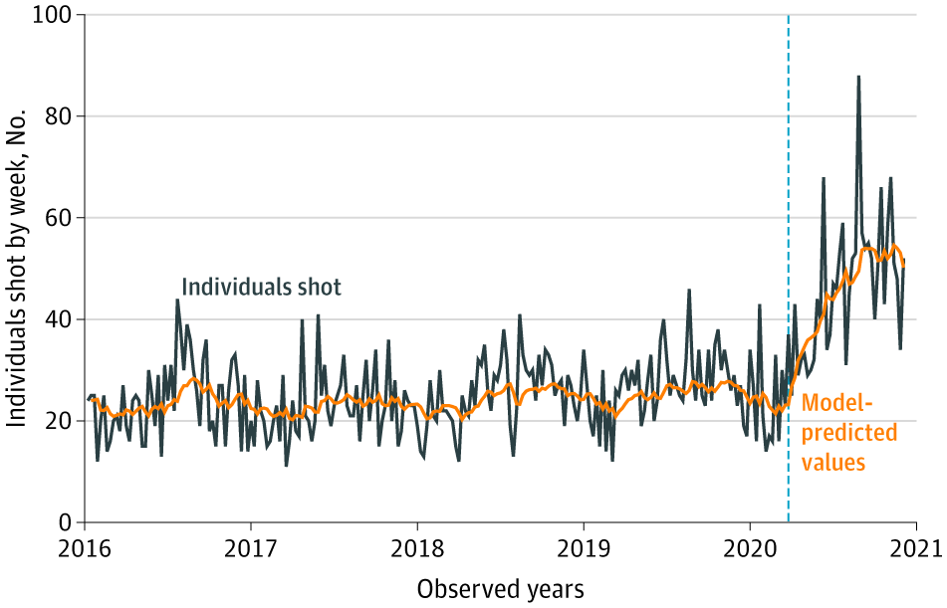
From: Changes in Shooting Incidence in Philadelphia, Pennsylvania, Between March and November 2020
JAMA. 2021;325(13):1327-1328. doi:10.1001/jama.2021.1534
^{Figure Legend:}
Individuals Shot by Firearms per Week in Philadelphia, 2016 to 2020The vertical dashed line indicates the beginning of COVID-19 containment policies in Philadelphia (March 16, 2020). The model-predicted values show a gradual permanent association beginning with COVID-19 containment policies. The autoregressive integrated moving average model was specified as 1, 0, 1; the Ljung-Box Q statistic at 24 lags was 19.6.
^{Date of download: 5/6/2021}
Copyright 2021 American Medical Association. All Rights Reserved.

