Slide 1

Word Clone: An Accessible Word Processor
Word Clone is designed to enhance accessibility. It offers a user-friendly experience.
Name- Soumyadeep Maity
UID- 21BCS11857
N

Slide 2
Project Overview & Motivation
Problem
Solution
Impact
Traditional word processors often lack essential accessibility features. This creates barriers for disabled individuals.
Develop a user-friendly processor with built-in accessibility. This allows for a more inclusive experience.
This tool provides a more inclusive and efficient writing experience. It caters to the needs of diverse users.

Slide 3

Core Features & Functionality
1
Basic Text Editing
2
File Management
Includes formatting, font selection, and paragraph adjustments. It can also make basic file adjustments.
Users can open, save, and create new documents. Supported formats include DOCX, TXT, and PDF.
3
Customizable Interface
Users can adjust font sizes, color schemes, and themes. This helps create their ideal experience.

Slide 4
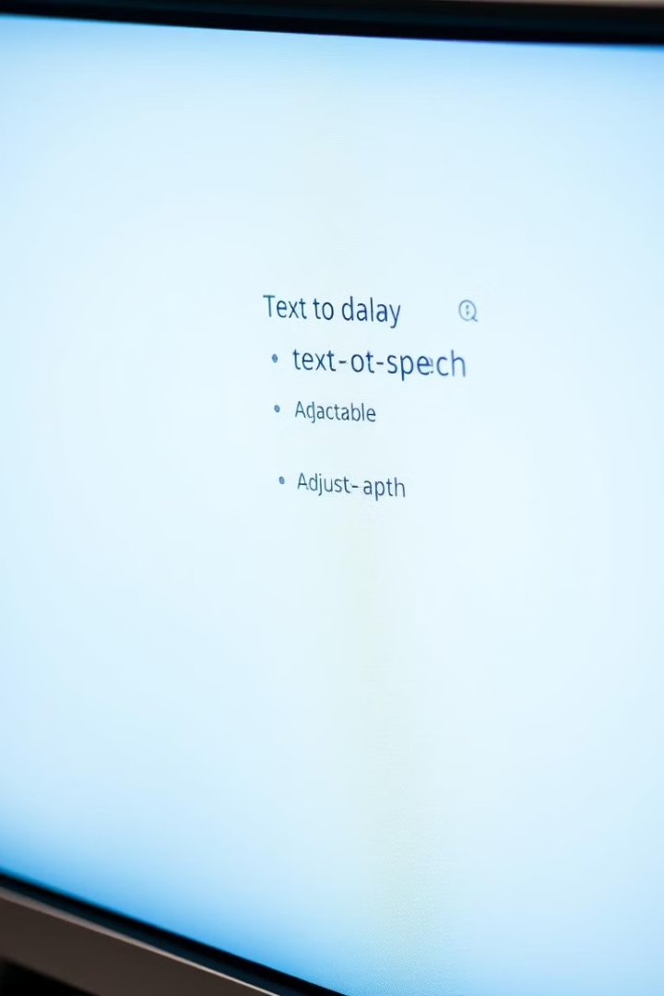



Enhanced Accessibility Features
Text-to-Speech
Speech-to-Text
High Contrast Mode
Converts text to audible speech. Supports multiple languages and adjustable reading speeds.
Converts speech to written text with high accuracy. It also utilizes noise cancellation.
Improves visibility for users with visual impairments. Complies with WCAG standards.

Slide 5
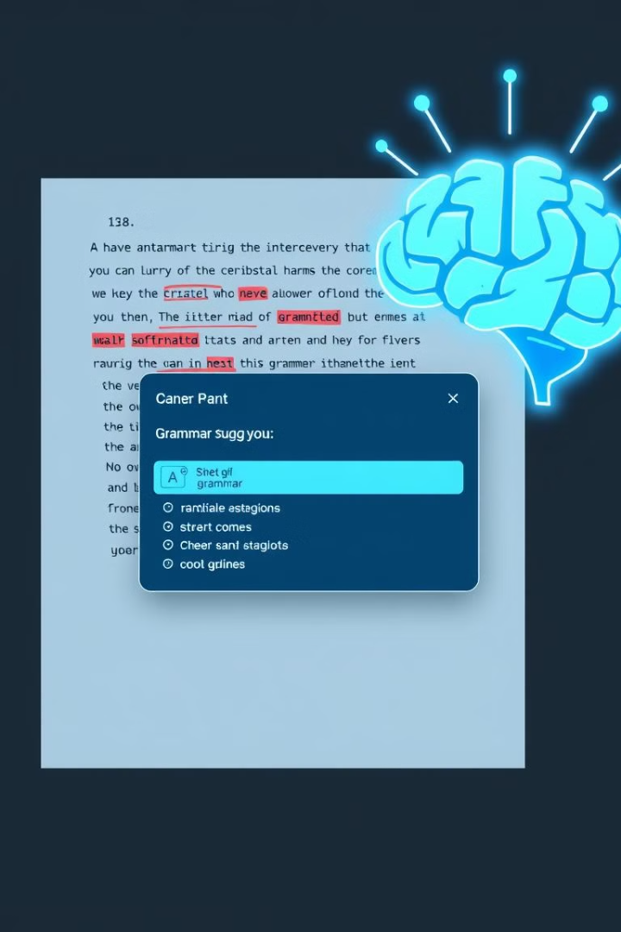




AI Integration & Advanced Capabilities
AI Grammar Check
Real-time grammar and spelling suggestions. Improves writing quality and reduces errors.
Content Suggestion
Provides contextual suggestions for improving writing style. Helps users overcome writer's block.
Automatic Summarization
Generates concise summaries of long documents. Saves time and improves information processing.
AI Translation
Real time translation to and from 100+ different languages.

Slide 6
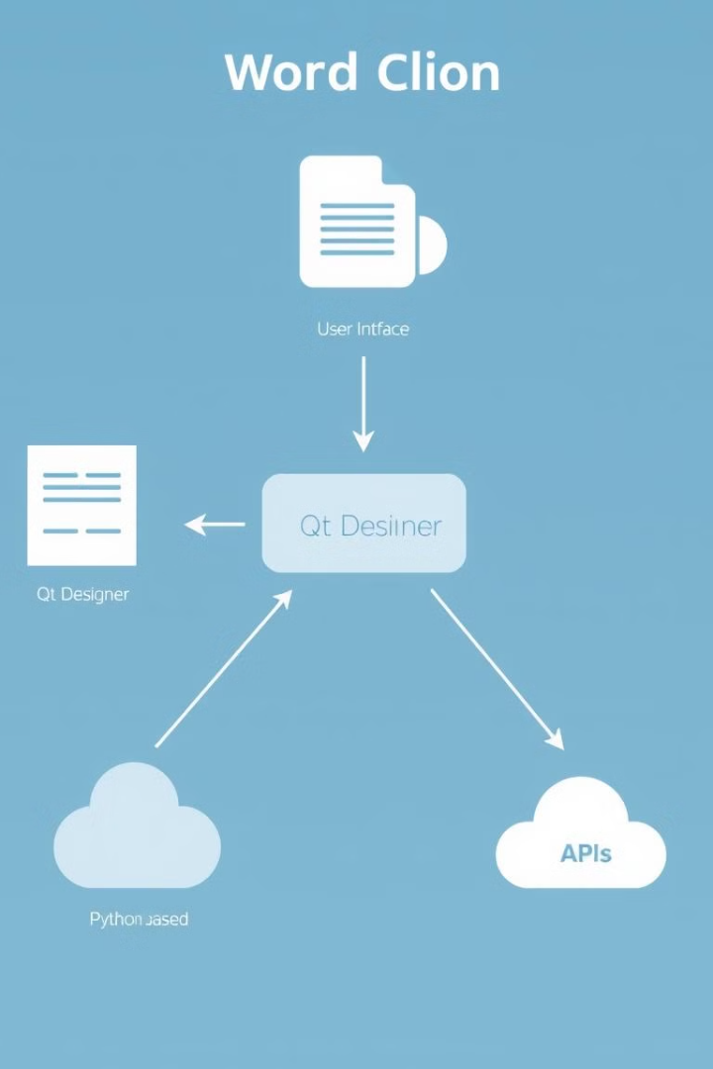
Technical Implementation & Architecture
1
Qt Designer
Created GUI, cross-platform compatibility, and MVC architecture. It ensures ease of use.
2
Python
Backend logic and AI integration implemented in Python. Libraries used: PyQt5, SpeechRecognition, transformers.
3
API Integrations
Cloud-based APIs for AI features: Speech-to-Text, Grammar Check. Allows for faster processing time.

Slide 7




Future Enhancements & Roadmap
Enhanced AI
Collaboration
Sentiment analysis and personalized writing suggestions can improve the user experience.
1
2
Real-time document sharing will help those who work on teams.
Mobile App
4
Cloud Integration
Extend accessibility to mobile with iOS and Android.
3
Sync across devices for easy access from anywhere.

Slide 8

Conclusion: Empowering Users Through Technology
Accessible
Word Clone is a powerful and accessible word processor.
Empowering
It is designed to empower users with disabilities.
Advanced
Combines core functionality with advanced AI features.
Open Source
It is open source and continuously improving.

