Slide 1
Chutes and Ladders in Java
Written by:
Ryan, Christina, David, Donnie, Joshua, and Bruce

Slide 2
Task Divisions
Bruce & Joshua -
Christina & Ryan -
Donnie & David -
Board Class, Score Class, and Meeting Coordination
Token Class, Game Logic, and Piece Movement
Dice Functionality, Methods, and Implementation

Slide 3
Project Requirements
2-4 Players
10x10 Board
Dice rolls
Chute and Ladder functionality
Report winner at square 100
Write winner

Slide 4
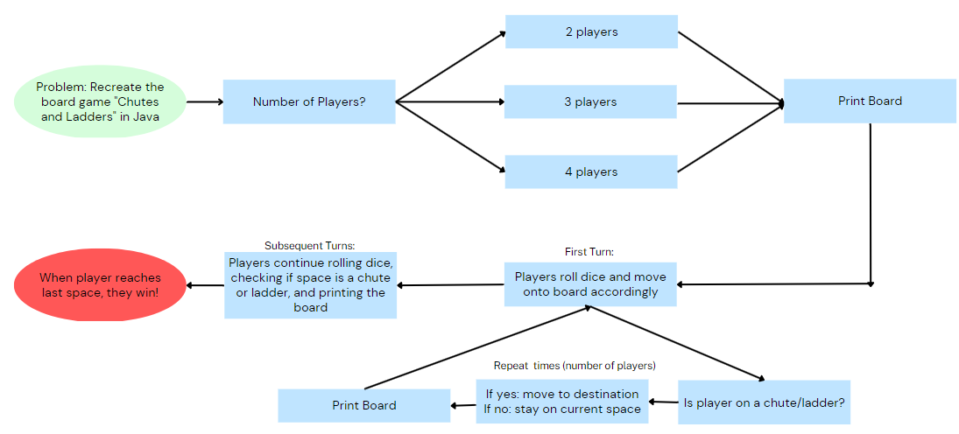
Project Objectives Flowchart

Slide 5
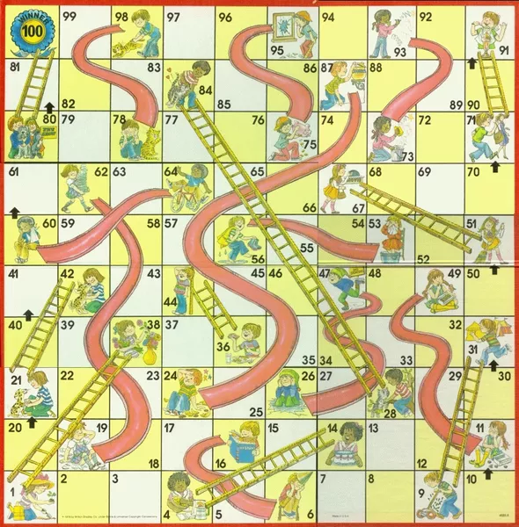
Board to Recreate:

Slide 6
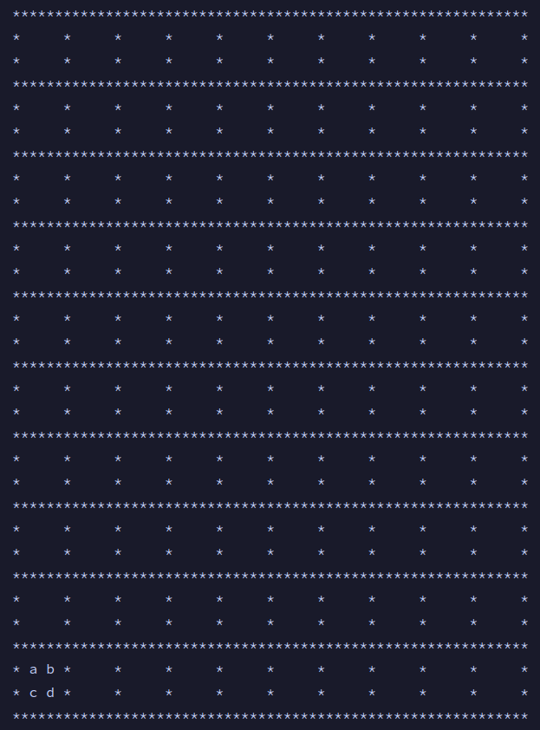
Joshua - Board
Dynamically print board based on Token coordinates
Uses x and y coordinates, (called “i“ and “j“ in the code), to print the board according to the position of the pieces on the coordinate plane

Slide 7
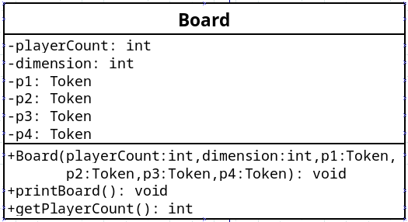
Bruce - Board

Slide 8
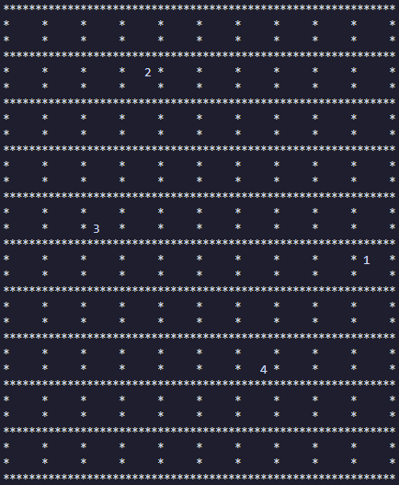
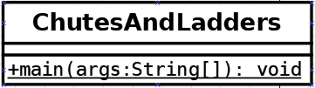
Christina & Ryan -
ChutesAndLadders
Main game logic
Handles looping through player turns and generating integers for rolls

Slide 9
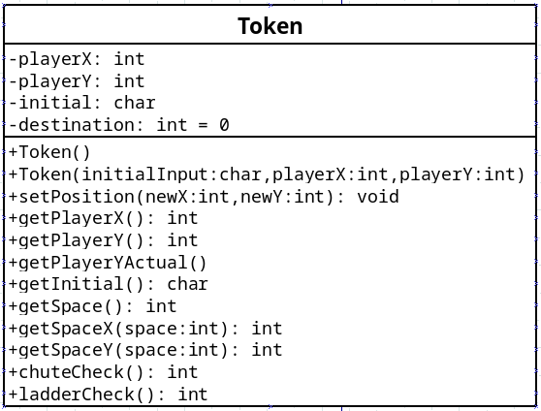
Ryan - Token
Stores player information and coordinates
Consists of main game logic (user
input, turn order, moving pieces,
etc.)

Slide 10
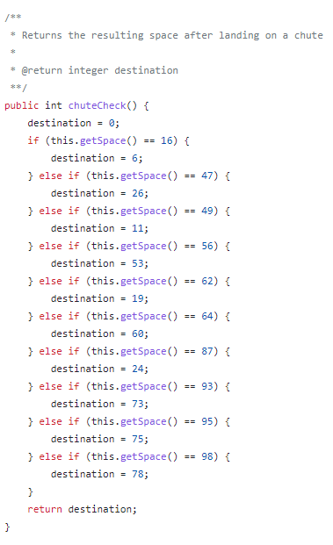
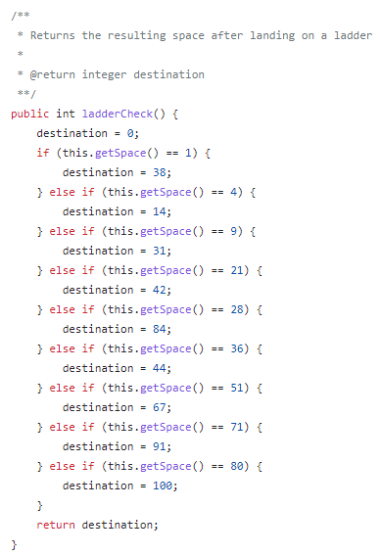
Christina - Token
Game Logic -
Chutes and Ladders
Checks to see if player has landed on a chute or a ladder space
Uses if/else statements to see if the player’s position is any of the values that correspond to a chute or ladder
If player position = any special space, return the value that the player should move to

Slide 11
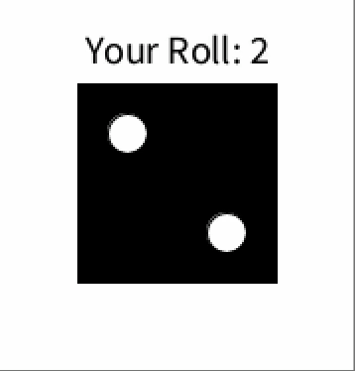
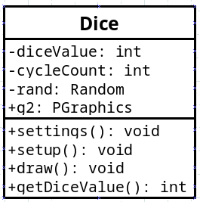
Joshua - Dice
Uses Processing library to generate and animate an integer and its associated die.

Slide 12
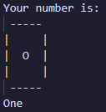
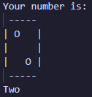
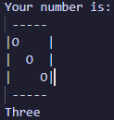
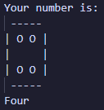
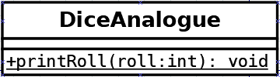
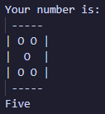
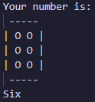
David - Dice Analogue
Receives an integer to print ascii art of the die.

Slide 13
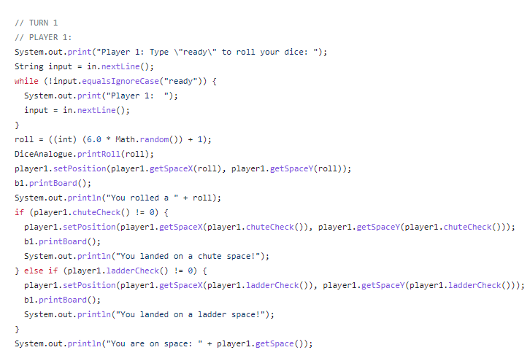
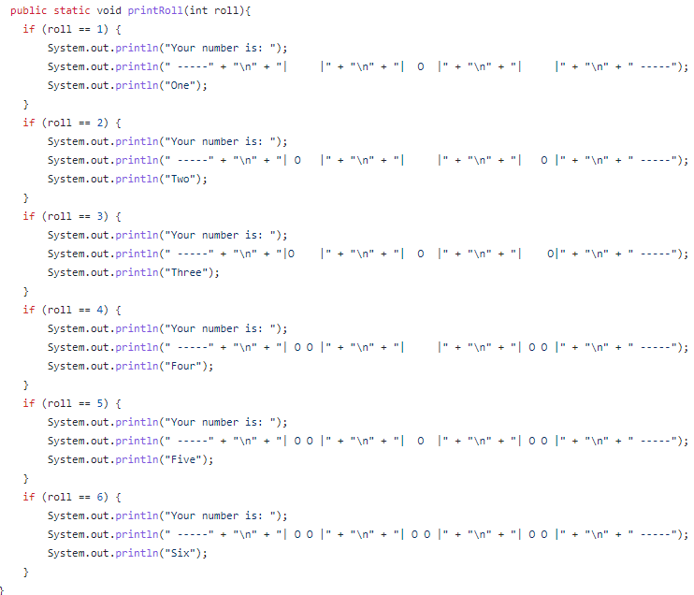
Donnie - DiceAnalogue Implementation
After each movement in ChutesAndLadders, DiceAnalogue.printRoll is called to generate the ASCII art for the face of the die
The number received by
the Math.random method determines the art displayed

Slide 14


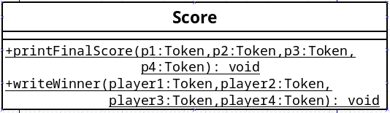
Bruce - Score
Class level scope to print each players score
Writes player number and score to winners.txt

Slide 15
Demonstrate Code

