Slide 1
Chutes and Ladders in Java
Written by:
Ryan, Christina, David, Donnie, Joshua, and Bruce

Slide 2
Task
2-4 Players
10x10 Board
Dice rolls
Chute and Ladder functionality
Report winner at square 100
Write winner

Slide 3
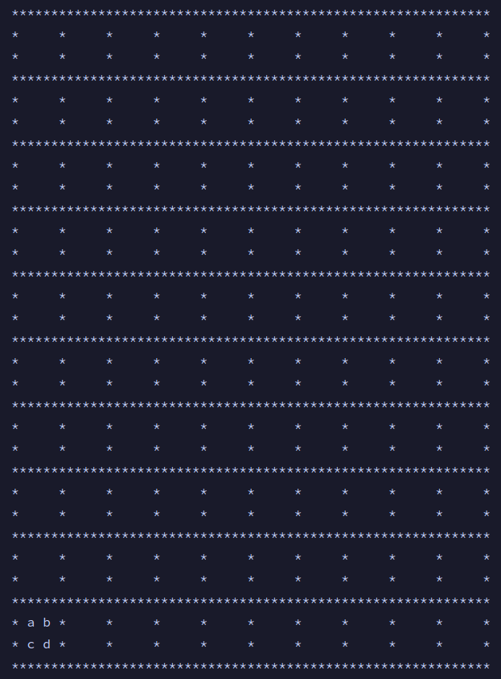
Board
Dynamically print board based on Token values

Slide 4
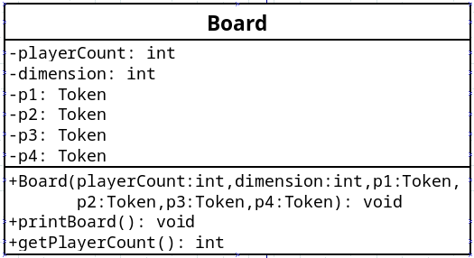
Board cont.

Slide 5
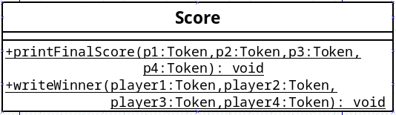
Score
Class level scope to print each players score
Writes player number and score to winners.txt

Slide 6
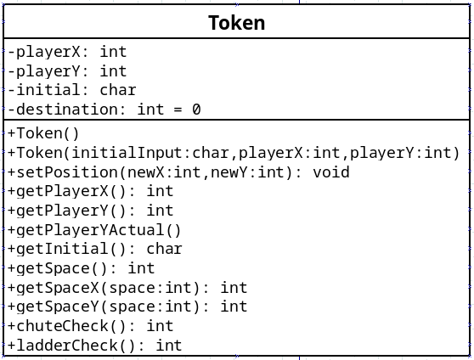
Token
Stores player information and coordinates

Slide 7
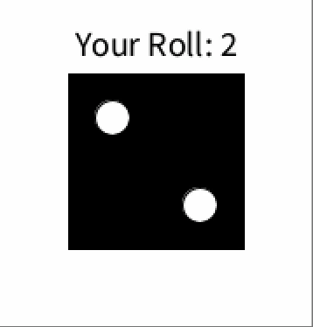
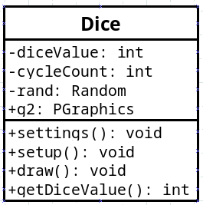
Dice
Uses Processing library to generate and animate an integer and its associated die.

