Slide 1
Chutes and Ladders in Java
Written by:
Ryan, Christina, David, Donnie, Joshua, and Bruce

Slide 2
Project Requirements
2-4 Players
10x10 Board
Dice rolls
Chute and Ladder functionality
Report winner at square 100
Write winner

Slide 3
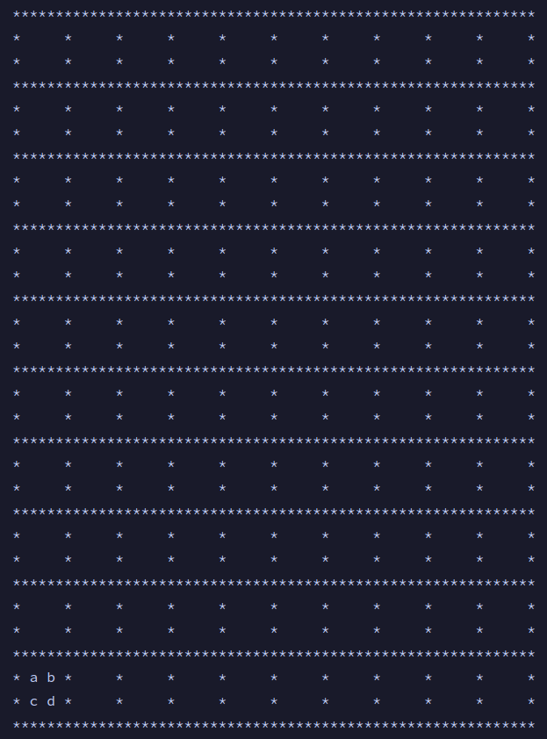
Board
Dynamically print board based on Token coordinates

Slide 4
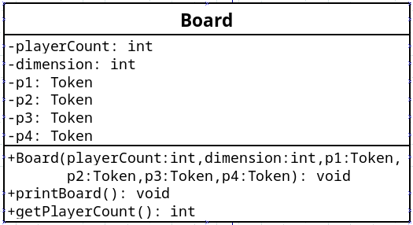
Board cont.

Slide 5
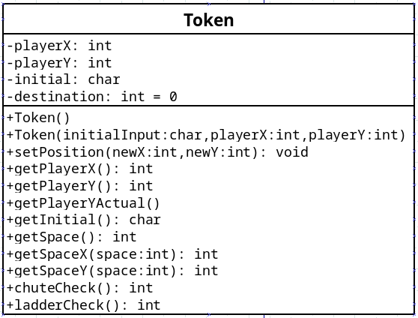
Token
Stores player information and coordinates

Slide 6
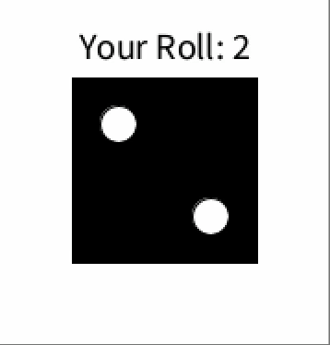
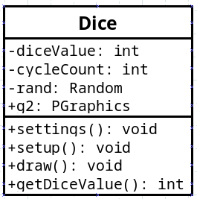
Dice
Uses Processing library to generate and animate an integer and its associated die.

Slide 7
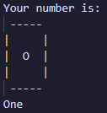
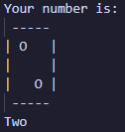
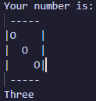
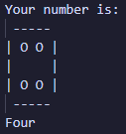
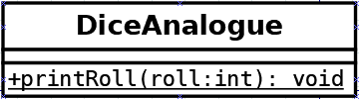
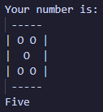
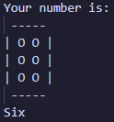
DiceAnalogue
Receives an integer to print ascii art of the die.

Slide 8


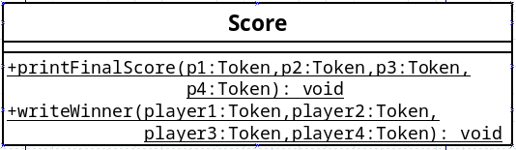
Score
Class level scope to print each players score
Writes player number and score to winners.txt

Slide 9
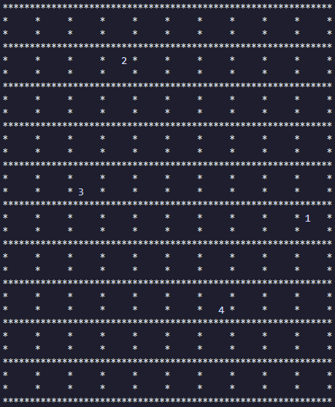
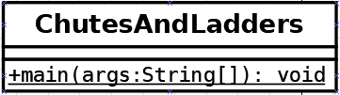
ChutesAndLadders
Main game logic
Handles looping through player turns and generating integers for rolls

