Slide 1
Vision Zero Impact Analysis (Queens)
2022
ACE - Data Analytics Program Capstone
J.P. Villegas

Slide 2
Vision Zero (2014- Present Day)
A comprehensive city policy shift that was intended to address the high pedestrian/cyclist injury/mortality rate in NYC.
Changes implemented include:
Turn Traffic Calming, Neighborhood Slow Zones, Enhanced Crossings, etc.

Slide 3
The goal of this analysis
Has vision zero had a net positive effect since its inception in Queens?
What has been the impact on a yearly basis?
What other factors could have contributed to finding e.g.(Covid-19)
Quick Cost/Benefit analysis

Slide 4
Some factors to frame our outlook by:
Realistically, we can’t expect a total drop in fatalities with the implementation of this program…We should therefore focus on looking for a significant drop in the number of Incident reports as a metric that the policy shifts and infrastructure mods are benefitting the city.
As a lifelong resident of Queens, I’m particularly interested in pedestrian counts as there’s a lot of walking involved to/from public transportation in our daily commute.
If incidents are generally remaining constant, are fatalities and accidents in general on the decline?

Slide 5
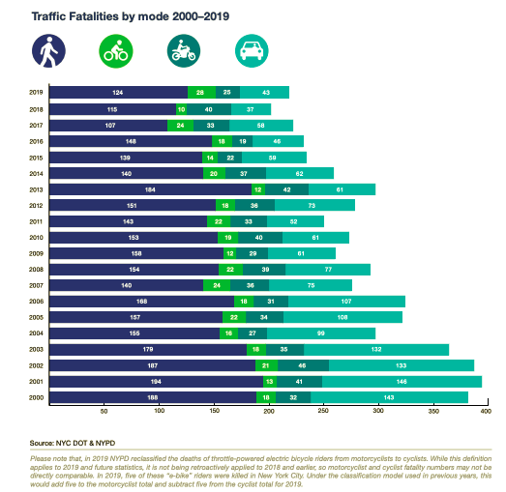
Break down by year: Number of incidents
2012- 19138 - 1113 inj. 15 deaths
2013 - 39309 - 2215 inj. 44 deaths
2014 - (VZ programs begins ) - 41021
2084 inj. 26 deaths
2015 - 42489 - 1936 inj. 25 deaths
2016 - 41394 - 1992 inj. 19 deaths
2017 - 38627 - 1820 inj. 22 deaths

Slide 6
Yearly breakdown Continued…
2018 - 41277 - 1921 inj. 31 deaths
2019 - 39865 - 1954 inj. 26 deaths
2020 - (COVID - 19) - 20664 - 1228 inj. 19 deaths
2021- (COVID - 19 Year 1) - 19561 - 1273 inj. 14 deaths
2022 - 10444 - 810 inj. 6 deaths Thus far…

Slide 7
Cost/Benefit breakdown
1.4 billion projected from 2020 through 2024.
Over 100 miles of bike lanes installed throughout the city
The average amount of incidents since the program’s inception has remained relatively constant.
Fatalities have definitely gone down but numbers of injured persons have also remained relatively constant.
In 20’ and 21’ Covid - 19 definitely played a role in lower numbers of injuries

Slide 8
Sources
Budget -
https://ibo.nyc.ny.us/iboreports/budget-changes-for-vision-zero-a-pandemic-related-blip-or-a-backpedal-foeb-june%202020.pdf

