Slide 1
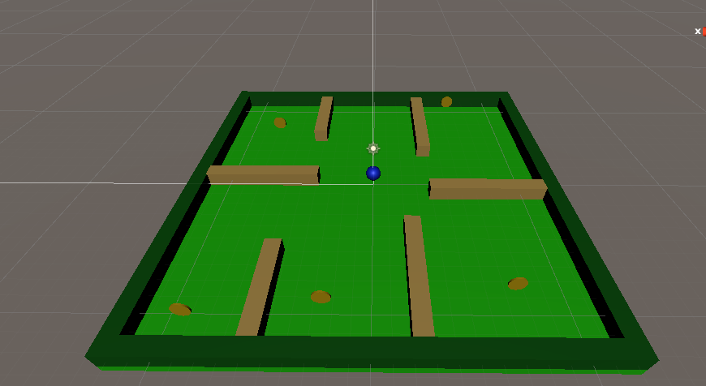
Step 4: level 1 layout
Paste your screenshot below

Slide 2
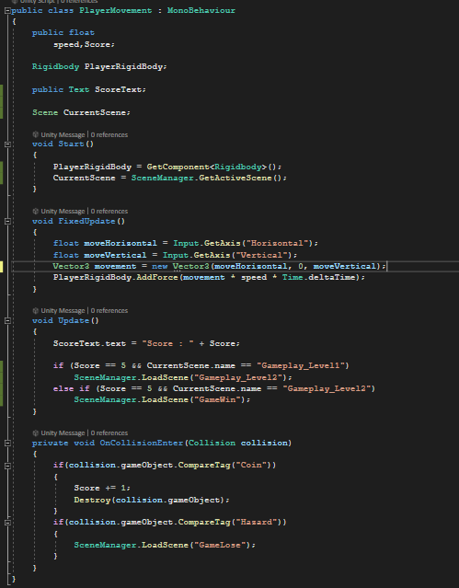
Step 7: PlayerMovement script
Paste the screenshot for updated PlayerMovement script below

Slide 3
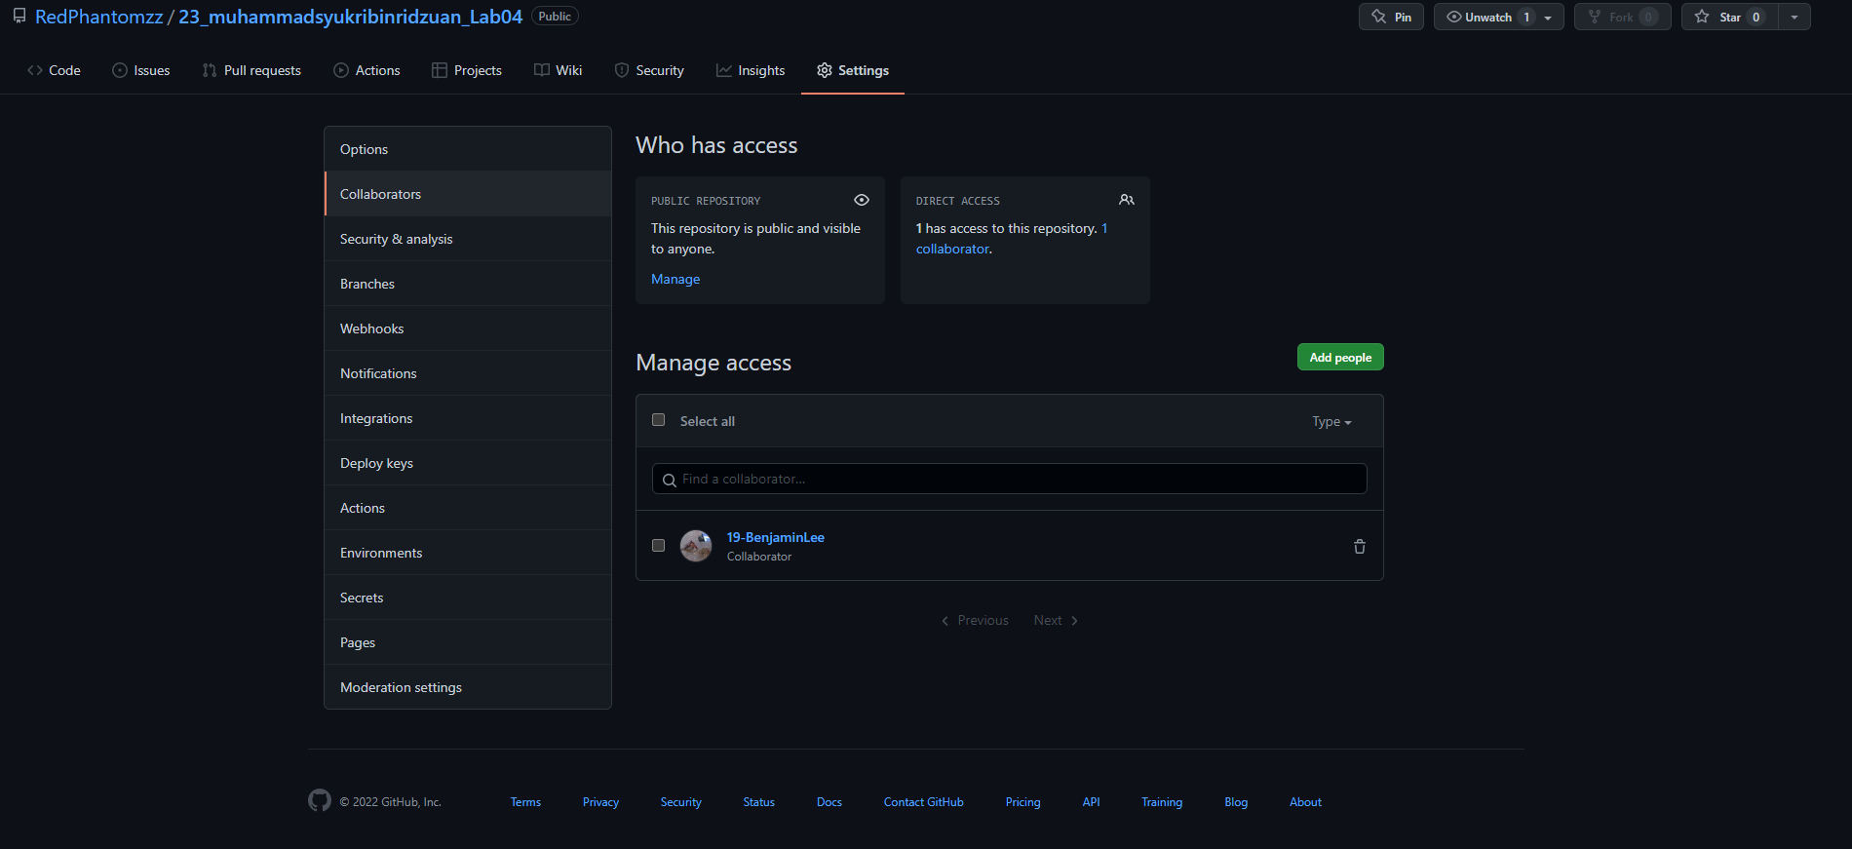
Step 13: Invited collaborator
Paste the screenshot below

Slide 4
Step 21: URL for submission
Paste the URL to your GIT repo below
https://github.com/RedPhantomzz/23_muhammadsyukribinridzuan_Lab04.git

