Slide 1

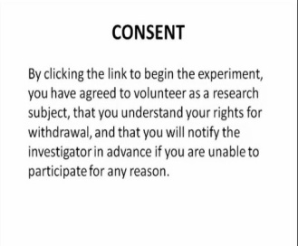
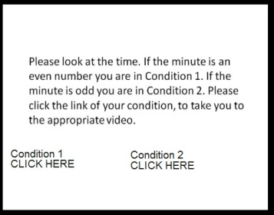



Stacie Heiberg
Eastern Oregon University
The Effects of Emotion on Change Blindness
Abstract
Tips
Design & Procedure
Heiberg & Ramirez (2015) proposed that strong emotion would increase the occurrence of the experience of change blindness. This proposal was tested by viewing a video that was meant to induce a strong emotion. After the emotional video was viewed, participants viewed a change blindness video. Results showed that strong emotion did not increase the occurrence of experiencing change blindness.
Some participants noted that they had a difficult time understanding the instructions, or navigating through multiple videos. Make instructions obvious and links visible.
In youtube, if a link is not clicked, a new video automatically begins to play. One participant noted watching15 minutes of a c-section birth.
Alternate the change blindness pictures more rapidly. The slow repetitions in this experiment may have contributed to the change not being seen.
Data Collection
Purpose
The Purpose of this experiment was to determine if change blindness increased with emotion. If a strong emotion increased the occurrence of change blindness and someone was aware, they may be able to make themselves more aware of their surroundings, decreasing accidents.
Note the condition and if a change in the change blindness video was seen to the researcher.
Summary
Some participants noted that they had a difficult time understanding the instructions, or navigating through multiple videos
While the results were insignificant, the videos were reported to have induced emotion.
Stimuli
https://www.youtube.com/watch?v=k0lT596YOX0
Results
References
50 participants emailed researchers with results. 4 were excluded from the data for noting a change that did not occur or noting a change before it occurred.
Results were insignificant p-value = .66
Heiberg, S. & Ramirez, P. (2015). The Effect of Emotions on Change Blindness. Eastern Oregon University, Psychology 441.

