Slide 1


Lecture 1: Introduction
to Concurrent
Programming
ECEN 4003, CSCI 4830-012:
Concurrent Programming

Slide 2
Welcome
What: Concurrent Programming
http://ecee.colorado.edu/pavol/ecen4003/
Where: ECCR 151
When: Lecture: MWF 2pm-2.50pm
Office hours: Wed 3-4pm and by appointment
Who: Pavol Cerny
pavol.cerny@colorado.edu
http://ecee.colorado.edu/pavol
Why? Topic for today.

Slide 3
Example

Slide 4
Example: Mutual Exclusion
flag[0] ←0
no access
flag[1] == 0
flag[0] ← 0
Flag is raised means
“I am going to access a shared resource”
request
flag[0] ← 1
access

Slide 5
Mutual Exclusion
Alice
Bob
flag[0] ←0
flag[1] ←0
no access
no access
flag[1] == 0
flag[0] == 0
flag[0]
← 0
flag[1]
← 0
request
request
flag[0] ← 1
flag[1] ← 1
Boom!
access
access

Slide 6
Mutual Exclusion: Attempt 2
Alice
Bob
flag[0] ←0
flag[1] ←0
no access
no access
flag[0] ← 1
flag[1] ← 1
flag[0]
← 0
flag[1]
← 0
request
request
flag[0] == 0
flag[1] == 0
Now what?!
access
access

Slide 7
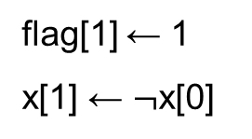
Mutual Exclusion: Attempt 3
Alice
Bob
flag[0] ←0, x[0] ←0
flag[1] ←0, x[1] ←0
no access
no access
flag[0] ← 1
x[0] ← x[1]
flag[1] ← 1
x[1] ← $¬$x[0]
flag[0]
← 0
flag[1]
← 0
request
request
flag[1] == 0 or
x[0] != x[1]
flag[0] == 0 or
x[0] == x[1]
OK, works!
access
access

Slide 8
More about the course

Slide 9
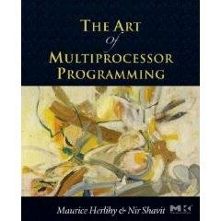
Textbook
The art of multiprocessor programming
by Maurice Herlihy and Nir Shavit

Slide 10
How many of you have seen…?
Programming in Java?
Have you programmed concurrent programs? In Java? In pthreads? …
Bakery algorithm?
Queue locks?
Linearizability? Sequential consistency?
compareAndSet?
Concurrent Hashtables?

Slide 11
Grading
The course will be graded based on
course project(30% of the course grade),
homework (30%)
exams (3 midterms) (30%)
class participation (10%).
Subject to change within next couple of weeks.

Slide 12
Course projects
The goal of your project is to write a larger concurrent program, and test its performance for various inputs and environments. Work on your own or in pairs. Performance study should be an integral part of the project.
Preliminary deadlines.
Feb 13: project proposal
April 3: checkpoint (project works on motivating examples, performance testing can begin)
April 27: project submission deadline (submit source code, examples, project report)
week of April 27: project presentations, demos

Slide 13


Sample Project 1: Web server
Implement a web-server that handles a very small subset of the HTTP/1.1 protocol, a full description of which is available in the W3C RFC-2616. The server must be concurrent, i.e., able to serve more than one request at the same time. Additionally, for record-keeping purposes, the server should be able to record the each client's IP address along with the requested files in a shared data-structure.
A performance evaluation. The evaluation must compare the performance of the concurrent web-server with a version of the web-server that processes requests sequentially. In particular, the evaluation must examine the effect on the speed-up of the concurrent web-server when the size of the served pages varies. The evaluation must also examine the effect of logging on the performance. To make the measurements, you can use httperf.

Slide 14

Sample Project 2: Irregular data parallelism
Cavity
Example: Delaunay mesh refinement
Effects of updates are local, but not bounded statically (“irregular”).
Can we still exploit locality for parallelism?

Slide 15
Sample Project 2: Irregular data parallelism
Locality of effects: Mesh retriangulation
http://iss.ices.utexas.edu/lonestar/index.html

Slide 16
Sample Project 2: Irregular data parallelism
Lonestar benchmark suite:
http://iss.ices.utexas.edu/lonestar/index.html
Barnes-Hut N-body Simulation
Delaunay Mesh refinement
Focused communities
Delaunay triangulation
…
Project: 1. pick one of these applications,
2. find a good (possibly novel) way of parallelizing it,
3. implement it (by modifying the sequential implementation
provided in Lonestar benchmarks),
4. confirm improvement in running time by experimentation.

Slide 17
Sample Project 3: Deductive verification: proving a concurrent data structure correct
Pick an implementation of a concurrent data structure: a stack, a queue, a set, ..
Pick a theorem prover or a verification tool: for example: PVS or QED
Prove that the implementation is linearizable
P1: remove(7)
3
5
7
9
P2: remove(5)

Slide 18
Sample Project 3: Deductive verification: proving a concurrent data structure correct
P1: remove(7)
3
5
7
9
P2: remove(5)
References:
R. Colvin, L. Groves, V. Luchangco, M. Moir: Formal Verification of a Lazy Concurrent List-Based Set Algorithm. CAV 2006
T. Elmas, S. Qadeer, A. Sezgin, O. Subasi, S. Tasiran: Simplifying Linearizability Proofs with Reduction and Abstraction. TACAS 2010.

Slide 19
Sample Project 4: Performance measurement/ performance model for concurrent programs
Pick a problem with at least three-four different solutions
Lock implementations
Data structures: queues, stacks, sets…
Examine the performance of the solutions in different settings:
small number of threads vs large number of threads
2 cores, small amount of memory (laptop) vs 8 cores, large memory/cache (server)
different usage models
input that generates little vs input that generates lots of contention
3a. Find a hybrid solution that works well in a particular setting
or
3b. Find a performance model that explains the data

Slide 20
Further Projects
4. Big Data processing in a MapReduce Framework (e.g., Hadoop)
Concurrent Processing of Photos
Concurrent Editor

Slide 21
Project 7: Your own!

Slide 22
Adapted from companion slides for
The Art of Multiprocessor Programming
by Maurice Herlihy & Nir Shavit
TexPoint fonts used in EMF.
Read the TexPoint manual before you delete this box.: AAAA
Notes:
22

Slide 23
Reading from today
The art of multiprocessor programming
by Maurice Herlihy and Nir Shavit
Chapter 1, Introduction

Slide 24
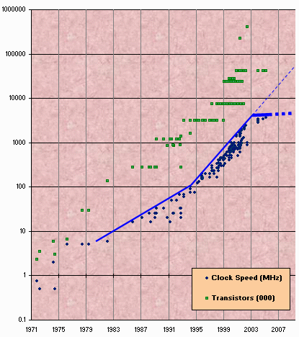
Moore’s Law
Transistor count still rising
Clock speed flattening sharply
24
Notes:
24
Most of you have probably heard of Moore’s law, which states that the number of transistors on a chip tends to double about every two years. Moore’s law has been the engine of growth for our field, and the reason you can buy a laptop for a few thousand dollars that would have cost millions a decade earlier. The green dots on this graph show

Slide 25
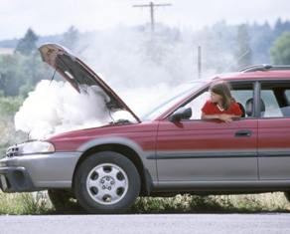
Moore’s Law (in practice)

Slide 26
Nearly Extinct: the Uniprocesor
cpu
memory
26
Notes:
26
Traditionally, we have had inexpensive single processor with an associated memory on a chip, which we call a uniprocessor.

Slide 27
Endangered: The Shared Memory Multiprocessor (SMP)
cache
cache
cache
Bus
Bus
shared memory
27
Notes:
27
And we had expensive multiprocessor chips in the enterprise, that is, in server farms, high performance computing centers and so on. The
Shared memory multiprocessor (SMP) consists of multiple CPUs connected by a bus or interconnect network to a shared memory.

Slide 28
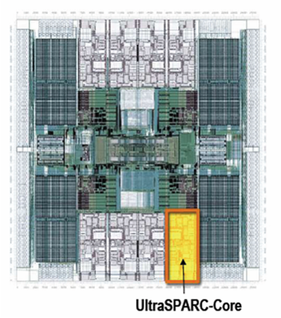
The New Boss: The Multicore Processor
cache
cache
cache
Bus
Bus
shared memory
28
Notes:
28
The revolution we are going through is that the desktop is now becoming a multiprocessor also. We call this type of processor a system-on-a-chip or a multicore machine or a chip multiprocessor (CMP). The chip you see here is the Sun T2000 Niagara CMP that has 8 cores and shared cache and memory. We will learn about the Niagara in more detail later. It is the machine you will be using for your homework assignments.

Slide 29
Why do we care?
29
Time no longer cures software bloat
The “free ride” is over
When you double your program’s path length
You can’t just wait 6 months
Your software must somehow exploit twice as much concurrency
Notes:
29
Why do you care? Because the way you wrote software until now will disappear in the next few years. The free ride where you write software once and trust Intel, Sun, IBM, and AMD to make it faster is no longer valid.

Slide 30
Traditional Scaling Process
7x
Speedup
3.6x
1.8x
User code
Traditional
Uniprocessor
Time: Moore’s law
30
Notes:
30
Recall the traditional scaling process for software: write it once, trust Intel to make the CPU faster to improve performance.

Slide 31
Ideal Scaling Process
7x
3.6x
Speedup
1.8x
User code
Multicore
Unfortunately, not so simple…
31
Notes:
31
With multicores, we will have to parallelize the code to make software faster, and we cannot do this automatically (except in a limited way on the level of individual instructions).

Slide 32
Actual Scaling Process
Speedup
2x
2.9x
1.8x
User code
Multicore
Parallelization and Synchronization
require great care…
32
Notes:
32
This is because splitting the application up to utilize the cores is not simple, and coordination among the various code parts requires care.

Slide 33
Multicore Programming: Course Overview
Fundamentals
Models, algorithms, impossibility
Real-World programming
Architectures
Techniques
33
Notes:
33
Here is our course overview. (at the end, we aim to give you a basic understanding of the issues, not to make you experts)
In this course, we will study a variety of synchronization algorithms,
with an emphasis on informal reasoning about correctness.
Reasoning about multiprocessor programs is different in many ways from the more
familiar style of reasoning about sequential programs.
Sequential correctness is mostly concerned with safety properties,
that is, ensuing that a program transforms each before-state to the correct
after-state.
Naturally, concurrent correctness is also concerned with safety,
but the problem is much, much harder,
because safety must be ensured despite the vast number of ways steps of
concurrent threads can be be interleaved.
Equally important, concurrent correctness encompasses a variety of
\emph{liveness} properties that have no counterparts in the sequential world.
The second part of the book concerns performance.
Analyzing the performance of synchronization algorithms is also different
in flavor from analyzing the performance of sequential programs.
Sequential programming is based on a collection of well-established and
well-understood abstractions.
When you write a sequential program,
you usually do not need to be aware that underneath it all,
pages are being swapped from disk to memory,
and smaller units of memory are being moved in and out of a hierarchy of
processor caches.
This complex memory hierarchy is essentially invisible,
hiding behind a simple programming abstraction.
In the multiprocessor context, this abstraction breaks down,
at least from a performance perspective.
To achieve adequate performance,
the programmer must sometimes ``outwit'' the underlying memory system,
writing programs that would seem bizarre to someone unfamiliar with
multiprocessor architectures.
Someday, perhaps, concurrent architectures will provide the same degree of
efficient abstraction now provided by sequential architectures,
but in the meantime, programmers should beware.
We start then with fundamentals, trying to understand what is and is not computable before we try and write programs. This is similar to the process you have probably gone through with sequential computation of learning computability and complexity theory so that you will not try and solve unsolvable problems. There are many such computational pitfals when programming multiprocessors.

Slide 34
Sequential Computation
thread
memory
object
object
34
Notes:
34

Slide 35
Concurrent Computation
threads
memory
object
object
35
Notes:
35

Slide 36
Asynchrony
Sudden unpredictable delays
Cache misses (short)
Page faults (long)
Scheduling quantum used up (really long)
36
Notes:
36

Slide 37
Model Summary
37
Multiple threads
Sometimes called processes
Single shared memory
Objects live in memory
Unpredictable asynchronous delays
Notes:
37

Slide 38
Road Map
38
We are going to focus on principles first, then practice
Start with idealized models
Look at simplistic problems
Emphasize correctness over pragmatism
“Correctness may be theoretical, but incorrectness has practical impact”
Notes:
38
We want to understand what we can and cannot compute before we try and write code. In fact, as we will see there are problems that are Turing computable but not asynchronously computable.

Slide 39
Concurrency Jargon
39
Hardware
Processors
Software
Threads, processes
Notes:
39
We will use the terms above, even though there are also terms like strands, CPUs, chips etc also…

Slide 40
Lecture 1: Introduction
to Concurrent
Programming
ECEN 4003, CSCI 4830-012:
Concurrent Programming

