Slide 1

Problems in Concurrency
Companion slides for
The Art of Multiprocessor Programming
by Maurice Herlihy & Nir Shavit
Modified by Pavol Cerny
ECEN4033, CSCI4830-012
Notes:


Slide 2
Announcements
TA: Prabhash Krishnan
  Office hours: Tue Thu 5pm? earlier?
  Email: Prabhash.Krishnan@Colorado.EDU
Course webpage
  http://ecee.colorado.edu/pavol/ecen4003/
Moodle
  Enrollment Key: qjae7y
  HW1 posted, due Friday 1/23 before class
Course server
  ecen5033.colorado.edu
Art of Multiprocessor Programming
Notes:

The caller is blocked until the thread's run{} method returns.

Slide 3
Concurrency Problems
Mutual Exclusion
Producer/Consumer
Readers/Writers
Parallelization
Bonus: Amdahl’s Law
Art of Multiprocessor Programming
Notes:

The caller is blocked until the thread's run{} method returns.

Slide 4
Formalizing the Problem
Two types of formal properties in asynchronous computation:
Safety Properties
  Nothing bad happens ever
Liveness Properties
  Something good happens eventually
Art of Multiprocessor Programming

Slide 5
Formalizing Mutual Exclusion
Mutual Exclusion
  Both pets never in pond simultaneously
  This is a safety property
No Deadlock
  if only one wants in, it gets in
  if both want in, one gets in.
  This is a liveness property
Art of Multiprocessor Programming
Notes:
Notice that we use the term deadlock and not livelock though some people would use both to describe the
Requirement. They are not the same thing. Deadlock is used to denote that Alice and Bob are stuck and no amount of retry (backoff) will help, while livelock means backoff can help. In any case both are different from “no starvation” which is the stronger requirement that means that every request always succeeds.

Slide 6
Moral of Story
It can be solved by
  one-bit shared variables
  that can be read or written
Peterson protocol
  See previous lectures
Art of Multiprocessor Programming
Notes:
During the course we will devote quite a bit of effort to understanding the tradeoffs that have to do with the use of mutual exclusion.

Slide 7
The Fable Continues
Alice and Bob fall in love & marry
Art of Multiprocessor Programming

Slide 8
The Fable Continues
Alice and Bob fall in love & marry
Then they fall out of love & divorce
  She gets the pets
  He has to feed them
Art of Multiprocessor Programming
Notes:
Joke: say that with a probability of 50% they divorce.

Slide 9
The Fable Continues
Alice and Bob fall in love & marry
Then they fall out of love & divorce
  She gets the pets
  He has to feed them
Leading to a new coordination problem: Producer-Consumer
Art of Multiprocessor Programming
Notes:
Joke: say that with a probability of 50% they divorce.

Slide 10
Bob Puts Food in the Pond
A
Art of Multiprocessor Programming

Slide 11
Alice releases her pets to Feed
mmm…
B
mmm…
Art of Multiprocessor Programming

Slide 12
Producer/Consumer
Alice and Bob can’t meet
  Each has restraining order on other
  So he puts food in the pond
  And later, she releases the pets
Avoid
  Releasing pets when there’s no food
  Putting out food if uneaten food remains
Art of Multiprocessor Programming
Notes:
Many coordination problems are producer consumer problems, in fact, whenever an algorith involves the word “buffer” chances are high that we are talking about a producer consumer algorithm.

Slide 13
Producer/Consumer
Need a mechanism so that
  Bob lets Alice know when food has been put out
  Alice lets Bob know when to put out more food
Art of Multiprocessor Programming

Slide 14
Surprise Solution
A
B
cola
Art of Multiprocessor Programming

Slide 15
Bob puts food in Pond
A
B
cola
Art of Multiprocessor Programming

Slide 16
Bob knocks over Can
A
B
cola
Art of Multiprocessor Programming

Slide 17
Alice Releases Pets
yum…
A
B
B
yum…
cola
Art of Multiprocessor Programming

Slide 18
Alice Resets Can when Pets are Fed
A
B
cola
Art of Multiprocessor Programming

Slide 19
Pseudocode
while (true) {
while (can.isUp()){};
pet.release();
pet.recapture();
can.reset();
}
Alice’s code
Art of Multiprocessor Programming

Slide 20
Pseudocode
while (true) {
while (can.isUp()){};
pet.release();
pet.recapture();
can.reset();
}
Bob’s code
while (true) {
while (can.isDown()){};
pond.stockWithFood();
can.knockOver();
}
Alice’s code
Art of Multiprocessor Programming

Slide 21
Correctness
Mutual Exclusion
  Pets and Bob never together in pond
Art of Multiprocessor Programming
Notes:
Mutual Exclusion: Bob and the pets are never in the yard together.

Slide 22
Correctness
Mutual Exclusion
  Pets and Bob never together in pond
No Starvation
  if Bob always willing to feed, and pets always famished, then pets eat infinitely often.
Art of Multiprocessor Programming
Notes:
No-Starvation: if Bob is always willing to feed, and
the pets are always famished, then the pets will eat infinitely
often.

Slide 23
Correctness
safety
Mutual Exclusion
  Pets and Bob never together in pond
No Starvation
  if Bob always willing to feed, and pets always famished, then pets eat infinitely often.
Producer/Consumer
  The pets never enter pond unless there is food, and Bob never provides food if there is unconsumed food.
liveness
safety
Art of Multiprocessor Programming
Notes:
Producer/Consumer:
The pets will not enter the yard unless there is food, and Bob
will never provide more food if there is unconsumed food.
Let the students guess which property is a safety property and which is a liveness property.

Slide 24
Waiting
Both solutions use waiting
  while(mumble){}
In some cases waiting is problematic
  If one participant is delayed
  So is everyone else
  But delays are common & unpredictable
Art of Multiprocessor Programming
Notes:
Again, waiting si problematic as one delays all causing the computation to proceed in a sequential manner.

Slide 25
The Fable drags on …
Bob and Alice still have issues
Art of Multiprocessor Programming

Slide 26
The Fable drags on …
Bob and Alice still have issues
So they need to communicate
Art of Multiprocessor Programming

Slide 27
The Fable drags on …
Bob and Alice still have issues
So they need to communicate
They agree to use billboards …
Art of Multiprocessor Programming

Slide 28
Billboards are Large
B
D
Letter
Tiles
From Scrabble™ box
A
C
2
3
E
1
3
1
Art of Multiprocessor Programming
Notes:
One tile at a time.

Slide 29
Write One Letter at a Time …
W
A
S
4
1
1
H
4
B
D
A
C
2
3
E
1
3
1
Art of Multiprocessor Programming

Slide 30
To post a message
W
A
S
H
T
H
E
C
A
R
4
1
1
4
1
4
1
3
1
1
whew
Art of Multiprocessor Programming

Slide 31
Let’s send another message
L
A
S
E
L
L
L
A
V
A
1
1
S
1
1
1
1
1
1
4
1
M
P
3
3
1
Art of Multiprocessor Programming

Slide 32
Uh-Oh
S
E
L
L
T
H
E
C
A
R
1
1
1
1
1
4
1
3
1
1
L
1
OK
Art of Multiprocessor Programming

Slide 33
Readers/Writers
Devise a protocol so that
  Writer writes one letter at a time
  Reader reads one letter at a time
  Reader sees “snapshot”
    Old message or new message
    No mixed messages
Art of Multiprocessor Programming
Notes:
This is a classical problem that captures how our machines memory really behaves. Memory consists of individual words that can be read or written one at a time, want if we read what is being written one word at a time while others are writing memory one word at a time, how can we guarantee to see correct values.

Slide 34
Readers/Writers (continued)
Easy with mutual exclusion
But mutual exclusion requires waiting
  One waits for the other
  Everyone executes sequentially
Remarkably
  We can solve R/W without mutual exclusion
Art of Multiprocessor Programming
Notes:
Its also easy with producer-consumer interrupt bit based solution if we have one producer and one consumer.
Using Mutex for large chunks of memory introduces performance problems. The surprising thing is that we can actually provide a “snapshot” of memory by reading memory locations one at a time, and while others are continuously writing it, all this WITHOUT mutual exclusion. Stay tuned to see how we do this.

Slide 35
Parallel Primality Testing
Challenge
  Print primes from 1 to 10¹⁰
Given
  Ten-processor multiprocessor
  One thread per processor
Goal
  Get ten-fold speedup (or close)
Art of Multiprocessor Programming
Notes:
We want to look at the problem of printing the primes from 1 to 10^10 in some arbitrary order.

Slide 36
Load Balancing
1
10⁹
2·10⁹
…
10¹⁰
P₀
P₁
…
P₉
Split the work evenly
Each thread tests range of 10⁹
Art of Multiprocessor Programming
Notes:
Split the range ahead of time

Slide 37
Procedure for Thread i
void primePrint {
int i = ThreadID.get(); // IDs in {0..9}
for (j = i*10⁹+1, j<(i+1)*10⁹; j++) {
if (isPrime(j))
print(j);
}
}
Art of Multiprocessor Programming
Notes:
Code matches code in Chapter 1 of book.

Slide 38
Issues
Higher ranges have fewer primes
Yet larger numbers harder to test
Thread workloads
  Uneven
  Hard to predict
Art of Multiprocessor Programming
Notes:
You can mention that the use of prime() is a bit artificial since it makes sense to use earlier numbers detected as prime in testing whether a later number is prime.
Jean-Paul Rigault of the University of Nice Sophia Antipolis in France tells us that there are
Overall 454 millions Primes between 1 and 10¹⁰, 51 million of them between 0x10⁹ and 1x10⁹ and 43 million of them between 9x10⁹ and 10x10⁹. The primes seem rather uniformly distributed in the given range, although there are indeed fewer between 9x10⁹ and 10¹⁰ than between 1 and 10⁹ (about 20% less).
He obtained these numbers using a Python program implementing Legendre's approximation for pi(n), the number of primes less than n: pi(n) = n/(log n - 1).

Slide 39
Issues
Higher ranges have fewer primes
Yet larger numbers harder to test
Thread workloads
  Uneven
  Hard to predict
Need dynamic load balancing
rejected
Art of Multiprocessor Programming
Notes:
You can mention that the use of prime() is a bit artificial since it makes sense to use earlier numbers detected as prime in testing whether a later number is prime.
Jean-Paul Rigault of the University of Nice Sophia Antipolis in France tells us that there are
Overall 454 millions Primes between 1 and 10¹⁰, 51 million of them between 0x10⁹ and 1x10⁹ and 43 million of them between 9x10⁹ and 10x10⁹. The primes seem rather uniformly distributed in the given range, although there are indeed fewer between 9x10⁹ and 10¹⁰ than between 1 and 10⁹ (about 20% less).
He obtained these numbers using a Python program implementing Legendre's approximation for pi(n), the number of primes less than n: pi(n) = n/(log n - 1).

Slide 40
Shared Counter
19
each thread takes a number
18
17
Art of Multiprocessor Programming

Slide 41
Procedure for Thread i
int counter = new Counter(1);
void primePrint {
long j = 0;
while (j < 10¹⁰) {
j = counter.getAndIncrement();
if (isPrime(j))
print(j);
}
}
Art of Multiprocessor Programming

Slide 42
Procedure for Thread i
Counter counter = new Counter(1);
void primePrint {
long j = 0;
while (j < 10¹⁰) {
j = counter.getAndIncrement();
if (isPrime(j))
print(j);
}
}
Shared counter
object
Art of Multiprocessor Programming

Slide 43
Procedure for Thread i
Counter counter = new Counter(1);
void primePrint {
long j = 0;
while (j < 10¹⁰) {
j = counter.getAndIncrement();
if (isPrime(j))
print(j);
}
}
Stop when every value taken
Art of Multiprocessor Programming

Slide 44
Procedure for Thread i
Counter counter = new Counter(1);
void primePrint {
long j = 0;
while (j < 10¹⁰) {
j = counter.getAndIncrement();
if (isPrime(j))
print(j);
}
}
Increment & return each new value
Art of Multiprocessor Programming

Slide 45
Counter Implementation
public class Counter {
private long value;
public long getAndIncrement() {
return value++;
}
}
Art of Multiprocessor Programming

Slide 46
Counter Implementation
public class Counter {
private long value;
public long getAndIncrement() {
return value++;
}
}
OK for single thread,
not for concurrent threads
Art of Multiprocessor Programming

Slide 47
What It Means
public class Counter {
private long value;
public long getAndIncrement() {
return value++;
}
}
Art of Multiprocessor Programming

Slide 48
What It Means
public class Counter {
private long value;
public long getAndIncrement() {
return value++;
}
}
temp = value;
value = temp + 1;
return temp;
Art of Multiprocessor Programming

Slide 49
Not so good…
Value… 1
2
3
2
read
1
write
2
read
2
write
3
read
1
write
2
time
Art of Multiprocessor Programming
Notes:
Time goes from left to right. The Blue thread might read 1 from \fValue{}, but before
it sets \fValue{} to 2, the Red thread would go through the
increment loop several times, reading 1 and setting to 2, reading
2 and setting to 3. When the Blue thread finally completes its
operation and sets \fValue{} to 2, it will actually be setting
the counter back from 3 to 2.

Slide 50
Is this problem inherent?
!!
!!
write
read
read
write
If we could only glue reads and writes together…
Art of Multiprocessor Programming
Notes:
Is this phenomena inherent or is there a better implementation we are missing?
To understand why such bad interleavings can always happen, consider
the following situation that all of us run into every once in a while.
You are walking down the street, and
suddenly someone is coming straight at you. You move to the right, and they
move to the right, so you move to the left, and they happen to do the
same, now you try and make a final break to either left or right, many
times you manage not to bump, but sometimes you do. Are these
collisions avoidable? Can we think of a protocol to follow in order to
prevent people from ever colliding?
The answer is NO! \footnote{One might think that you
can agree to always move to the right, to which you can answer ``but
what if the other person is British?'' Alternately,
think of Atlantis and Mir flying one towards the other in space, where
the is no predefined ``right side.''} It can be mathematically shown
that there is always a sequence of moves that will result in people
bumping (this is the famous result of Fischer, Lynch, and Paterson we will
Study later in the course).
The problem arises from the fact that ``looking'' at the other person
and ``moving'' aside to avoid him are two separate operations. If one
could ``look-and-jump'' instantaneously the problem could be avoided.
In the same way that people compete for the right to pass, computers
compete to gain access to shared locations in memory. In the case of
our {\tt shared-counter}, processors are in a competition where the
winner gets the lower counter value and the looser gets the higher
one. The moral of the ``people in the street'' example is that we need
to ``glue together'' the {\tt get} and {\tt increment} operations to
get an ``instantaneous'' {\tt get-and-increment}. This operation
would execute the {\tt get} and the {\tt increment} instructions
like one indivisible operation with no other operation taking place
between the start of the {\tt get} and the end of the {\tt
increment}. If we have such an operation then the following is a
correct and efficient solution to the prime printing problem.

Slide 51
Challenge
public class Counter {
private long value;
public long getAndIncrement() {
temp = value;
value = temp + 1;
return temp;
}
}
Art of Multiprocessor Programming

Slide 52
Challenge
public class Counter {
private long value;
public long getAndIncrement() {
temp = value;
value = temp + 1;
return temp;
}
}
Make these steps atomic (indivisible)
Art of Multiprocessor Programming

Slide 53
Hardware Solution
public class Counter {
private long value;
public long getAndIncrement() {
temp = value;
value = temp + 1;
return temp;
}
}
ReadModifyWrite()
instruction
Art of Multiprocessor Programming
Notes:
We will see later that modern multiprcessors provide special types of readModiftWrite() instructions to allow us to overcome the
problem at hand. But how do we solve this problem in software?

Slide 54
An Aside: Java™
public class Counter {
private long value;
public long getAndIncrement() {
synchronized {
temp = value;
value = temp + 1;
}
return temp;
}
}
Art of Multiprocessor Programming

Slide 55
An Aside: Java™
public class Counter {
private long value;
public long getAndIncrement() {
synchronized {
temp = value;
value = temp + 1;
}
return temp;
}
}
Synchronized block
Art of Multiprocessor Programming

Slide 56
An Aside: Java™
public class Counter {
private long value;
public long getAndIncrement() {
synchronized {
temp = value;
value = temp + 1;
}
return temp;
}
}
Mutual Exclusion
Art of Multiprocessor Programming
Notes:
Java provides us with a solution: mutual exclusion in software…lets try and understand how this is done

Slide 57
Amdahl’s Law
We want as much of the code as possible to execute concurrently (in parallel)
A larger sequential part implies reduced performance
Amdahl’s law: this relation is not linear…
Art of Multiprocessor Programming
Notes:
Mutual exclusion and waiting imply that code is essentially executed sequentially, while one is executing it others spin doing nothing useful. The larger these sequential parts, the worst our utilization of the multiple processors on our machine. Moreover, this relation is not linear: if 25% of the code is sequential, it does not mean that on a ten processor machine we will see a 25% loss of speedup…to understand the real realation, we need to understand
Amdahl’s law. Gene Amdahl was a computer science pioneer.

Slide 58
Amdahl’s Law
1-thread execution time
Speedup=
n-thread execution time
Art of Multiprocessor Programming
Notes:
This kind of analysis is very important for concurrent computation.
The formula we need is called \emph{Amdahl's Law}.
It captures the notion that the extent to
which we can speed up any complex job (not just painting)
is limited by how much of the job must be executed sequentially.
Define the \emph{speedup} $S$ of a job to be the ratio between the
time it takes one processor to complete the job (as measured by a wall clock)
versus the time it takes $n$ concurrent processors to complete the same job.
\emph{Amdahl's Law} characterizes the maximum speedup $S$ that can be achieved by $n$
processors collaborating on an application where $p$ is the fraction of
the job that can be executed in parallel.
Assume, for simplicity,
that it takes (normalized) time 1 for a single processor to complete the job.
With $n$ concurrent processors, the parallel part takes time $p/n$ and the sequential part takes time $1-p$.
Overall, the parallelized computation takes time:
$$
1 - p + \frac{p}{n}
$$
Amdahl's Law says that the speedup, that is,
the ratio between the sequential (single-processor) time and the parallel time,
is:
$$
S = \frac{1}{1 - p + \frac{p}{n}}
$$
We show this in the next set of slides

Slide 59
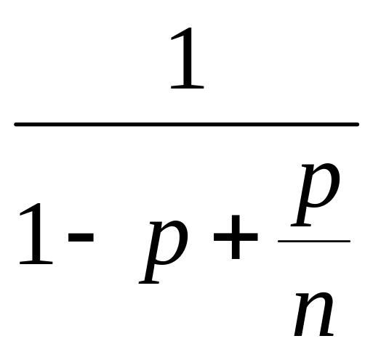
Amdahl’s Law
Speedup=
Art of Multiprocessor Programming
Notes:
AVOID USING THE WORD “CODE”, P is not a fraction of the code but if the execution time of the solution algorithm. It could be that 5% of the code are executed in a loop and account for 90% of the execution time.

Slide 60
Amdahl’s Law
Parallel fraction
Speedup=
Art of Multiprocessor Programming
Notes:
AVOID USING THE WORD “CODE”, P is not a fraction of the code but if the execution time of the solution algorithm. It could be that 5% of the code are executed in a loop and account for 90% of the execution time.

Slide 61
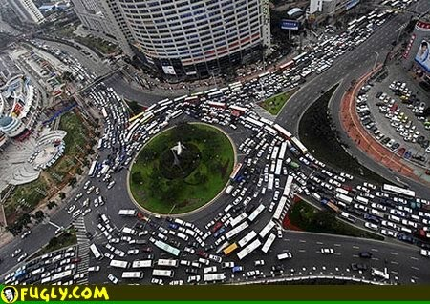
Amdahl’s Law (in practice)
Art of Multiprocessor Programming

Slide 62
Example
Ten processors
60% concurrent, 40% sequential
How close to 10-fold speedup?
Art of Multiprocessor Programming

Slide 63
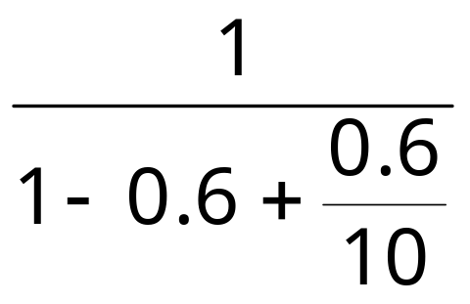
Example
Ten processors
60% concurrent, 40% sequential
How close to 10-fold speedup?
Speedup = 2.17=
Art of Multiprocessor Programming
Notes:
Explain to students that you work really hard and parallelize 60% of the applications execution (NOT ITS CODE, its EXECUTION)
and get little for your money

Slide 64
Example
Ten processors
80% concurrent, 20% sequential
How close to 10-fold speedup?
Art of Multiprocessor Programming

Slide 65
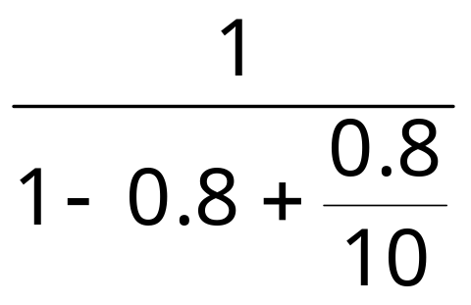
Example
Ten processors
80% concurrent, 20% sequential
How close to 10-fold speedup?
Speedup = 3.57=
Art of Multiprocessor Programming
Notes:
Even with 80% we are only 2/5 utilization, we paid for 10 CPUs and got 4…

Slide 66
Example
Ten processors
90% concurrent, 10% sequential
How close to 10-fold speedup?
Art of Multiprocessor Programming
Notes:
With 90% parallelized we are using only half our computing capacity…

Slide 67

Example
Ten processors
90% concurrent, 10% sequential
How close to 10-fold speedup?
Speedup = 5.26=
Art of Multiprocessor Programming
Notes:
With 99% parallelized we are now utilizing 9 out of 10. What does this say to us?

Slide 68
Example
Ten processors
99% concurrent, 01% sequential
How close to 10-fold speedup?
Art of Multiprocessor Programming

Slide 69
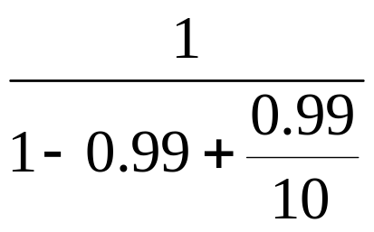
Example
Ten processors
99% concurrent, 01% sequential
How close to 10-fold speedup?
Speedup = 9.17=
Art of Multiprocessor Programming

Slide 70
Back to Real-World Multicore Scaling
Speedup
2x
2.9x
1.8x
User code
Multicore
Not reducing sequential % of code
Art of Multiprocessor Programming
Notes:
A saying that is in todays jargon something like “It’s the parallel part, stupid” is attributed to Amdahl.

Slide 71
Shared Data Structures
Coarse
Grained
Fine
Grained
25%
Shared
25%
Shared
75%
Unshared
75%
Unshared

Slide 72
Shared Data Structures
Honk!
Honk!
Honk!
Why only 2.9 speedup
Coarse
Grained
Fine
Grained
25%
Shared
25%
Shared
75%
Unshared
75%
Unshared

Slide 73
Shared Data Structures
Honk!
Honk!
Why fine-grained parallelism maters
Honk!
Coarse
Grained
Fine
Grained
25%
Shared
25%
Shared
75%
Unshared
75%
Unshared

