Slide 1
RELIABLE UDP
A FTP over UDP client-server Application
Simone Falvo

Slide 2
PROJECT MAIN GOALS
Realize a client-server FTP application
Make use of UDP transport protocol
Ensure a concurrent reliable service

Slide 3
FTP FUNCTIONAL REQUIREMENTS
Concurrent Operations
Connection without authentication
LIST command
GET command
PUT command

Slide 4

CONCURRENT OPERATIONS

Slide 5
SERVER ARCHITECTURE CHOICES
Multi-Process Model
+ Simple code - Overhead
+ independent Connections - Memory drain
Multi-Thread Model
+ Simple code - Synchronization handling
+ Lightweight - Single point of failure
Event Model
+ High performance - Complex code
+ No overhead - Single point of failure

Slide 6
FTP CRITICAL ISSUE
File transfer duration ~ minutes
Fault tolerance vs Process creation time
MULTI-PROCESS SERVER

Slide 7
MULTI-PROCESS SERVER
Listen
Process
Connection
Process 1
Connection
Process 2
Connection
Process n
Listen Socket
Connection Socket

Slide 8
ARCHITECTURE DESIGN
VIRTUAL TRANSPORT LAYER
APPLICATION
LAYER
VIRTUAL TRANSPORT LAYER
SOCKET
SOCKET
TRANSPORT
LAYER
NETWORK
LAYER

Slide 9
UDT HIDING
Reliable
Data
Transfer
VIRTUAL TRANSPORT LAYER
APPLICATION
LAYER
Unreliable
Data
Transfer
SOCKET
TRANSPORT
LAYER
NETWORK
LAYER

Slide 10
UDT HIDING
rdt_recv(..)
rdt_send(..)
VIRTUAL TRANSPORT LAYER
APPLICATION
LAYER
read(..)
udt_send(..)
SOCKET
TRANSPORT
LAYER
NETWORK
LAYER

Slide 11
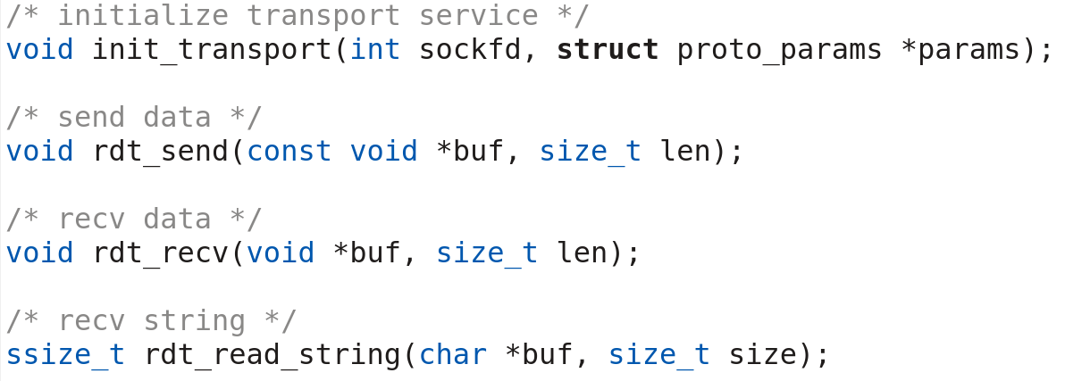
RDT INTERFACE

Slide 12
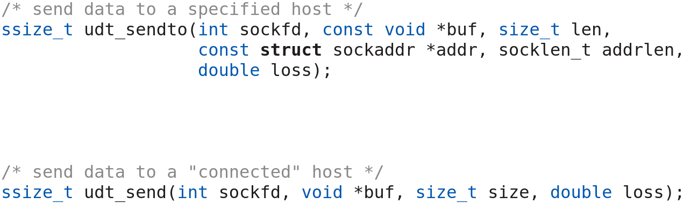
UDT SIMULATION INTERFACE

Slide 13
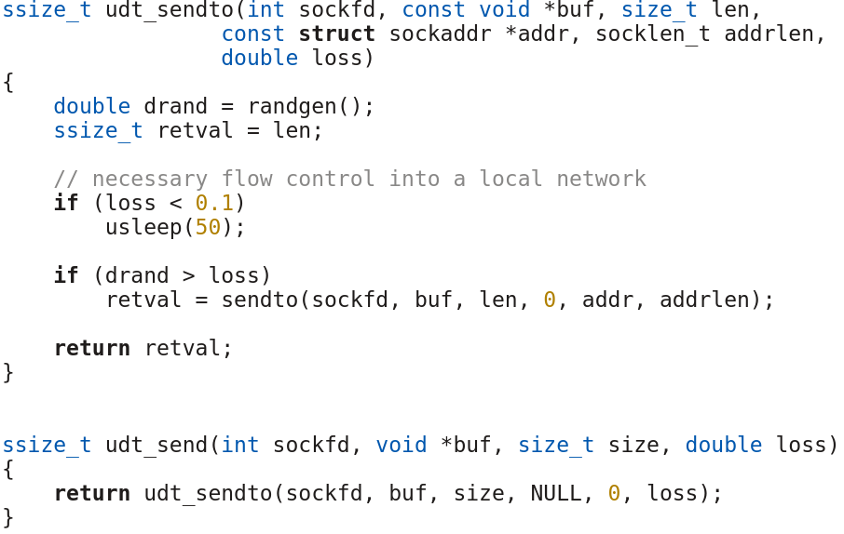
UDT SIMULATION

Slide 14
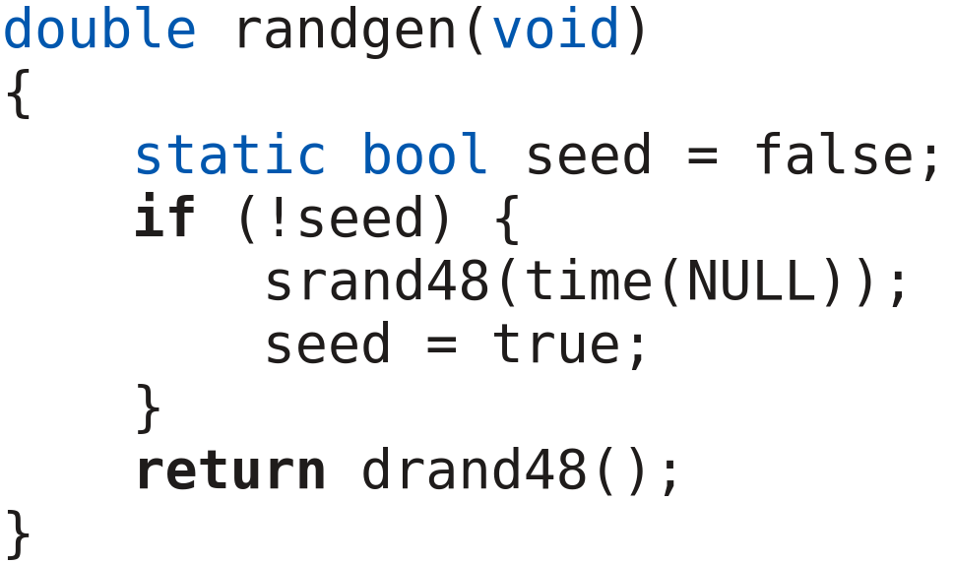
RANDOM SEQUENCE GENERATOR

Slide 15
VIRTUAL TRANSPORT LAYER
DATA
SELECTIVE
REPEAT
DATA
TRANSPORT AND
NETWORK
LAYER
APPLICATION LAYER

Slide 16
CONNECTION ESTABLISHMENT
UDT
SYN
Listen
Process
Connection
Process
SYN ACK
(NEW PORT + SR PARAMS)
Start connection
Start connection
RDT

Slide 17

WHAT IF A SYN MESSAGE GETS LOST
Loss
SYN
Listen
Process
Connection
Process
SYN
fork()
Loss
SYN ACK
Start connection
Connection
Process
SYN
fork()
SYN ACK
Close connection
Start connection
Start connection

Slide 18
COMMUNICATION DETAILS
Unidirectional
Chunk based
Segment of size MSS

Slide 19
MSS: MAXIMUM SEGMENT SIZE
MSS = MTU – H_{UDP/IP} – H_{VTransport}
MTU = Maximum Transmission Unit (1500 bytes for ethernet)
H_{UDP/IP} = UDP/IP header (8 + 20 bytes)
H_{VTransport} = Virtual transport layer header

Slide 20
PROCESSING MESSAGES
MESSAGE
APPLICATION
LAYER
MESSAGE
SELECTIVE
REPEAT
PKT 1
PKT 2
PKT N
VIRTUAL TRANSPORT LAYER
PKT N
PKT 2
SELECTIVE
REPEAT
PKT 1
TRANSPORT
&
NETWORK
LAYER

Slide 21
FTP COMMANDS
GET
LIST
PUT

Slide 22
COMMANDS PROTOCOL
GET
[file_name]
[outcome]
[file_size]
[file...]
PUT
[file_name]
[file_size]
[file...]
[outcome]
LIST
[file...]

