Slide 1
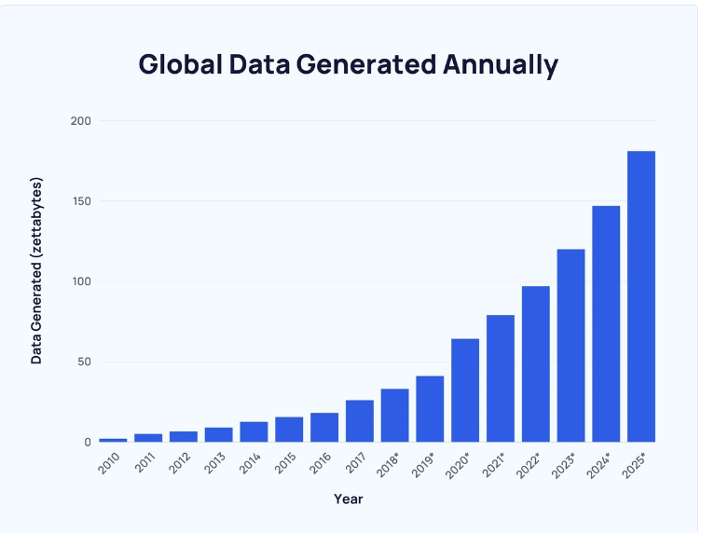
Data privacy & protection
Exponential data growth Approximately 328.77 million terabytes of data are created each day, and the number keeps growing
Data security Today there are a lot of requirements of storing user data One of many of the advanced technologies are AES encryption Still with the strict requirements for data storage data breaches still happen where skill people manage to access the stored data costing the company millions
1 zettabyte = 1 000 000 000 000 gigabytes And daily the world creates 0.32877 zettabytes
Notes:
Sources https://www.imperva.com/learn/data-security/data-security/ https://explodingtopics.com/blog/data-generated-per-day

Slide 2

Data security risks
Data Threats There are a lot of threats when humans and data are mixed Such as Insider threats anonymous employees could create a security risk By accidentally or intentionally leak a company’s data Simply clicking on the wrong link could infest the systems of a company
Unsecure websites (httpS) Running unsecure websites allows an attacker to track data between the website and users If a banking system ran a unsure site for example once, you entered your password for your bank An attacker could snatch your password and any other data passed through the website
Notes:
Sources https://www.imperva.com/learn/data-security/data-security/ https://explodingtopics.com/blog/data-generated-per-day

Slide 3
Internal restrictions
Restrict employee's access By having limitations of what employee can access what data Reduces margin for accidental data leaks The internal operation in banks takes this to an extreme level An employee from 1 end of the IT department may not even talk or contact 1 IT employee from the other department Banks have very strict guidelines for what their employees can and cannot do
Notes:
Sources https://www.imperva.com/learn/data-security/data-security/ https://explodingtopics.com/blog/data-generated-per-day

