Slide 1
us.gov

Slide 2
P2P networks
Decentralized flat model in which all nodes have the same authority.
Nodes are untrusted → P2P untrusted network.
Nodes follow an agreed communications protocol.

Slide 3

Energy.
Centralization.
Extremely limited for SC. Designed only for cash.
Unfair consensus mechanism. PoW.
Hierarchical community have been stuck for 3 years solving byzantine problems.

Slide 4

Centralization.
Limited for SC. Based on a bitcoin-like opcode interpreter.
SC can not be programmed in general computing languages.
Unfair consensus mechanism. PoW/PoS.
Hierarchical community have been able to decide unilaterally a hard-fork.

Slide 5
PoW / PoS
Consensus algorithm based on the length of the chain . All nodes agree the longest is the legitimate one.
Possible blockchains
G
G
G
Legitimate blockchain
G
G
PoW:Energy invested
PoS: Money invested

Slide 6
PoW / PoS
Competition based consensus models.
Race in which only one winner obtains the profit.
PoW: Chances of winning increases by wasting more energy. Unsustainable model in which the energy draw always increase.
PoS: Chances of winning increases with the personal wealth. Undesirable model in which the profit goes to the rich.

Slide 7
Podpoc.
Consensus algorithm based on democratic agreement on the tip of the chain.
T
G
T
T
T
T
G
T
T
G
T
T
T
T
Successful simulation of a botnet under attacking vectors agreeing on the legitimate Tip.

Slide 8


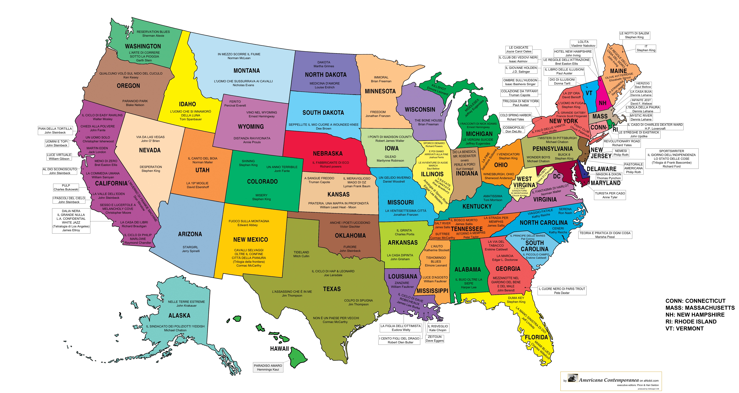


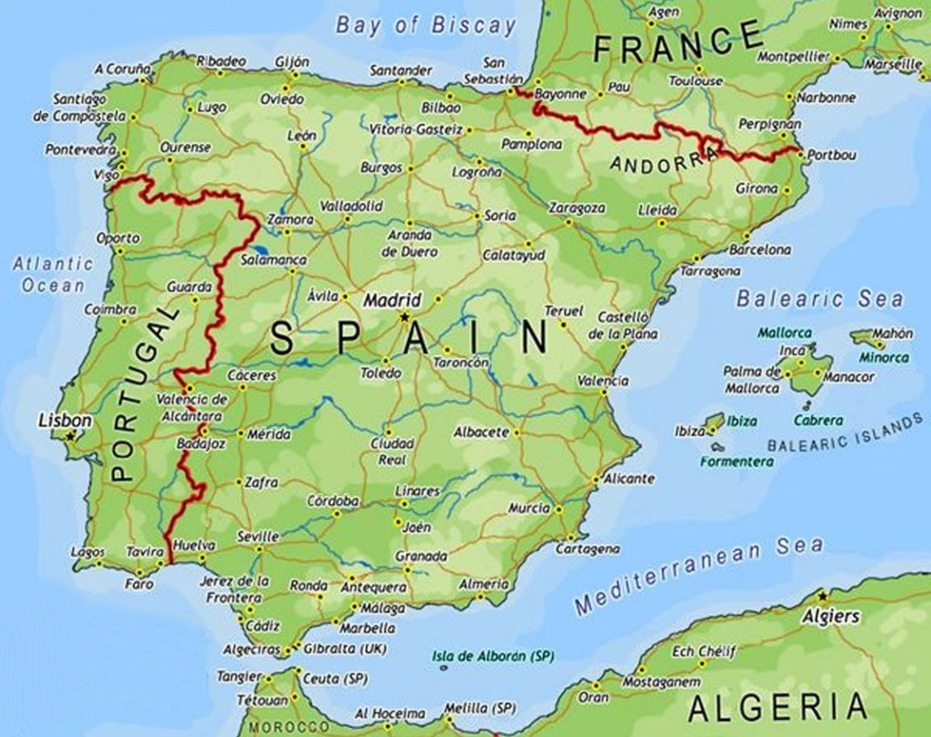


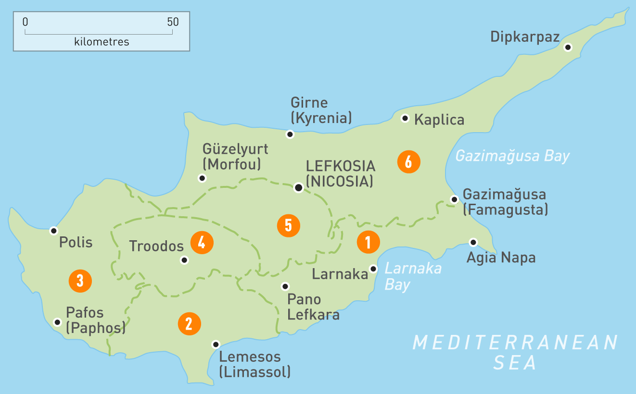
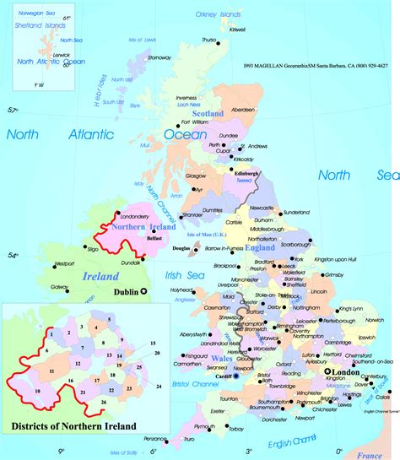

Our world
VERSUS
Automated Government

Slide 9
us.gov ; Scope – vision
Pretty ambitious goal.
Self-managed, self-regulated society of anonymous citizens.
Flat society without decision-making-power hierarchies.
World-wide sovereign country.
Automated Government system.
us
gov

Slide 10
us.gov ; Social goals
Safety net. Basic income. Universal salary. Homeless eradication. Minimum quality of life.
Education. Universities. Proof of Skill. Meritocracy.
Remote Work
Economic freedom. Gov doesn’t tax you based on your income.
Fast processes.
Business enabler.

Slide 11

us.gov ; Social goals
Individual wealth
RICH
Health, home, food, clothes, laptop, broadband
Minimum
level
POOR
NO NEED TO TAX
profit
NO NEED TO TRACE MONEY
population
us.gov
feed

Slide 12
us.gov ; automatic services
us.gov
CASH
WORK
LAND
DNS
POLITICS
DONATIONS
EDUCATION
JUSTICE
LOAN
UNIVERSAL SALARY
DFS
GAMBLING

Slide 13
us.gov ; deployment
Goal to achieve a giant botnet. The security of the network is based on the number of nodes.
Steps to join the network:
Buy a raspberry PI, Download its Operating System ISO image from any other node.
Keep the device connected to internet.
Pair your mobile with your node.

Slide 14
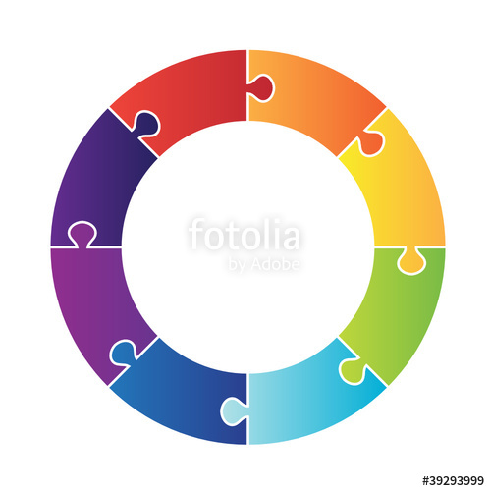
us.gov ; botnet topology
Nodes are vertexes of a graph where edges represent their connection with other nodes.
NODE
PROTOCOL
NODE
PROTOCOL
NODE
PROTOCOL
PROTOCOL
NODE
NODE
PROTOCOL

Slide 15
us.gov ; protocol
Disconnect and connect to another node periodically.
Work in cycle with a period T=1 minute, not necessarily equal to the period of mutation.
Respond to ping.
Relay evidences.
Transmit vote for next diff within the agreed time window.
Deliver any file identified by the hash of its content.
Follow an auth sub-protocol based on Public/Private key infrastructure.

Slide 16
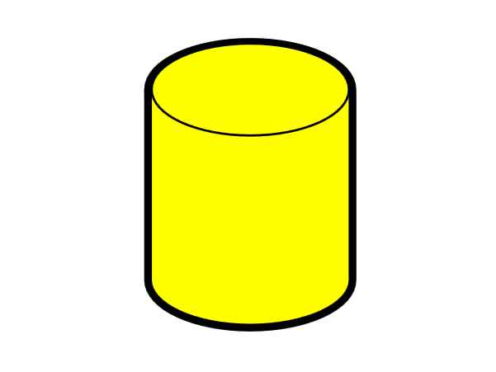
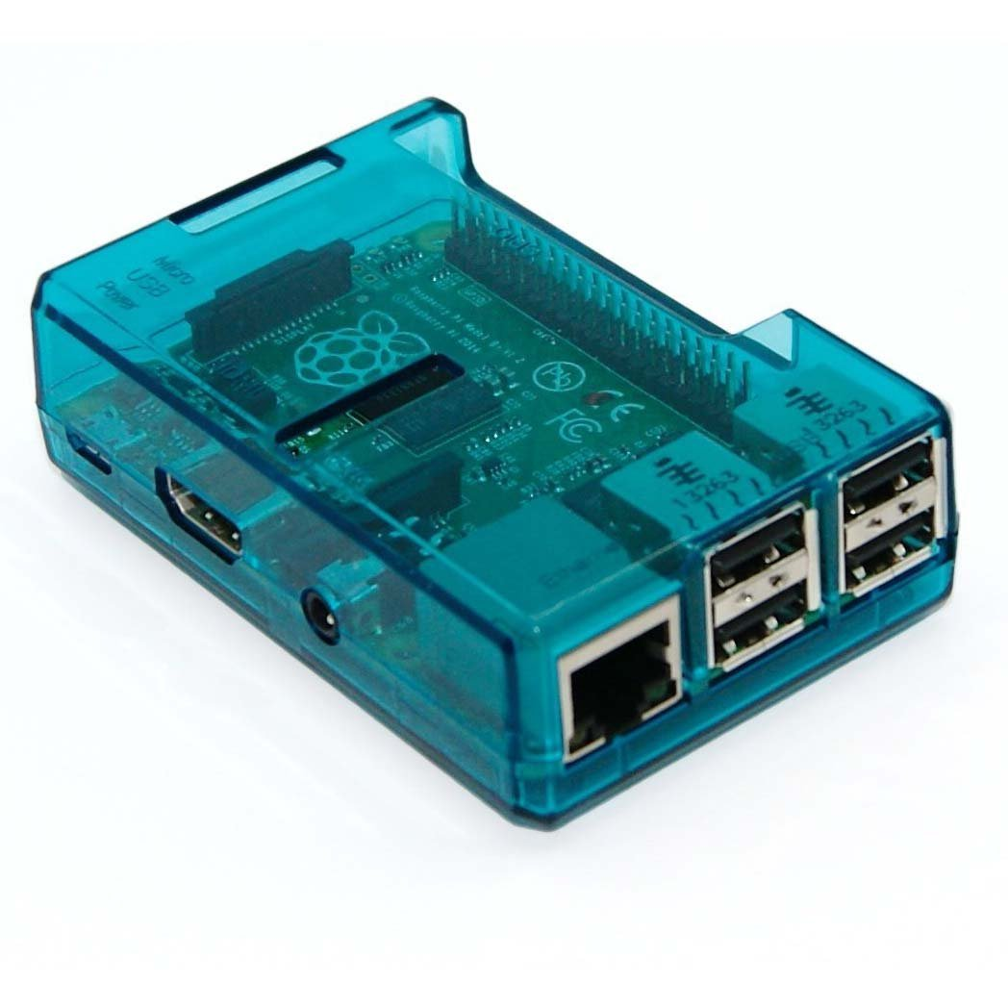
us.gov ; node responsibilities
Execute communications protocol.
Store network status locally.
protocol
The protocol is designed to keep node databases in sync, i.e. db replication.

Slide 17
us.gov ; database dynamics - 1
Basediff math
‘
+
Δ
=
block

Slide 18
us.gov ; database dynamics - 2
Blockchain is the sequence of diffs to bring the genesis database to its current state.
+Δ + Δ’+Δ’’+...
=
Empty database
Current state
blockchain

Slide 19
us.gov ; diff forging
Network cycle initially set to 1 min.
Nodes clocks are synchronized via NTP
All nodes will have the same database provided they can forge the same diff on each cycle.
Collect evidences and build block
Receive votes
Vote tip
Append most voted block
Close current block,
Open empty one.
Second 0
Network cycle – 1 minute
59 s.

Slide 20
us.gov ; evidences
The network will produce empty diffs in absence of evidences coming from external sources. E.g. A signed transfer order.
Evidences are protected from tampering using EC cryptography.
Once a node receive an evidence it is relayed to the rest of nodes by just sending copies to its neighbours.

Slide 21

us.gov ; evidences (II)
evidence
Evidences are state change orders,
They are relayed as soon as one node receives them
State change order
signature
relay
The node creates a diff to the database based on all evidences received during the cycle.
At some point in the cycle the diff is closed and ready for the consensus leg.

Slide 22
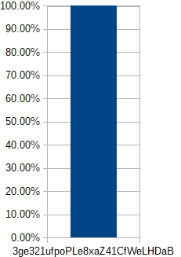
us.gov ; consensus
Once the diff is closed, the node share its hash.
As a result an histogram can be drawn.
If the network is 100% honest, and there is no propagation failures, the histogram every node sees is:
hash1– 100% (all nodes computed the same diff)

Slide 23
us.gov; consensus (II)
Evil nodes and propagation failures produce a wider histogram.

Slide 24
us.gov ; cash injection
Bitcoin / us.gov. Total supply:
2.100.000.000.000.000 satoshis

Slide 25
us.gov ; roadmap
Resiliency / scalability tests
today
Week 20: 1M nodes
Feb 2017
Mar 2017
Jun/Jul 2018
Jun 2019
Sep 2018
Poc
simulation
Start of
Development
Deployment
Core nodes
Launch
Goal:
Botnet with millions of nodes

Slide 26
us.gov ; steps to become a node
Buy a raspberry PI
Download ISO image from any node
Install OS in the PI
Plug to broadband
Download mobile-app from any node
Pair mobile devices with the node to access your built-in wallet

Slide 27

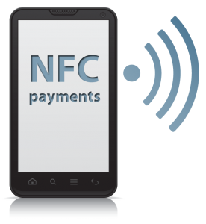

us.gov ; deployment; sw
Latest ISO image for raspberry PI can be downloaded from any node.
protocol
22
sshd
shell
16672
us-govd
Open source O/S
cash
scm
shell
us-walletd
PAIRED DEVICES
apache2
16673
Download links
Web content
supervisor
PUBLIC HTTP SERVICE
80
EASY CASH
TRANSFERS

Slide 28
us.gov ; software components
Shared library
Key:
secp256k1
Dependency relationship
Elliptic Curve cryptography
Binary file
Shared library
libusgov.so
C++
executable
executable
executable
us-govd
us-walletd
us-wallet
Protocol daemon
Wallet daemon
Wallet shell interface
Android app
java
Planned:
Wallet web interface
us-gov.apk

Slide 29

us.gov: libusgov.so
Backed by gov
Crypto currency
Associates skills to citizens
Work for skilled developers
Perpetuation system
citizens with matching skillset
cash
loan
rep
university
apps
university
group
...
blockchain
blockchain
Consensual database
dfs
Distributed file system
auth
Node Id, Hall (waiting queue), sysop
peer
Network graph
socket
Node communication
SIMULATION / REAL switch
POSIX - TCP / IP stack

Slide 30
us.gov; next session
Software high level design
Codebase organization, source code …
Elliptic curve cryptography
THANKS! : )

