Slide 1
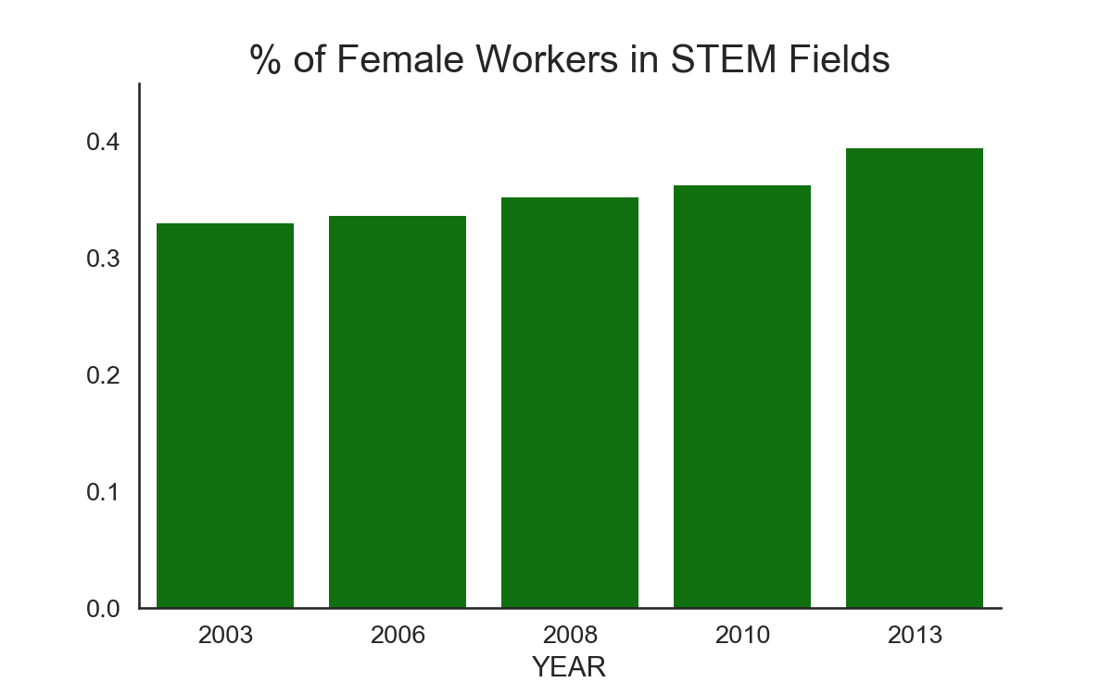
Women In STEM
Shuojia Shi
Springboard Data Science Career Track

Slide 2
Outlines
Motivation. Potential Clients.
Data Source and Wrangling
Explorative Data Analysis
Women participation in STEM
Unemployment and gender pay gap
Women in STEM in job fields.
Statistical Analysis— is it statistically significant?
Classification
Feature selection
Predict salary levels
Predict principal job fields
Summary

Slide 3
Motivation & Potential Clients
It is reported that half as many women are working in STEM jobs¹. It is also reported that women make 78 cents for every dollar men make².
Questions I would like to answer:
How many women are actually in STEM workforce?
Does the gender pay gap change over the years?
How do race/job fields affect the gender gap?
Can we predict the salary level for women STEM workers?
Can we recommend a job field for a certain individual? …
As a woman in STEM field myself, I am intrinsically interested in these problems.
Potential clients:
Women majoring in STEM or preparing themselves into STEM jobs.
Career building websites such as Linkedin.com and CareerBuilder.com.
Universities and higher education institutes.
Media and Journalists
http://www.esa.doc.gov/sites/default/files/womeninstemagaptoinnovation8311.pdf
http://money.cnn.com/2016/04/12/pf/gender-pay-gap-equal-pay-day/index.html

Slide 4
Data Source and Wrangling
Survey data from IPUMS Higher Ed https://highered.ipums.org/highered/
Leading surveys for studying the science and engineering (STEM) workforce in the United States.
Data include National Surveys of College Graduates (NSCG) and Doctorate Recipients (SDR)
The relevant variables such as demographic, education and employment were chosen with the available samples between 2003 and 2013.
Filter columns with mostly missing data.
Final data size: 478747 entries and 47 columns (175.3+ MB).

Slide 5

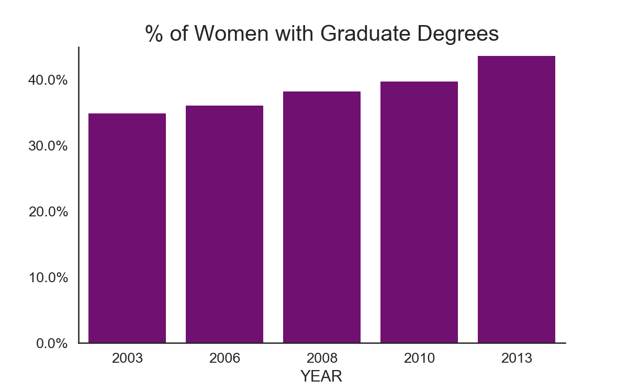
Explorative Data Analysis Women participation in STEM
Bar plot on the left: women made up 33% of the STEM workforce in 2003.
That number rises steadily over the next ten years with a jump from 2010 to 2013, as the percentage rose to almost 40%!
We see a similar trend in the % of women with graduate degrees in the bar plot on the right.

Slide 6
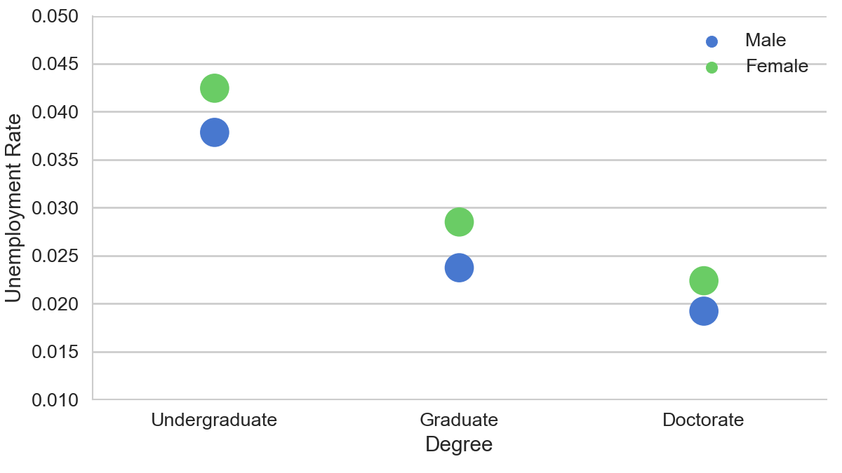
Explorative Data Analysis Gender unemployment gap
Unemployment rate trending down with higher education degrees.
Men has slightly lower (1%) unemployment rate than women.
The gender unemployment gap shrinks with higher education degrees.
Note the rate here only consider individuals that are in labor force.

Slide 7
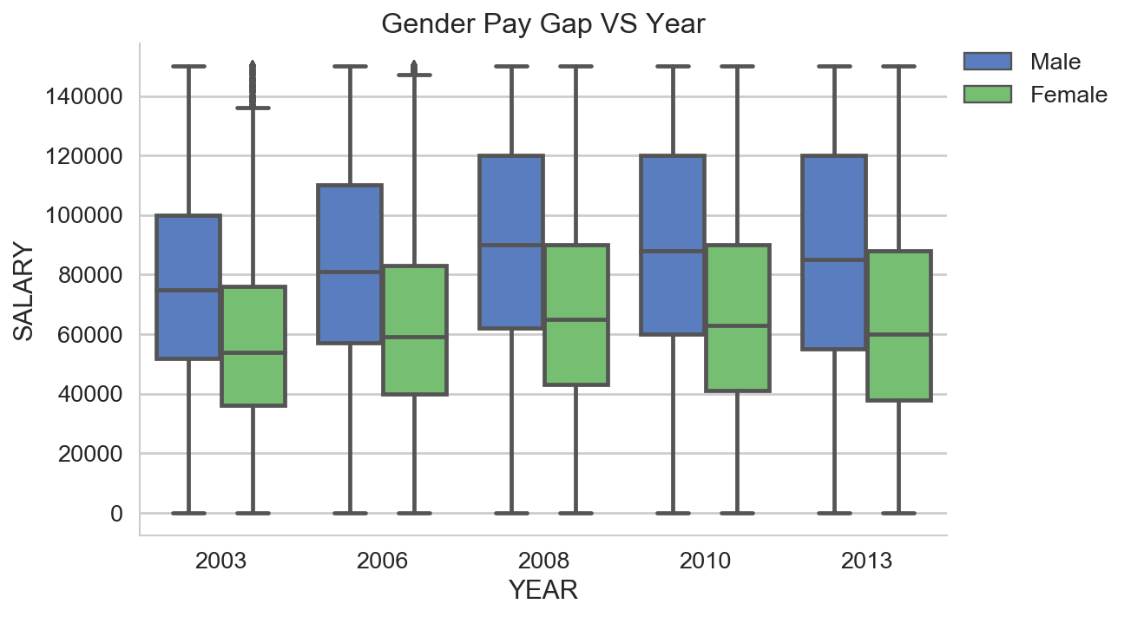
Explorative Data Analysis Gender pay gap (2003 to 2013)
Women have come a long way but are still not at parity. We have seen women's increased education and workforce participation. But the wages for men is about 30% higher than women, for all years listed.
There is NO shrinking trend in the gender pay gap over the years.
The mean wages increased from year 2003 to 2008. Then we see a small decrease from 2008 to 2013. This makes sense considering the financial crisis in 2008.

Slide 8
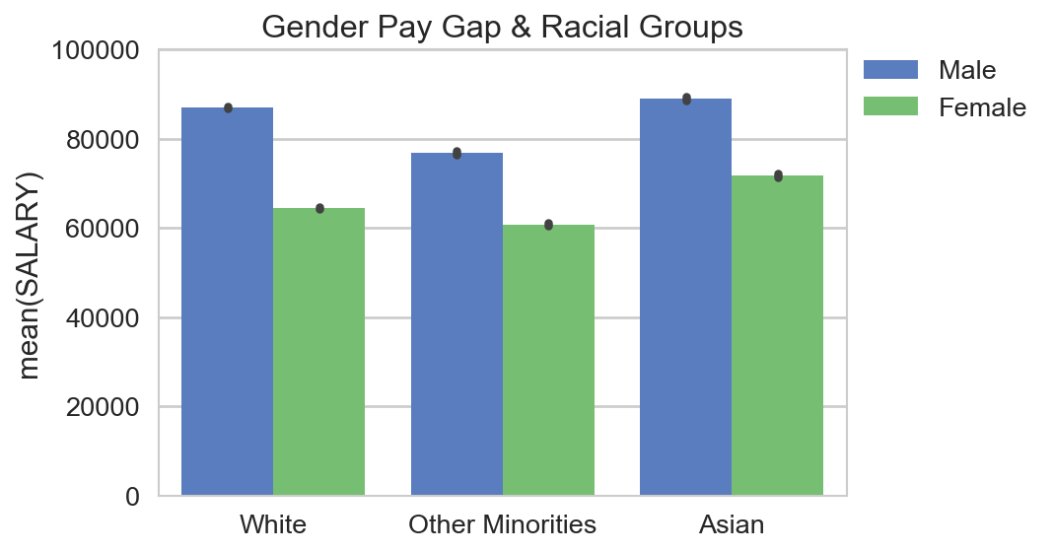
Explorative Data Analysis Gender/race pay gap
The pay gap between men and women exist in all race groups.
For every dollar Asian men make, Asian women make 81 cents. For every dollar white men make, white women make 74 cents. For every dollar other minorities (include black, Hispanic, and etc.) men make, women in the same group make 79 cents.

Slide 9
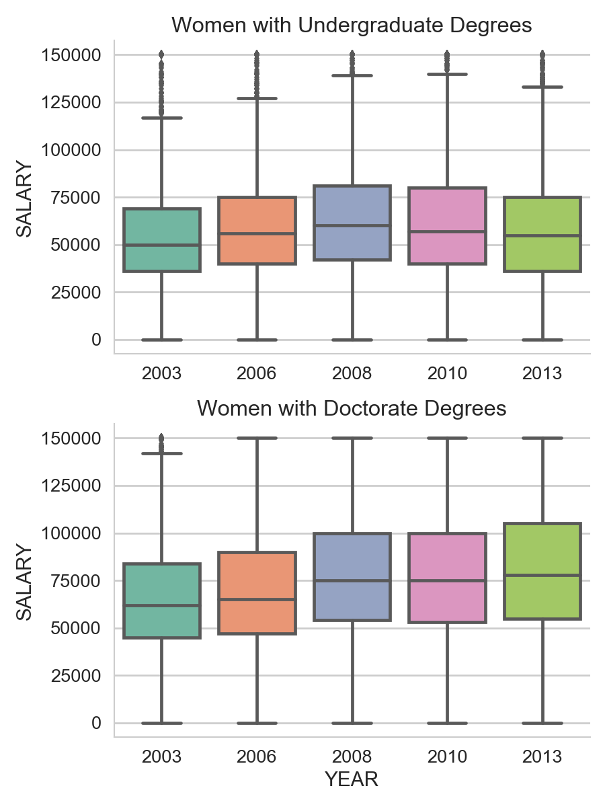
Explorative Data Analysis Women In Education Level Groups
The plot on top presents the quantiles of the salaries for women with undergraduate degrees. It clearly indicates the trending down after year 2008.
The plot on the bottom shows salaries for women from the doctorate group. Big difference! This median wage and quantiles kept increasing after 2008, even though the increase from 2008 to 2010 is minimal!
Median wage for women doctors is 20% higher than that of women with undergraduate degrees. This difference is even larger after 2008.

Slide 10
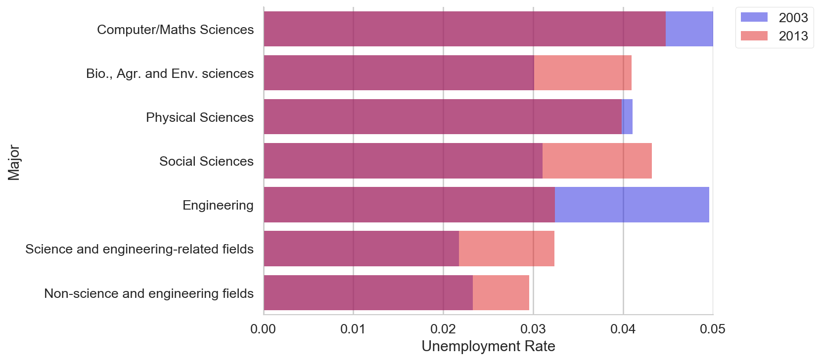
Explorative Data Analysis Fields of major– women unemployment rate
The plot of female unemployment rate for field of major groups in 2003 and 2013 can give us some insight what majors are having a better performance in job placement.
There is a significant decrease in the unemployment rate for the female engineering group (from 5% to 3%).
Fields saw a larger increase of unemployment rate: social sciences, bio and life sciences, and other science and engineering related fields.

Slide 11
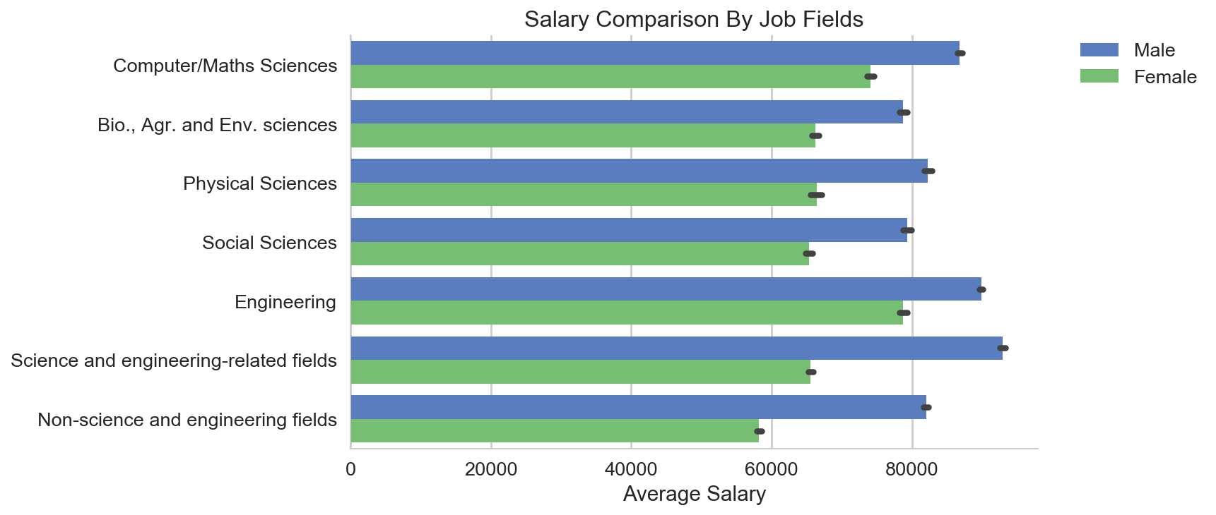
Explorative Data Analysis Principal job fields - gender pay gap
The job fields that have the least pay gap between men and women are: engineering, computer/maths sciences and bio/life sciences.
Engineering field gives the best compensation to their female employees compared with other jobs. And women in non-science and engineering field reports lowest income averagely.
Non-science and engineering fields has the largest gender pay gap. The field group contains job title such as 'Management' and 'Administration'. This could be indicating the even more severe gender disparity in these positions.

Slide 12
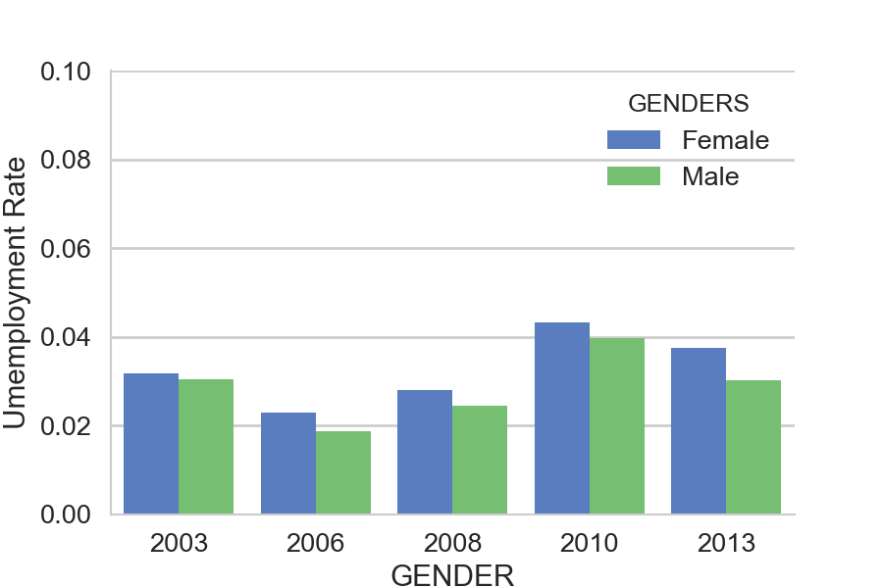
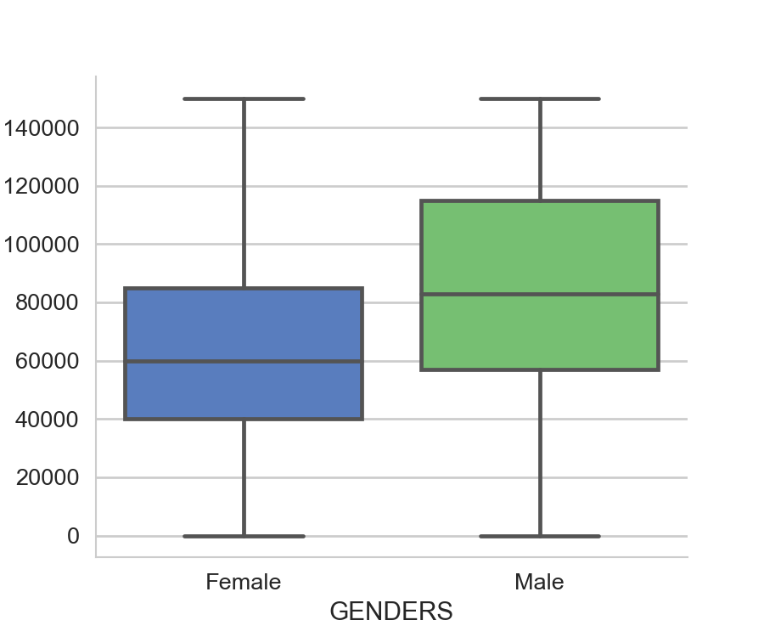
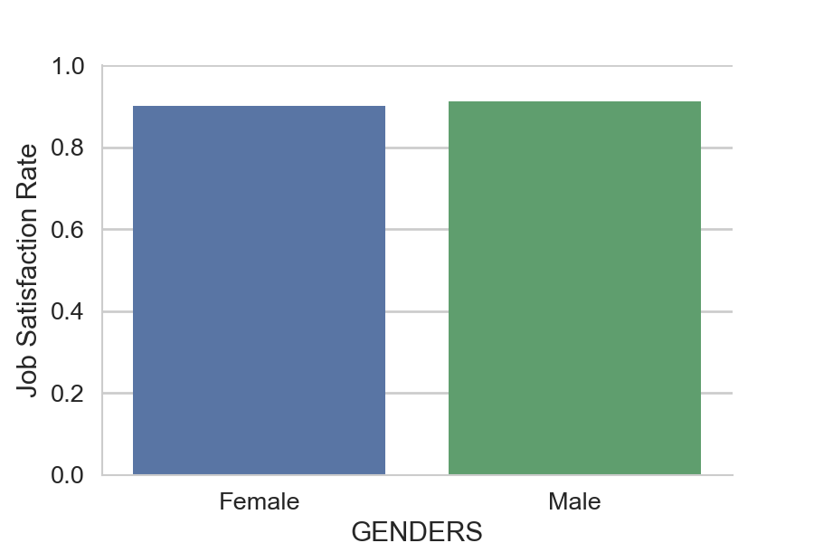
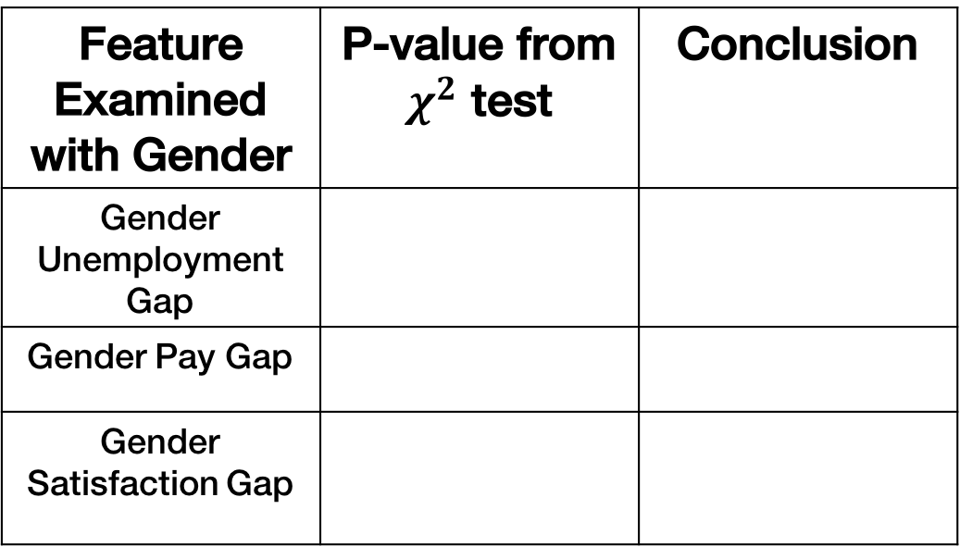
Statistical Analysis
Gender Unemployment Gap
Gender Pay Gap
Gender Job Satisfaction Gap
Feature Examined with Gender | P-value from $χ^{2}$ test | Conclusion
Gender Unemployment Gap
Gender Pay Gap
Gender Satisfaction Gap

Slide 13
Classification
Predict Salary Level

