Slide 1
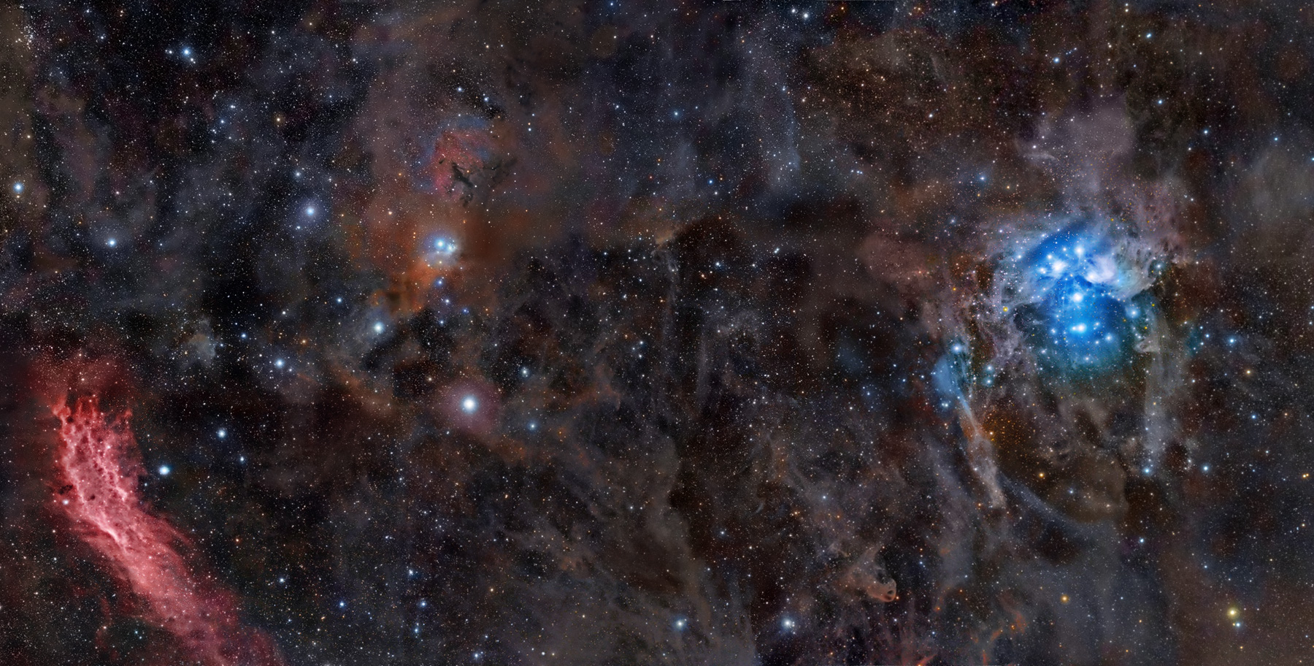
Stargazer: Automatic Telescope Control System
Course: COSC 470/471
Instructor: Youry Khmelevsky
Project Team: Red Team
Students: Rob Grmek, Robert Smith
Notes:
Rob

Slide 2
Background
Customers currently manually position their telescope and capture images through it
What are we doing
telescope control system
set schedules to position the telescope
capture images once telescope in position
Why is it needed?
to automate the process
Notes:
rob

Slide 3
Requirements
Store scheduling and positioning information
Position Telescope automatically
Capture images automatically
Mobile device connectivity
Authentication and authorization
Optional SSL
Online help
Notes:
Rob

Slide 4
Hardware
Telescope
Meade ETX-60AT-TC (local testing)
Meade LX200 (customer’s telescope)
Digital camera
Canon 30D (local testing)
Sony A900 DSLR (customer’s camera)
Mobile device
Nokia N97
Apple iPhone
Notes:
Rob
Telescope: Meade LX200 (Customer)
Digital camera: Sony A900 DSLR (Customer)
Mobile device: Nokia phones, Apple iPhone

Slide 5
Current Options
Starry Night Pro 6.3 Astronomy Software
$150
No camera support
Supports many telescopes
TheSky6 Professional Edition
$280
limited camera support(for $100 more)
Supports many telescopes
Current Options don’t meet our requirements
Notes:
Robert

Slide 6
Our Solution
Create a web interface to allow users to create schedules for the position of the telescope and associated options.
The web interface will require a login process to access.
Store schedules in a database.
Write a program to communicate with available hardware drivers for the telescope and camera.
The database will run the hardware control application at the scheduled time.
Notes:
robert

Slide 7
Why is it Unique?
We allow for scheduling
Users can access our solution from any computer with an internet connection
We offer mobile device functionality
We automate both the telescope and the camera
Our code is open source
Notes:
rob

Slide 8
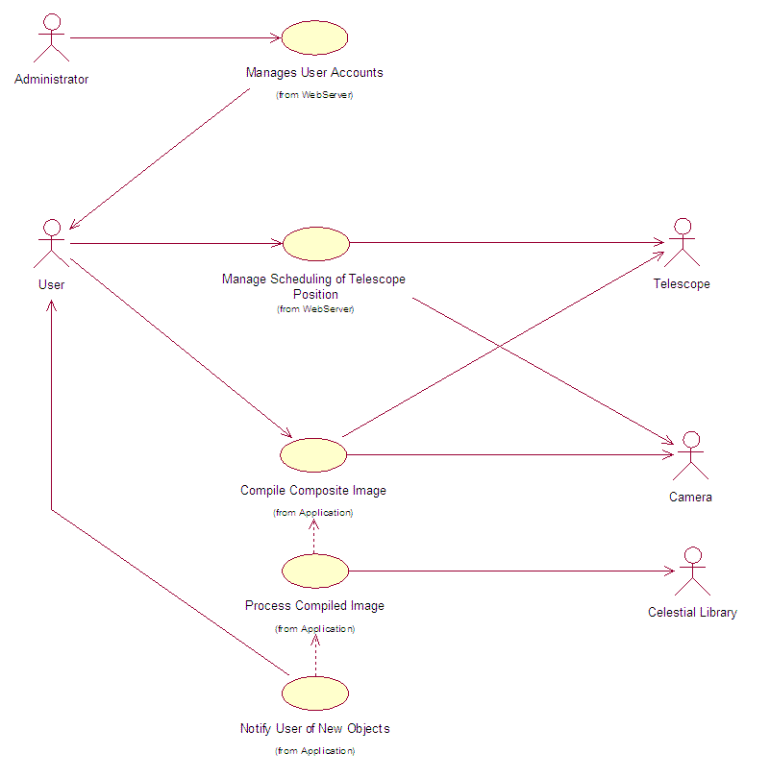
Use Case Diagram
Notes:
Robert

Slide 9
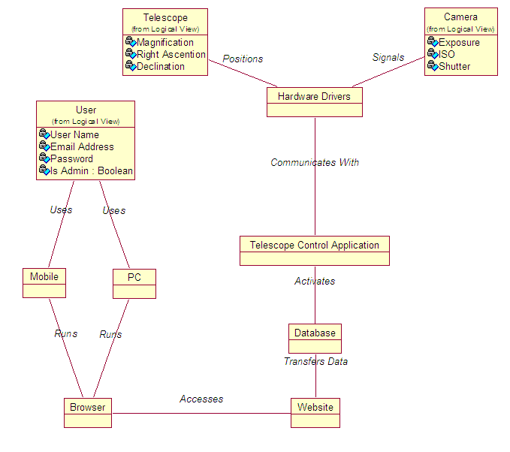
Domain Model
Notes:
Rob

Slide 10
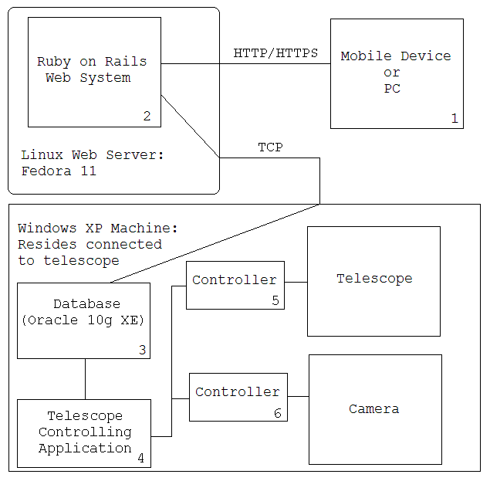
Architecture
Notes:
Rob

Slide 11
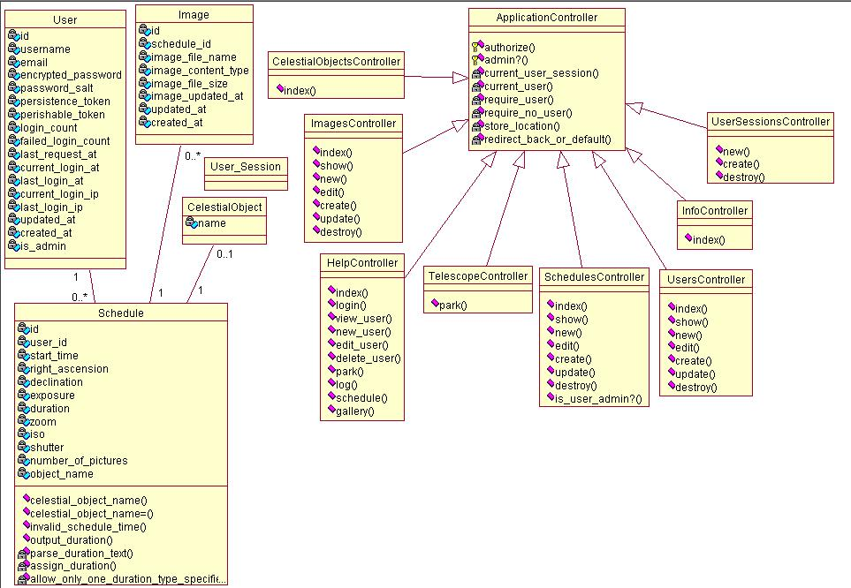
Class Diagram: Web Application
Notes:
Rob

Slide 12
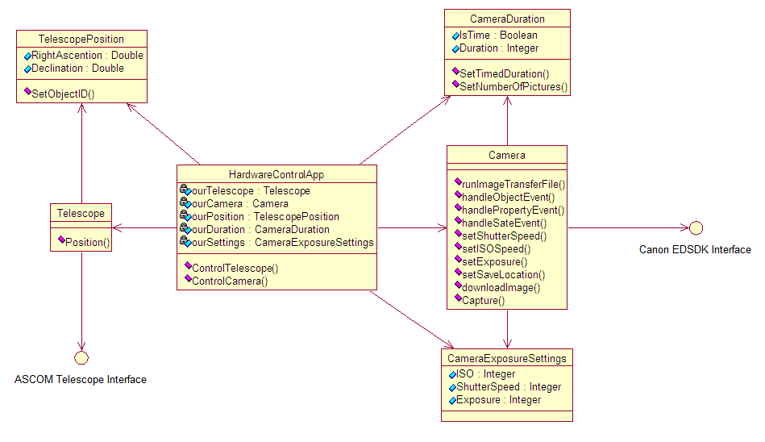
Class Diagram: Hardware Controller Application
Notes:
Robert

Slide 13
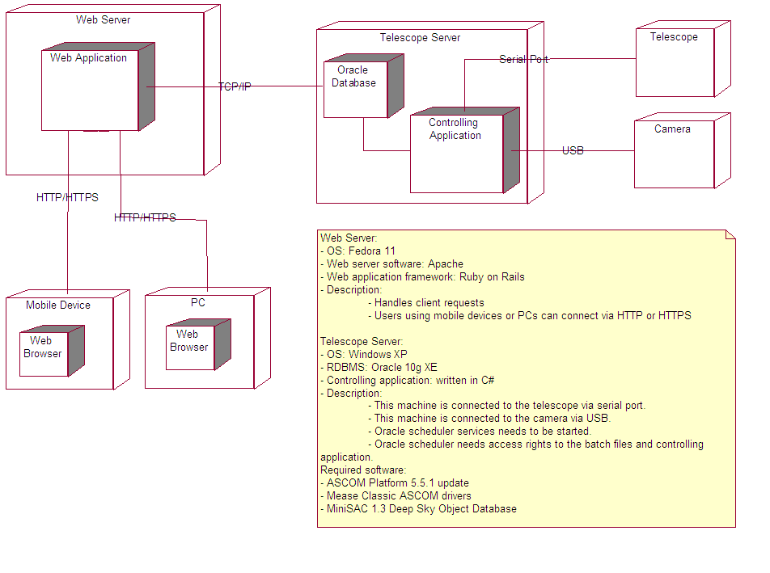
Deployment
Notes:
Rob

Slide 14
Development
GIT versioning control system
Fast
Small
Easy to learn
Methodologies used
Xtreme Programming (semester 1)
Rational Unified Process (semester 2)
Testing
Unit tests
Acceptance tests
Notes:
Rob

Slide 15
Project Timeline: Semester 1
Iteration 1: Inception
Iteration 2: SPIKE project (Ruby On Rails)
Iteration 3: Authentication and Authorization
Iteration 4: Image Gallery
Iteration 5: Final Refactored Release
Each iteration = ~1 week
Notes:
robert
Mention that we only had prototype web system complete
no parking
no scheduling
no image gathering
few, rough mobile device views

Slide 16
Project Timeline: Semester 2
Iteration 5: Automated Scheduling and Telescope Positioning
Iteration 6: Libraries and GUI Enhancements
Iteration 7: Mobile Views
Iteration 8: Image Capturing
Iteration 9: The Final Release
Each iteration = 2-3 weeks
Notes:
robert

Slide 17
Statistics: Semester 2
Workflow | It. 5 | It. 6 | It. 7 | It. 8 | It. 9
Business Modelling: | 1 | 0 | 1 | 0 | 0
Implementation: | 52 | 97 | 42 | 80 | 12
Testing: | 22 | 0 | 4 | 19 | 36
Analysis and Design: | 32 | 32 | 40 | 25 | 12
Deployment: | 1 | 1 | 1 | 1 | 10
Total: | 108 | 130 | 88 | 125 | 70
Workflow | It. 5 | It. 6 | It. 7 | It. 8 | It. 9
Business Modelling: | 1 | 0 | 1 | 0 | 0
Implementation: | 67 | 97 | 52 | 154 | 2
Testing: | 16 | 0 | 4 | 0 | 6
Analysis and Design: | 53 | 45 | 41 | 39 | 13
Deployment: | 1 | 2 | 1 | 1 | 6
Total: | 138 | 149 | 99 | 194 | 38
Notes:
Robert

Slide 18
Risk Management
Did not receiving equipment from customer
Use alternative devices (such as a different digital camera) and try to use a generalized solution that should work for both devices.
Client unavailable or unresponsive.
Use alternative methods of communication (phone or email). Build project to original specifications.
Underestimated the time the project would take.
Remove non-essential features and focus on core functionality
Notes:
Robert
Probabilities can be: low, moderate, high.
Effects can be: tolerable, serious and catastrophic

Slide 19
What Did We Learn?
More experienced with Ruby on Rails
Improved planning
Hardware interfacing with drivers
Notes:
Robert

Slide 20
Summary
Automatic Telescope Control System
Can:
Schedule telescope for future dates
Automatically positions telescope
Captures images of that area
Automatically uploads images to a web server
Notes:
Robert

Slide 21
Acknowledgements
Thanks to the following:
Dave Goodall
Nokia
Canon
Department Head of Computer Science
Michael Minions
Notes:
Rob
Customers for giving us such an interesting project and supplying us with the Meade telescope
Youry for guiding us through the software development lifecycle
Dave Goodall for giving us a domain name for our project allowing outside access to our web server
Nokia for supplying us with two Nokia N97’s used for testing
Canon for development kit and drivers

Slide 22
Demonstration
Here is a demonstration of our solution

Slide 23
Questions
Are there any questions
?

